Slide 1
Natural Language Processing
Jim Martin -- Lecture 3
CSCI 5832

Slide 2
Today
More language modeling with N-grams
Probabilistic model
Independence assumptions
Practical Issues
Dealing with zeroes

Slide 3
Word Prediction
Guess the next word...
So I notice three guys standing on the ???
What are some of the knowledge sources you used to come up with those predictions?

Slide 4
The Chain Rule
Recall the definition of conditional probabilities
Rewriting:
For sequences...
P(A,B,C,D) = P(A)P(B|A)P(C|A,B)P(D|A,B,C)
In general
P(x₁,x₂,x₃,…x_{n}) = P(x₁)P(x₂|x₁)P(x₃|x₁,x₂)…P(x_{n}|x₁…x_{n-1})

Slide 5
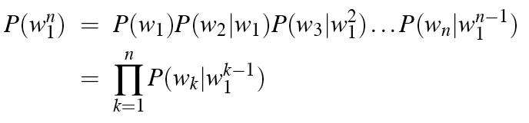
The Chain Rule
P(its water was so transparent)=
P(its)*
P(water|its)*
P(was|its water)*
P(so|its water was)*
P(transparent|its water was so)

Slide 6
Unfortunately
There are still a lot of problematic long sequences in there
In general, we’ll never be able to get enough data to compute the statistics for those longer prefixes
Same problem we had for the original sequence.

Slide 7
Independence Assumption
Make the simplifying assumption
P(lizard|the,other,day,I,was,walking,along,and,saw,a) = P(lizard|a)
Or maybe
P(lizard|the,other,day,I,was,walking,along,and,saw,a) = P(lizard|saw,a)
That is, the probability in question is to some degree independent of its earlier history.

Slide 8
Markov Assumption
So for each component in the product replace with the approximation (assuming a prefix of size N - 1)
Bigram version

Slide 9
Estimating Bigram Probabilities
The Maximum Likelihood Estimate (MLE)

Slide 10

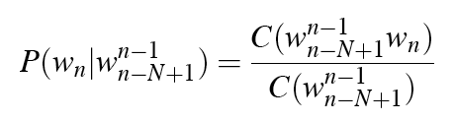
Example
<s> I am Sam </s>
<s> Sam I am </s>
<s> I do not like green eggs and ham </s>

Slide 11
Berkeley Restaurant Project
can you tell me about any good cantonese restaurants close by
mid priced thai food is what i’m looking for
tell me about chez panisse
can you give me a listing of the kinds of food that are available
i’m looking for a good place to eat breakfast
when is caffe venezia open during the day

Slide 12
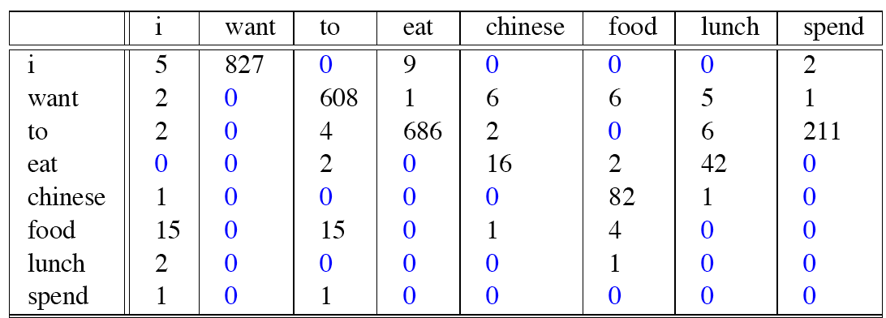
Bigram Counts
Vocabulary size is 1446 |V|
Out of 9222 sentences
“I want” occurred 827 times

Slide 13
Bigram Probabilities
Divide bigram counts by the prefix unigram counts to get bigram probabilities.

Slide 14
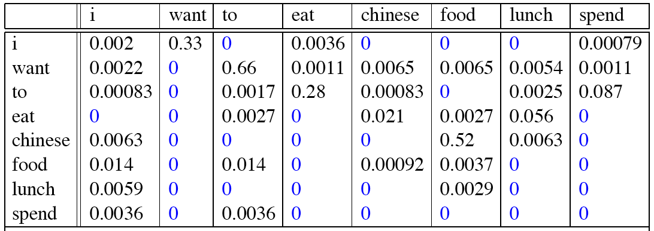
Bigram Probabilities
Divide bigram counts by the prefix unigram counts to get bigram probabilities.

Slide 15
Bigram Estimates of Sentence Probabilities
P(<s> I want english food </s>) =
P(i|<s>)*
P(want|I)*
P(english|want)*
P(food|english)*
P(</s>|food)*
=.000031

Slide 16
Kinds of Knowledge
As crude as they are, N-gram probabilities capture a range of interesting facts about language.
P(english|want) = .0011
P(chinese|want) = .0065
P(to|want) = .66
P(eat | to) = .28
P(food | to) = 0
P(want | spend) = 0
P (i | <s>) = .25
World knowledge
Syntax
Discourse

Slide 17
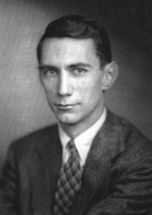
Shannon’s Method
Assigning probabilities to sentences is all well and good, but it’s not terribly illuminating.
A more entertaining task is to turn the model around and use it to generate random sentences that are similar to the sentences from which the model was derived.
Generally attributed to
Claude Shannon.

Slide 18
Shannon’s Method
Sample a random bigram (<s>, w) according to the probability distribution over bigrams
Now sample a new random bigram (w, x) according to its probability. Where the prefix w matches the suffix of the first bigram chosen.
And so on until we randomly choose a (y, </s>)
Then string them together
<s> I
I want
want to
to eat
eat Chinese
Chinese food
food </s>

Slide 19
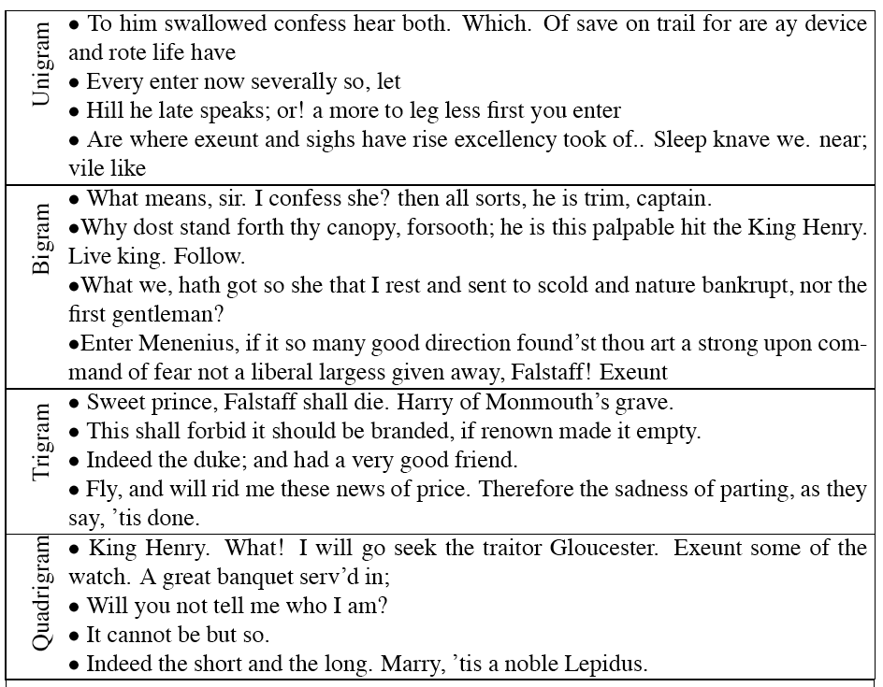
Shakespeare

Slide 20
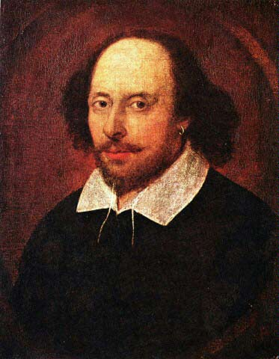
Shakespeare as a Corpus
N=884,647 tokens, V=29,066
Shakespeare produced 300,000 bigram types out of V²= 844 million possible bigrams...
So, 99.96% of the possible bigrams were never seen (have zero entries in the table)
This is the biggest problem in language modeling; we’ll come back to it.
Quadrigrams are worse: What's coming out looks
like Shakespeare because it is Shakespeare

Slide 21
Model Evaluation
How do we know if our models are any good?
And in particular, how do we know if one model is better than another.
Well Shannon’s game gives us an intuition.
The generated texts from the higher order models surely sound better.
That is, they sound more like the text the model was obtained from.
The generated texts from the WSJ and Shakespeare models look very different
That is, they look like they’re based on different underlying models.
But what does that mean? How can we make that notion operational?

Slide 22
Evaluating N-Gram Models
Best evaluation for a language model
Put model A into an application
For example, a machine translation system
Evaluate the performance of the application with model A
Put model B into the application and evaluate
Compare performance of the application with the two models
Extrinsic evaluation
A/B Testing

Slide 23
Evaluation
Extrinsic evaluation
This is really time-consuming and can be hard
Not something you want to do unless you’re pretty sure you’ve got a good solution
So
As a intermediate evaluation, in order to run rapid experiments we evaluate N-grams with an intrinsic evaluation
An evaluation that tries to capture how good the model is intrinsically, not how much it improves performance in some larger system

Slide 24
Evaluation
Standard method
Train parameters of our model on a training set.
Evaluate the model on some new data: a test set.
A dataset which is different than our training set, but is drawn from the same source

Slide 25
Perplexity
The intuition behind perplexity is as a measure is the notion of surprise.
How surprised is the language model when it sees the test set?
Where surprise is a measure of...
Gee, I didn’t see that coming...
The more surprised the model is, the lower the probability it assigned to the test set
The higher the probability, the less surprised it was

Slide 26
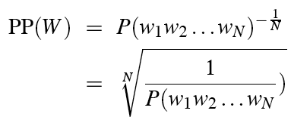
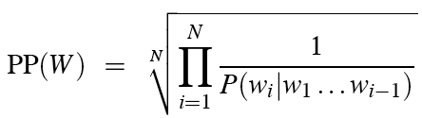
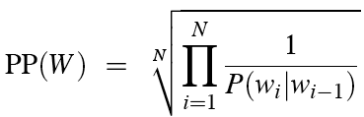
Perplexity
Perplexity is just the probability of a test set (assigned by the language model), as normalized by the number of words:
Chain rule:
For bigrams:
Minimizing model perplexity is the same as maximizing probability of a test set

Slide 27

Lower perplexity is better
Training 38 million words, test 1.5 million words, WSJ

Slide 28
Practical Issues
Once we start looking at test data, we’ll run into words that we haven’t seen before. So our models won’t work. Standard solution:
Given a corpus
Create a fixed lexicon L, of size V
Say from a dictionary or
A subset of terms from the training set
At text normalization phase, any training word not in L is changed to <UNK>
Collect counts for that as for any normal word
At test time
Use UNK counts for any word not seen in training

Slide 29
Practical Issues
Multiplying a bunch of really small numbers < 0 is a really bad idea.
Underflow is likely
So do everything in log space
Avoids underflow (and adding is faster than multiplying)

Slide 30
Admin
Any questions?
HW discussion

Slide 31
Smoothing
Back to Shakespeare
Shakespeare produced 300,000 bigram types out of V²= 844 million possible bigrams… meaning 99.96% of the possible bigrams were never seen
Does that mean that any sentence that contains one of those bigrams should have a probability of 0?
For generation (Shannon game) it means we’ll never emit those bigrams
For analysis it’s problematic because if we run across a new bigram in the future then we have no choice but to assign it a probability of zero

Slide 32
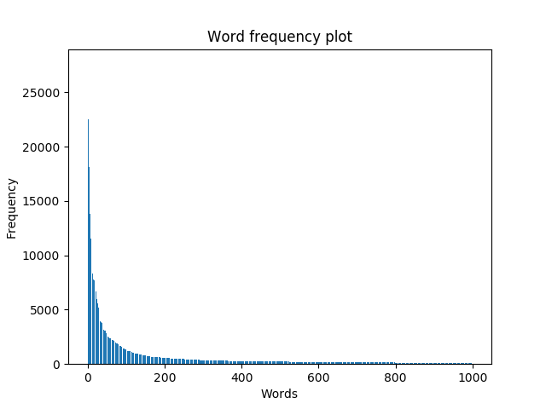
Zero Counts
Some of those zeros are really zeros...
Things that really aren’t ever going to happen
On the other hand, some of them are just rare events. That is, if the training corpus had been a little bigger they would have had a non-zero count
What would that count be in all likelihood?
Zipf’s Law (long tail phenomenon):
A small number of events occur with high frequency
A large number of events occur with low frequency
You can quickly collect statistics on the high frequency events
You might have to wait an arbitrarily long time to get valid statistics on low frequency events
Result:
Our estimates are sparse! We have no counts at all for the vast number of things we want to estimate!

Slide 33
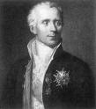
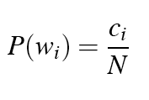

Laplace Smoothing
Also known as Add-One smoothing
Just add one to all the counts!
Very simple
MLE estimate:
Laplace estimate:

Slide 34
Bigram Counts

Slide 35
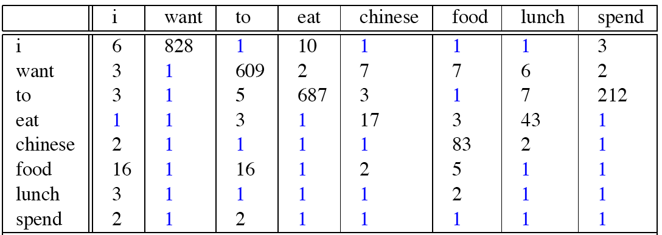
Laplace-Smoothed Bigram Counts

Slide 36

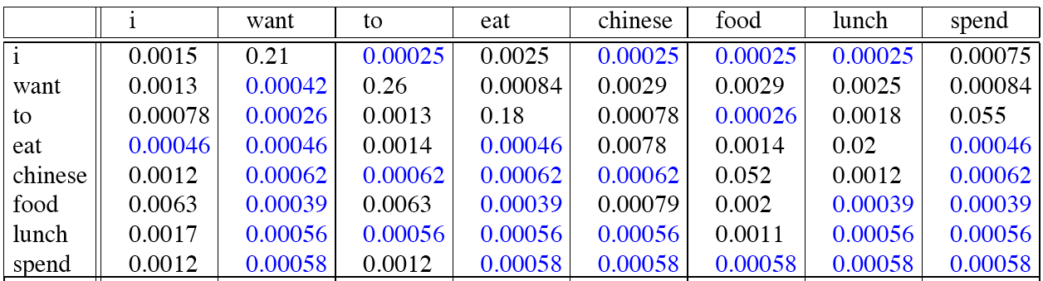
Laplace-Smoothed Bigram Probabilities

Slide 37
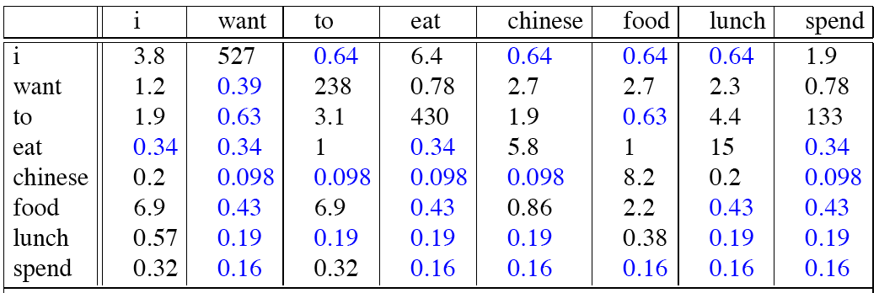
Reconstituted Counts

Slide 38
Reconstituted Counts (2)

Slide 39
Big Change to the Counts!
C(want to) went from 608 to 238!
P(to|want) from .66 to .26!
Discount d= c*/c
d for “chinese food” =.10!!! A 10x reduction
So, in general, Laplace is a very blunt instrument
Because of this Laplace smoothing not often used for language models, as we have much better methods
Despite its flaws Laplace (add-1) is still used to smooth other probabilistic models in NLP and IR, especially
For pilot studies
In document classification
In domains where the number of zeros isn’t so huge.

