Slide 1
Natural Language Processing
CSCI 5832— Lecture 4
Jim Martin

Slide 2
Today
More language modeling
Smoothing
Laplace smoothing (add-1)
Kneyser-Ney
Part of speech tagging
Hidden Markov Models (HMMs)

Slide 3
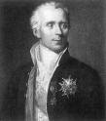
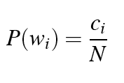

Laplace Smoothing
Also known as Add-One smoothing
Just add one to all the counts!
Very simple
MLE estimate:
Laplace estimate:

Slide 4
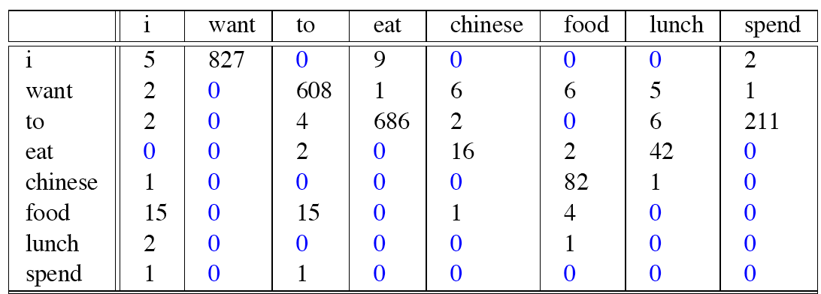
Bigram Counts

Slide 5
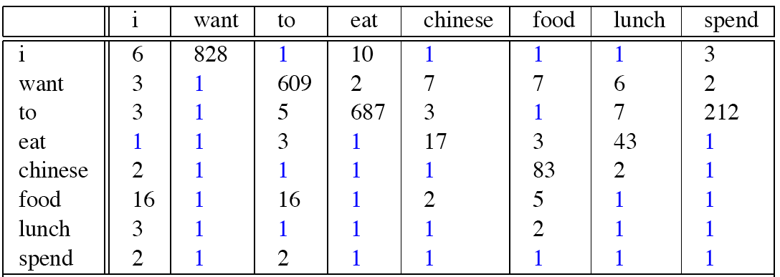
Laplace-Smoothed Bigram Counts

Slide 6

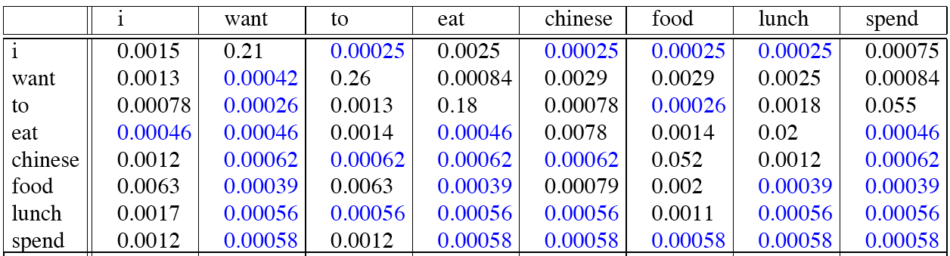
Laplace-Smoothed Bigram Probabilities

Slide 7
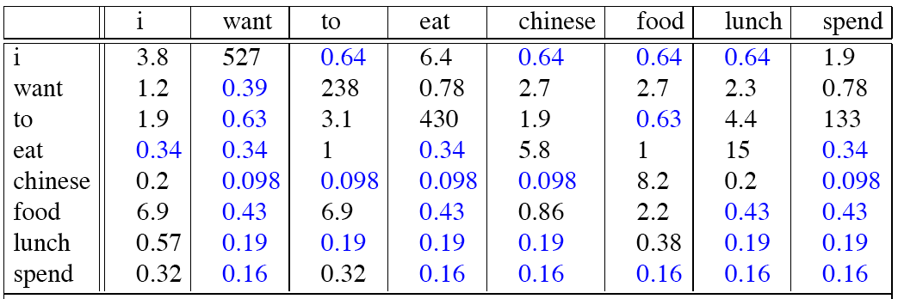
Reconstituted Bigram Counts

Slide 8
Reconstituted Counts (2)

Slide 9
Big Change to the Counts!
C(want to) went from 608 to 238!
P(to|want) from .66 to .26!
Discount d= c*/c
d for “chinese food” =.10!!! A 10x reduction
So, in general, Laplace is a very blunt instrument
Because of this Laplace smoothing not often used for language models, as we have much better methods
Despite its flaws Laplace (add-1) is still used to smooth other probabilistic models in NLP and IR, especially
For pilot studies
In document classification
In domains where the number of zeros isn’t so huge.

Slide 10
Types, Tokens and Fish
Much of what’s coming up was first studied by biologists who are often faced with 2 related problems
Determining how many species occupy a particular area (types)
And determining how many individuals of a given species are living in a given area (tokens)

Slide 11
One Fish Two Fish
Imagine you are fishing
There are known to be 8 species of fish where you’re fishing: carp, perch, whitefish, trout, salmon, eel, catfish, bass
Not sure where this fishing hole is...
Up to now you have caught
10 carp, 3 perch, 2 whitefish, 1 trout, 1 salmon, 1 eel = 18 fish
How likely is it that the next fish to be caught is an eel?
How likely is it that the next fish caught will be a member of one of the as yet to be seen species (bass or catfish)?
Now how likely is it that the next fish caught will be an eel?
Slide adapted from Josh Goodman

Slide 12
Fishing Lesson
We need to steal part of the observed probability mass to give it to the as yet unseen N-Grams. So the questions are:
How much to steal
How to redistribute it

Slide 13
Smoothing Concepts
Backoff
Using lower order N-grams when counts are lacking for higher order ones
Interpolation
Mixing unigram, bigram, trigram probabilities
Discounting
Stealing from the rich

Slide 14
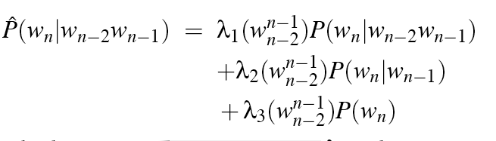
Linear Interpolation
Simple interpolation
Lambdas conditional on context

Slide 15
How to set the Lambdas?
Use a held-out corpus
Choose λs to maximize the probability of held-out data:
Fix the N-gram probabilities (using the training data)
Then search for λs that give largest probability to held-out set
Training Data
Held-Out Dev Data
Test
Data

Slide 16
Absolute Discounting
Subtract a small fixed amount from all the observed counts (call that d)
So instead of
We’ll use

Slide 17
Absolute Discounting
That leaves two issues...
What’s d?
And how to redistribute it?

Slide 18
Absolute Discounting
How much to subtract?
Split training data in ½
Get bigram counts from the first ½ of the data
Observe how often bigrams that occurred with count M in the first ½ occur in the other ½ of the training data.
Bigram count in training | Bigram count in heldout set
0 | .0000270
1 | 0.448
2 | 1.25
3 | 2.24
4 | 3.23
5 | 4.21
6 | 5.23
7 | 6.21
8 | 7.21
9 | 8.26
Bigrams that occurred twice in the first batch, occurred on average 1.25 times in the second batch.

Slide 19
Absolute Discounting w/ Interpolation
discounted bigram
Interpolation weight
unigram prob

Slide 20
Using Context
Better estimate for probabilities of unigrams.
Shannon generator: I can’t see without my reading___________?
“Kong” is more common than “glasses”
… but “Kong” frequently follows “Hong”, not “reading”.
Really shouldn’t be using P(w)
glasses
Kong

Slide 21
Kneser-Ney Smoothing
P_{continuation}(w): How likely is it for w to appear in a new context (ie. as the second word in bigram)
For each word, count the number of bigram types it completes

Slide 22
Kneser-Ney Smoothing
Normalize by the total number of word bigram types to get a true probability

Slide 23
Kneser-Ney Smoothing
λ is a normalizing constant; the probability mass we’ve discounted
The number of word types that can follow w_{i-1}
the normalized discount

Slide 24
BERP
Let’s look at smoothing “chinese food”. We’ll need:
Count(“chinese food”)
Count(“chinese”)
P_continuation(“food”)
Count of bigrams “food” completes
Count of all bigram types
Count of bigrams that “chinese” starts

Slide 25
BERP
Let’s look at “chinese food”. We’ll need:
Count(“chinese food”) 82
Count(“chinese”) 158
P_continuation(“food”)
Count of bigrams “food” completes 110
Count of all bigram types 9421
Count of bigrams that “chinese” starts 17

Slide 26
Caveats
Smoothing N-gram counts is directed at N-grams for words that have occurred.
Dealing with unknown words (UNK) is a separate (related) issue.
The more data you have the less important the choice of smoothing method

Slide 27
SRILM
You don’t really have to implement any of this stuff.
The standard tool to use is the SRI Language Modeling Toolkit

Slide 28
Parts of Speech

Slide 29
Word Classes: Parts of Speech
8 (ish) traditional parts of speech
Noun, verb, adjective, preposition, adverb, article, interjection, pronoun, conjunction, etc
Lots of names for this notion
Part of speech, lexical category, word class, morphological class, lexical tag...
Lots of debate within linguistics about the number, nature, and universality of these
We’ll largely ignore this debate.

Slide 30
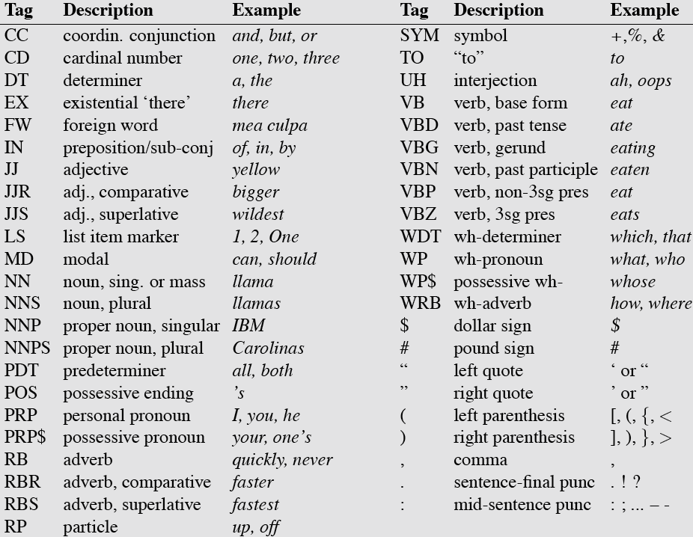
Penn TreeBank POS Tagset

Slide 31
POS Tagging
The process of assigning a part of speech or lexical class marker to each word in a text.
WORD tag
the DET
koala N
put V
the DET
keys N
on P
the DET
table N
The is our first example of a sequence labeling task
Assigning a category label to each element of a sequence.

Slide 32
POS Tagging
Words typically have more than one part of speech: back
The back door = JJ
On my back = NN
Win the voters back = RB
Promised to back the bill = VB
The POS tagging problem is to determine the tag for a particular instance of a word in context
Usually a sentence

Slide 33
POS Tagging
Note this is distinct from the task of identifying which sense of a word is being used given a particular part of speech. That’s called word sense disambiguation. We’ll get to that later.
“… backed the car into a pole”
“… backed the wrong candidate”

Slide 34
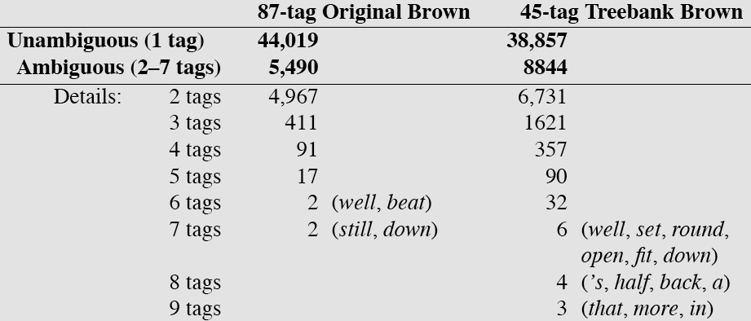
How Hard is POS Tagging? Measuring Ambiguity

Slide 35
Methods for POS Tagging
Rule-based tagging
Probabilistic sequence models
HMM (Hidden Markov Model) tagging
MEMMs (Maximum Entropy Markov Models)
RNNs (Recurrent neural networks)

Slide 36
POS Tagging as Sequence Labeling
We are given a sentence (an “observation” or “sequence of observations”)
Secretariat is expected to race tomorrow
What is the best sequence of tags that corresponds to this sequence of observations?
Probabilistic view
Consider all possible sequences of tags and assign a probability to each
Out of this universe of sequences, choose the tag sequence that is most probable given the observation sequence of n words w₁…w_{n}.

Slide 37
Hidden Markov Models

Slide 38

Probabilistic Approach
We want, out of all sequences of n tags t₁…t_{n} the single tag sequence such that
P(t₁…t_{n}|w₁…w_{n}) is highest.
Hat ^ means “our estimate of the best one”
Argmax_{x} f(x) means “the x such that f(x) is maximized”

Slide 39
Getting to HMMs
This equation gives us our objective
How do we make this operational? How to compute this value? Two steps
Use Bayes rule to transform this equation into a new set of equations
Use independence assumptions to make computing these tractable

Slide 40
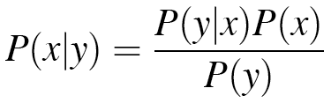
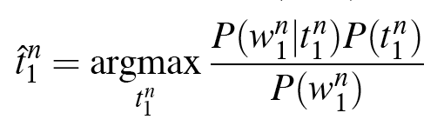
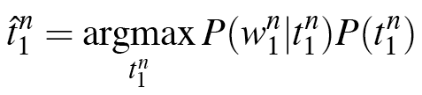
Using Bayes Rule
Know this.

Slide 41
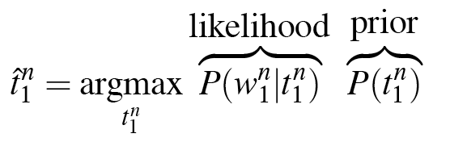
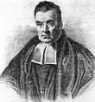
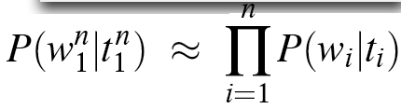
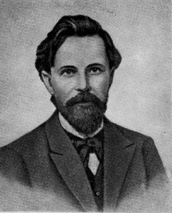
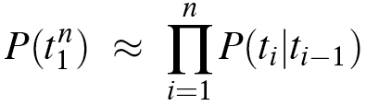
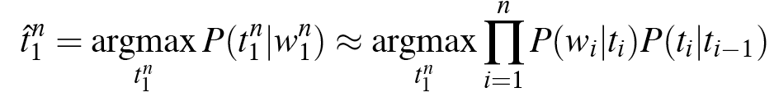
Likelihood and Prior

Slide 42
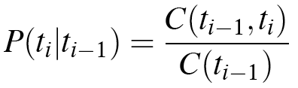
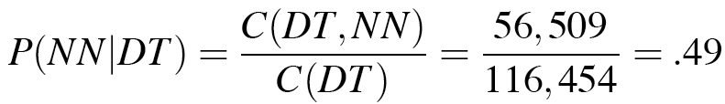
Two Kinds of Probabilities
Tag transition probabilities p(t_{i}|t_{i-1})
Determiners likely to precede adjs and nouns
That/DT flight/NN
The/DT yellow/JJ hat/NN
So we expect P(NN|DT) and P(JJ|DT) to be high
Compute P(NN|DT) by counting in a labeled corpus:

Slide 43
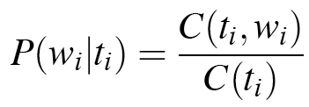
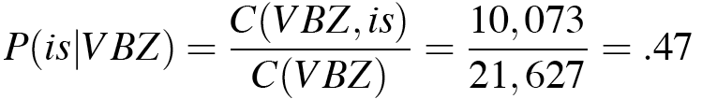
Two Kinds of Probabilities
Word likelihood probabilities p(w_{i}|t_{i})
VBZ (3sg Pres Verb) likely to be “is”
Compute P(is|VBZ) by counting in a labeled corpus:

Slide 44
Example: The Verb “race”
Secretariat/NNP is/VBZ expected/VBN to/TO race/VB tomorrow/NR
People/NNS continue/VB to/TO inquire/VB the/DT reason/NN for/IN the/DT race/NN for/IN outer/JJ space/NN

Slide 45
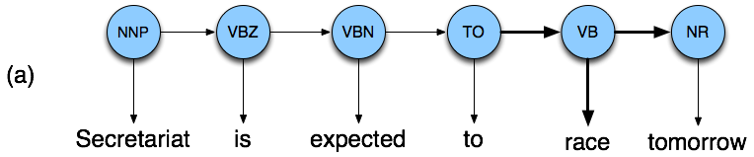

Disambiguating “race”

Slide 46
Disambiguating “race”

Slide 47
Example
P(NN|TO) = .00047
P(VB|TO) = .83
P(race|NN) = .00057
P(race|VB) = .00012
P(NR|VB) = .0027
P(NR|NN) = .0012
P(VB|TO)P(NR|VB)P(race|VB) = .00000027
P(NN|TO)P(NR|NN)P(race|NN)=.00000000032
So we (correctly) choose the verb tag for “race”

Slide 48
Hidden Markov Models
What we’ve just described is called a Hidden Markov Model (HMM)
This is an example of a generative model.
There is a hidden underlying generator of observable events
The hidden generator can be modeled as a network of states and transitions
We want to infer the underlying state sequence given the observed event sequence

Slide 49
HMM Tagging
The hidden process is the unseen process of part of speech sequences
Modeled as states and state transitions
The observations are the words that are emitted for each POS
Modeled as emissions from states

Slide 50
Hidden Markov Models
States Q = q₁, q₂…q_{N;}
Observations O= o₁, o₂…o_{N;}
Each observation is a symbol from a vocabulary V = {v₁,v₂,…v_{V}}
Transition probabilities
Transition probability matrix A = {a_{ij}}
Observation likelihoods
Output probability matrix B={b_{i}(k)}
Special initial probability vector π

Slide 51
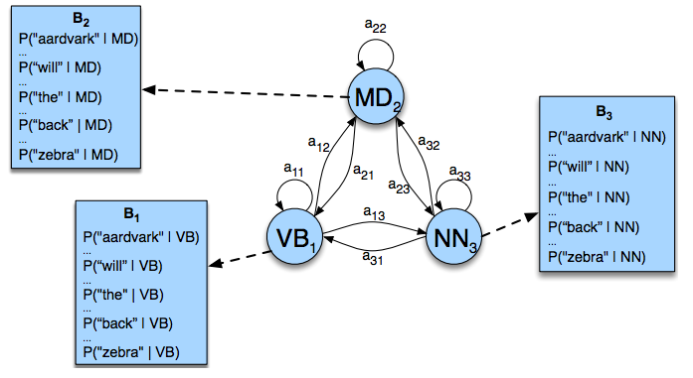
POS Tagging as an HMM

Slide 52
Question
If there are 30 or so tags in the Penn set
And the average sentence is around 20 words...
How many tag sequences do we have to enumerate to argmax over?
30²⁰

