Slide 1
Natural Language Processing
CSCI 5832—Lecture 10
Jim Martin

Slide 2
Today
Neural networks
Structure
Basic forward inference
Common NLP use cases
Language models
Sequence classification
Sequence labeling

Slide 3
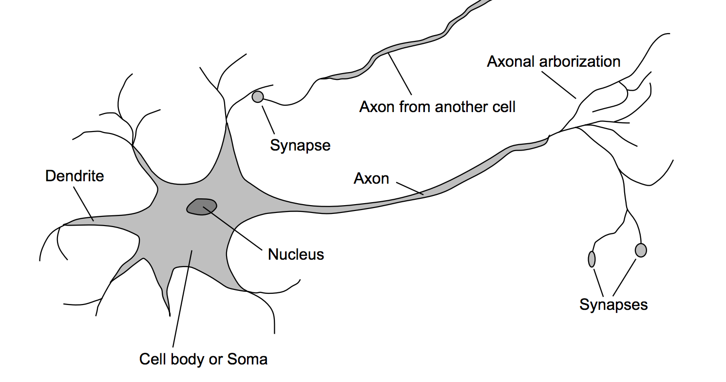
Neurons

Slide 4
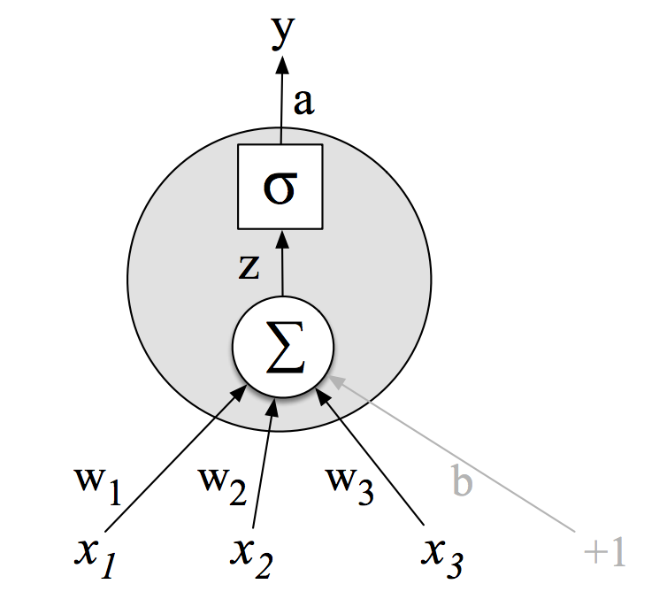
Single Unit McCulloch-Pitts
Activation value
Non-linear transform
Weighted sum
Weights
Input layer

Slide 5
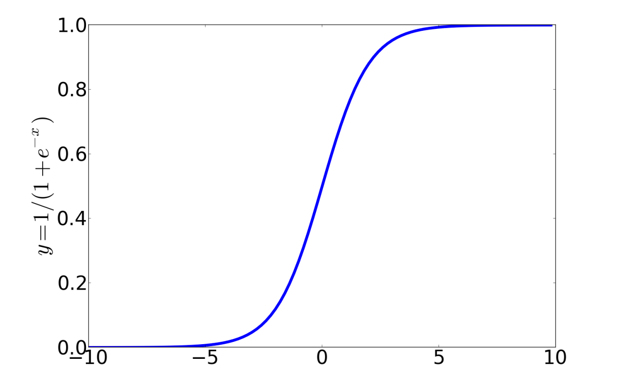
Non-Linear Functions
Sigmoid

Slide 6
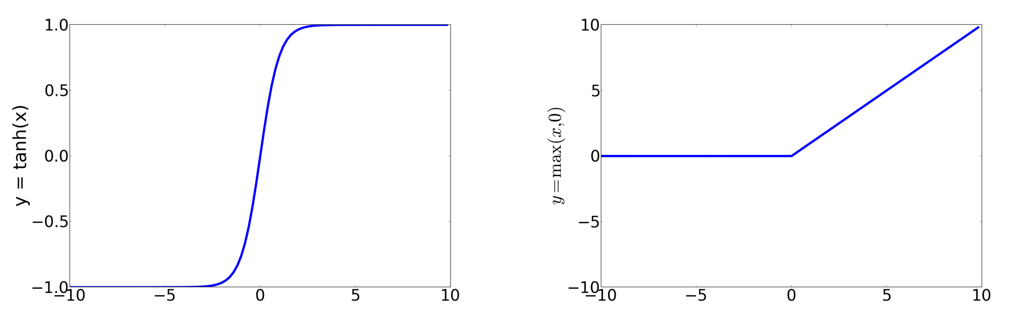
Non-Linear Functions
Tanh
Relu

Slide 7

Networks of Units
Binary Logistic Regression
$$σ$$
W
x1
xn

Slide 8
Network of Units
Fully connected single layer network
Multinomial Logistic
Regression
W
x1
xn

Slide 9

Multilayer Network
y
U
W
x1
xn

Slide 10
2-Layer Network
y
U
W
x1
xn

Slide 11
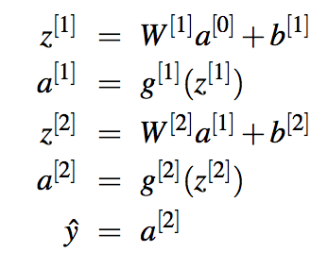
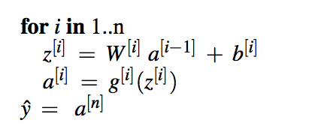
Two Layer Notation

Slide 12
Use Cases
Ok, so how do we apply these networks to language problems
Classification
Language modeling
Sequence labeling

Slide 13
Sentiment Analysis
Let’s apply this approach to the problem of sentiment analysis doing exactly what we did with logistic regression
Input layer are binary features as before
Output layer is number between
0 and 1 (> .5 is positive)
U
W
x1
xn

Slide 14
Sentiment Features

Slide 15
NN Classification
This is a good example of a classic approach to using NNs for classification
Take an existing set of training items with associated features, swap out your favorite ML algorithm for a feed-forward network and you’re done, results may or may not be better than you had before
If it improves over logistic regression its due to that additional layer which allows the network to reason about non-linear interactions in the information in the features.

Slide 16
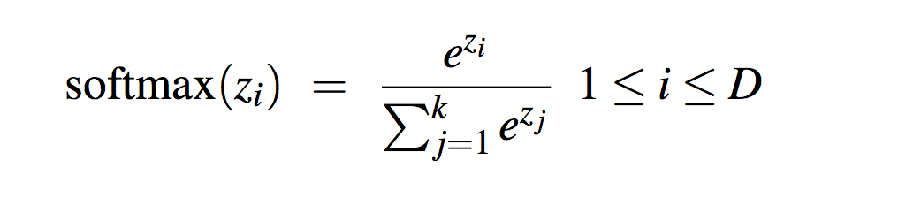
Multiclass Outputs
What if you have more than two classes?
Add more output units (one for each class)
And use a “softmax layer”
U
W
x1
xn

Slide 17
NN Classification
But the real power of “deep learning” comes from its ability to infer features from the raw data without the need for human analysts to engineer the features.
U
W
x1
xn

Slide 18
NN Sentiment Classification
How might we “use the input words” directly as an input feature vector?
More generally, how do we represent stuff as vectors of numbers?

Slide 19
NN Sentiment Classification
View the vocabulary as a long bit vector, where each element represents a word. Then, for a given movie review (document), turn on the entry for each word present in the review
Big long vector of mostly zeroes
Doesn’t capture word frequency

Slide 20
NN Sentiment Classification
2. Do as we did with naïve Bayes, represent the document word positions and assign a word index value to each position... Where the word index is based on some code for each word in the lexicon.

Slide 21
NN Sentiment Classification
“cast is great” → [525, 4812, 121]
Problems
Reviews come in different lengths; networks require fixed length input vectors
Pad short reviews to a common fixed length; truncate long reviews
Is 525 “close” to 524? Yes and no.
Need an encoding that doesn’t imply closeness to the network
Assign each word an index in the vocab, create a long bit vector where the word is “on” and all others are zero

Slide 22
NN Sentiment Classification
Input vector for a review is then the concatenation of the word vectors of the words in each position in the review
Suitably padded
Two problems...
Still a lot o zeroes
Now nothing is close to anything (the vectors are all orthogonal)

Slide 23
Word Embeddings
Assume instead we’ll represent words as short, dense vectors of real numbers
Say with length 50 to 300
View these as dimensions in some high dimensional “meaning space”
Such that words that are similar in meaning are close in the space

Slide 24
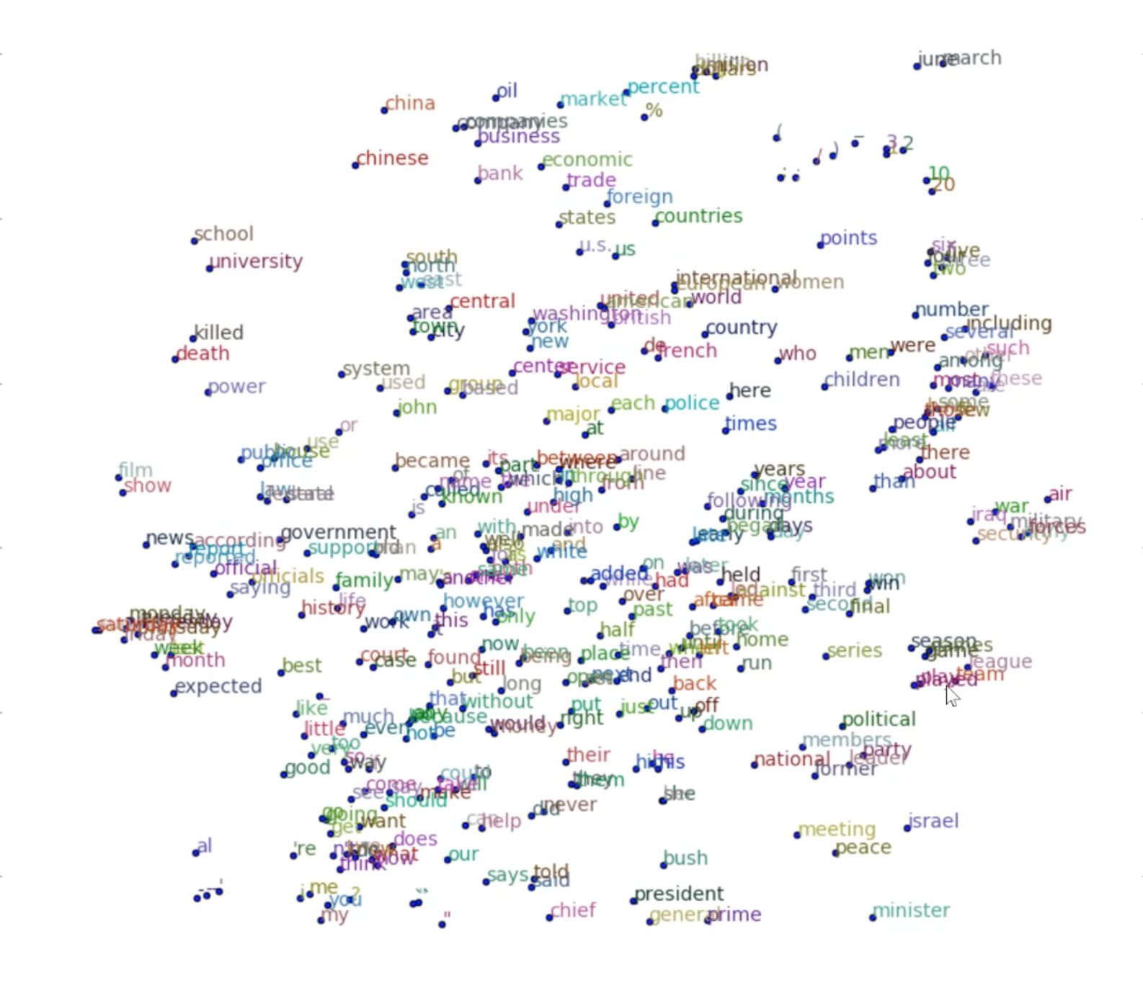
Embeddings

Slide 25
NN Sentiment w/ Embeddings

Slide 26
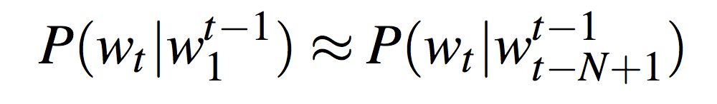
Neural Language Models
Let’s return to the problem of language modeling... Calculating the probability of the next word in a sequence given some history.
Problem: Now we’re dealing with sequences of arbitrary length.
Sliding windows (of fixed length)
Recurrent networks

Slide 27
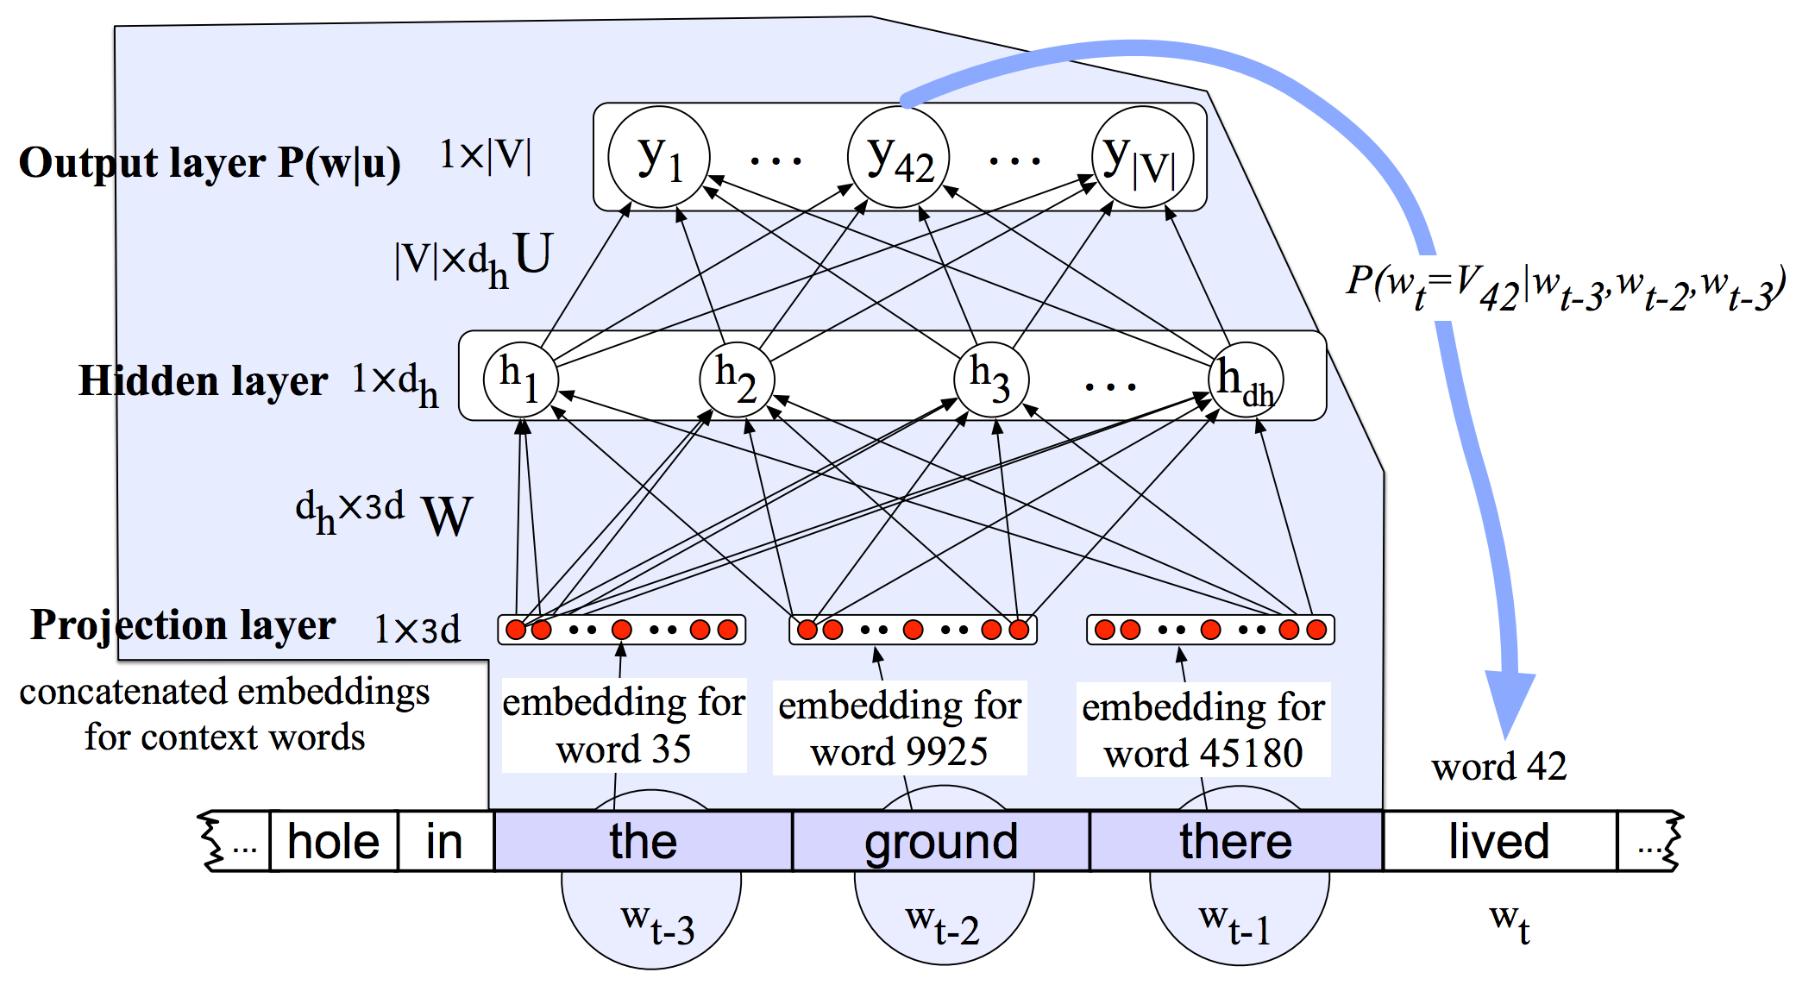
Neural Language Model

Slide 28
Neural Language Model

Slide 29
Issues
How many things are we predicting as output (for the softmax layer)?

Slide 30
Issues
How many things are we predicting as output (for the softmax layer)?
|V|
Training takes forever
So does forward inference
In most applications we don’t need the full distribution, just the probability of a small candidate set

Slide 31
Neural Sequence Tagging

Slide 32
Summary
NNs → Logistic regression with
More layers
Non-linear activations across layers
Classification
Text embeddings as inputs
Softmax over classes as output
Language models
Sliding window over embeddings as input
Softmax over vocab as output
Sequence classification
Sliding window over embeddings as input
Softmax over tagset as outputs

Slide 33
Worries
How exactly do we provide inputs to a NN text classifier?
Softmax over entire vocab is an issue
Sliding windows are problematic
And where do all those weights come from

