Slide 1
Natural Language Processing
CSCI 5832 Lecture 10
Jim Martin

Slide 2
Today
Neural networks
HW discussion
Quiz is Tuesday
Learning

Slide 3
Readings
Chapter 2: All
Chapter 3: Skip 3.7
Chapter 4: Skip 4.9 and 4.10
Chapter 5: Skip 5.8
Chapter 6: All
Chapter 7: Only 7.1 and 7.3 (no learning)
Chapter 8: Skip 8.5, 8.6 and 8.7

Slide 4
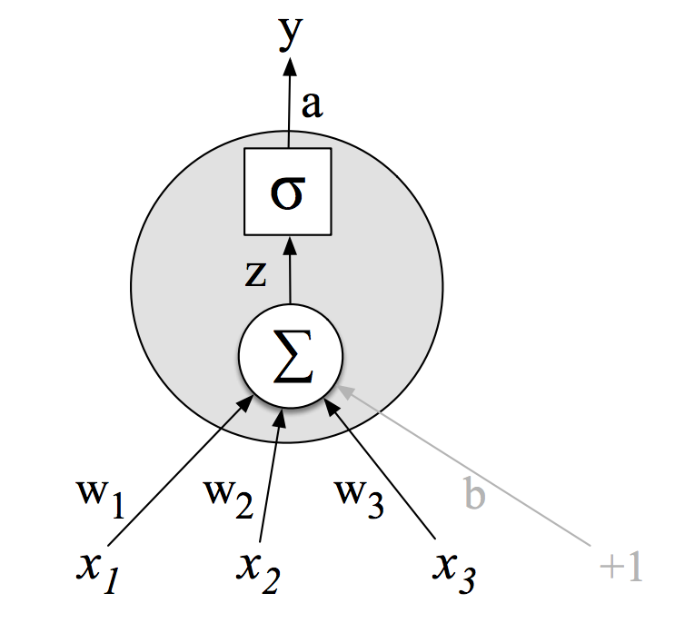
Single Unit McCulloch-Pitts
Activation value
Non-linear transform
Weighted sum
Weights
Input layer

Slide 5
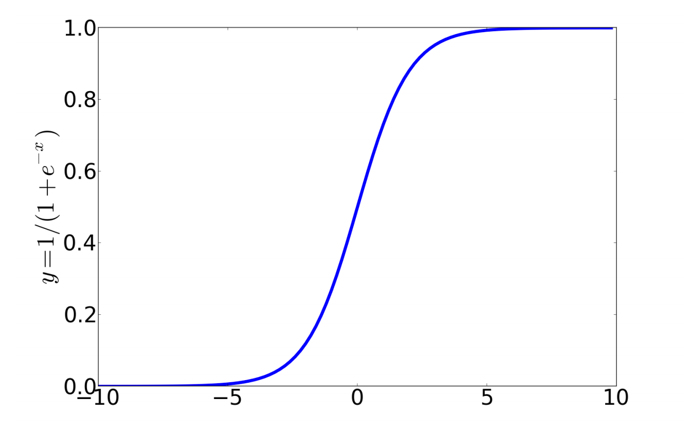
Non-Linear Functions
Sigmoid

Slide 6
Network of Units
Fully connected single layer network
W
x1
xn

Slide 7

Multilayer Network
y
U
W
x1
xn

Slide 8
Network Training
For every item (x,y) in the training set
Run forward computation to find an answer for x
For every output node
Assess the difference between true value y and the computed value y’
For every weight from the hidden layer to the output layer
Update the weight (w = w + delta)
For very hidden node
Assess how much blame it deserves for the current answer
For every weight from the input layer to the hidden layer
Update the weight

Slide 9
Multilayer Network
Actual answer
Loss function
System output
U
W
Training instance
x1
xn

Slide 10
Loss Function
We need a measure for how far off the current answer is to the right answer
Loss function
Lots of them out there. Today we’ll use something called the L2 norm

Slide 11
Weight Updates
Basic idea is to use the derivative of the loss function with respect to the weights to tell us how to adjust the weights for each training element
Move them in the direction that minimizes the error

Slide 12

Motivation

Slide 13
Weight Updates
For the output layer with weights U
First compute an error term for each output unit
Then use that to update the weights to it

Slide 14
Weight Updates
Wait what? Where did all that come from?
Start with chain rule

Slide 15
Individual Pieces
Derivative of the loss function wrt y
Derivative of the sigmoid wrt the sum
Derivative of the sum wrt the weights

Slide 16
Previous Layer
Now to perform the same process on the previous layer we would need to know how far off the hidden unit values are... But we don’t have that knowledge.
This is the credit (or blame) assignment problem.
The intuition is to take the sum of the output unit errors scaled by how much each hidden unit contributed to that error

Slide 17
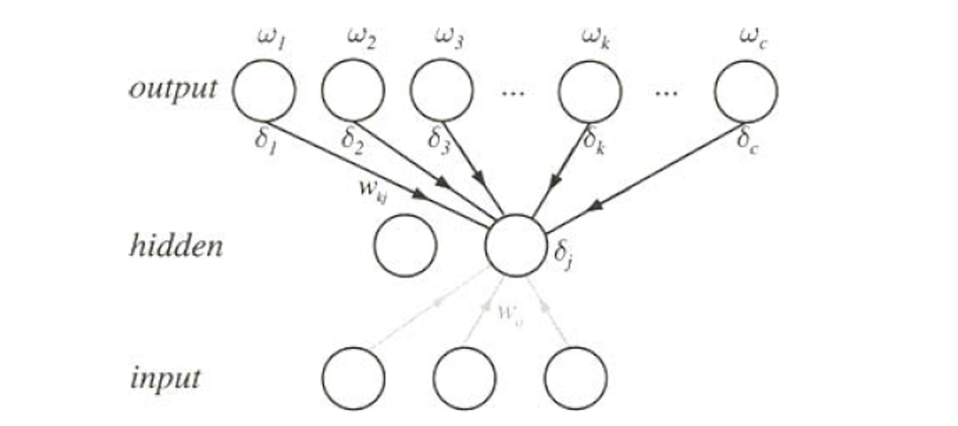
Previous Layer

Slide 18
Weight Updates
For the previous layer
Compute an error term for each hidden unit
Then use that to update the weights leading to it

Slide 19
Network Training
For every item (x,y) in the training set
Run forward computation to find an answer for x
For every output node
Assess the difference between true value y and the computed value y’
For every weight from the hidden layer to the output layer
Update the weight (w = w + delta)
For very hidden node
Assess how much blame it deserves for the current answer
For every weight from the input layer to the hidden layer
Update the weight

Slide 20
Network Training
For multiple passes over the training data (epochs)
For every item (x,y) in the training set
Run forward computation to find an answer for x
For every output node
Assess the difference between true value y and the computed value y’
For every weight from the hidden layer to the output layer
Update the weight (w = w + delta)
For very hidden node
Assess how much blame it deserves for the current answer
For every weight from the input layer to the hidden layer
Update the weight
Until we’re happy

Slide 21
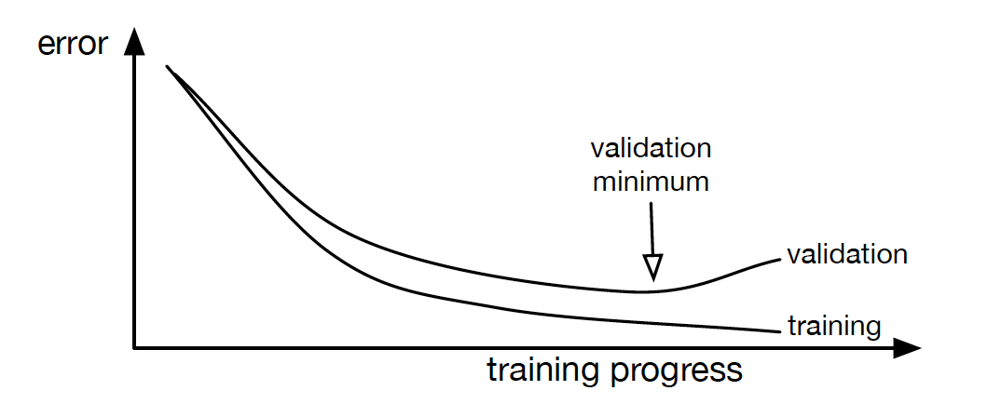
Training Issues (1)
What does happy mean?
Driving the loss function towards zero on the training set.

Slide 22
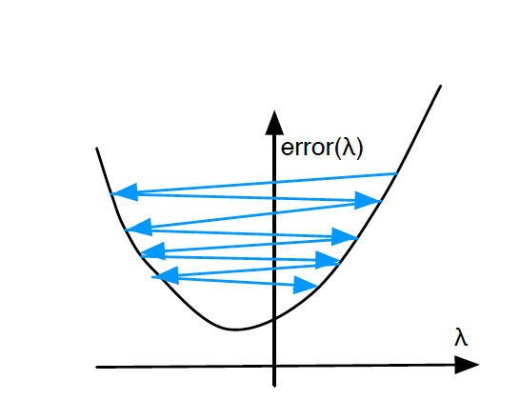
Training Issues (2)
We ignored our “step size”

Slide 23
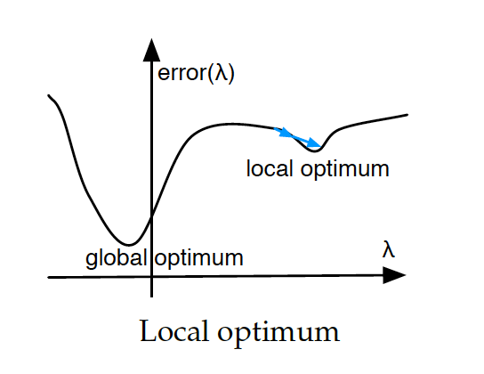
Training Issues (3)
Local optima
Random restarts

Slide 24
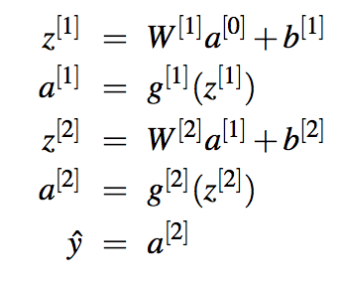
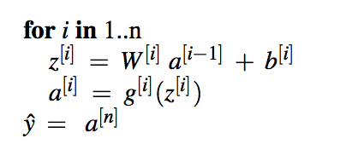
Multi-Layer Notation

Slide 25
Computation Graphs
Backprop is a special case of reverse differentiation.
Given a forward computation graph, we can break things down into the basic elements of the computation and use static knowledge of derivatives to perform the gradient computation (automatically).

Slide 26

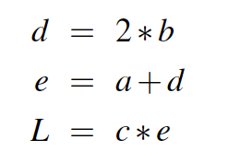
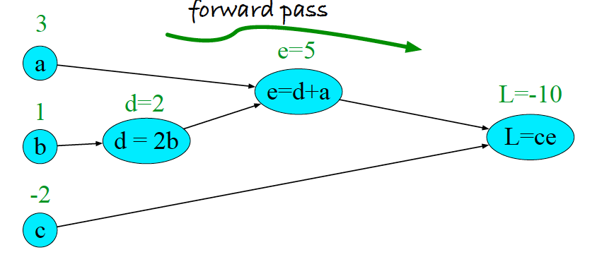
Example

Slide 27
Example
When we’re talking about partial derivatives, all we’re asking about is how does L change in the context of a small change to one of the input variables, holding the others constant.

Slide 28
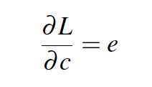
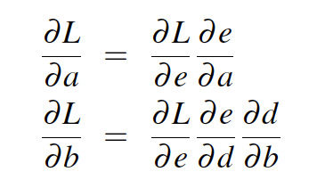
Example

Slide 29
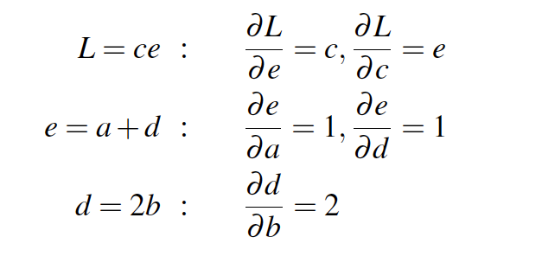
Example

Slide 30
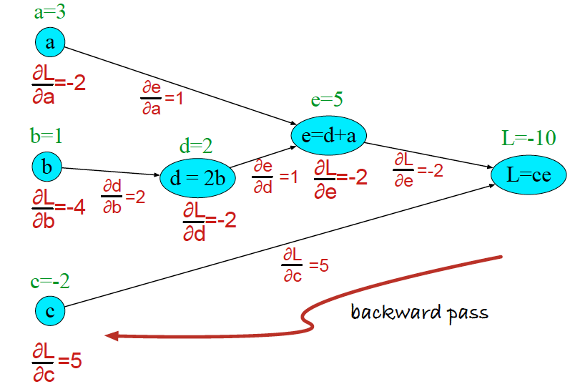
Example

Slide 31
Multilayer Network
y
Assume a sigmoid activation on the output
W²
Assume a RELU activation on the hidden
W¹
x1
x2

Slide 32
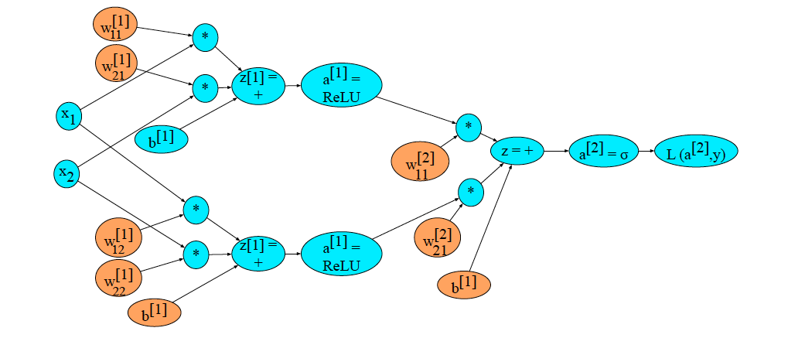
Example

