Slide 1
Natural Language Processing
CSCI 5832 — Lecture 24
Jim Martin

Slide 2
Today
Review NNs
Recurrent neural networks
  Basic RNNs
    Language models, sequence classification, sequence labeling
  BiRNNs
  Stacked RNNs

Slide 3
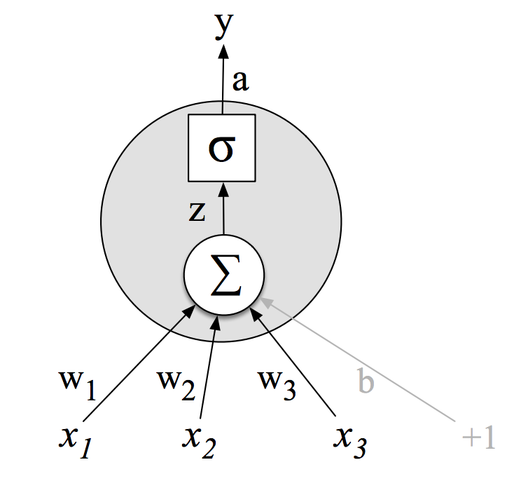
Single Unit
McCulloch-Pitts
Activation value
Non-linear transform
Weighted sum
Weights
Input layer

Slide 4
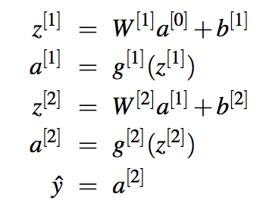
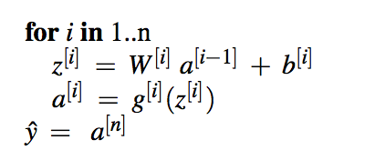
Inference in 2-Layer Net

Slide 5
NN Sentiment w/ Embeddings

Slide 6
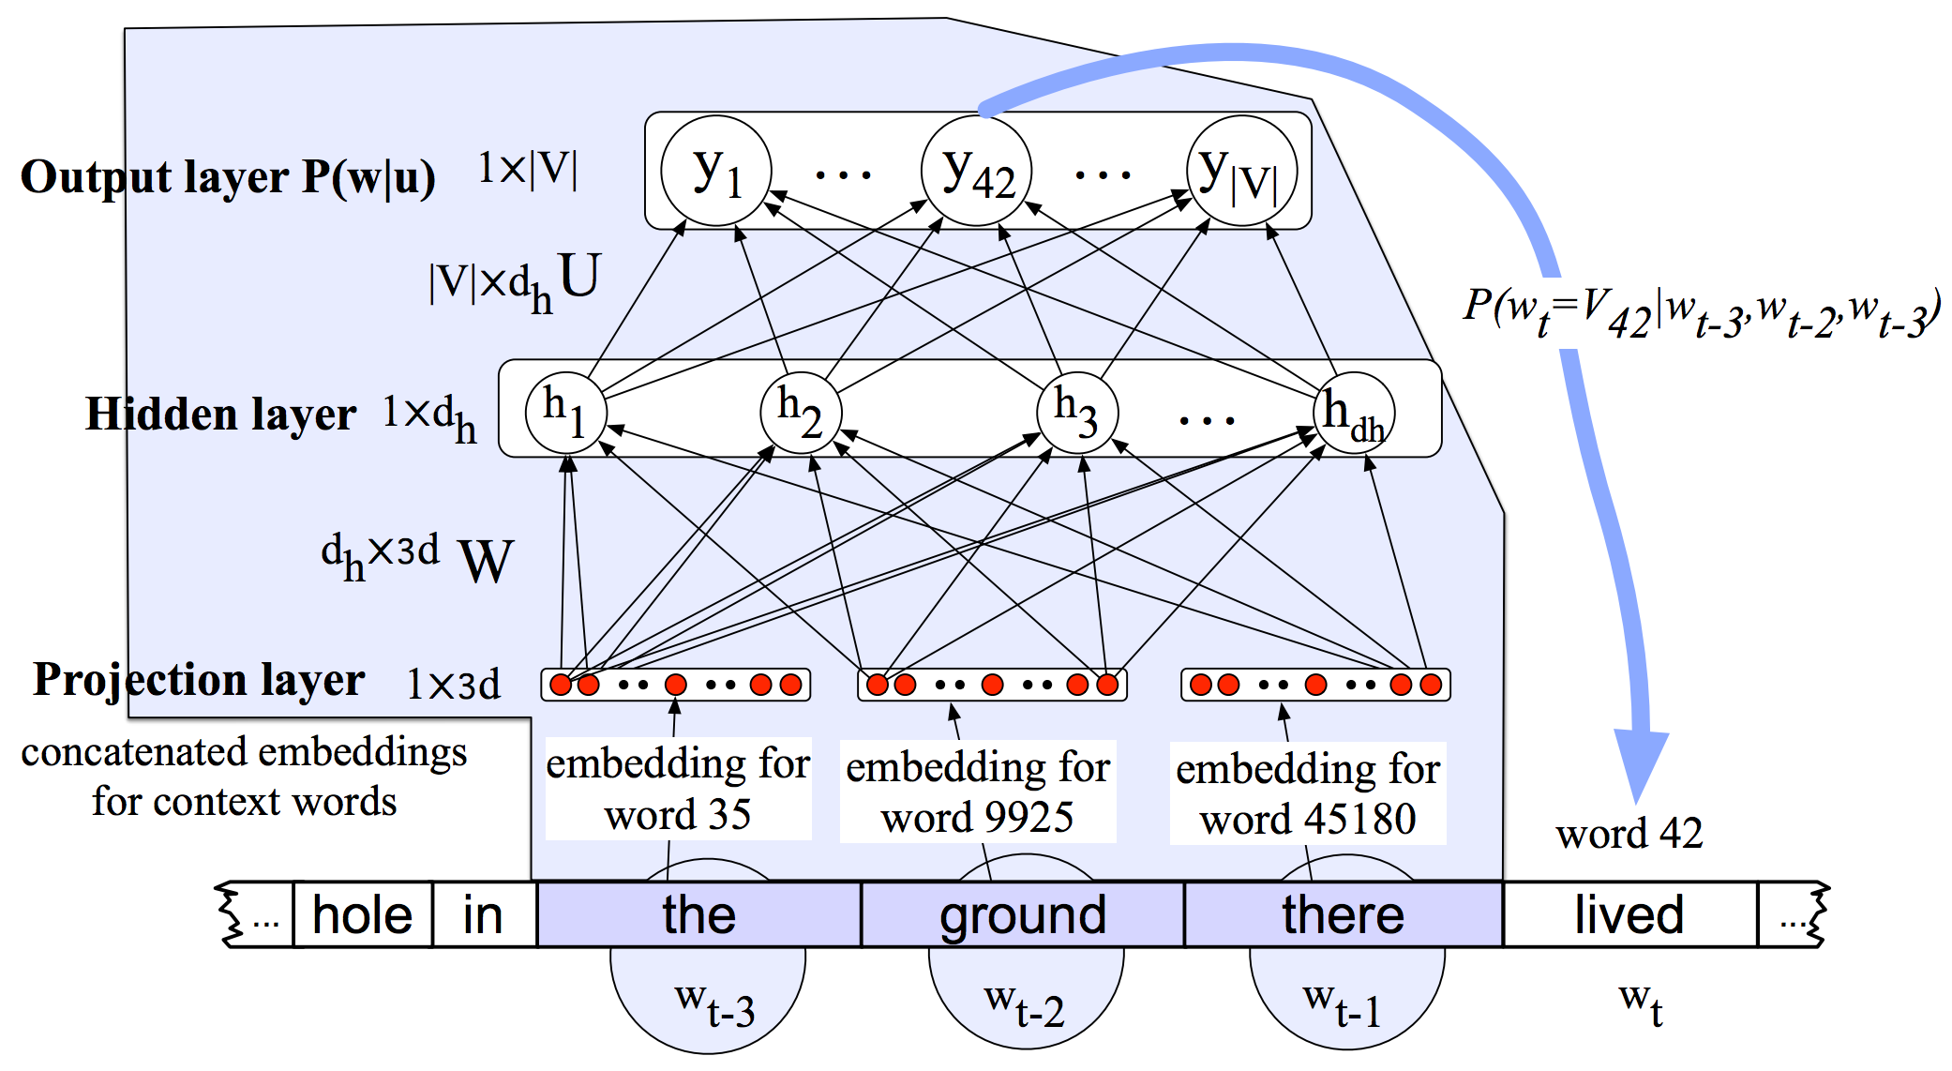
Neural Language Model

Slide 7
Neural Sequence Tagging

Slide 8
Issues
That fixed sized window is there because these networks required a fixed sized input. That’s a problem
  Stuff outside the window might be relevant to the current classification
  Hard to learn patterns since
  they vary positionally

Slide 9
Solution
Networks that can deal with time (sequences) explicitly. Rather than with hacks like windows.
Recurrent networks are networks where the value of some units are based on their own outputs from earlier processing.
  In general, complex to train and reason about
Simple recurrent networks can address our problems.

Slide 10
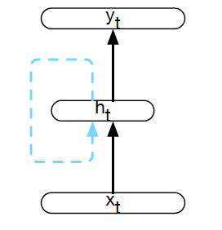
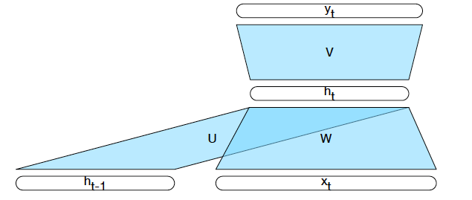
Simple Recurrent Neural Network
Feed words/inputs in a sequence one at a time, compute a corresponding output at each step
Add a copy of the previous hidden layer as input to the current hidden layer as context
Notes:
Instead of a sliding window.

Slide 11
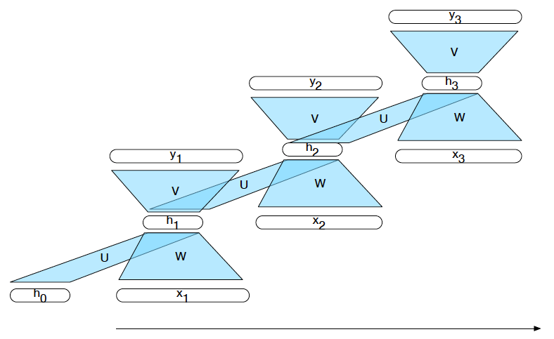
Unrolled in Time

Slide 12
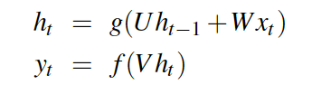
Inference in SRN

Slide 13
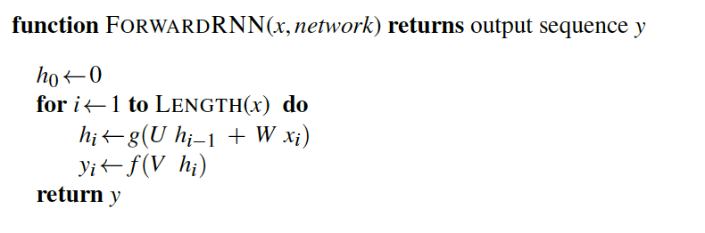
Sequence Processing

Slide 14
Common Use Cases
Language modeling
  Predict the next word P(w_{i}| w_{1…}w_{i-1})
Sequence labeling
  POS tagging, IOB tagging, parsing
Sequence classification
  Classify a whole sequence (sentiment, deception, topic classification, authorship, etc)

Slide 15
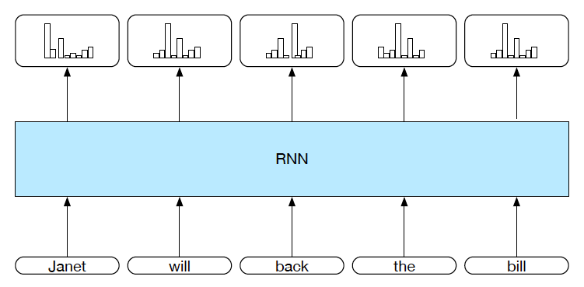
Sequence Labeling

Slide 16
Sequence Labeling

Slide 17
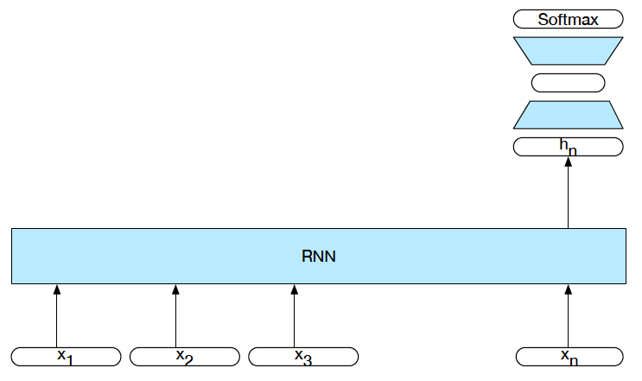
Sequence Classification
Intermediate outputs aren’t needed. Only the hidden layer activations.
Training is driven by the loss from the classification task.

Slide 18
Computation Graphs and Unrolling
There really isn’t any recurrence if you view it this way. Its just a complicated feed-forward network.

Slide 19
Deep Learning

Slide 20
Deep Learning
As we’ve seen we can view these networks as black boxes with vectors going in and out.
This modular view leads to more and more complex architectures.

Slide 21
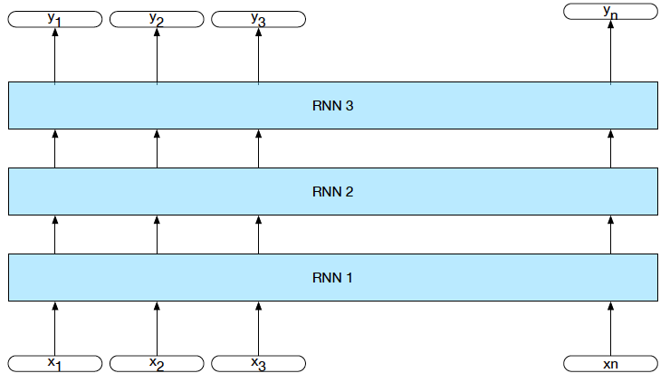
Stacked RNNs

Slide 22
Sequence Labeling

Slide 23


Bidirectional RNNs
At time t, what information is contained in h_{t}?
Everything we know about the sequence from
1 to t. And nothing about the rest.
What if we ran a different network over the input in reverse?

Slide 24
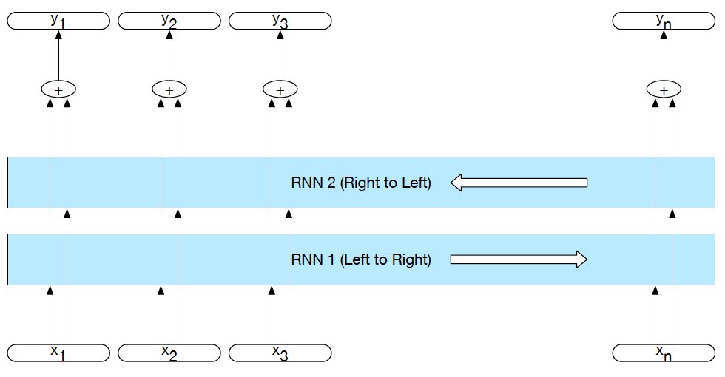
Bidirectional RNNs

Slide 25
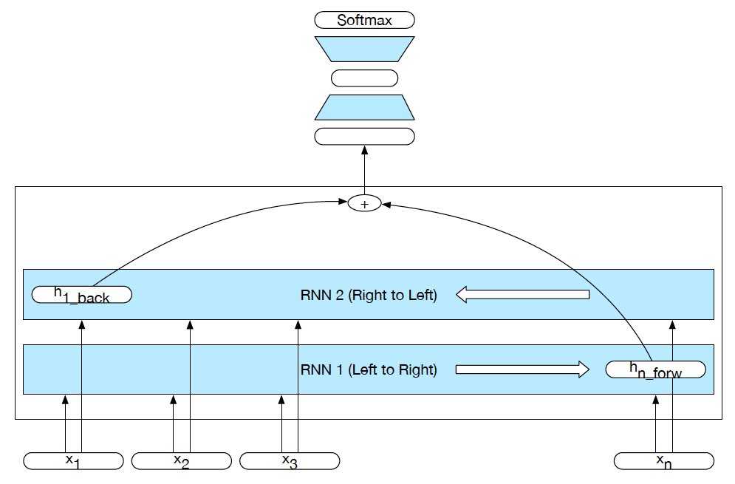
Bi-RNN for Classification

Slide 26
Deep Learning
Of course, now you can make that a black box and make it a module that can be stacked.
The number of layers becomes yet another hyper-parameter

Slide 27
Next time
Learning
  Backprop through time
Dealing with difficulty training RNNs
  Long short-term memory (LSTMs)
  Gated recurrent units (GRUs)

