Slide 1
Natural Language Processing
CSCI 5832—Lecture 14
Jim Martin

Slide 2
Today
Quiz review
HW comments
Recurrent networks
Review
Subword units
Learning in RNNs
LSTMs

Slide 3
HW
Lots of different answers
Highest accuracy is 94.69 (5512 / 5821)
Recurring bug in otherwise correct implementation is not outputting the tags for the final sentence (5816 outputs)
Differences in accuracy among the top ones mainly due to training data differences
Below 92 is probably a serious bug

Slide 4
HW
Buggy output
Not using tabs
Not including blank lines between sentences
Not emitting the ‘. .’ lines
Not using the test file
Emitting <unk> instead of a word
Using a zip file

Slide 5
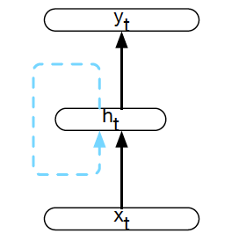
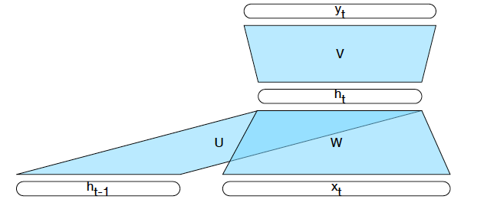
Simple Recurrent Neural Network
Feed words/inputs in a sequence one at a time, compute a corresponding output at each step
Add a copy of the previous hidden layer as input to the current hidden layer as context
Notes:
Instead of a sliding window.

Slide 6
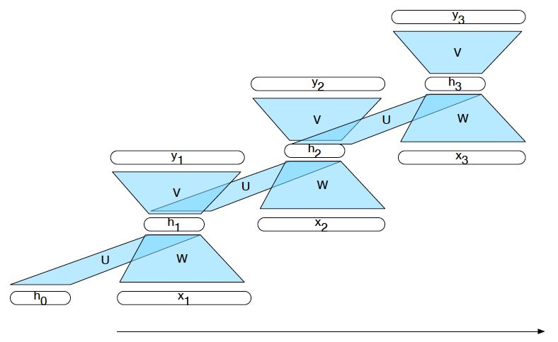
Unrolled in Time

Slide 7
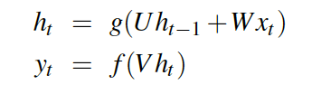
Inference in SRN

Slide 8
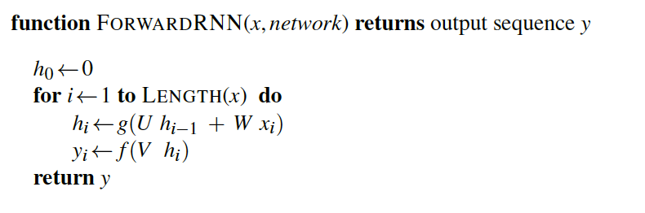
Sequence Processing

Slide 9
Common Use Cases
Language modeling
Predict the next word P(w_{i}| w_{1…}w_{i-1})
Sequence labeling
POS tagging, IOB tagging, parsing
Sequence classification
Classify a whole sequence (sentiment, deception, topic classification, authorship, etc)

Slide 10
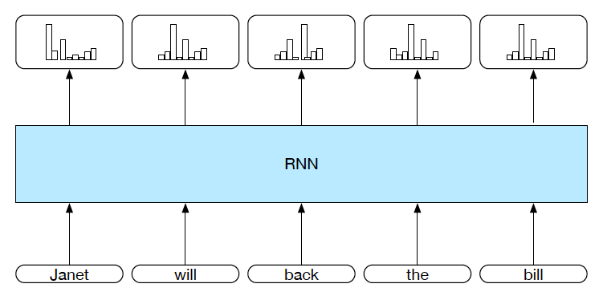
Sequence Labeling

Slide 11
Sequence Labeling

Slide 12
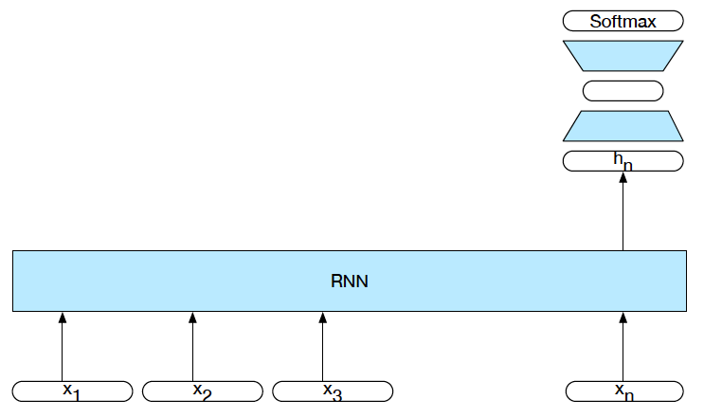
Sequence Classification
Intermediate outputs aren’t needed. Only the hidden layer activations.
Training is driven by the loss from the classification task.

Slide 13
Problem: Words
There are a lot of situations where dealing solely with word embeddings is a problem
Unknown words
Lack of access to morphological information
Antifracking -- > anti-frack-ing
Languages where its infeasible to list all the words
Polysynthetic and agglutinative languages

Slide 14
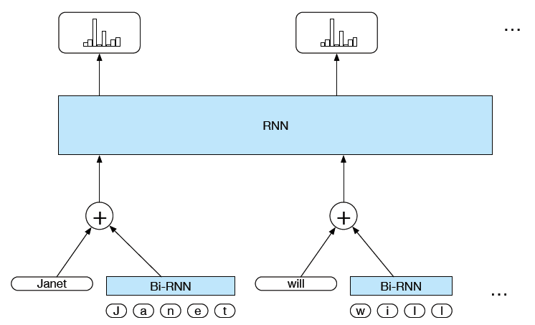
Solution Add Character Embeddings

Slide 15
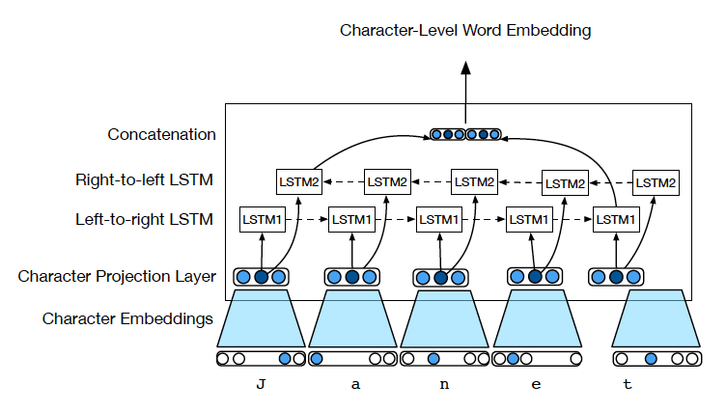
Generating Character-Level Embeddings

Slide 16
Learning
Proceeds pretty much as with normal feedforward networks
Need training data
Weights are randomly initialized
Loss function is based on the end application
Error is backpropagated as before
Weights are shared across timesteps

Slide 17
FF Network Training
For every item (x,y) in the training set
Run forward computation to find an answer for x
For every output node
Assess the difference between true value y and the computed value y’
For every weight from the hidden layer to the output layer
Update the weight (w = w + delta)
For very hidden node
Assess how much blame it deserves for the current answer
For every weight from the input layer to the hidden layer
Update the weight

Slide 18
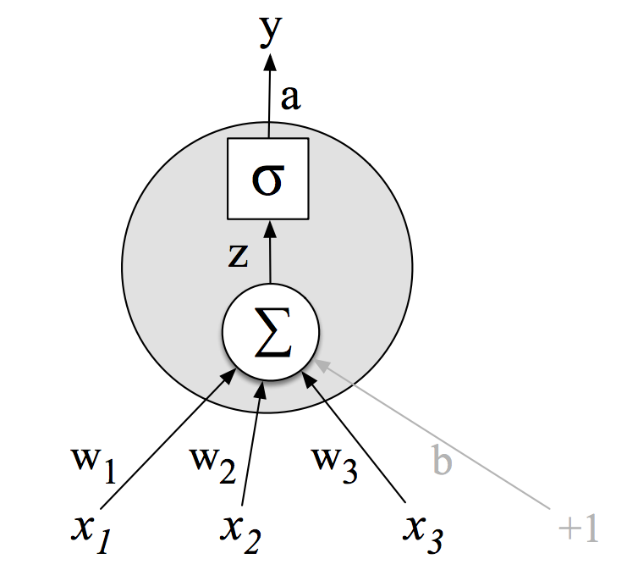
Weight Updates

Slide 19
Individual Pieces
Derivative of the loss function wrt y
Derivative of the activation function (y) wrt the sum
Derivative of the sum wrt the weights

Slide 20
Layers
Updating the layer from the hidden to the output is just like logistic regression since we have direct access to the error
We have the output and the correct answer.
To perform the same process on the previous layer we would need to know how far off the hidden unit values are... But we don’t have that knowledge.
The intuition is to take the sum of the output unit errors scaled by how much each hidden unit contributed to that error

Slide 21
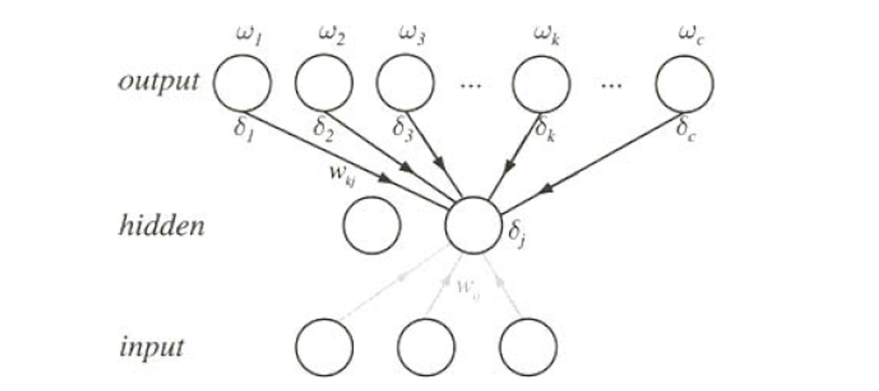
Previous Layer
The error term for a hidden unit is the weighted sum of the errors its contributed to.

Slide 22

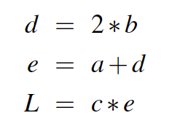
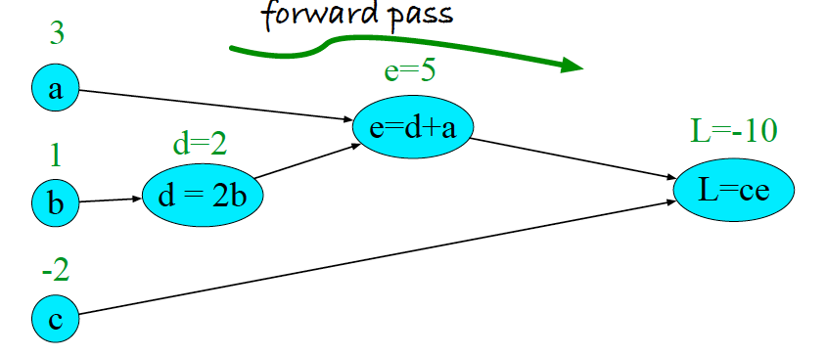
Example

Slide 23
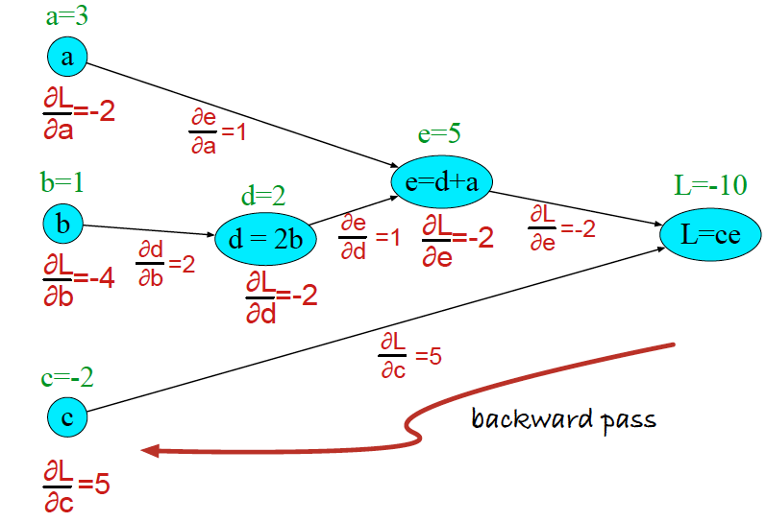
Example

Slide 24
Multilayer Network
y
Assume a sigmoid activation on the output
W²
Assume a RELU activation on the hidden
W¹
x1
x2

Slide 25
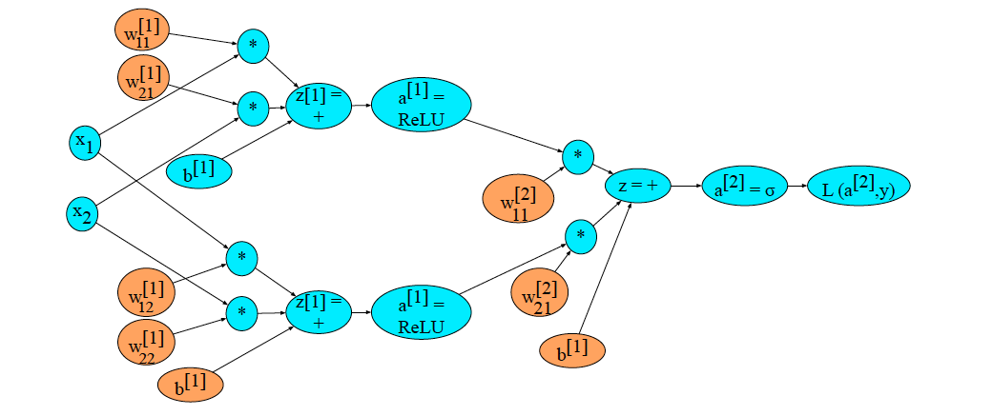
Example

Slide 26
SRN Unrolled in Time

Slide 27
SRN Version: Forward Pass

Slide 28
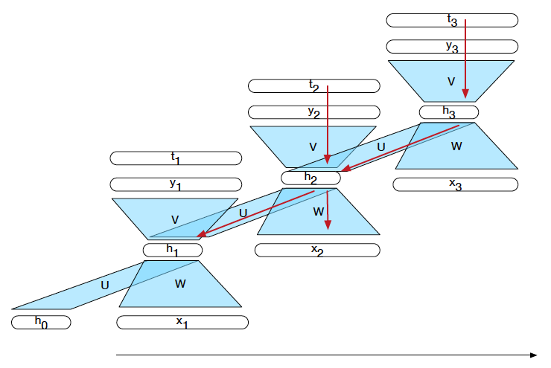
SRN Version:Backward Pass

Slide 29
LSTMs
Problem: Simple recurrent networks don’t work well as the sequences get longer.
Hard to train because of all the multiplications back in time.
Hard to get the hidden units to remember exactly what they need to remember over time.

Slide 30
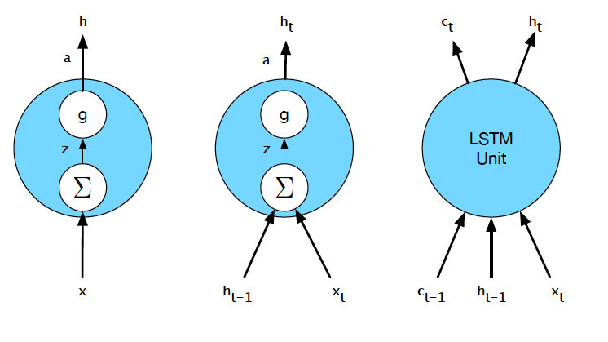
LSTMs
Solution: Use more complex units that explicitly manage a (1) context layer through the (2) use of “gates”.

Slide 31
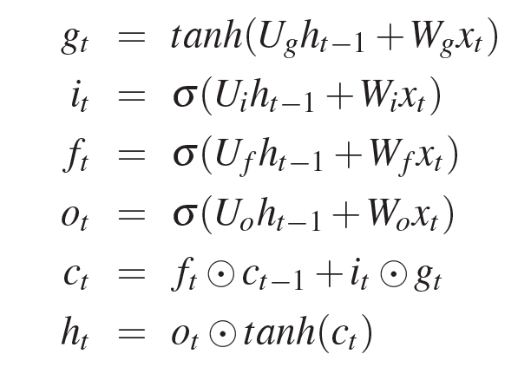

LSTMs
Usual thing
Think of these as bit masks
Input, forget and output gates
Decide what to forget and insert, store as new context
Compute the new h

Slide 32
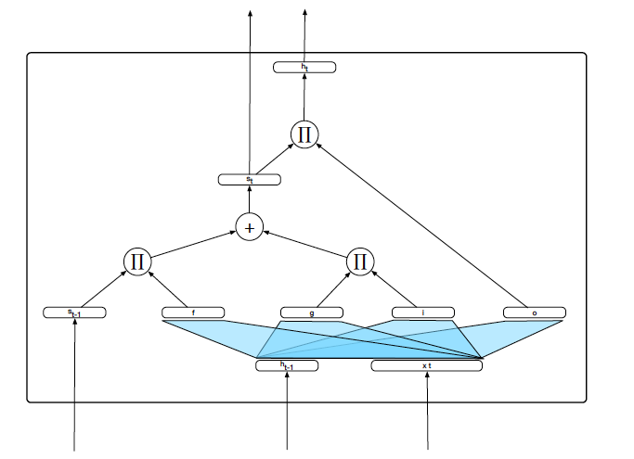
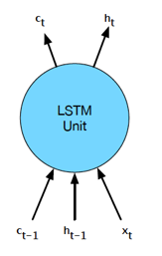
LSTMs

