Slide 1
Natural Language Processing
CSCI 5832—Lecture 17
Jim Martin

Slide 2
Today
Where we are
Grammars (Chapter 10)
CKY Parsing (Chapter 11)
Today: Statistical Parsing (Chapter 12)
Next: Dependency Parsing (Chapter 13)

Slide 3
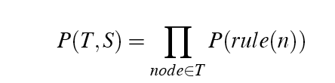
Simple Probability Model
A derivation (tree) consists of the collection of grammar rules that are in the tree
The probability of a tree is the product of the probabilities of the rules in the derivation.

Slide 4
Rule Probabilities
What’s the probability of a rule? Start at the top...
A tree should have an S at the top. So given that we know we need an S, we can ask about the probability of each particular S rule in the grammar.
That is P(particular S rule | S is what I need)
So in general we need
For each rule in the grammar

Slide 5

Training the Model
We can get the estimates we need from an annotated database (i.e., a treebank)
For example, to get the probability for a particular VP rule, just count all the times the rule is used and divide by the number of VPs overall.

Slide 6
Question
Given this approach…
Do we have to worry about smoothing to deal with zero counts?

Slide 7
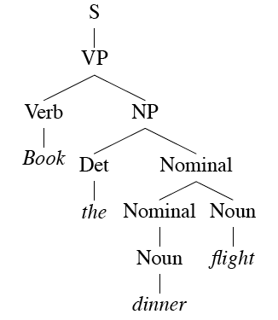
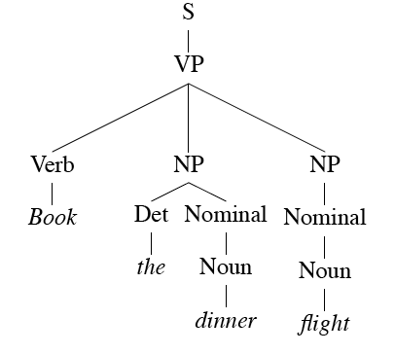
Example
Book the dinner flight

Slide 8
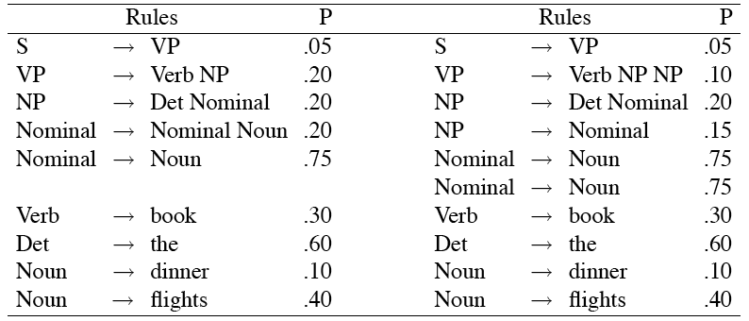
Examples
These two trees consist of the following rules

Slide 9
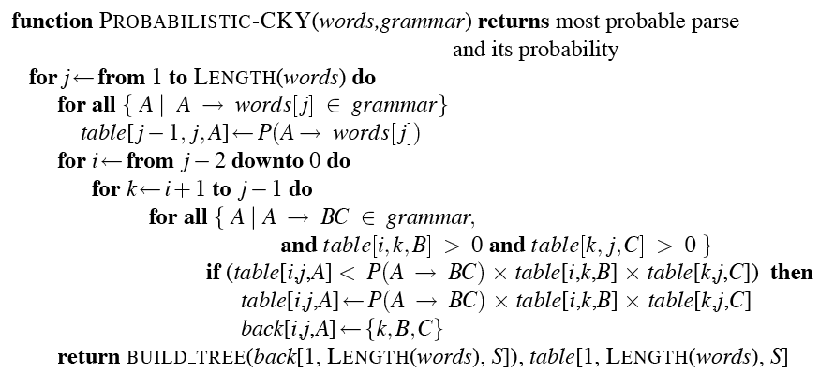
Probabilistic CKY

Slide 10
Problems with Simple PCFGs
The probability model we’re using is just based on the the bag of rules in the derivation…
Doesn’t take the actual words into account in any useful way.
Doesn’t take into account where in the derivation a rule is used
Doesn’t work terribly well
That is, the most probable parse isn’t usually the right one (the one in the treebank test set).

Slide 11
Evaluation
First, how do we measure how well a parser is working?
Assume we have a training/dev set from a treebank so we have “reference” answers for some set of trees.
We could look for straight accuracy across a test set of sentences
How many sentences received exactly the correct parse?

Slide 12
Evaluation
That’s too depressing
And not informative enough --- we might be making useful changes to the system and not see any improvement given this metric
The trees are getting better, but they’re still not right.
A better metric looks at the contents of the reference tree and the hypothesis tree

Slide 13
Example
Consider...
Book the dinner flight
Parser output
Reference answer

Slide 14
Evaluation
Precision
What fraction of the sub-trees in the hypothesis match corresponding sub-trees in the reference answer?
How much of what we’re producing is right?
Recall
What fraction of the sub-trees in the reference answer did we actually get?
How much of what we should have gotten did we actually get?

Slide 15
Example
Reference answer
Book the dinner flight
Parser output

Slide 16
Example: Precision
Precision: 6/10
Book the dinner flight
Reference answer
Parser output

Slide 17
Example: Precision
Precision: 2/10
Book the dinner flight
Reference answer
Parser output

Slide 18
Example: Recall
Recall: 2/11
Book the dinner flight
Reference answer
Parser output

Slide 19
Sources of Difficulty for PCFGs
Attachment ambiguities
PP attachment
Coordination problems

Slide 20
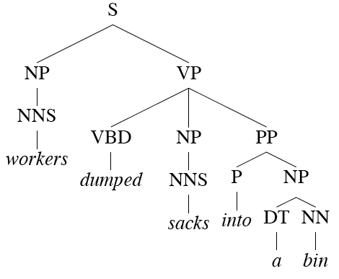
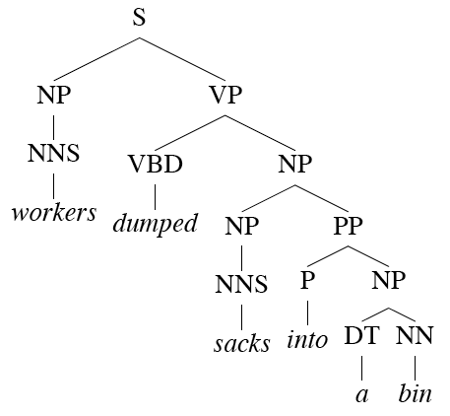
PP Attachment

Slide 21
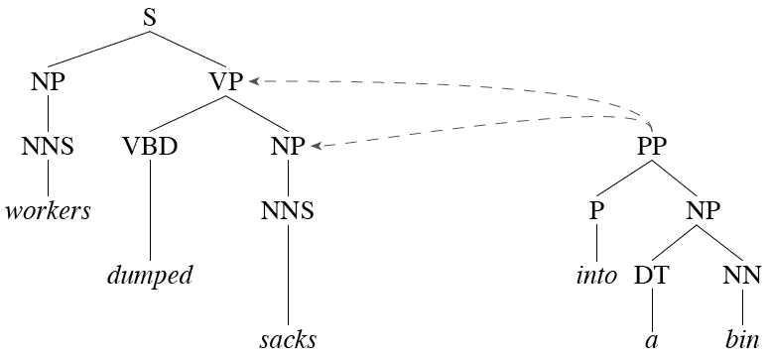
PP Attachment
Another view

Slide 22
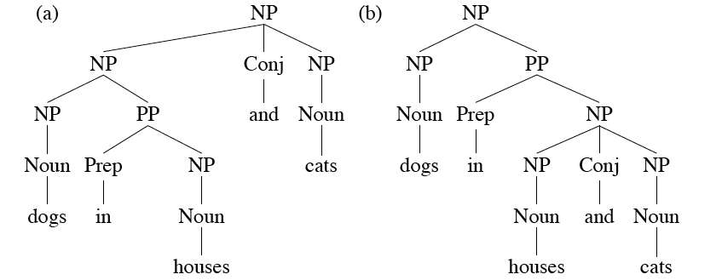
Coordination
Most grammars have a rule (implicitly) of the form
X -> X and X. This leads to massive ambiguity problems.

Slide 23
Better Statistical Parsing
We’ll consider the two main approaches to overcoming these shortcomings
Rewriting the grammar to better capture the dependencies among rules
Integrate lexical dependencies into the model
And come up with the independence assumptions needed to make it work.

Slide 24
Solution 1: Rule Rewriting
The grammar rewriting approach attempts to better capture local tree information by rewriting the grammar so that the rules capture the regularities we want.
By splitting and merging the non-terminals in the grammar
Example: split NPs into different classes… that is, split the NP rules into separate rules

Slide 25
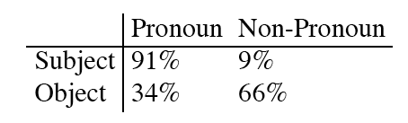
Motivation
Our CFG rules for NPs don’t condition on where in a tree the rule is applied (that’s why they’re context-free)
But we know that not all the rules will occur with equal frequency in all contexts.
Consider NPs that
involve pronouns vs.
those that don’t.

Slide 26
Example: NPs
So we might take this single rule
NP --> Pronoun
And replace it with two rules
NP_Subj --> Pronoun
NP_Obj --> Pronoun
Separate rules with different counts in the treebank and therefore different probabilities

Slide 27
Rule Rewriting
Three approaches
Use linguistic knowledge to directly rewrite rules by hand
NP_Obj and the NP_Subj approach
Automatically rewrite the rules using local context to capture some of what we want
That is incorporate some context into the rules
Search through the space of all possible rewrites for the grammar that maximizes the probability of the training set

Slide 28
Local Context Approach
Condition the rules based on parent nodes
Splitting based on tree-context captures some of the linguistic intuitions we saw with the NP example

Slide 29
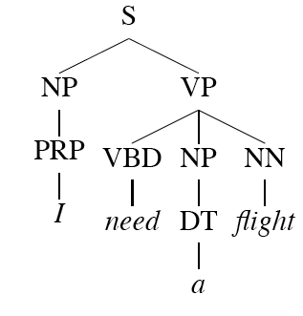
Parent Annotation

Slide 30
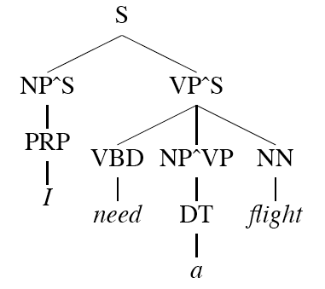
Parent Annotation
Now we have non-terminals NP^S and NP^VP that should capture the subject/object and pronoun/full NP cases. That is…
NP^S -> PRP
NP^VP -> DT
VP^S -> NP^VP

Slide 31
Auto Rewriting
If this is such a good idea we may as well apply a learning approach to it.
Start with a grammar (perhaps a treebank grammar)
Search through the space of splits/merges for the grammar that in maximizes parsing performance on a held-out dev set.

Slide 32
Solution 2: Lexicalized Grammars
Lexicalize the grammars with heads
Compute the rule probabilities on these lexicalized rules
Run probabilistic CKY as before

Slide 33
Dumped Example

Slide 34
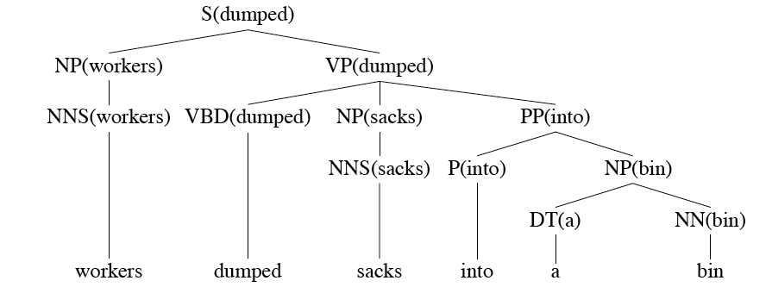
Dumped Example

Slide 35
How?
We used to have
VP -> V NP PP P(this rule|VP)
That’s the count of this rule divided by the number of VPs in a treebank
Now we have fully lexicalized rules...
VP(dumped) -> V(dumped) NP(sacks) PP(into)
To get the probability for that just count and divide

Slide 36
Use Independence
When stuck, exploit independence and collect the statistics you can. There are a large number of ways to do this… Let’s consider one generative story: given a rule we’ll
Generate the head
Generate the stuff to the left of the head
Generate the stuff to the right of the head

Slide 37
Example
So the probability of a lexicalized rule such as
VP(dumped) → V(dumped)NP(sacks)PP(into)
Is the product of the probability of
“dumped” as the head of a VP
With nothing to its left
“sacks” as the head of the first right-side thing
“into” as the head of the next right-side element
And nothing after that

Slide 38

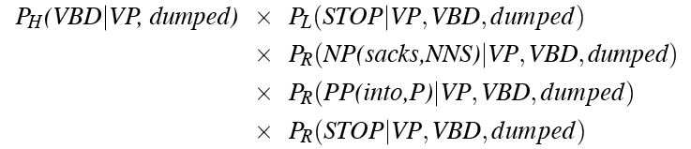
Example
That is, the rule probability for
is estimated as

Slide 39
Framework
That’s just one simple model
Collins Model 1
You can imagine a gazzillion other assumptions that might lead to better models
You just have to make sure that you can get the counts you need
And that it can be used/exploited efficiently during decoding

Slide 40
N-Best
Statistical parsers are getting quite good, but its still quite silly to expect them to come up with a single best parse given only syntactic information.
But its not so crazy to think that they can come up with the right parse among the top-N parses.
But N-Best approaches and dynamic programming don’t work well together. An alternative is to use heuristic search with an agenda.

Slide 41
Finally
Lexicalization is a shallow attempt to incorporate semantics into the syntactic parsing process…
Duh, picking the right parse requires the use of semantics.
Which we’ll get to real soon now.

