Slide 1
Natural Language Processing
CSCI 5832—Lecture 18
Jim Martin

Slide 2
Today
Dependency parsing (Chapter 13)
Dependency trees
Basic transition-based parsing
Next time
Evaluation
Beam search
Graph-based methods

Slide 3
Dependency Parsing
A different way of capturing syntax
Emphasis on dependency (head/child) and grammatical relations
Subject, direct object, case, etc.
Constituency does not play a significant role
Critical for languages with complex morpho-syntax
Significant computational advantages
Linear vs. O(N⁵) for probabilistic CFGs

Slide 4
Dependency Trees vs. Constituent Trees

Slide 5
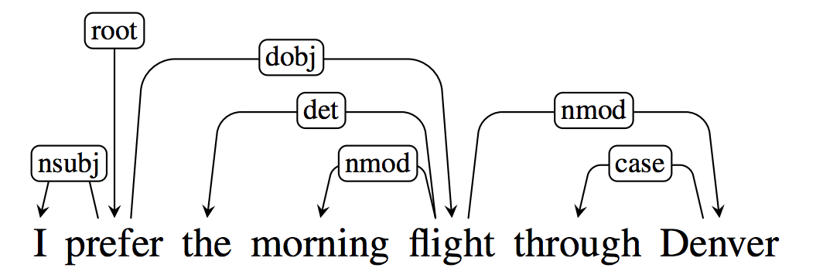
Dependency Parse

Slide 6
Tree Constraints
Words can only have one head
One incoming arc
Every word has to have a head
The structure is connected and rooted
Dummy root node
Result is a tree
There’s a unique path from the root to each word
These are the formal constraints on dependency trees. For any given sentence, there may be many such trees.

Slide 7
Dependency Grammar
The linguistic constraints underlying “correct trees” are usually called a dependency grammar
Which may or may not correspond to an explicit formal generative grammar of the kind we’ve been using
The parsing technique discussed today doesn’t use an explicitly represented grammar

Slide 8
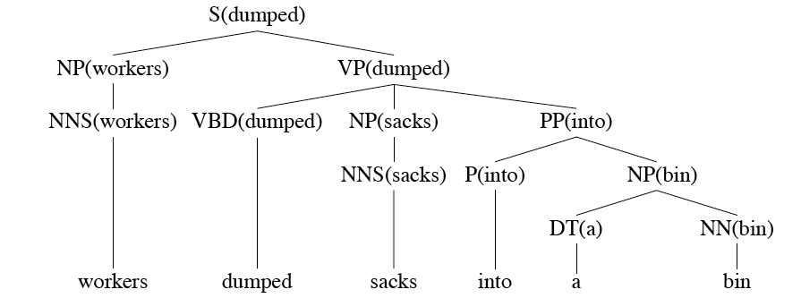
Relation to Head-Finding
Workers dumped sacks into a bin

Slide 9
Relation to Head-Finding
Dumped
Workers
sacks
Into
This suggests one way to do dependency parsing is to first do a phrase-structure parse and then extract heads to get a dependency tree.
Bin
a
Workers dumped sacks into a bin

Slide 10
Dependency Relations

Slide 11
Universal Dependencies

Slide 12
Parsing
Two dominant approaches
Transition-based parsing based on shift-reduce methods
Fast and accurate
But can’t produce certain kinds of trees
Graph-based methods
More accurate on longer dependencies
Can produce non-projective trees

Slide 13
Transition-Based Parsing
Transition-based parsing is a greedy word-by-word approach to parsing
A single dependency tree is built up an arc at a time as we move left to right through a sentence
No backtracking
ML-based classifiers are used to make decisions as we move through the sentence

Slide 14
Dependency Parse
I booked a morning flight.

Slide 15
Transition-Based Parsing
As with phrase-based parsing, we can view this process as a search through a set of states for a state that contains what we want
In the standard notation a state, or configuration, consists of three elements
A stack representing partially processed words
A buffer containing words yet to be processed
A set containing the dependency relations determined so far

Slide 16
Search States
The start state looks like this
[[root], [word list], ()]
A valid final state looks like
[[root], [] (R)]
Where R is the set of relations that we’ve discovered. The [] represents the fact that all the words in the sentence are accounted for
Root is a dummy terminal that points to the head of the sentence.

Slide 17
Example
Start
[[root], [I booked a morning flight], ()]
End
[[root],
[],
((booked, I) (booked, flight) (flight, a) (flight, morning))]

Slide 18
Parsing
The parsing problem is how to get from the start state to the final state
To do this let’s define a set of operators that take in a state and produce a new state
At each step, we choose an operator, apply it to the current state to get the next state
We continue until we reach the goal state

Slide 19
Parsing

Slide 20
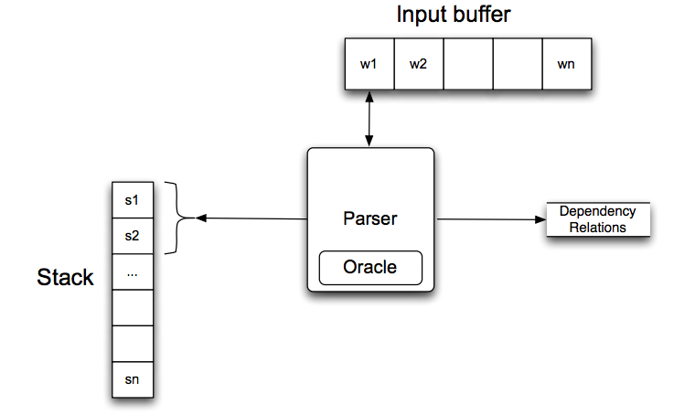
Parsing

Slide 21
Arc Standard Operators
In the standard approach, we’ll use three basic operators
Left
Right
Shift

Slide 22
Shift
Shift takes the next word to be processed and pushes it onto the stack and removes it from the buffer.
So a shift for our example at the start looks like this
[[root], [I booked a morning flight], ()]
→
[[root, I], [booked a morning flight], ()]

Slide 23
Left
The Left operator
Adds relation (a → b) to the set of relations where
a is the top of the stack
b is the word beneath it
Removes b from the stack
So for the state:
[[root, I, booked], [a, morning, flight], ()]
→
[[root, booked], [a, morning, flight],
(booked → I)]

Slide 24
Right
The Right operator
Adds (b → a) to the set of relations
Where b and a are the same as before: a is the top of the stack, and b is the word below
Pops the stack

Slide 25
Example
Operation | New State
 | {[root], [I booked a morning flight], []}

Slide 26
Example
Operation | New State
 | {[root], [I booked a morning flight], []}
Shift | {[root, I], [booked a morning flight], []}

Slide 27
Example
Operation | New State
 | {[root], [I booked a morning flight], []}
Shift | {[root, I], [booked a morning flight], []}
Shift | {[root, I, booked], [a morning flight], []}

Slide 28
Example
Operation | New State
 | {[root], [I booked a morning flight], []}
Shift | {[root, I], [booked a morning flight], []}
Shift | {[root, I, booked], [a morning flight], []}
Left | {[root, booked], [a morning flight], [(booked, I)]}

Slide 29
Example
Operation | New State
 | {[root], [I booked a morning flight], []}
Shift | {[root, I], [booked a morning flight], []}
Shift | {[root, I, booked], [a morning flight], []}
Left | {[root, booked], [a morning flight], [(booked, I)]}
Shift | {[root, booked, a], [morning flight], [(booked, I)]}

Slide 30
Example
Operation | New State
 | {[root], [I booked a morning flight], []}
Shift | {[root, I], [booked a morning flight], []}
Shift | {[root, I, booked], [a morning flight], []}
Left | {[root, booked], [a morning flight], [(booked, I)]}
Shift | {[root, booked, a], [morning flight], [(booked, I)]}
Shift | {[root, booked, a, morning], [flight], [(booked, I)]}

Slide 31
Example
Operation | New State
 | {[root], [I booked a morning flight], []}
Shift | {[root, I], [booked a morning flight], []}
Shift | {[root, I, booked], [a morning flight], []}
Left | {[root, booked], [a morning flight], [(booked, I)]}
Shift | {[root, booked, a], [morning flight], [(booked, I)]}
Shift | {[root, booked, a, morning], [flight], [(booked, I)]}
Shift | {[root, booked, a, morning, flight], [], [(booked, I)]}

Slide 32
Example
Operation | New State
 | {[root], [I booked a morning flight], []}
Shift | {[root, I], [booked a morning flight], []}
Shift | {[root, I, booked], [a morning flight], []}
Left | {[root, booked], [a morning flight], [(booked, I)]}
Shift | {[root, booked, a], [morning flight], [(booked, I)]}
Shift | {[root, booked, a, morning], [flight], [(booked, I)]}
Shift | {[root, booked, a, morning, flight], [], [(booked, I)]}
Left | {[root, booked, a, flight], [], [(booked, I), (flight, morning)]

Slide 33
Example
Operation | New State
 | {[root], [I booked a morning flight], []}
Shift | {[root, I], [booked a morning flight], []}
Shift | {[root, I, booked], [a morning flight], []}
Left | {[root, booked], [a morning flight], [(booked, I)]}
Shift | {[root, booked, a], [morning flight], [(booked, I)]}
Shift | {[root, booked, a, morning], [flight], [(booked, I)]}
Shift | {[root, booked, a, morning, flight], [], [(booked, I)]}
Left | {[root, booked, a, flight], [], [(booked, I), (flight, morning)]
Left | {[root, booked, flight], [], [(booked, I), (flight, morning), (flight, a)]}

Slide 34
Example
Operation | New State
 | {[root], [I booked a morning flight], []}
Shift | {[root, I], [booked a morning flight], []}
Shift | {[root, I, booked], [a morning flight], []}
Left | {[root, booked], [a morning flight], [(booked, I)]}
Shift | {[root, booked, a], [morning flight], [(booked, I)]}
Shift | {[root, booked, a, morning], [flight], [(booked, I)]}
Shift | {[root, booked, a, morning, flight], [], [(booked, I)]}
Left | {[root, booked, a, flight], [], [(booked, I), (flight, morning)]
Left | {[root, booked, flight], [], [(booked, I), (flight, morning), (flight, a)]}
Right | {[root, booked], [], [(booked, I), (flight, morning), (flight, a), (booked, flight)]}

Slide 35
Example
Operation | New State
 | {[root], [I booked a morning flight], []}
Shift | {[root, I], [booked a morning flight], []}
Shift | {[root, I, booked], [a morning flight], []}
Left | {[root, booked], [a morning flight], [(booked, I)]}
Shift | {[root, booked, a], [morning flight], [(booked, I)]}
Shift | {[root, booked, a, morning], [flight], [(booked, I)]}
Shift | {[root, booked, a, morning, flight], [], [(booked, I)]}
Left | {[root, booked, a, flight], [], [(booked, I), (flight, morning)]
Left | {[root, booked, flight], [], [(booked, I), (flight, morning), (flight, a)]}
Right | {[root, booked], [], [(booked, I), (flight, morning), (flight, a), (booked, flight)]}
Right | {[root], [], [(booked, I), (flight, morning), (flight, a), (booked, flight), (root, booked)] }

Slide 36
Issues
We really want labeled relations
That is, we want things like subject, direct object, indirect object, etc. as relations
How did we know which operator (L, R, S) to invoke at each step along the way?
Since we’re not backtracking, one wrong step will lead us away from the tree we seek

Slide 37
Grammatical Relations
Well, to handle relations we can just add new transitions (operators)
Replace Left and Right with
{Left, Right} X {all the relations of interest}
Note this isn’t going to make problem 2 any easier to deal with
Standard approaches have roughly 40 kinds of dependency relations

Slide 38
Parsing

Slide 39
Making Choices
Use some form of supervised machine learning (ML) to train a classifier to choose among the available operators
Based on features derived from the states
Then use that classifier to make intelligent choices as we move along

Slide 40
Three Problems
To apply ML in situations like this we have three problems
Finding (learning?) features that are useful indicators of what to do in any situation
Characteristics of the state we’re in
Acquiring the necessary training data
Training a classifier

Slide 41
Three Problems: Features
Features are typically described along two dimensions in this style of parsing
Position in the configuration
Position in the stack, position in the word list, location in the partial tree
Attributes of particular locations or attributes of tuples of locations
Part of speech of the top of the stack, POS of the third word in the remainder list, lemmas, last three letters
Head word of a word, number of relations already attached to a word, does the word already have a SUBJ relation, etc.

Slide 42
Feature Templates
If we think that a feature like
“the word at the top of the stack AND the POS tag at the front of the buffer”
is useful… we don’t want to have to generate features like
If word at S_1 is “booked” and B_1 tag is NN” and OP=RIGHT
by hand.
Instead we’ll use “feature templates” that automatically generate features directly from the training data

Slide 43
Feature Templates
Given a template like
<Stack_1.word & Buffer_1.POS, op>
Run through the training data and instantiate a training instance of this feature for every training instance with the word and POS and operator filled in.
<Stack_1.booked & Buffer_1.NN, Left>

Slide 44
Three Problems: Data
Training data
Get a treebank
Directly as a dependency treebank
Or derived from a phrase-structure treebank

Slide 45
Structure Prediction
Up to now, we’ve used classifiers to find labels for objects
Class labels for texts (sentiment)
Lexical class labels for POS tagging
Now we want to use classifiers to learn to find structured outputs (trees)

Slide 46
Three Problems: Training
This is tricky. Supervised ML methods require training material in the form of (input, output) pairs.
Treebanks associate sentences with their corresponding trees
But we need parser states paired with their corresponding correct operators

Slide 47
Three Problems: Training
During training we’ll parse with our standard algorithm, asking an oracle which operator to use at any given time.
During training, the oracle has access to the correct tree for each sentence. At each stage it chooses as a case statement
Left if the resulting relation is in the correct tree.
Right if the resulting relation is in the correct tree AND if all the other outgoing relations associated with the dependent are already in the relation list.
Otherwise shift

Slide 48
Three Problems: Training
During training we’ll parse with our standard algorithm, asking an oracle which operator to use at any given time.
The oracle has access to the correct tree for this sentence. At each stage it chooses as a case statement
Left if the resulting relation is in the correct tree.
Right if the resulting relation is in the correct tree AND if all the other outgoing relations associated with the dependent are already in the relation list.
Otherwise shift

Slide 49
Example
[root, cancelled, flights] [to, Houston]
[(canceled United) (flights morning) (flights the)]

Slide 50
Example
Left ?
[root, cancelled, flights] [to, Houston]
[(canceled United) (flights morning) (flights the)]

Slide 51
Example
Right ?
[root, cancelled, flights] [to, Houston]
[(canceled United) (flights morning) (flights the)]

Slide 52
Example
Shift
[root, cancelled, flights] [to, Houston]
[(canceled United) (flights morning) (flights the)]

Slide 53
Three Problems: Training
To generate training data
Step through training sentence/tree pairs
Use the oracle to generate state/operator pairs
Extract training features for each instance using feature templates
Use the training data to train an oracle that chooses the right operators

