Slide 1
Natural Language Processing
CSCI 5832 — Lecture 19
Jim Martin

Slide 2
Today
More dependency parsing
Review
Beam search
Alternative transition systems
Graph-based search

Slide 3
Evaluation
If we have a test set from a treebank and if we represent parses as lists of relations
Unlabeled attachment score (UAS) is just the fraction of words were assigned the right head.
Labeled attachment score (LAS) is the fraction of words assigned the right head with the right relation.
(booked, I) (booked, flight) (flight, a) (flight, morning)

Slide 4
Transition-Based Parsing: Review
Transition-based parsing is a greedy word-by-word approach to parsing
A single dependency tree is built up an arc at a time as we move left to right through a sentence
No backtracking
Classifiers make decisions as we move through the sentence

Slide 5
Parsing

Slide 6
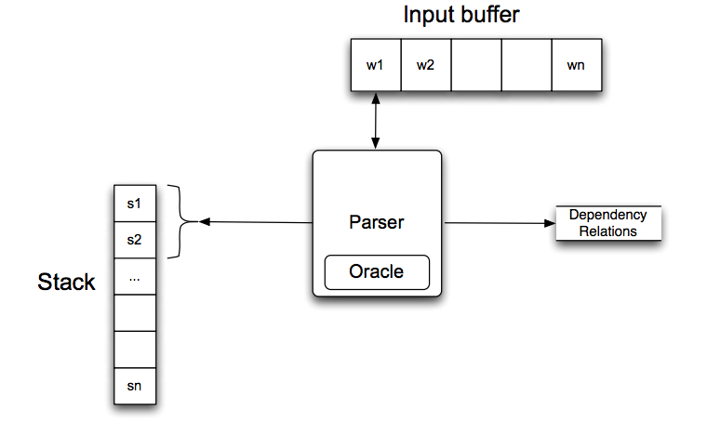
Parsing

Slide 7
Arc Standard Operators
In the standard approach, we’ll use three operators
Left
Right
Shift

Slide 8
Shift
Shift takes the next word to be processed and pushes it onto the stack and removes it from the buffer.
So a shift for our example at the start looks like this
[[root], [I booked a morning flight], ()]
→
[[root, I], [booked a morning flight], ()]

Slide 9
Left
The Left operator
Adds relation (a → b) to the set of relations where
a is the top of the stack
b is the word beneath it
Removes b from the stack
So for the state:
[[root, I, booked], [a, morning, flight], ()]
→
[[root, booked], [a, morning, flight],
(booked → I)]

Slide 10
Right
The Right operator
Adds (b → a) to the set of relations
Where b and a are the same as before: a is the top of the stack, and b is the word below
Pops the stack

Slide 11
Example
Operation | New State
 | {[root], [I booked a morning flight], []}

Slide 12
Example
Operation | New State
 | {[root], [I booked a morning flight], []}
Shift | {[root, I], [booked a morning flight], []}

Slide 13
Example
Operation | New State
 | {[root], [I booked a morning flight], []}
Shift | {[root, I], [booked a morning flight], []}
Shift | {[root, I, booked], [a morning flight], []}

Slide 14
Example
Operation | New State
 | {[root], [I booked a morning flight], []}
Shift | {[root, I], [booked a morning flight], []}
Shift | {[root, I, booked], [a morning flight], []}
Left | {[root, booked], [a morning flight], [(booked, I)]}

Slide 15
Example
Operation | New State
 | {[root], [I booked a morning flight], []}
Shift | {[root, I], [booked a morning flight], []}
Shift | {[root, I, booked], [a morning flight], []}
Left | {[root, booked], [a morning flight], [(booked, I)]}
Shift | {[root, booked, a], [morning flight], [(booked, I)]}

Slide 16
Example
Operation | New State
 | {[root], [I booked a morning flight], []}
Shift | {[root, I], [booked a morning flight], []}
Shift | {[root, I, booked], [a morning flight], []}
Left | {[root, booked], [a morning flight], [(booked, I)]}
Shift | {[root, booked, a], [morning flight], [(booked, I)]}
Shift | {[root, booked, a, morning], [flight], [(booked, I)]}

Slide 17
Example
Operation | New State
 | {[root], [I booked a morning flight], []}
Shift | {[root, I], [booked a morning flight], []}
Shift | {[root, I, booked], [a morning flight], []}
Left | {[root, booked], [a morning flight], [(booked, I)]}
Shift | {[root, booked, a], [morning flight], [(booked, I)]}
Shift | {[root, booked, a, morning], [flight], [(booked, I)]}
Shift | {[root, booked, a, morning, flight], [], [(booked, I)]}

Slide 18
Example
Operation | New State
 | {[root], [I booked a morning flight], []}
Shift | {[root, I], [booked a morning flight], []}
Shift | {[root, I, booked], [a morning flight], []}
Left | {[root, booked], [a morning flight], [(booked, I)]}
Shift | {[root, booked, a], [morning flight], [(booked, I)]}
Shift | {[root, booked, a, morning], [flight], [(booked, I)]}
Shift | {[root, booked, a, morning, flight], [], [(booked, I)]}
Left | {[root, booked, a, flight], [], [(booked, I), (flight, morning)]

Slide 19
Example
Operation | New State
 | {[root], [I booked a morning flight], []}
Shift | {[root, I], [booked a morning flight], []}
Shift | {[root, I, booked], [a morning flight], []}
Left | {[root, booked], [a morning flight], [(booked, I)]}
Shift | {[root, booked, a], [morning flight], [(booked, I)]}
Shift | {[root, booked, a, morning], [flight], [(booked, I)]}
Shift | {[root, booked, a, morning, flight], [], [(booked, I)]}
Left | {[root, booked, a, flight], [], [(booked, I), (flight, morning)]
Left | {[root, booked, flight], [], [(booked, I), (flight, morning), (flight, a)]}

Slide 20
Example
Operation | New State
 | {[root], [I booked a morning flight], []}
Shift | {[root, I], [booked a morning flight], []}
Shift | {[root, I, booked], [a morning flight], []}
Left | {[root, booked], [a morning flight], [(booked, I)]}
Shift | {[root, booked, a], [morning flight], [(booked, I)]}
Shift | {[root, booked, a, morning], [flight], [(booked, I)]}
Shift | {[root, booked, a, morning, flight], [], [(booked, I)]}
Left | {[root, booked, a, flight], [], [(booked, I), (flight, morning)]
Left | {[root, booked, flight], [], [(booked, I), (flight, morning), (flight, a)]}
Right | {[root, booked], [], [(booked, I), (flight, morning), (flight, a), (booked, flight)]}

Slide 21
Example
Operation | New State
 | {[root], [I booked a morning flight], []}
Shift | {[root, I], [booked a morning flight], []}
Shift | {[root, I, booked], [a morning flight], []}
Left | {[root, booked], [a morning flight], [(booked, I)]}
Shift | {[root, booked, a], [morning flight], [(booked, I)]}
Shift | {[root, booked, a, morning], [flight], [(booked, I)]}
Shift | {[root, booked, a, morning, flight], [], [(booked, I)]}
Left | {[root, booked, a, flight], [], [(booked, I), (flight, morning)]
Left | {[root, booked, flight], [], [(booked, I), (flight, morning), (flight, a)]}
Right | {[root, booked], [], [(booked, I), (flight, morning), (flight, a), (booked, flight)]}
Right | {[root], [], [(booked, I), (flight, morning), (flight, a), (booked, flight), (root, booked)] }

Slide 22
Classifier Training
This is indirect. Supervised ML methods require training material in the form of (input, output) pairs.
Treebanks associate sentences with their corresponding trees
But we need parser states paired with their corresponding correct operators

Slide 23
Training
To produce training data, we’ll simulate parsing with our standard algorithm, asking an oracle which operator to use at any given time.
The oracle accesses the reference tree for each sentence. It chooses using this strategy:
Left if the resulting relation is in the reference tree.
Right if the resulting relation is in the correct tree AND if all the other outgoing relations associated with the dependent are already in the relation list.
Otherwise shift

Slide 24
Example
Reference answer
Top of stack
Current state
[root, cancelled, flights] [to, Houston]
[(canceled United) (flights morning) (flights the)]

Slide 25
Example
Left: No because (flights canceled) is not in the reference tree.
[root, cancelled, flights] [to, Houston]
[(canceled United) (flights morning) (flights the)]

Slide 26
Example
Right: No, because (flights Houston) is not yet in the set of relations.
[root, cancelled, flights] [to, Houston]
[(canceled United) (flights morning) (flights the)]

Slide 27
Example
Shift: Only thing left to do.
[root, cancelled, flights] [to, Houston]
[(canceled United) (flights morning) (flights the)]

Slide 28
Example
So the training pair generated is:
Input: [root, cancelled, flights] [to, Houston] [(canceled United) (flights morning) (flights the)]
Output: Shift

Slide 29
Training
To generate training data
Step through every training sentence/tree pairs
Use the oracle to generate state/operator pairs
Extract training features for each instance using feature templates
Use the training data to train a classifier that chooses the right operators

Slide 30
Variations on Transition-Based Methods
Alternative transition systems (operators)
Arc eager
Change the simple greedy search to a backtracking search with the addition of an agenda
Usually with a fixed size agenda → Beam Search

Slide 31
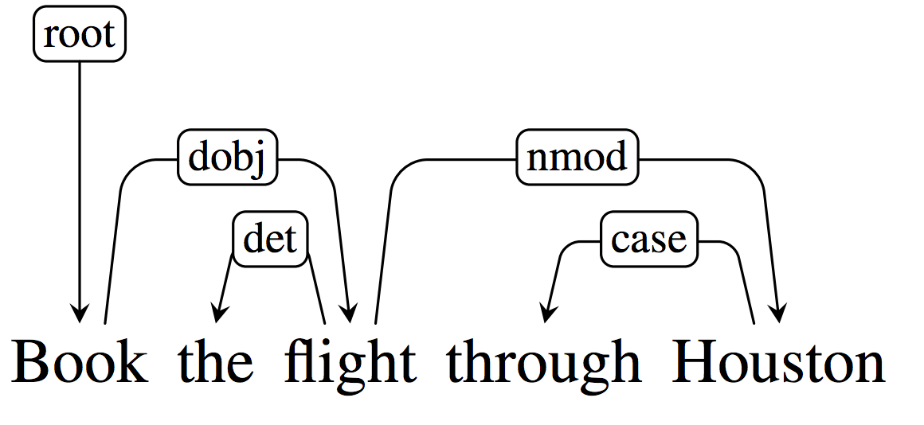
Arc Eager

Slide 32
Arc Eager
Couple of changes
First, the Left and Right operators now apply to the top of the stack and the front of the buffer
And we’ll add, a new operator called Reduce that just pops the stack

Slide 33
Arc Eager
Left
Add a relation from the front of the buffer to the top of the stack; pop the stack
Right
Add a relation from the top of the stack to the front of the buffer; shift the word at the top of buffer onto the stack

Slide 34
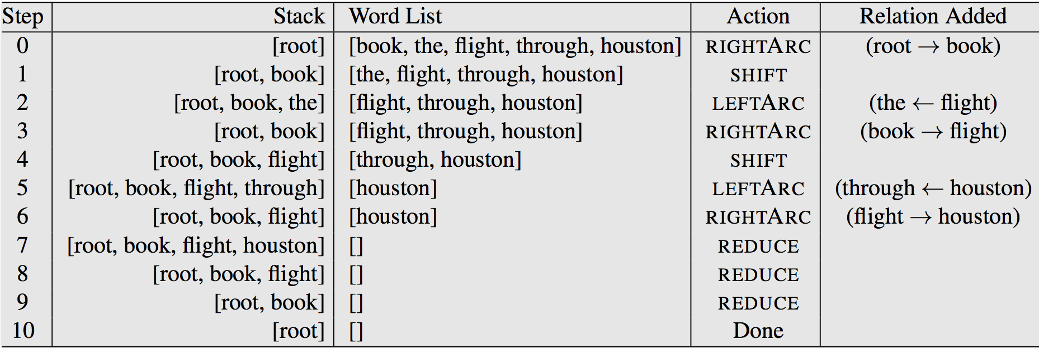
Arc Eager

Slide 35
Beam Search
Instead of taking the single best operator suggested by the oracle, how about we pursue all the possible paths from all operators?
Too many possibilities
How about instead we keep the N best possibilities at each step in time.
N = “beam width”

Slide 36
Beam Search
In the original greedy approach the oracle chose the operator that looked best to apply at any given point in time
What does best mean here with a search?

Slide 37
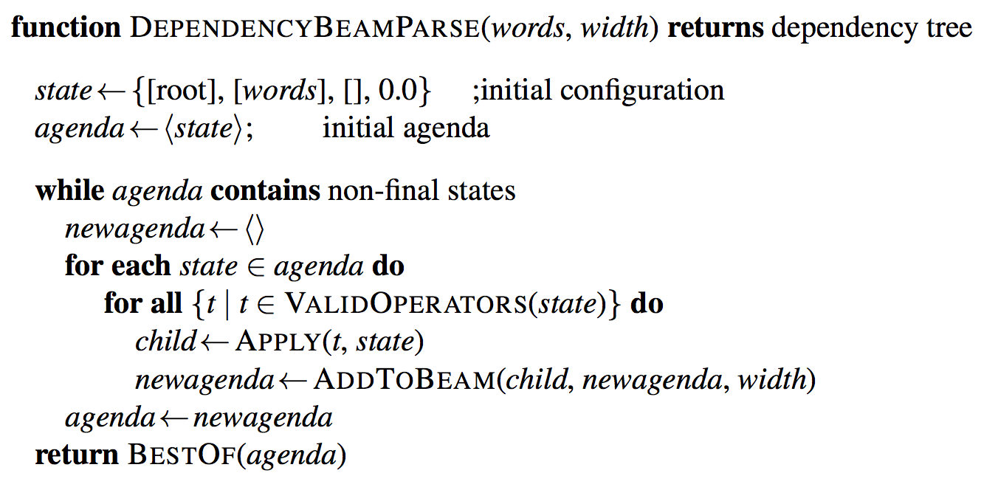
Beam Search

Slide 38
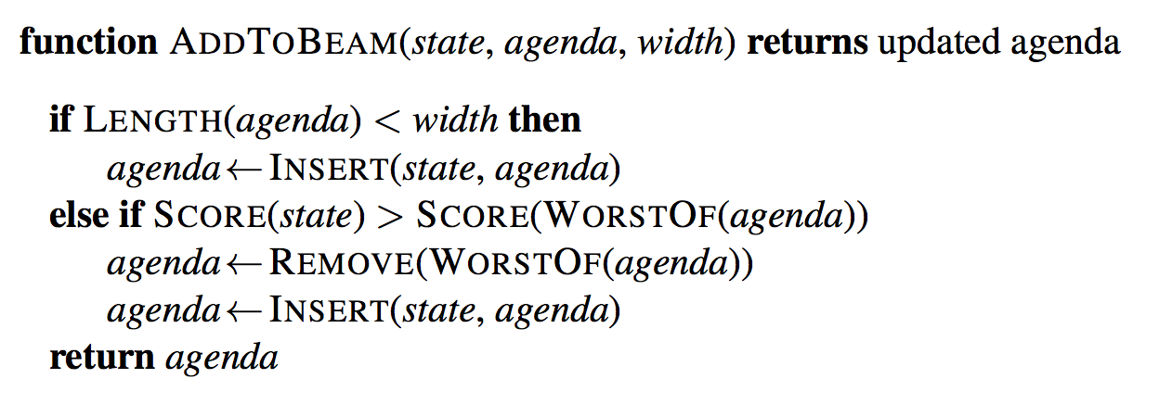
Beam Search

Slide 39
Other Parsing Methods
Graph-based approaches based on weighted spanning trees
Maximum spanning tree algorithms for weighted directed graphs

Slide 40
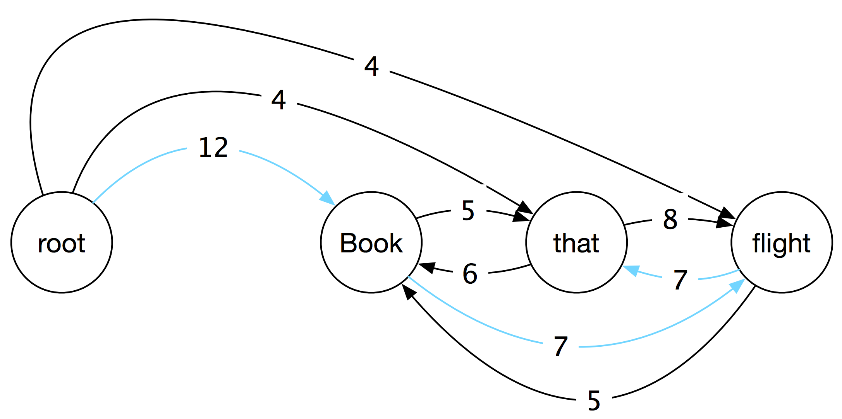
MST-Based Parsing
Start with a fully connected graph that represents all possible parses (all possible head assignments
Weights represent the “score” for an edge
How “good” that head assignment is

Slide 41
MST-Based Parsing

Slide 42
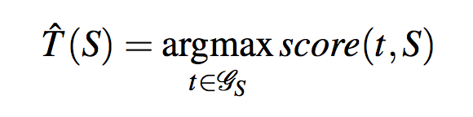
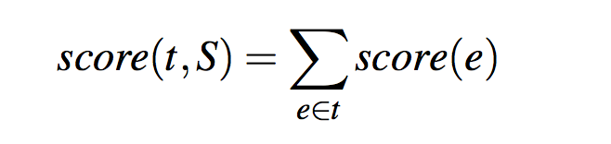
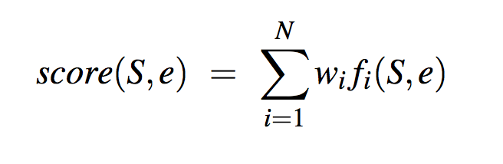
Scoring
Find the highest scoring tree from among all the trees
Score for a tree is the sum of the scores of its edges
Score for an edge is the weighted score of the features of the edge

Slide 43
Search
For undirected graphs, greedy approaches like Prim’s algorithm work fine.
Greedy meaning iteratively add in the best (highest scoring edge)
With a twist greedy also works here
With a clever cleanup phase to the algorithm

Slide 44
Chu-Liu/Edmonds MST Algorithm
First, for each vertex pick the highest scoring incoming edge
If that results in a tree then we’re done. It has to be the best tree.
But…

Slide 45
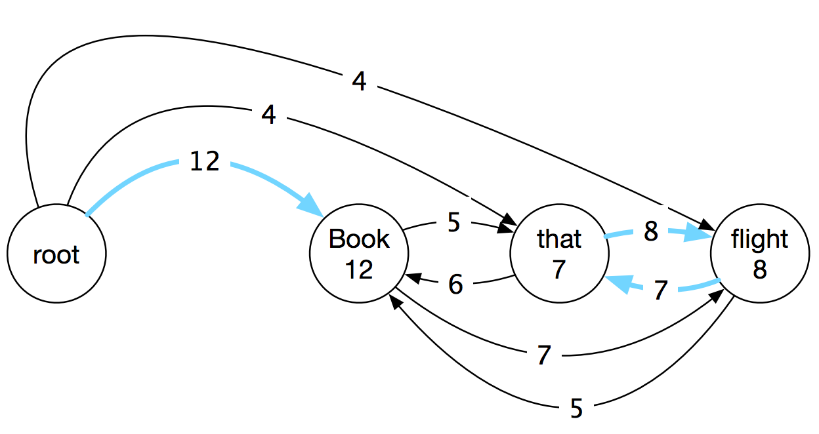
Cycles

Slide 46
Cleanup
If there’s a cycle, we’ll
Readjust/rescale the weights
Collapse the cycle into a new dummy node to create a new graph
Recurse to find the MST of the new graph
Expand back out, deleting edges from cycles as appropriate

Slide 47
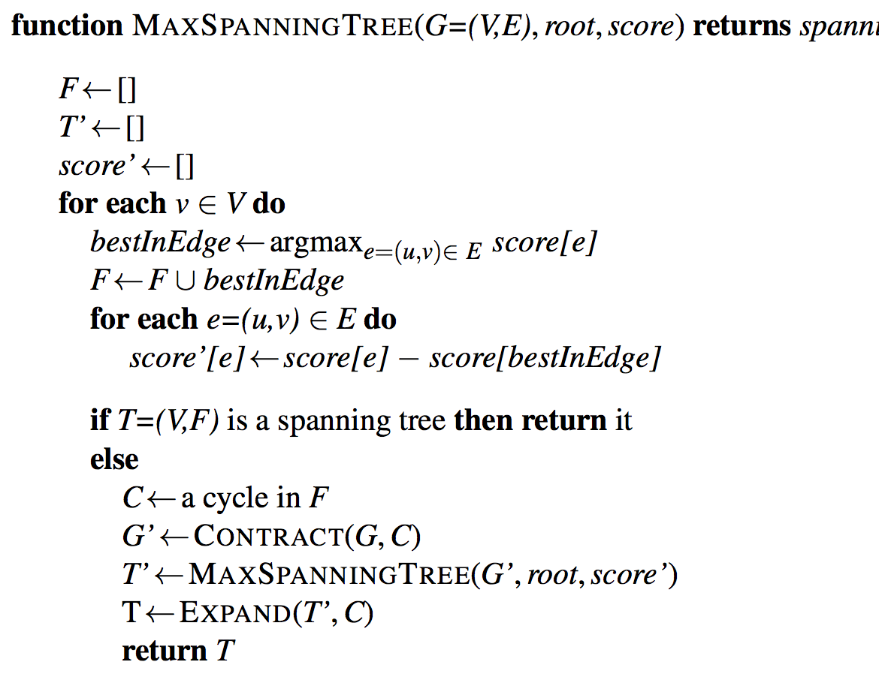
Chu-Liu Edmonds

Slide 48
Weight Adjustment
The absolute value of the weights doesn’t determine the argmax tree. Just the value of the best weight coming into a node, relative to all the other weights
If we were to scale all the weights by some constant amount for each node, we will still get the same MST

Slide 49
Weight Adjustment

Slide 50
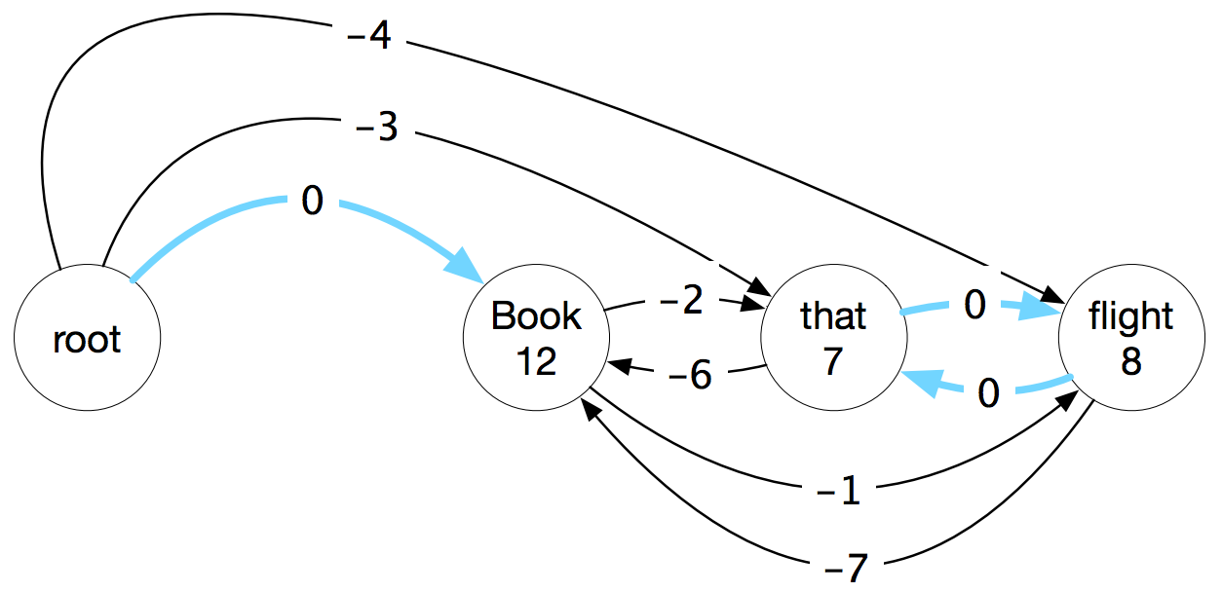
Adjust Weights
For each node, subtract the value of the maximum incoming weight to that node from the values of all its incoming edges.

Slide 51
Adjust Weights
What does that get us?
The weights in the cycle will all go to 0
Edges in the cycle are by definition edges that got selected. Selected edges are the max valued edges
Max – Max = 0
So what?

Slide 52
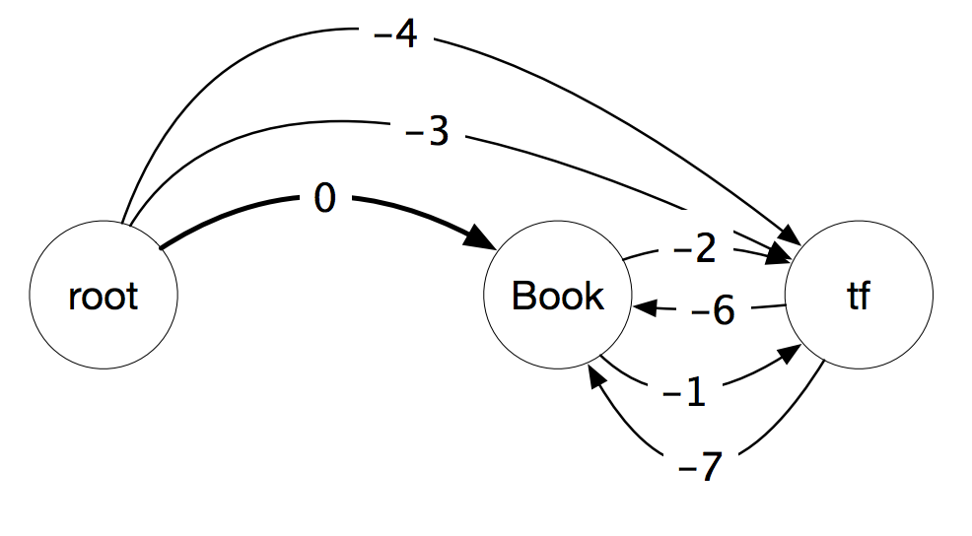
Collapse Cycles

Slide 53
Recursion
Now we can find the MST of this new graph…
Safely ignoring the cost of the cycle since its zero.
And when we find the encompassing MST we’ll know which edge to remove from the cycle.
The edge that enters into the cycle will tell use that

Slide 54
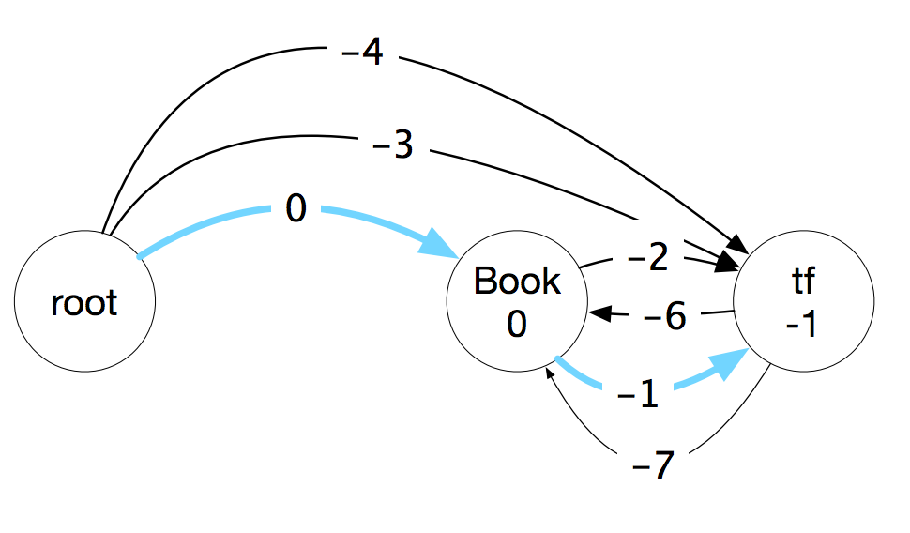
Recurse: Greedy Select
This is a tree.

Slide 55
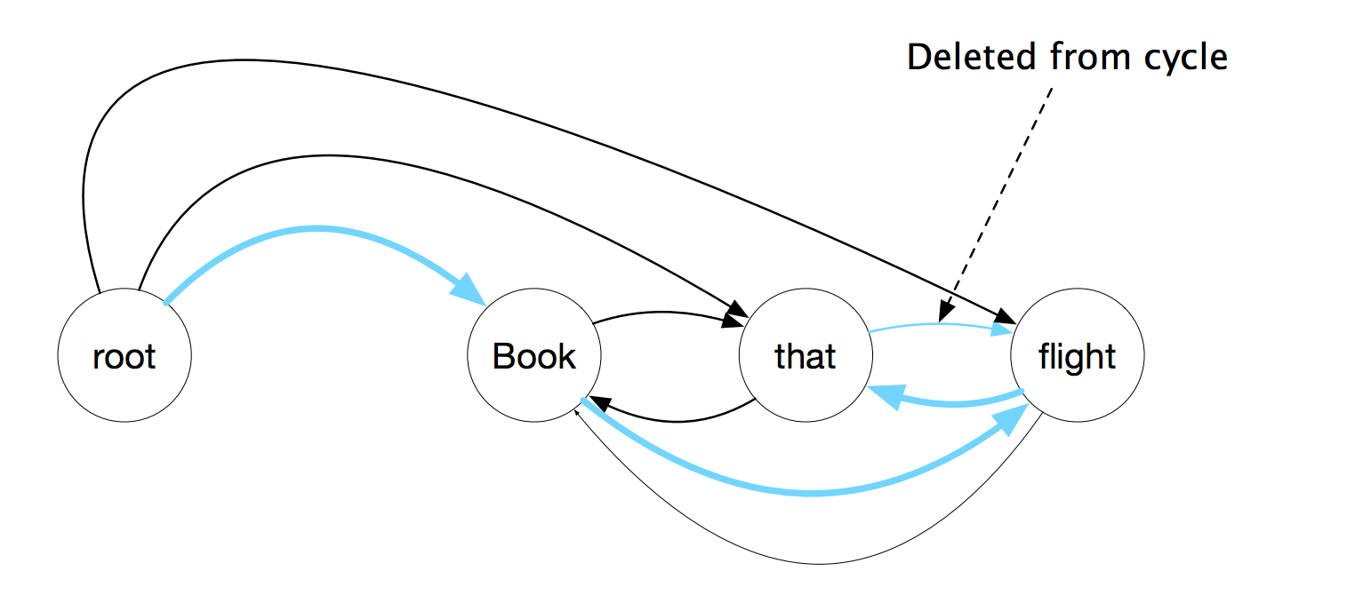
Delete Edge

Slide 56
Weights/Features
Features are based based on the arcs present in the training data
(head, dependent) tuples along with the relation as well as things like the lemma, POS, and word form
Weights are trained for each feature from the training set. Using your favorite learning algorithm.
Once you have the features and their weights you can parse using CLE algorithm.

Slide 57
Scoring
Find the highest scoring tree from among all the trees
Score for a tree is the sum of the scores of its edges
Score for an edge is the weighted score of the features of the edge

Slide 58
Scoring
Score for a tree is the sum of the scores of its edges
Score for an edge is the weighted score of the features of the edge
This is a serious limitation. There are aspects of good trees that we’d like to capture that aren’t just a function of the set of edges. We’d like features that involve pairs or triples of edges. Or the presence or absence of distant pairs of edges, etc.
But doing that moves us away from easy greedy MST algorithms.

