Slide 1
Natural Language Processing
CSCI 5832—Lecture 20
Jim Martin

Slide 2
New HW
Sentiment analysis on reviews
This is a fantastic botique hotel in Portland, Oregon. All the rooms are suites and include a kitchenette. This hotel is great for small families because it allows you ample space and you have the kitchen included where you can prepare some meals in order to save on some food costs while on vacation. The best part is that there are piles of Starbursts candies throughout the hotel available for the taking!
This Hotel is filthy, bedbugs, dirt, mold, the bedding looked dirty. There is only one person that runs the front desk and he is old and does not speak english. I could not get a refund for my stay and I wanted to get out of this place as soon as I walked into the room. There are obvious drug users and other illegal activity on the premises. I would never stay here again. The front desk operator is rude and the place is not worth what I paid for it. If I wanted to pay for bedbugs and filth I wouldnt have had a problem with the place. They alley would have been cleaner and probably safer. STAY AWAY!!!!

Slide 3
Quiz 2
Next Tuesday (11/13)
Readings
Recurrent Networks
Chapter 9
Grammars
Chapter 10
Parsing
Chapter 11: Skip 11.3
Chapter 12: Skip 12.6.2, 12.7, 12.9
Chapter 13: All

Slide 4
Today
Start on Semantics
The next couple of lectures are a mix of stuff from Chapters 14 (on the book website) and 15 (on Moodle)

Slide 5
Transition
First we did words
Then simple sequences of words
Then we looked at syntax
Now we’re moving on to meaning

Slide 6
Meaning Representations
We’re going to take the same basic approach to meaning that we took to syntax
Create representations of linguistic inputs that capture the meanings of those inputs.
But unlike parse trees, these representations aren’t solely representations of the structure of the inputs…

Slide 7
Meaning Representations
They are simultaneously representations of the meanings of utterances and representations of some potential state of affairs in some world.

Slide 8
Meaning Representations
What could this mean…
representations of linguistic inputs that capture the meanings of those inputs
For us it means
Representations that permit or facilitate semantic processing

Slide 9
Semantic Processing
Ok, so what does that mean?
Representations that
Permit us to reason about their truth (i.e., their relationship to some world)
Permit us to answer questions based on their content
Permit us to perform inference (answer questions and determine the truth of things we don’t already know to be true)

Slide 10
Semantic Processing
Touchstone application is often question answering
Can a machine answer questions involving the meaning of some text or discourse?
What kind of representations do we need to mechanize that process?

Slide 11
Semantic Processing
Natural Language Understanding Shared Tasks
Entailment
MNLI, SNLI
Question answering
SQUAD
Story cloze
ROC stories

Slide 12
Web

Slide 13
Semantic Processing
We’re going to discuss 2 ways to attack this problem
A principled, theoretically motivated approach
Computational/Compositional Semantics
Chapters from 2nd edition. I’ll post soon.
And more limited, practical approaches that have some hope of actually being useful
Information extraction
Draft chapter Chapter 21

Slide 14
Semantic Analysis
Compositional Analysis
Create a First Order Logic representation that accounts for all the entities, roles and relations present in a sentence.
Information Extraction
Find a shallow analysis that captures the entities, relations and roles that are of interest to the consuming application.

Slide 15
Information Extraction Preview
Investigators worked leads Monday in Riverside County where the car was reported stolen and reviewed security tape from Highway 241 where it was abandoned, said city of Anaheim spokesman John Nicoletti.

Slide 16
Information Extraction Named Entities
Investigators worked leads Monday in Riverside County where the car was reported stolen and reviewed security tape from Highway 241 where it was abandoned, said city of Anaheim spokesman John Nicoletti.
Investigators worked leads [Monday] in [Riverside County] where the car was reported stolen and reviewed security tape from [Highway 241] where it was abandoned, said city of [Anaheim] spokesman [John Nicoletti].

Slide 17
Information Extraction Events
Investigators worked leads Monday in Riverside County where the car was reported stolen and reviewed security tape from Highway 241 where it was abandoned, said city of Anaheim spokesman John Nicoletti.
Investigators worked leads Monday in Riverside County where the car was reported stolen and reviewed security tape from Highway 241 where it was abandoned, said city of Anaheim spokesman John Nicoletti.

Slide 18
Representational Schemes
For deep semantics, we’re going to use First Order Logic (FOL) as our representational framework
Not because we think it’s perfect
Many of the alternatives turn out to be either too limiting or
They turn out to be notational variants

Slide 19
FOL
Allows for…
The analysis of truth conditions
Allows us to answer yes/no questions
Supports the use of variables
Allows us to answer questions through the use of variable binding
Supports inference
Allows us to answer questions that go beyond what we know explicitly

Slide 20
Meaning Structure of Language
Natural languages convey meaning through the use of
Predicate-argument structures
Variables
Quantifiers
Compositional semantics
And a host of other stuff
Lexical choice, grammatical constructions, intonation, metaphor, irony, sarcasm…

Slide 21
Predicate-Argument Structure
Events, actions and relationships can be captured with representations that consist of predicates and arguments to those predicates.
Languages display a division of labor where some words and constituents (typically) function as predicates and some as arguments.

Slide 22
Predicate-Argument Structure
Predicates
Primarily Verbs, VPs, Sentences
Sometimes Nouns and NPs
Arguments
Primarily Nouns, Nominals, NPs, PPs
But also everything else; as we’ll see it depends on the context

Slide 23
Example
Mary gave the list to John.
Giving(Mary, John, List)
More precisely
Gave conveys a three-argument predicate
The first argument is the agent
The second is the recipient, which is conveyed by the NP inside the PP
The third argument is the thing given, conveyed by the direct object

Slide 24
Note
Giving(Mary, John, List) is pretty the same as
Subj(Giving, Mary), Obj(Giving, John), IndObj(Giving, List)
Which should look an awful lot like.... what?

Slide 25
Better
Turns out this representation is not quite as useful as it could be.
Better would be

Slide 26
Predicates
The notion of a predicate just got more complex
In this example, think of the verb/VP providing a template like the following
The semantics of the NPs and the PPs in the sentence plug into the slots provided in the template

Slide 27
Two Issues
How can we create this kind of representation in a principled way
What makes that representation a “meaning” representation, as opposed say to a parse tree?

Slide 28
Semantic Analysis
Semantic analysis is the process of taking in some linguistic input and assigning a meaning representation to it.
There a lot of different ways to do this that make more or less (or no) use of syntax
We’re going to start with the idea that syntax does matter
The compositional rule-to-rule approach

Slide 29
Compositional Analysis
Principle of Compositionality
The meaning of a whole is derived from the meanings of the parts
What parts?
The constituents of the syntactic parse of the input
What does it mean for a part to have a meaning?

Slide 30
Example
Franco likes Frasca.

Slide 31
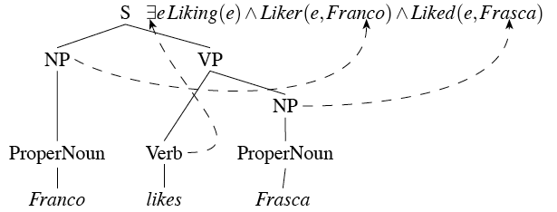
Compositional Analysis

Slide 32
Augmented CFG Rules
We’ll accomplish this by attaching semantic formation rules to our syntactic CFG rules
Abstractly
This should be read as follows…
The semantics we attach to A can be computed from some function f applied to the semantics of A’s parts.

Slide 33
Example
Easy parts…
NP -> PropNoun
PropNoun -> Frasca
PropNoun -> Franco
Attachments
{PropNoun.sem}
{Frasca}
{Franco}

Slide 34
Example
S -> NP VP
VP -> Verb NP
Verb -> likes
{VP.sem(NP.sem)}
{Verb.sem(NP.sem)
???

Slide 35
Lambda Forms
A simple addition to FOL
Take a FOL sentence with variables in it that are to be bound.
Allow those variables to be bound by treating the lambda form as a function with formal arguments

Slide 36
Compositional Semantics via Lambda Application

Slide 37
Lambda Applications and Reductions
VP
VP → Verb NP {Verb.sem(NP.Sem)}
Frasca

Slide 38
Lambda Applications and Reductions
S
S → NP VP {VP.sem(NP.sem) }
Franco

Slide 39
Lambda Applications and Reductions

Slide 40
Complications
You really ought to be suspicious that all those examples involve proper nouns that map to constants in the representation.
That’s the simplest possible case. Making it work for harder cases is more involved...
Mismatches between the syntax and semantics
Complex NPs with quantifiers

Slide 41
Complex NPs
Things get quite a bit more complicated when we start looking at more realistic NPs
Such as...
A menu
Every restaurant
Not every waiter
Most restaurants
All the morning non-stop flights to Houston

Slide 42
Quantifiers
There exists
Frasca closed
Every
Every restaurant closed

Slide 43

Quantified NPs
From a compositional point of view what should the semantic fragment for “every restaurant” look like?
Hint... This isn’t it

Slide 44

Quantifiers
Roughly, “every” in an NP like this is used to stipulate something about every member of some class. The NP specifies the class. And something else specifies the something stipulated.... So the NP is a template-like object
The trick is going to be getting the Q to be right thing

Slide 45

Quantifiers
Wrap a lambda around it...
This requires a change to the kind (type) of things that we’ll allow lambda variables to range over... Now it’s both FOL predicates and terms.

Slide 46
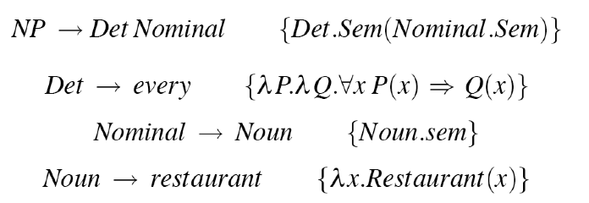
Rules

Slide 47
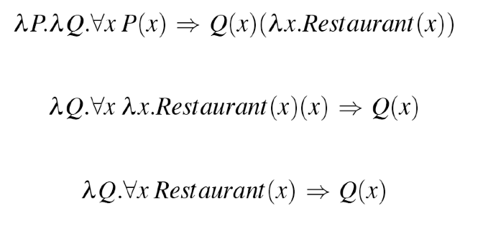
Example
NP
NP → Det Nominal { Det.Sem(Nominal.Sem) }
Every
restaurant

Slide 48
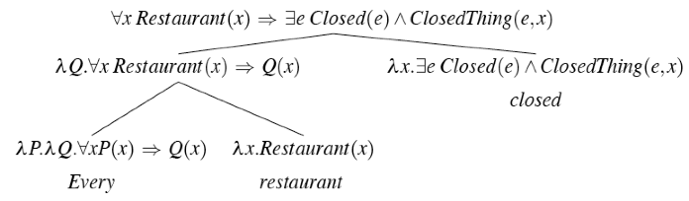
Every Restaurant Closed

Slide 49
Grammar Engineering
In the rule-to-rule approach we’re designing separate semantic attachments for each grammar rule. So we constantly have to check to see if things still work with the rest of the rules we developed earlier, and now clearly they don’t. Two places to revise...
The S rule
S --> NP VP VP.Sem(NP.Sem)
Simple NP’s like proper nouns...
Proper-Noun --> Sally Sally

Slide 50
S Rule
We were applying the semantics of the VP to the semantics of the NP... Now we’re swapping that around
S --> NP VP NP.Sem(VP.Sem)

Slide 51
Every Restaurant Closed

Slide 52
Simple NP fix
And the semantics of proper nouns used to just be things that amounted to constants... Franco. Now they need to be a little more complex. This works
\lambda x Franco(x)

Slide 53
Revised
Now all these examples should work
Every restaurant closed.
Sunflower closed.
What about?
A restaurant closed.
This rule stays the same
NP --> Det Nominal
Just need an attachment for
Det --> a

Slide 54


Revised
So if the template for “every” is
Then the template for “a” should be what?

Slide 55
So Far So Good
We can make effective use of lambdas to overcome
Mismatches between the syntax and semantics
While still preserving strict compositionality

Slide 56
Problem
Contrast
Every American has a governor.
Every Coloradan has a governor.
Given our current scheme which one do we get?

Slide 57
Problem
Clearly these sentences have the same syntax. The only difference is in the words American and Coloradan. Words that have the same part of speech (lexical class) and very similar meanings.
The fact that both interpretations are possible is an idiosyncratic fact about our political system. Not something in the language.

