Slide 1
Natural Language Processing
Lecture 18—10/26/2017
Jim Martin

Slide 2
Today
More Semantics
Finish up compositional semantics
Model-theoretic semantics

Slide 3
Semantic Analysis
Semantic analysis is the process of taking in some linguistic input and assigning a meaning representation to it.
There a lot of different ways to do this that make more or less (or no) use of syntax
We’re going to start with the idea that syntax does matter
The compositional rule-to-rule approach

Slide 4
Augmented Rules
We’ll accomplish this by attaching semantic formation rules to our syntactic CFG rules
One semantic rule for each syntactic rule.
Abstractly
This should be read as the semantics we attach to A can be computed from some function applied to the semantics of A’s parts.

Slide 5
Example
Easy parts…
NP -> PropNoun
PropNoun -> Frasca
PropNoun -> Franco
Attachments
{PropNoun.sem}
{Frasca}
{Franco}

Slide 6
Example
S -> NP VP
VP -> Verb NP
Verb -> likes
{VP.sem(NP.sem)}
{Verb.sem(NP.sem)
???

Slide 7
Lambda Forms
A simple addition to FOL
Take a FOL sentence with variables in it that are to be bound.
Allow those variables to be bound by treating the lambda form as a function with formal arguments

Slide 8
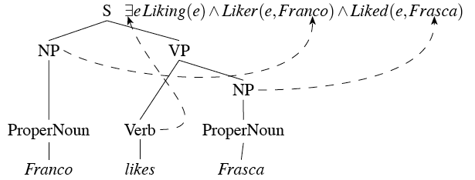
Compositional Semantics by Lambda Application

Slide 9
Lambda Applications and Reductions
VP
VP → Verb NP {Verb.sem(NP.Sem)
Frasca

Slide 10
Lambda Applications and Reductions
S
S → NP VP {VP.sem(NP.sem) }
Franco

Slide 11
Complex NPs
Things get quite a bit more complicated when we start looking at more realistic NPs
Such as...
A menu
Every restaurant
Not every waiter
Most restaurants
All the morning non-stop flights to Houston

Slide 12
Quantifiers
Contrast...
Frasca closed
With
Every restaurant closed

Slide 13

Quantifiers
Roughly, “every” in an NP like this is used to stipulate something about every member of some class. The NP is specifies the class. And somebody else is specifies the thing stipulated.... So the NP is a template-like thing
The trick is going to be getting the Q to be right thing

Slide 14

Quantifiers
Wrap a lambda around it...
This requires a change to the kind (type) of things that we’ll allow lambda variables to range over... Now it’s both FOL predicates and terms.

Slide 15
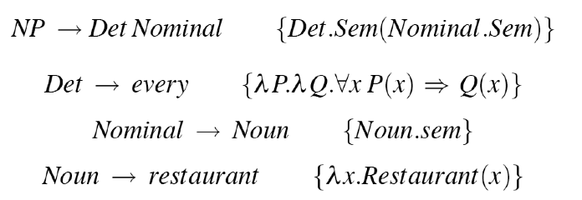
More Rules

Slide 16
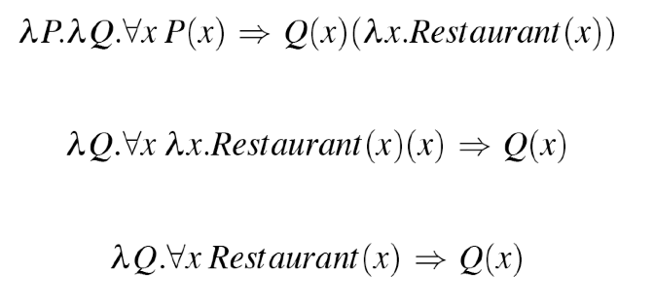
Example
NP → Det Nominal { Det.Sem(Nominal.Sem) }
NP
Every
restaurant

Slide 17
Grammar Engineering
In the rule-to-rule approach we’re designing separate semantic attachments for each grammar rule. So we constantly have to check to see if things still work with the rest of the rules we developed earlier, and now clearly they don’t. Two places to revise...
The S rule
S --> NP VP VP.Sem(NP.Sem)
Simple NP’s like proper nouns...
Proper-Noun --> Sally Sally

Slide 18
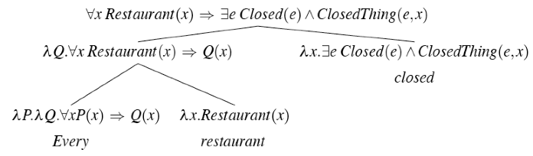
Every Restaurant Closed
S
S → NP VP { NP.Sem(VP.Sem) }
NP
VP

Slide 19
Simple NP fix
The semantics of proper nouns used to just be things that amounted to constants... Franco. Now they need to be a little more complex. This works
\lambda x Franco(x)

Slide 20
Revised
Now all these examples should work
Every restaurant closed.
Sunflower closed.
What about?
A restaurant closed.
This rule stays the same
NP --> Det Nominal
Just need the semantic attachment for
Det --> a

Slide 21


Rule for ”a”
So if the template for “every” is
Then the template for “a” should be what?

Slide 22
So Far So Good
We can make effective use of lambdas to overcome
Mismatches between the syntax and semantics
While still preserving strict compositionality
The style of the grammar is such that
Lexical items provide the bulk of the “content” of the representations
Grammar rules provide the instructions for how to put things together
Mainly in terms of which elements should be treated as functions and which are arguments.

Slide 23
Quantifier Ambiguity
Contrast
Every American has a governor.
Every Coloradan has a governor.
Given our current scheme which one do we get?

Slide 24
Problem
These sentences have the same syntax. The only difference is in the words American and Coloradan. Words that have the same part of speech (lexical class) and very similar meanings.
The fact that both interpretations are possible is an idiosyncratic fact about our political system. Not something in the language.

Slide 25
Problem
Every restaurant has a menu.

Slide 26
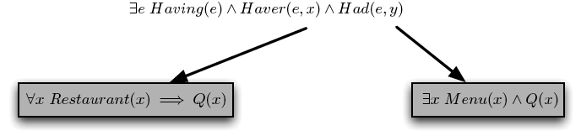
What We Really Want
Captures the predicate argument structure and the relevant possibilities for the quantifiers. But underspecifies the final representation.

Slide 27
Store and Retrieve
Now, given a representation like that we can generate all the meanings that we want by
Retrieving the quantifiers one at a time and placing them in front (again, using lambdas)
Where the order of application determines the scoping (the meaning).

Slide 28
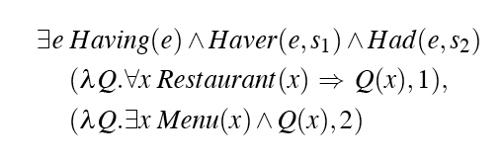
Store
The Store..

Slide 29
Retrieve
Use lambda reduction to retrieve from the store and incorporate the arguments in the right way.
Retrieve element from the store and apply it to the core representation
With the variable corresponding to the retrieved element as a lambda variable
Huh?

Slide 30
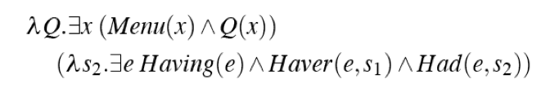
Retrieve
Example, pull out 2 first (that’s s2) and apply it to the predicate representation.

Slide 31
Example
Then pull out S1 and apply it to the previous result.

Slide 32
Ordering Determines Outcome
Now if we had done it in the other order (first S1, and then S2) we could have gotten the other meaning (other quantifier scoping.

Slide 33
So...
What is the implication of this kind of approach to examples like this?
Almost every show from every broadcast network is now free online, at all the networks sites or at hubs like Hulu, while almost every cable show is not.

Slide 34
Semantics
Why are these representations “semantic”
Rather than just a bunch of words with parentheses and greek characters?
That is, what is it about these representations that allow them to say things about some state of affairs in some world we care about?

Slide 35
Semantics
Let’s start with the basics of what we might want to say about some world
There are entities in this world
We’d like to assert properties of these entities
And we’d like to assert relations among them
Let’s call a scheme that can capture these things a model
And let’s claim that we can use basic set theory to represent such models

Slide 36
Set-Based Models
In such a scheme
All the entities of a world are elements of a set
We’lll call the set of all such elements the domain
Properties of the elements are just sets of elements from the domain
Relations are represented as sets of tuples of elements from the domain

Slide 37
Restaurant World

Slide 38
Models
Next we need a way to map the elements of our meaning representation to the model. For FOL....
FOL Terms → elements of the domain
Med -> “f”
FOL atomic formula → sets of domain elements, or sets of tuples
Noisy(Med) is true if “f” is in the set of elements that corresponds to the noisy relation.
Near(Med, Rio) is true if “the tuple <f,g> is in the set of tuples that corresponds to “Near” in the interpretation

Slide 39
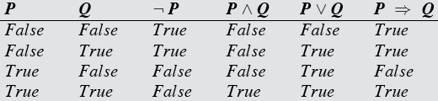
Models
What about the other stuff... Bigger formula containing logical connectives and quantifiers...
The meaning of the whole is based on the meanings of the parts, and the defined semantics of the connectives and the quantifiers.

Slide 40
Models
Consider
Everyone likes a noisy restaurant
First what the heck does this mean?

Slide 41
Models
There is a particular restaurant out there; it’s a noisy place; everybody likes it
Everbody likes The Med.
Everybody has at least one noisy restaurant that they like
Everbody has a favorite noisy restaurant.
Everybody likes noisy restaurants (i.e., there is no noisy restaurant out there that is disliked by anyone)
Everybody loves a cute puppy

Slide 42
Models
Let’s assume 2 is the one we want...
Is this true given our model?

Slide 43
Restaurant World

Slide 44
Models
Nope. Does the Rio like a noisy restaurant?
The forall operator really means forall. Not forall the things that you think it ought to mean forall for.
So this formulation is wrong
It’s wrong it two related ways...
We need some categories
people and restaurants
And the connective (and) is wrong

Slide 45
Categories as Properties
Properties
Noisy | {e,f,g}
Restaurant | {e,f,g}
Person | {a,b,c,d}

Slide 46
Note
It’s important to see why this works.
It’s not the case the the \forall is only looping over all the people based on some category (type).
\forall still means \forall
As in...

Slide 47
Note
What happens to an “implies” formula when P is false?

Slide 48
Back to Categories
Using predicates to create categories of concepts is a pretty rudimentary approach
Description logics are the primary modern way to
Reason about categories
And individuals with respect to categories
They are the basis for OWL (Web Ontology Language) which in turn is the basis for most work on the Semantic Web

