Slide 1
Natural Language Processing
CCSI 5832 – Lecture 23
Jim Martin

Slide 2
Today
HW Questions?
Remaining schedule
Machine translation framework
Evaluation methods

Slide 3
What’s Left
Machine translation
Next two lectures
Question answering
Dialog agents
Review
Last lecture
Final
12/17 4:30 to 7:00

Slide 4
Machine Translation
Automatic translation of text (and speech) from one language to another.
One of the oldest applications of natural language processing (1950s)
Neural approaches have taken over the field in the last 5 years.

Slide 5
Why is MT Hard?
Duhh... Because languages differ in a wide variety of ways.
Some more than others...

Slide 6
Morphological Variation
Languages differ in their basic parts: morphemes
Isolating languages
Cantonese, Vietnamese: roughly each word consists of one morpheme
Polysynthetic languages
Siberian Yupik (`Eskimo’): single word may have very many morphemes
Agglutinative languages
Turkish: words have affixes made up of lots of morphemes with clean boundaries
Fusion languages
Russian: single affix may have many morphemes and multiple functional roles

Slide 7
Segmentation Differences
Not every writing system has word boundaries marked in written text
Chinese, Japanese, Thai, Vietnamese
莎拉波娃现在居住在美国东南部的佛罗里达。
Some languages tend to have sentences that are quite long, closer to English paragraphs than sentences:
Modern Standard Arabic, Chinese

Slide 8

Syntactic Variation
SVO (Subject-Verb-Object) languages
English, German, French, Mandarin
SOV Languages
Japanese, Hindi
VSO languages
Irish, Classical Arabic

Slide 9
Inferential Load
Cold languages require the hearer to do more “figuring out” of who the various actors in the various events are:
Japanese, Chinese,
Hot languages are pretty explicit about saying who did what to whom.
English

Slide 10
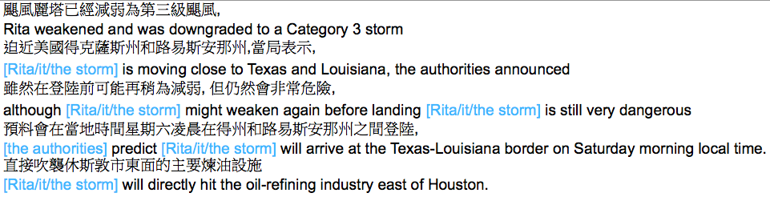
Inference
The noun phrases in
blue do not appear
in Chinese text …
But they are needed
for a good translation

Slide 11
Current MT Frameworks
If we’re translating French to English, the French we’re seeing is just a weird garbled version of English
The key problem is to decode the garbles back into the original English through some form of statistical model

Slide 12
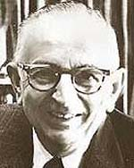
Warren Weaver (1947)
When I look at an article in Russian, I say to myself: This is really written in English, but it has been coded in some strange symbols. I will now proceed to decode.

Slide 13
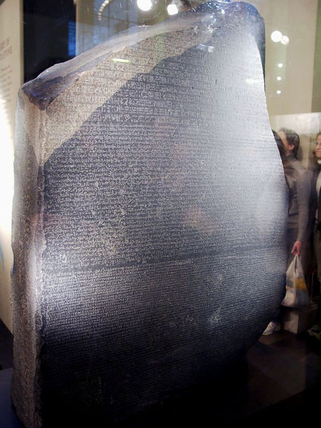
What’s This?

Slide 14
Rosetta Stone
Egyptian
hieroglyphs
Roughly 196 BCE
Ptolemy V
Demotic
Greek

Slide 15
Exercise
Translate the following text from Centauri to Arcturan.
Farok crrrok hihok yorok clok kantok ok-yurp

Slide 16
Centauri/Arcturan [Knight, 1997]
farok crrrok hihok yorok clok kantok ok-yurp
1a. ok-voon ororok sprok .
1b. at-voon bichat dat .
7a. lalok farok ororok lalok sprok izok enemok .
7b. wat jjat bichat wat dat vat eneat .
2a. ok-drubel ok-voon anok plok sprok .
2b. at-drubel at-voon pippat rrat dat .
8a. lalok brok anok plok nok .
8b. iat lat pippat rrat nnat .
3a. erok sprok izok hihok ghirok .
3b. totat dat arrat vat hilat .
9a. wiwok nok izok kantok ok-yurp .
9b. totat nnat quat oloat at-yurp .
4a. ok-voon anok drok brok jok .
4b. at-voon krat pippat sat lat .
10a. lalok mok nok yorok ghirok clok .
10b. wat nnat gat mat bat hilat .
5a. wiwok farok izok stok .
5b. totat jjat quat cat .
11a. lalok nok crrrok hihok yorok zanzanok .
11b. wat nnat arrat mat zanzanat .
6a. lalok sprok izok jok stok .
6b. wat dat krat quat cat .
12a. lalok rarok nok izok hihok mok .
12b. wat nnat forat arrat vat gat .

Slide 17
Centauri/Arcturan [Knight, 1997]
Your assignment, translate this to Arcturan: farok crrrok hihok yorok clok kantok ok-yurp
1a. ok-voon ororok sprok .
1b. at-voon bichat dat .
7a. lalok farok ororok lalok sprok izok enemok .
7b. wat jjat bichat wat dat vat eneat .
2a. ok-drubel ok-voon anok plok sprok .
2b. at-drubel at-voon pippat rrat dat .
8a. lalok brok anok plok nok .
8b. iat lat pippat rrat nnat .
3a. erok sprok izok hihok ghirok .
3b. totat dat arrat vat hilat .
9a. wiwok nok izok kantok ok-yurp .
9b. totat nnat quat oloat at-yurp .
4a. ok-voon anok drok brok jok .
4b. at-voon krat pippat sat lat .
10a. lalok mok nok yorok ghirok clok .
10b. wat nnat gat mat bat hilat .
5a. wiwok farok izok stok .
5b. totat jjat quat cat .
11a. lalok nok crrrok hihok yorok zanzanok .
11b. wat nnat arrat mat zanzanat .
6a. lalok sprok izok jok stok .
6b. wat dat krat quat cat .
12a. lalok rarok nok izok hihok mok .
12b. wat nnat forat arrat vat gat .

Slide 18
Centauri/Arcturan [Knight, 1997]
Your assignment, translate this to Arcturan: farok crrrok hihok yorok clok kantok ok-yurp
1a. ok-voon ororok sprok .
1b. at-voon bichat dat .
7a. lalok farok ororok lalok sprok izok enemok .
7b. wat jjat bichat wat dat vat eneat .
2a. ok-drubel ok-voon anok plok sprok .
2b. at-drubel at-voon pippat rrat dat .
8a. lalok brok anok plok nok .
8b. iat lat pippat rrat nnat .
3a. erok sprok izok hihok ghirok .
3b. totat dat arrat vat hilat .
9a. wiwok nok izok kantok ok-yurp .
9b. totat nnat quat oloat at-yurp .
4a. ok-voon anok drok brok jok .
4b. at-voon krat pippat sat lat .
10a. lalok mok nok yorok ghirok clok .
10b. wat nnat gat mat bat hilat .
5a. wiwok farok izok stok .
5b. totat jjat quat cat .
11a. lalok nok crrrok hihok yorok zanzanok .
11b. wat nnat arrat mat zanzanat .
???
6a. lalok sprok izok jok stok .
6b. wat dat krat quat cat .
12a. lalok rarok nok izok hihok mok .
12b. wat nnat forat arrat vat gat .

Slide 19
Centauri/Arcturan [Knight, 1997]
Your assignment, translate this to Arcturan: farok crrrok hihok yorok clok kantok ok-yurp
1a. ok-voon ororok sprok .
1b. at-voon bichat dat .
7a. lalok farok ororok lalok sprok izok enemok .
7b. wat jjat bichat wat dat vat eneat .
2a. ok-drubel ok-voon anok plok sprok .
2b. at-drubel at-voon pippat rrat dat .
8a. lalok brok anok plok nok .
8b. iat lat pippat rrat nnat .
3a. erok sprok izok hihok ghirok .
3b. totat dat arrat vat hilat .
9a. wiwok nok izok kantok ok-yurp .
9b. totat nnat quat oloat at-yurp .
4a. ok-voon anok drok brok jok .
4b. at-voon krat pippat sat lat .
10a. lalok mok nok yorok ghirok clok .
10b. wat nnat gat mat bat hilat .
5a. wiwok farok izok stok .
5b. totat jjat quat cat .
11a. lalok nok crrrok hihok yorok zanzanok .
11b. wat nnat arrat mat zanzanat .
6a. lalok sprok izok jok stok .
6b. wat dat krat quat cat .
12a. lalok rarok nok izok hihok mok .
12b. wat nnat forat arrat vat gat .

Slide 20
Centauri/Arcturan [Knight, 1997]
Your assignment, translate this to Arcturan: farok crrrok hihok yorok clok kantok ok-yurp
1a. ok-voon ororok sprok .
1b. at-voon bichat dat .
7a. lalok farok ororok lalok sprok izok enemok .
7b. wat jjat bichat wat dat vat eneat .
2a. ok-drubel ok-voon anok plok sprok .
2b. at-drubel at-voon pippat rrat dat .
8a. lalok brok anok plok nok .
8b. iat lat pippat rrat nnat .
3a. erok sprok izok hihok ghirok .
3b. totat dat arrat vat hilat .
9a. wiwok nok izok kantok ok-yurp .
9b. totat nnat quat oloat at-yurp .
4a. ok-voon anok drok brok jok .
4b. at-voon krat pippat sat lat .
10a. lalok mok nok yorok ghirok clok .
10b. wat nnat gat mat bat hilat .
5a. wiwok farok izok stok .
5b. totat jjat quat cat .
11a. lalok nok crrrok hihok yorok zanzanok .
11b. wat nnat arrat mat zanzanat .
6a. lalok sprok izok jok stok .
6b. wat dat krat quat cat .
12a. lalok rarok nok izok hihok mok .
12b. wat nnat forat arrat vat gat .

Slide 21
Centauri/Arcturan [Knight, 1997]
Your assignment, translate this to Arcturan: farok crrrok hihok yorok clok kantok ok-yurp
1a. ok-voon ororok sprok .
1b. at-voon bichat dat .
7a. lalok farok ororok lalok sprok izok enemok .
7b. wat jjat bichat wat dat vat eneat .
2a. ok-drubel ok-voon anok plok sprok .
2b. at-drubel at-voon pippat rrat dat .
8a. lalok brok anok plok nok .
8b. iat lat pippat rrat nnat .
3a. erok sprok izok hihok ghirok .
3b. totat dat arrat vat hilat .
9a. wiwok nok izok kantok ok-yurp .
9b. totat nnat quat oloat at-yurp .
4a. ok-voon anok drok brok jok .
4b. at-voon krat pippat sat lat .
10a. lalok mok nok yorok ghirok clok .
10b. wat nnat gat mat bat hilat .
5a. wiwok farok izok stok .
5b. totat jjat quat cat .
11a. lalok nok crrrok hihok yorok zanzanok .
11b. wat nnat arrat mat zanzanat .
6a. lalok sprok izok jok stok .
6b. wat dat krat quat cat .
12a. lalok rarok nok izok hihok mok .
12b. wat nnat forat arrat vat gat .

Slide 22
Centauri/Arcturan [Knight, 1997]
Your assignment, translate this to Arcturan: farok crrrok hihok yorok clok kantok ok-yurp
1a. ok-voon ororok sprok .
1b. at-voon bichat dat .
7a. lalok farok ororok lalok sprok izok enemok .
7b. wat jjat bichat wat dat vat eneat .
2a. ok-drubel ok-voon anok plok sprok .
2b. at-drubel at-voon pippat rrat dat .
8a. lalok brok anok plok nok .
8b. iat lat pippat rrat nnat .
3a. erok sprok izok hihok ghirok .
3b. totat dat arrat vat hilat .
9a. wiwok nok izok kantok ok-yurp .
9b. totat nnat quat oloat at-yurp .
4a. ok-voon anok drok brok jok .
4b. at-voon krat pippat sat lat .
10a. lalok mok nok yorok ghirok clok .
10b. wat nnat gat mat bat hilat .
5a. wiwok farok izok stok .
5b. totat jjat quat cat .
11a. lalok nok crrrok hihok yorok zanzanok .
11b. wat nnat arrat mat zanzanat .
6a. lalok sprok izok jok stok .
6b. wat dat krat quat cat .
12a. lalok rarok nok izok hihok mok .
12b. wat nnat forat arrat vat gat .

Slide 23
Centauri/Arcturan [Knight, 1997]
Your assignment, translate this to Arcturan: farok crrrok hihok yorok clok kantok ok-yurp
1a. ok-voon ororok sprok .
1b. at-voon bichat dat .
7a. lalok farok ororok lalok sprok izok enemok .
7b. wat jjat bichat wat dat vat eneat .
2a. ok-drubel ok-voon anok plok sprok .
2b. at-drubel at-voon pippat rrat dat .
8a. lalok brok anok plok nok .
8b. iat lat pippat rrat nnat .
3a. erok sprok izok hihok ghirok .
3b. totat dat arrat vat hilat .
9a. wiwok nok izok kantok ok-yurp .
9b. totat nnat quat oloat at-yurp .
4a. ok-voon anok drok brok jok .
4b. at-voon krat pippat sat lat .
10a. lalok mok nok yorok ghirok clok .
10b. wat nnat gat mat bat hilat .
process of
elimination
5a. wiwok farok izok stok .
5b. totat jjat quat cat .
11a. lalok nok crrrok hihok yorok zanzanok .
11b. wat nnat arrat mat zanzanat .
6a. lalok sprok izok jok stok .
6b. wat dat krat quat cat .
12a. lalok rarok nok izok hihok mok .
12b. wat nnat forat arrat vat gat .

Slide 24
Centauri/Arcturan [Knight, 1997]
Your assignment, translate this to Arcturan: farok crrrok hihok yorok clok kantok ok-yurp
1a. ok-voon ororok sprok .
1b. at-voon bichat dat .
7a. lalok farok ororok lalok sprok izok enemok .
7b. wat jjat bichat wat dat vat eneat .
2a. ok-drubel ok-voon anok plok sprok .
2b. at-drubel at-voon pippat rrat dat .
8a. lalok brok anok plok nok .
8b. iat lat pippat rrat nnat .
3a. erok sprok izok hihok ghirok .
3b. totat dat arrat vat hilat .
9a. wiwok nok izok kantok ok-yurp .
9b. totat nnat quat oloat at-yurp .
4a. ok-voon anok drok brok jok .
4b. at-voon krat pippat sat lat .
10a. lalok mok nok yorok ghirok clok .
10b. wat nnat gat mat bat hilat .
5a. wiwok farok izok stok .
5b. totat jjat quat cat .
11a. lalok nok crrrok hihok yorok zanzanok .
11b. wat nnat arrat mat zanzanat .
cognate?
6a. lalok sprok izok jok stok .
6b. wat dat krat quat cat .
12a. lalok rarok nok izok hihok mok .
12b. wat nnat forat arrat vat gat .

Slide 25
Centauri/Arcturan [Knight, 1997]
Your new assignment, put these words in order: { jjat, arrat, mat, bat, oloat, at-yurp }
1a. ok-voon ororok sprok .
1b. at-voon bichat dat .
7a. lalok farok ororok lalok sprok izok enemok .
7b. wat jjat bichat wat dat vat eneat .
2a. ok-drubel ok-voon anok plok sprok .
2b. at-drubel at-voon pippat rrat dat .
8a. lalok brok anok plok nok .
8b. iat lat pippat rrat nnat .
3a. erok sprok izok hihok ghirok .
3b. totat dat arrat vat hilat .
9a. wiwok nok izok kantok ok-yurp .
9b. totat nnat quat oloat at-yurp .
4a. ok-voon anok drok brok jok .
4b. at-voon krat pippat sat lat .
10a. lalok mok nok yorok ghirok clok .
10b. wat nnat gat mat bat hilat .
5a. wiwok farok izok stok .
5b. totat jjat quat cat .
11a. lalok nok crrrok hihok yorok zanzanok .
11b. wat nnat arrat mat zanzanat .
zero
fertility
6a. lalok sprok izok jok stok .
6b. wat dat krat quat cat .
12a. lalok rarok nok izok hihok mok .
12b. wat nnat forat arrat vat gat .

Slide 26
Spanish/English text
Translate: Clients do not sell pharmaceuticals in Europe.
1a. Garcia and associates .
1b. Garcia y asociados .
7a. the clients and the associates are enemies .
7b. los clients y los asociados son enemigos .
2a. Carlos Garcia has three associates .
2b. Carlos Garcia tiene tres asociados .
8a. the company has three groups .
8b. la empresa tiene tres grupos .
3a. his associates are not strong .
3b. sus asociados no son fuertes .
9a. its groups are in Europe .
9b. sus grupos estan en Europa .
4a. Garcia has a company also .
4b. Garcia tambien tiene una empresa .
10a. the modern groups sell strong pharmaceuticals .
10b. los grupos modernos venden medicinas fuertes .
5a. its clients are angry .
5b. sus clientes estan enfadados .
11a. the groups do not sell zenzanine .
11b. los grupos no venden zanzanina .
6a. the associates are also angry .
6b. los asociados tambien estan enfadados .
12a. the small groups are not modern .
12b. los grupos pequenos no son modernos .

Slide 27
The Point
You managed to come up with a passable translation with no knowledge of either language
No dictionary
No grammar
No meaning
No broader context
Just text pairs and a bunch of heuristics

Slide 28
MT Evaluation
Traditionally difficult because there is no single “right answer”.
20 human translators will translate the same sentence 20 different ways.

Slide 29
Neural MT
Fortunately, we’ve already covered (almost) all we need for doing Neural MT

Slide 30
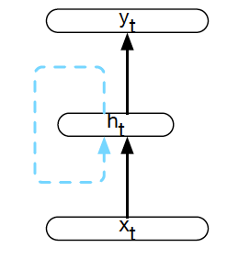
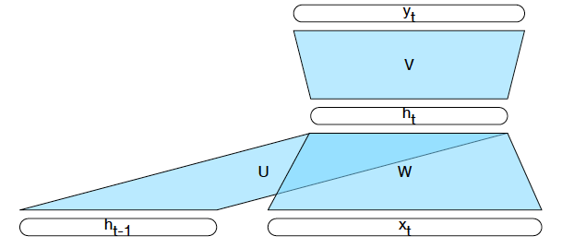
Simple Recurrent Neural Network
Feed words/inputs in a sequence one at a time, compute a corresponding output at each step
Add a copy of the previous hidden layer as input to the current hidden layer as context
Notes:
Instead of a sliding window.

Slide 31
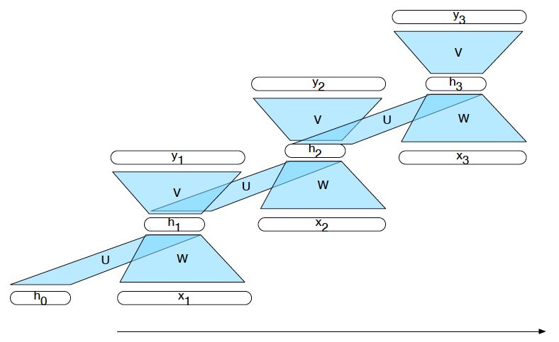
Unrolled in Time

Slide 32
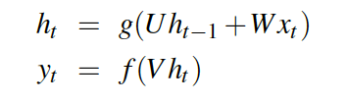
Inference in SRN

Slide 33
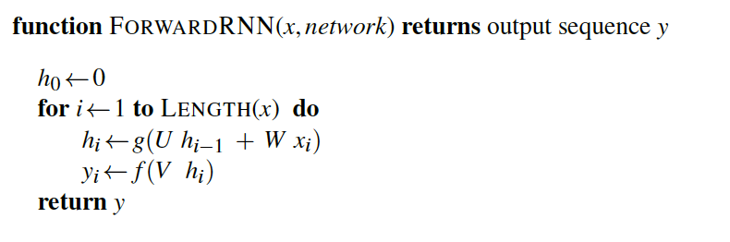
Sequence Processing

Slide 34
Common Use Cases
Language modeling
Predict the next word P(w_{i}| w_{1…}w_{i-1})
Sequence labeling
POS tagging, IOB tagging, parsing
Sequence classification
Classify a whole sequence (sentiment, deception, topic classification, authorship, etc)

Slide 35
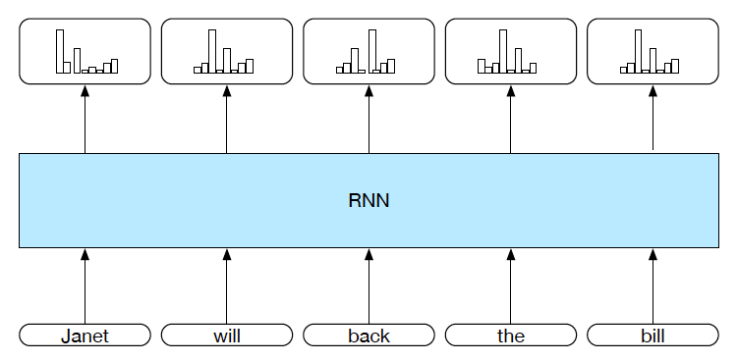
Sequence Labeling

Slide 36
Sequence Labeling

Slide 37
Language Modeling

Slide 38
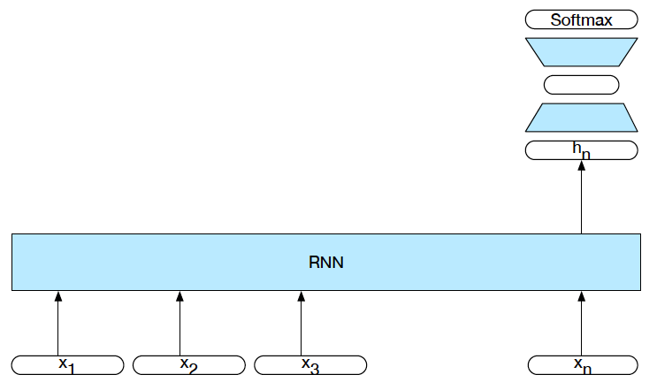
Sequence Classification
Intermediate outputs aren’t needed. Only the hidden layer activations.
Training is driven by the loss from the classification task.

Slide 39


Bidirectional RNNs
At time t, what information is contained in h_{t}?
Everything we know about the sequence from
1 to t. And nothing about the rest.
What if we ran a different network over the input in reverse?

Slide 40
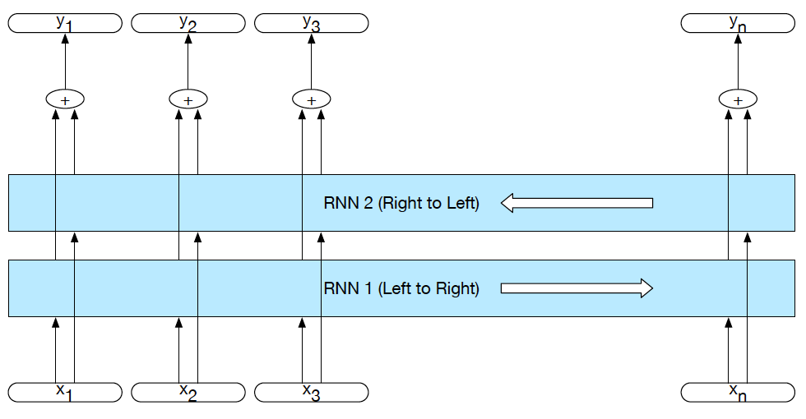
Bidirectional RNNs

Slide 41
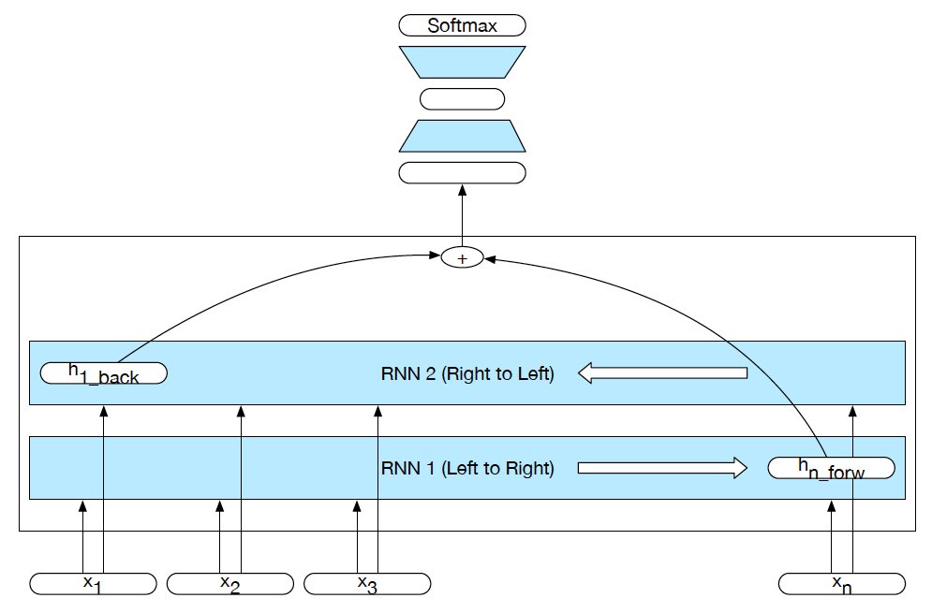
Bi-RNN for Classification

Slide 42
Language Modeling: Training
Word 2
Word 3
Word 4
Word n
…
Hidden 1
Hidden 2
Hidden 3
Hidden n
Word 1
Word 2
Word 3
Word n-1

Slide 43
Language Modeling: Training
The
house
is
big
.
</s>
Hidden 1
Hidden 2
Hidden 3
Hidden 4
Hidden 5
Hidden 5
<s>
The
house
is
big
.

Slide 44
Language Models as Generators
Recall back from the start of the semester that we can use language models as random generators
The better the output looked the better the language model

Slide 45
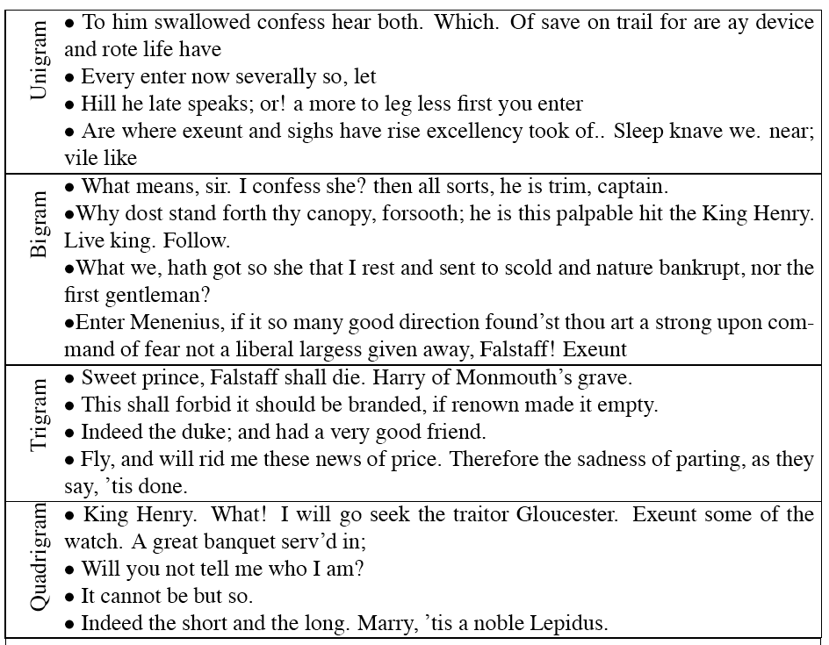
Shakespeare

Slide 46
Language Modeling: Generation

Slide 47
Language Modeling: Generation
Hidden 1
<s>

Slide 48
Language Modeling: Generation
The
Hidden 1
Hidden 2
<s>
The

Slide 49
Language Modeling: Generation
The
house
Hidden 1
Hidden 2
Hidden 3
<s>
The
house

Slide 50
Language Modeling: Generation
The
house
is
Hidden 1
Hidden 2
Hidden 3
Hidden 4
<s>
The
house
is

Slide 51
Language Modeling: Generation
The
house
is
big
.
Hidden 1
Hidden 2
Hidden 3
Hidden 4
Hidden 5
<s>
The
house
is
big

Slide 52
Language Modeling: Generation
The
house
is
big
.
</s>
Hidden 1
Hidden 2
Hidden 3
Hidden 4
Hidden 5
Hidden 5
<s>
The
house
is
big
.

Slide 53
Contextual Generation
Of course, for most tasks we don’t want some random sentence. We want a sentence that makes sense given some context. For MT, we need a target sentence that’s a reasonable translation of a particular source sentence.
Assume we have some parallel text
Source/target pairs
Let’s do the dumbest thing we can think of

Slide 54
Contextual Generation
Let’s do the dumbest thing we can think of
Concatenate the source and target pairs into single sequences
Train a single neural language model on that data
Use that to generate (decode)

Slide 55
Language Modeling: Neural MT Training
The
house
is
big
.
</s>
Das
Haus
ist
groß
.
</s>
Hidden 1
Hidden 2
Hidden 3
Hidden 4
Hidden 5
Hidden 5
Hidden 1
Hidden 2
Hidden 3
Hidden 4
Hidden 5
Hidden 5
<s>
The
house
is
big
.
</s>
Das
Haus
ist
groß
.
<s> The house is big . </s> Das Haus ist groß . </s>

Slide 56
Language Modeling: Decoding
The
house
is
big
.
</s>
Das
Haus
ist
groß
.
</s>
Hidden 1
Hidden 2
Hidden 3
Hidden 4
Hidden 5
Hidden 5
Hidden 1
Hidden 2
Hidden 3
Hidden 4
Hidden 5
Hidden 5
<s>
The
house
is
big
.
</s>
Das
Haus
ist
groß
.
<s> The house is big . </s> Das Haus ist groß . </s>

Slide 57
Language Modeling: Decoding
Hidden 1
Hidden 2
Hidden 3
Hidden 4
Hidden 5
Hidden 5
Hidden 1
Hidden 2
Hidden 3
Hidden 4
Hidden 5
Hidden 5
<s>
The
house
is
big
.
</s>

Slide 58
Language Modeling: Decoding
Das
Hidden 1
Hidden 2
Hidden 3
Hidden 4
Hidden 5
Hidden 5
Hidden 1
Hidden 2
Hidden 3
Hidden 4
Hidden 5
Hidden 5
<s>
The
house
is
big
.
</s>
Das

Slide 59
Language Modeling: Decoding
Das
Haus
Hidden 1
Hidden 2
Hidden 3
Hidden 4
Hidden 5
Hidden 5
Hidden 1
Hidden 2
Hidden 3
Hidden 4
Hidden 5
Hidden 5
<s>
The
house
is
big
.
</s>
Das
Haus

Slide 60
Language Modeling: Decoding
Das
Haus
ist
Hidden 1
Hidden 2
Hidden 3
Hidden 4
Hidden 5
Hidden 5
Hidden 1
Hidden 2
Hidden 3
Hidden 4
Hidden 5
Hidden 5
<s>
The
house
is
big
.
</s>
Das
Haus
ist

Slide 61
Language Modeling: Decoding
Das
Haus
ist
groß
Hidden 1
Hidden 2
Hidden 3
Hidden 4
Hidden 5
Hidden 5
Hidden 1
Hidden 2
Hidden 3
Hidden 4
Hidden 5
Hidden 5
<s>
The
house
is
big
.
</s>
Das
Haus
ist
groß

Slide 62
Language Modeling: Decoding
Das
Haus
ist
groß
.
Hidden 1
Hidden 2
Hidden 3
Hidden 4
Hidden 5
Hidden 5
Hidden 1
Hidden 2
Hidden 3
Hidden 4
Hidden 5
Hidden 5
<s>
The
house
is
big
.
</s>
Das
Haus
ist
groß
.

Slide 63
Language Modeling: Decoding
Das
Haus
ist
groß
.
</s>
Hidden 1
Hidden 2
Hidden 3
Hidden 4
Hidden 5
Hidden 5
Hidden 1
Hidden 2
Hidden 3
Hidden 4
Hidden 5
Hidden 5
<s>
The
house
is
big
.
</s>
Das
Haus
ist
groß
.
Stop generating when you get an </s>.

Slide 64
Language Modeling: Decoding
Das
Haus
ist
groß
.
</s>
Hidden 1
Hidden 2
Hidden 3
Hidden 4
Hidden 5
Hidden 5
Hidden 1
Hidden 2
Hidden 3
Hidden 4
Hidden 5
Hidden 5
<s>
The
house
is
big
.
</s>
Das
Haus
ist
groß
.
What’s the most important hidden layer in this scheme?

Slide 65
Language Modeling: Decoding
Das
Haus
ist
groß
.
</s>
Hidden 1
Hidden 2
Hidden 3
Hidden 4
Hidden 5
Hidden 5
Hidden 1
Hidden 2
Hidden 3
Hidden 4
Hidden 5
Hidden 5
<s>
The
house
is
big
.
</s>
Das
Haus
ist
groß
.

Slide 66
Encoder/Decoder Architecture
Das
Haus
ist
groß
.
</s>
Hidden 1
Hidden 2
Hidden 3
Hidden 4
Hidden 5
Hidden 5
Hidden 1
Hidden 2
Hidden 3
Hidden 4
Hidden 5
Hidden 5
<s>
The
house
is
big
.
</s>
Das
Haus
ist
groß
.
Encoder
Decoder

Slide 67
Problems
As with sequence classification, relying on that single final hidden layer to capture everything about the input is a dubious notion.
Just choosing the single best (argmax) word at each point in decoding is unlikely to yield the argmax sequence.
The softmax over the entire vocab at each step is a big issue
Keep vocab small makes it tractable.
But large vocabs are needed for lots of languages/domains

Slide 68
Solutions
We’ll add a richer context to the decoder
Attention
Add a beam search to the decode to explore more options
Switch to character-level models

Slide 69
MT Evaluation
Traditionally difficult because there is no single “right answer”.
20 human translators will translate the same sentence 20 different ways.

Slide 70
Evaluation Metric (BLEU)
Reference (human) translation: The U.S. island of Guam is maintaining a high state of alert after the Guam airport and its offices both received an e-mail from someone calling himself the Saudi Arabian Osama bin Laden and threatening a biological/chemical attack against public places such as the airport .
N-gram precision (score is between 0 & 1)
What percentage of machine n-grams can be found in the reference translation?
An n-gram is an sequence of n words
Not allowed to use same portion of reference translation twice (can’t cheat by typing out “the the the the the”)
Brevity penalty
Can’t just type out single word “the” (precision 1.0!)
Amazingly hard to “game” the metric (i.e., find a way to change machine output so that BLEU goes up, but quality doesn’t)
Contra doesn’t hold. Can find perfectly good improvements that hurt, or don’t help, BLEU
Machine translation: The American [?] international airport and its the office all receives one calls self the sand Arab rich business [?] and so on electronic mail , which sends out ; The threat will be able after public place and so on the airport to start the biochemistry attack , [?] highly alerts after the maintenance.

Slide 71
Multiple Reference Translations
Reference translation 1: The U.S. island of Guam is maintaining a high state of alert after the Guam airport and its offices both received an e-mail from someone calling himself the Saudi Arabian Osama bin Laden and threatening a biological/chemical attack against public places such as the airport .
Reference translation 2: Guam International Airport and its offices are maintaining a high state of alert after receiving an e-mail that was from a person claiming to be the wealthy Saudi Arabian businessman Bin Laden and that threatened to launch a biological and chemical attack on the airport and other public places .
Machine translation: The American [?] international airport and its the office all receives one calls self the sand Arab rich business [?] and so on electronic mail , which sends out ; The threat will be able after public place and so on the airport to start the biochemistry attack , [?] highly alerts after the maintenance.
Reference translation 3: The US International Airport of Guam and its office has received an email from a self-claimed Arabian millionaire named Laden , which threatens to launch a biochemical attack on such public places as airport . Guam authority has been on alert .
Reference translation 4: US Guam International Airport and its office received an email from Mr. Bin Laden and other rich businessman from Saudi Arabia . They said there would be biochemistry air raid to Guam Airport and other public places . Guam needs to be in high precaution about this matter .

Slide 72
BLEU in Action
枪手被警方击毙。 (Foreign Original)
the gunman was shot to death by the police . (Reference Translation)
System Outputs
the gunman was police kill . #1 wounded police jaya of #2 the gunman was shot dead by the police . #3 the gunman arrested by police kill . #4 the gunmen were killed . #5 the gunman was shot to death by the police . #6
gunmen were killed by police #7
al by the police . #8 the ringer is killed by the police . #9 police killed the gunman . #10

Slide 73
Multiple Reference Translations
Reference translation 1: The U.S. island of Guam is maintaining a high state of alert after the Guam airport and its offices both received an e-mail from someone calling himself the Saudi Arabian Osama bin Laden and threatening a biological/chemical attack against public places such as the airport .
Reference translation 2: Guam International Airport and its offices are maintaining a high state of alert after receiving an e-mail that was from a person claiming to be the wealthy Saudi Arabian businessman Bin Laden and that threatened to launch a biological and chemical attack on the airport and other public places .
Machine translation: The American [?] international airport and its the office all receives one calls self the sand Arab rich business [?] and so on electronic mail , which sends out ; The threat will be able after public place and so on the airport to start the biochemistry attack , [?] highly alerts after the maintenance.
Reference translation 3: The US International Airport of Guam and its office has received an email from a self-claimed Arabian millionaire named Laden , which threatens to launch a biochemical attack on such public places as airport . Guam authority has been on alert .
Reference translation 4: US Guam International Airport and its office received an email from Mr. Bin Laden and other rich businessman from Saudi Arabia . They said there would be biochemistry air raid to Guam Airport and other public places . Guam needs to be in high precaution about this matter .

