Slide 1
Natural Language Processing
CCSI 5832 – Lecture 24
Jim Martin

Slide 2
Today
MT Evaluation
Beam search for MT
More Encoder/Decoder refinements
Encoder changes
Attention

Slide 3
MT Evaluation
Translation evaluation is difficult because there is no single “right answer”.
20 human translators will translate the same sentence 20 different ways.
Gold standard is human evaluation of MT system output
Expensive and time consuming
More reasonable are human reference translations for fixed dev/text sets
Also expensive

Slide 4
Automatic Evaluation Metric (BLEU)
Reference (human) translation: The U.S. island of Guam is maintaining a high state of alert after the Guam airport and its offices both received an e-mail from someone calling himself the Saudi Arabian Osama bin Laden and threatening a biological/chemical attack against public places such as the airport .
N-gram precision (score is between 0 & 1)
What percentage of machine n-grams can be found in a reference translation?
An n-gram is an sequence of n words
Not allowed to use same portion of reference translation twice (can’t cheat by typing out “the the the the the”)
Amazingly hard to “game” this metric (i.e., find a way to change machine output so that BLEU goes up, but quality also doesn’t)
Contra doesn’t hold. Can find perfectly good improvements that hurt, or don’t help, BLEU
Machine translation: The American [?] international airport and its the office all receives one calls self the sand Arab rich business [?] and so on electronic mail , which sends out ; The threat will be able after public place and so on the airport to start the biochemistry attack , [?] highly alerts after the maintenance.

Slide 5
Multiple Reference Translations
Reference translation 1: The U.S. island of Guam is maintaining a high state of alert after the Guam airport and its offices both received an e-mail from someone calling himself the Saudi Arabian Osama bin Laden and threatening a biological/chemical attack against public places such as the airport .
Reference translation 2: Guam International Airport and its offices are maintaining a high state of alert after receiving an e-mail that was from a person claiming to be the wealthy Saudi Arabian businessman Bin Laden and that threatened to launch a biological and chemical attack on the airport and other public places .
Machine translation: The American [?] international airport and its the office all receives one calls self the sand Arab rich business [?] and so on electronic mail , which sends out ; The threat will be able after public place and so on the airport to start the biochemistry attack , [?] highly alerts after the maintenance.
Reference translation 3: The US International Airport of Guam and its office has received an email from a self-claimed Arabian millionaire named Laden , which threatens to launch a biochemical attack on such public places as airport . Guam authority has been on alert .
Reference translation 4: US Guam International Airport and its office received an email from Mr. Bin Laden and other rich businessman from Saudi Arabia . They said there would be biochemistry air raid to Guam Airport and other public places . Guam needs to be in high precaution about this matter .

Slide 6
BLEU in Action
枪手被警方击毙。 (Foreign Original)
the gunman was shot to death by the police . (Reference Translation)
System Outputs
the gunman was police kill . #1 wounded police jaya of #2 the gunman was shot dead by the police . #3 the gunman arrested by police kill . #4 the gunmen were killed . #5 the gunman was shot to death by the police . #6
gunmen were killed by police #7
al by the police . #8 the ringer is killed by the police . #9 police killed the gunman . #10

Slide 7
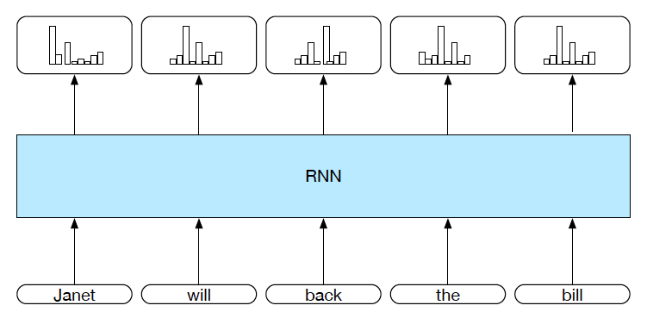
Language Modeling

Slide 8


Bidirectional RNNs
At time t, what information is contained in h_{t}?
Everything we know about the sequence from
1 to t. And nothing about the rest.
What if we ran a different network over the input in reverse?

Slide 9
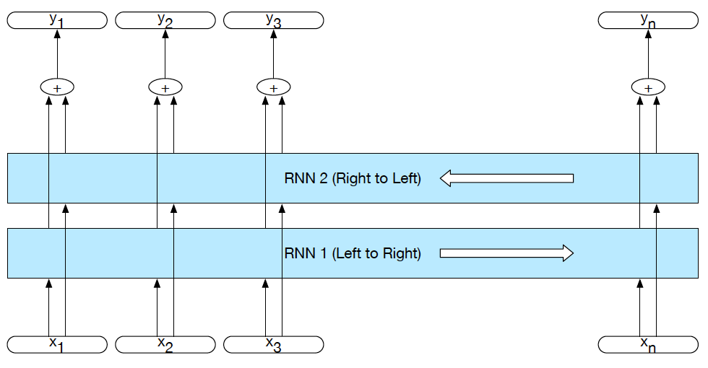
Bidirectional RNNs

Slide 10
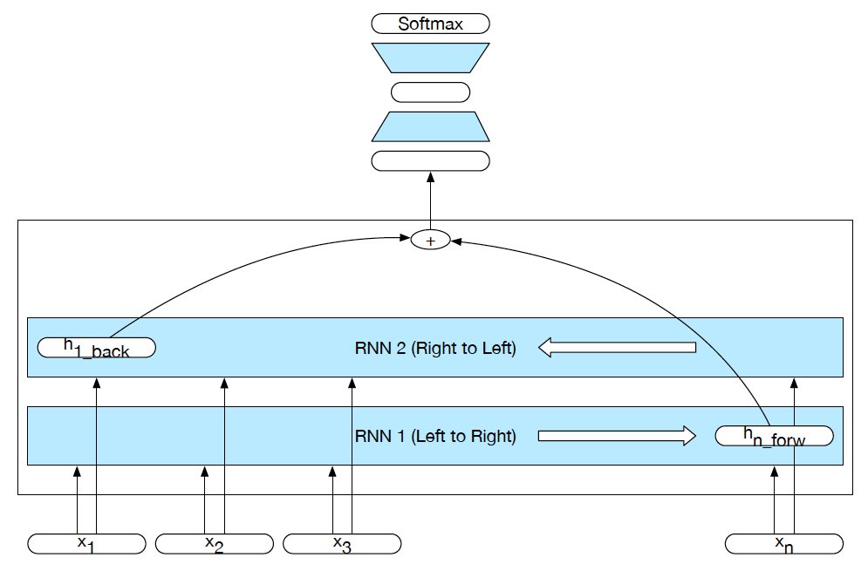
Bi-RNN for Classification

Slide 11
Language Modeling: Generation

Slide 12
Language Modeling: Generation
Hidden 1
<s>

Slide 13
Language Modeling: Generation
The
Hidden 1
Hidden 2
<s>
The

Slide 14
Language Modeling: Generation
The
house
Hidden 1
Hidden 2
Hidden 3
<s>
The
house

Slide 15
Language Modeling: Generation
The
house
is
Hidden 1
Hidden 2
Hidden 3
Hidden 4
<s>
The
house
is

Slide 16
Language Modeling: Generation
The
house
is
big
.
Hidden 1
Hidden 2
Hidden 3
Hidden 4
Hidden 5
<s>
The
house
is
big

Slide 17
Language Modeling: Generation
The
house
is
big
.
</s>
Hidden 1
Hidden 2
Hidden 3
Hidden 4
Hidden 5
Hidden 5
<s>
The
house
is
big
.

Slide 18
Language Modeling: Neural MT Training
The
house
is
big
.
</s>
Das
Haus
ist
groß
.
</s>
Hidden 1
Hidden 2
Hidden 3
Hidden 4
Hidden 5
Hidden 5
Hidden 1
Hidden 2
Hidden 3
Hidden 4
Hidden 5
Hidden 5
<s>
The
house
is
big
.
</s>
Das
Haus
ist
groß
.
<s> The house is big . </s> Das Haus ist groß . </s>

Slide 19
Language Modeling: Decoding
The
house
is
big
.
</s>
Das
Haus
ist
groß
.
</s>
Hidden 1
Hidden 2
Hidden 3
Hidden 4
Hidden 5
Hidden 5
Hidden 1
Hidden 2
Hidden 3
Hidden 4
Hidden 5
Hidden 5
<s>
The
house
is
big
.
</s>
Das
Haus
ist
groß
.
<s> The house is big . </s> Das Haus ist groß . </s>

Slide 20
Language Modeling: Decoding
Hidden 1
Hidden 2
Hidden 3
Hidden 4
Hidden 5
Hidden 5
Hidden 1
Hidden 2
Hidden 3
Hidden 4
Hidden 5
Hidden 5
<s>
The
house
is
big
.
</s>

Slide 21
Language Modeling: Decoding
Das
Hidden 1
Hidden 2
Hidden 3
Hidden 4
Hidden 5
Hidden 5
Hidden 1
Hidden 2
Hidden 3
Hidden 4
Hidden 5
Hidden 5
<s>
The
house
is
big
.
</s>
Das

Slide 22
Language Modeling: Decoding
Das
Haus
Hidden 1
Hidden 2
Hidden 3
Hidden 4
Hidden 5
Hidden 5
Hidden 1
Hidden 2
Hidden 3
Hidden 4
Hidden 5
Hidden 5
<s>
The
house
is
big
.
</s>
Das
Haus

Slide 23
Language Modeling: Decoding
Das
Haus
ist
Hidden 1
Hidden 2
Hidden 3
Hidden 4
Hidden 5
Hidden 5
Hidden 1
Hidden 2
Hidden 3
Hidden 4
Hidden 5
Hidden 5
<s>
The
house
is
big
.
</s>
Das
Haus
ist

Slide 24
Language Modeling: Decoding
Das
Haus
ist
groß
Hidden 1
Hidden 2
Hidden 3
Hidden 4
Hidden 5
Hidden 5
Hidden 1
Hidden 2
Hidden 3
Hidden 4
Hidden 5
Hidden 5
<s>
The
house
is
big
.
</s>
Das
Haus
ist
groß

Slide 25
Language Modeling: Decoding
Das
Haus
ist
groß
.
Hidden 1
Hidden 2
Hidden 3
Hidden 4
Hidden 5
Hidden 5
Hidden 1
Hidden 2
Hidden 3
Hidden 4
Hidden 5
Hidden 5
<s>
The
house
is
big
.
</s>
Das
Haus
ist
groß
.

Slide 26
Language Modeling: Decoding
Das
Haus
ist
groß
.
</s>
Hidden 1
Hidden 2
Hidden 3
Hidden 4
Hidden 5
Hidden 5
Hidden 1
Hidden 2
Hidden 3
Hidden 4
Hidden 5
Hidden 5
<s>
The
house
is
big
.
</s>
Das
Haus
ist
groß
.
Stop generating when you get an </s>.

Slide 27
Language Modeling: Decoding
Das
Haus
ist
groß
.
</s>
Hidden 1
Hidden 2
Hidden 3
Hidden 4
Hidden 5
Hidden 5
Hidden 1
Hidden 2
Hidden 3
Hidden 4
Hidden 5
Hidden 5
<s>
The
house
is
big
.
</s>
Das
Haus
ist
groß
.
What’s the most important hidden layer in this scheme?

Slide 28
Language Modeling: Decoding
Das
Haus
ist
groß
.
</s>
Hidden 1
Hidden 2
Hidden 3
Hidden 4
Hidden 5
Hidden 5
Hidden 1
Hidden 2
Hidden 3
Hidden 4
Hidden 5
Hidden 5
<s>
The
house
is
big
.
</s>
Das
Haus
ist
groß
.

Slide 29
Encoder/Decoder Architecture
Das
Haus
ist
groß
.
</s>
Hidden 1
Hidden 2
Hidden 3
Hidden 4
Hidden 5
Hidden 5
Hidden 1
Hidden 2
Hidden 3
Hidden 4
Hidden 5
Hidden 5
<s>
The
house
is
big
.
</s>
Das
Haus
ist
groß
.
Encoder
Decoder

Slide 30
Problems
Just choosing the single best (argmax) word at each point in decoding is unlikely to yield the argmax sequence.
As with sequence classification, relying on that single final hidden layer to capture everything about the input is a dubious notion.
The softmax over the entire vocab at each step is a big issue
Keep vocab small makes it tractable.
But large vocabs are needed for lots of languages/domains

Slide 31
Solutions
Add a beam search to the decode to explore more options
We’ll add a richer context to the decoder
Attention
Switch to character-level models

Slide 32
Beam Search
In general, at each time in decoding there are 1 or 2 high probability words and a long tail of low probability options.
Beam search entails taking the top N choices at the start.
Then conditioning subsequent ones based on those… and so on.

Slide 33
Beam Search
We can get the probability for each choice from the decoder output distribution.
So the goodness of a sequence is the product of the individual choices.
Beam width is fixed and we keep only the best sequences as we proceed.

Slide 34
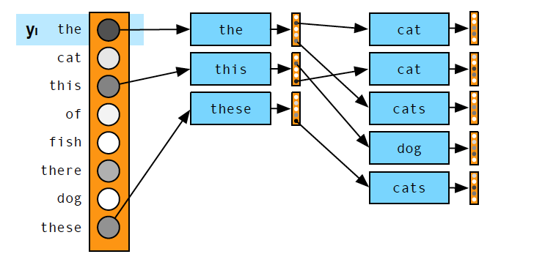
Beam Search

Slide 35
Beam Search
When do we stop extending a branch?
When we generate a </s>
Then what?
Reduce the beam width by 1 and continue until we get N complete sentences

Slide 36
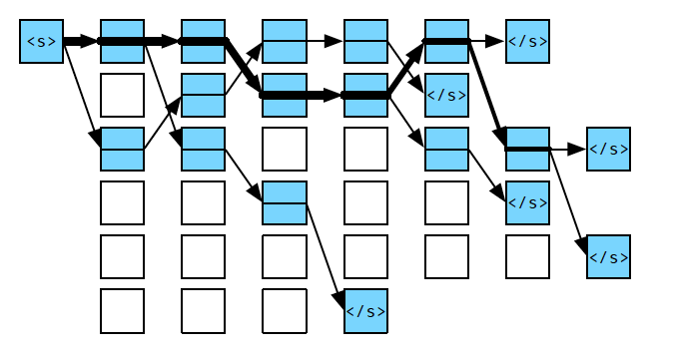
Beam Search

Slide 37
Beam Search
Then what?
Pick the best (the one with the highest prob)

Slide 38
Beam Search
Then what?
Pick the best (the one with the highest prob)
Any problems with that?

Slide 39
Beam Search
Then what?
Pick the best (the one with the highest prob)
Any problems with that?
They’re not all the same length
So shorter answers will look better
Normalize probs by length.

Slide 40
Encoder/Decoder Architecture
Das
Haus
ist
groß
.
</s>
Hidden 1
Hidden 2
Hidden 3
Hidden 4
Hidden 5
Hidden 5
Hidden 1
Hidden 2
Hidden 3
Hidden 4
Hidden 5
Hidden 5
<s>
The
house
is
big
.
</s>
Das
Haus
ist
groß
.
Encoder
Decoder

Slide 41
Encoder-Decoder
Diese
grune
hexe
</s>
Hidden 1
Hidden 2
Hidden 3
Hidden n
</s>
Diese
grune
hause
…
The
green
witch
</s>
Hidden 1
Hidden 2
Hidden 3
Hidden n
<s>
The
green
week

Slide 42
Encoder-Decoder (Option 1)
Diese
grune
hexe
</s>
Share the source sentence encoder representation across all the decoder inputs
Hidden 1
Hidden 2
Hidden 3
Hidden n
</s>
Diese
grune
hause
…
…
The
green
witch
</s>
Still has the issue that the entire source is represented in that single final hidden state.
Hidden 1
Hidden 2
Hidden 3
Hidden n
The
green
week
<s>

Slide 43
Encoder-Decoder (Option 2)
Diese
grune
hexe
</s>
Share each hidden state in the encoder sequence with each of the decoder inputs
Hidden 1
Hidden 2
Hidden 3
Hidden n
</s>
Diese
grune
hause
…
…
The
green
witch
</s>
Hidden 1
Hidden 2
Hidden 3
Hidden n
The
green
week
<s>

Slide 44
But
Not all the hidden encoder states are equally relevant to each of the decoder states…
Duh… the most relevant state to each of the decode states is the encode state relevant to the word being emitted.
Need some way of knowing what to attend to

Slide 45
Encoder-Decoder (3)
Provide access to the intermediate states of the encoder.
Add an attentional mechanism/layer.
Diese
grune
hexe
</s>
Hidden 1
Hidden 2
Hidden 3
Hidden n
</s>
Diese
grune
hause
…
c_0
c_1
c_2
c_n
The
green
witch
</s>
Hidden 1
Hidden 2
Hidden 3
Hidden n
The
green
week
<s>

Slide 46
Attention Layer
Provide a different weighted combination of all the encoder hidden states to the decoder at each point in time.
For h_i in the decoder, compute a similarity score between h_{i-1} and each encoder hidden state.
Normalize those scores to produce a probability for each
Computed a weighted sum the hidden states in the encoder by this distribution that’s c_i

Slide 47
Attention Layer
For each decoder state i compute a similarity score between hidden state i-1 and each of the encoder hidden states

Slide 48
Attention Layer
For each decoder state i compute a similarity score between hidden state i-1 and each of the encoder hidden states
Normalize to get a probability distribution over the encoder states

Slide 49
Attention Layer
For each decoder state i compute a similarity score between hidden state i-1 and each of the encoder hidden states
Normalize to get a probability distribution over the encoder states
Compute the weighted sum

Slide 50
Encoder-Decoder (3)
Provide access to the intermediate states of the encoder.
Add an attentional mechanism/layer.
Diese
grune
hexe
</s>
Hidden 1
Hidden 2
Hidden 3
Hidden n
</s>
Diese
grune
hause
…
c_3
The
green
witch
</s>
Hidden 1
Hidden 2
Hidden 3
Hidden n
The
green
week
<s>

Slide 51
Next Time
What’s that similarity score?
How does training work?
What about large vocabularies?

