Slide 1
Natural Language Processing
CCSI 5832 – Lecture 25
Jim Martin

Slide 2
Today
More on Encoder/Decoder & Attention
Attention scores
Training
Dealing with large vocabularies
Byte-pair encoding
Transformers and Bert

Slide 3
Final
For the final quiz period
Quiz 3: Covering only the material since the last quiz.
Optional makeup quiz covering material from the first two quizzes.
If your score is > than the sum of your first two quizzes I’ll use that.
Will not impact grades of folks who don’t do it.

Slide 4
HW 4
Named entity recognition
Detecting mentions of genes in biological journal abstracts.
Structure, promoter analysis and chromosomal assignment of the human APEX gene.

Slide 5
HW 4
Named entity recognition
Detecting mentions of genes in biological journal abstracts.
Structure, promoter analysis and chromosomal assignment of the human APEX gene.

Slide 6
Encoder/Decoder Architecture
Das
Haus
ist
groß
.
</s>
Hidden 1
Hidden 2
Hidden 3
Hidden 4
Hidden 5
Hidden 5
Hidden 1
Hidden 2
Hidden 3
Hidden 4
Hidden 5
Hidden 5
<s>
The
house
is
big
.
</s>
Das
Haus
ist
groß
.
Encoder
Decoder

Slide 7
Encoder-Decoder
Diese
grune
hexe
</s>
Hidden 1
Hidden 2
Hidden 3
Hidden n
</s>
Diese
grune
hause
…
The
green
witch
</s>
Hidden 1
Hidden 2
Hidden 3
Hidden n
<s>
The
green
week

Slide 8
Encoder-Decoder (Option 1)
Diese
grune
hexe
</s>
Share the source sentence encoder representation across all the decoder inputs
Hidden 1
Hidden 2
Hidden 3
Hidden n
</s>
Diese
grune
hause
…
…
The
green
witch
</s>
Still has the issue that the entire source is represented in that single final hidden state.
Hidden 1
Hidden 2
Hidden 3
Hidden n
The
green
week
<s>

Slide 9
Encoder-Decoder (Option 2)
Diese
grune
hexe
</s>
Share each hidden state in the encoder sequence with each of the decoder inputs
Hidden 1
Hidden 2
Hidden 3
Hidden n
</s>
Diese
grune
hause
…
…
The
green
witch
</s>
Hidden 1
Hidden 2
Hidden 3
Hidden n
The
green
week
<s>

Slide 10
But
Not all the hidden encoder states are equally relevant to each of the decoder states…
Duh… the most relevant state to each of the decode states is the encode state relevant to the word being emitted.
Need some way of knowing what to attend to

Slide 11
Encoder-Decoder (3)
Provide access to the intermediate states of the encoder.
Add an attentional mechanism/layer.
Diese
grune
hexe
</s>
Hidden 1
Hidden 2
Hidden 3
Hidden n
</s>
Diese
grune
hause
…
c_0
c_1
c_2
c_n
The
green
witch
</s>
Hidden 1
Hidden 2
Hidden 3
Hidden n
The
green
week
<s>

Slide 12
Attention Layer
Provide a different weighted combination of all the encoder hidden states to the decoder at each point in time.
For h_i in the decoder, compute a similarity score between h_{i-1} and each encoder hidden state.
Normalize those scores to produce a probability for each
Computed a weighted sum the hidden states in the encoder by this distribution that’s c_i

Slide 13
Encoder-Decoder (3)
Provide access to the intermediate states of the encoder.
Add an attentional mechanism/layer.
Diese
grune
hexe
</s>
Hidden 1
Hidden 2
Hidden 3
Hidden n
</s>
Diese
grune
hause
…
c_3
The
green
witch
</s>
Hidden 1
Hidden 2
Hidden 3
Hidden n
The
green
week
<s>

Slide 14
Attention Layer
For each decoder state i compute a similarity score between hidden state i-1 and each of the encoder hidden states

Slide 15
Attention Layer
For each decoder state i compute a similarity score between hidden state i-1 and each of the encoder hidden states
Normalize to get a probability distribution over the encoder states

Slide 16
Attention Layer
For each decoder state i compute a similarity score between hidden state i-1 and each of the encoder hidden states
Normalize to get a probability distribution over the encoder states
Compute the weighted sum

Slide 17
Attention Scores
So what’s this similarity score?
Just dot product of the two vectors
Add a weighting mechanism

Slide 18
Training
Training is based on end-to-end training with the loss based on the decoder output compared to training outputs.
Cross-entropy loss. Not BLEU directly.
Diese
grune
hexe
</s>
Hidden 1
Hidden 2
Hidden 3
Hidden n
</s>
Diese
grune
hause
…
c_3
Hidden 1
Hidden 2
Hidden 3
Hidden n
The
green
week
<s>

Slide 19
Large Vocabularies
How do we make sure we’re dealing with all the high frequency words that Zipf’s law predicts
While still allowing ourselves to deal with out of vocabulary terms (on either the source or target side).
And keep vocab size reasonable?

Slide 20
Reminder <UNK>
Given a corpus, replace all the terms that occur below some frequency count with <UNK>
Use that to collect stats, and to deal with any unknown words that occur in the test set.
Pretty unsatisfying approach.

Slide 21
Reminder: Embeddings
For all these neural approaches, the starting point is to have a trained embedding for all the inputs.
That is a fixed size vocab represented as a set of 1-hot vectors for all the vocab items and a “projection” weight matrix that gives us the embeddings for each word.
Using <unk> here is pretty dismal

Slide 22
Byte-Pair Encoding
Very cheap and dirty method that works really well.
Given a corpus split by characters
Start with a vocab that consists of
Characters+digits+punctuation
Say around 50
That’s your starting vocabulary
Count the frequency of all pairs in the corpus and create a new entry for the most frequent pair
Repeat until you’re happy

Slide 23
Byte-Pair Encoding
Really operates on a dictionary with counts of words (we don’t operate across word boundaries.
Stopping point is usually based on how big a dictionary you can deal with.

Slide 24
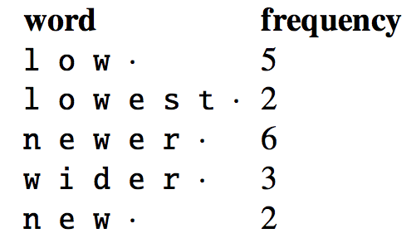
Byte-Pair Encoding
Vocab:
l
o
w
.
e
s
t
n
r
i
d

Slide 25
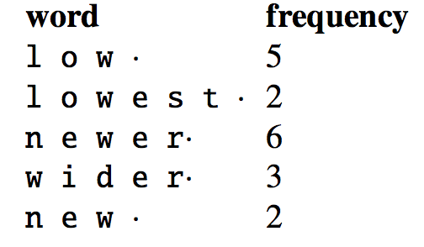
Byte-Pair Encoding
Vocab:
l
o
w
.
e
s
t
n
r
I
d
r.

Slide 26
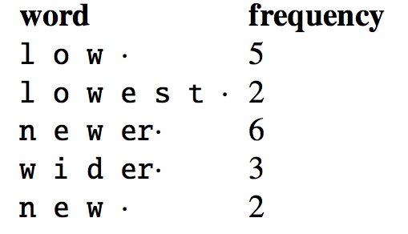
Byte-Pair Encoding
Vocab:
l
o
w
.
e
s
t
n
r
I
d
r.
er.

Slide 27
Byte-Pair Encoding
If you do that for 8 iterations you get the following vocabulary
Vocab:
l, o, w, ., e, s, t, n, r, i, d,
r., er., ew, new, lo, low, newer., low.

Slide 28
Byte-Pair Encoding
If you do that for 8 iterations you get the following vocabulary
Vocab:
l, o, w, ., e, s, t, n, r, i, d,
r., er., ew, new, lo, low, newer., low.

Slide 29
Byte-Pair Encoding
Merges
‘r’, ‘.’ → ‘r.’
‘e’, ‘r.’ → ‘er.’
’e’, ’w’ → ‘ew’
’n’ ,’ew’ → ‘new’
’l’ , ’o’ → ‘lo’
’lo’ , ’w’ → ‘low’
’new’ , ’er·’ → newer.
’low’ , ’·’ → low.
lower
l o w e r .
l o w e r.
Use the trained embeddings for ‘low’ and ‘er.’
By definition, there are no unknowns in this approach (modulo unknown characters).
l o w er.
lo w er.
low er.

Slide 30
Web

