Slide 1
Natural Language Processing
CSCI 5832—Lecture 26
Jim Martin

Slide 2
Quiz 3 Readings
Semantics
Chapter 14
Skip 14.4.1, 14.4.2, 14.5
Chapter 18 (moodle link, not on web)
Just 18.1 and 18.2
Information Extraction
Chapter 17
Skip 17.2.5, 17.3, 17.4, 17.5
MT and Encoder/Decoder Networks
Koehn chapter: Focus on 13.5
Q/A
Chapter 23
Dialog
Chapter 24
Skip 24.3

Slide 3
Today
Dialog agents and models (Chapter 24)
Task-based dialog agents
Chatbots
And a mix of the two

Slide 4
Outline
Basic Dialog Agents
ASR
Understanding
Generation
Dialog Management
Dialogue Manager Design
Finite State
Frame-based
Dialogue Design Considerations

Slide 5
Conversational Agents
Applications:
Travel arrangements (Amtrak, United Airlines)
Telephone call routing
Tutoring
Communicating with robots
Anything with limited screen/keyboard access

Slide 6
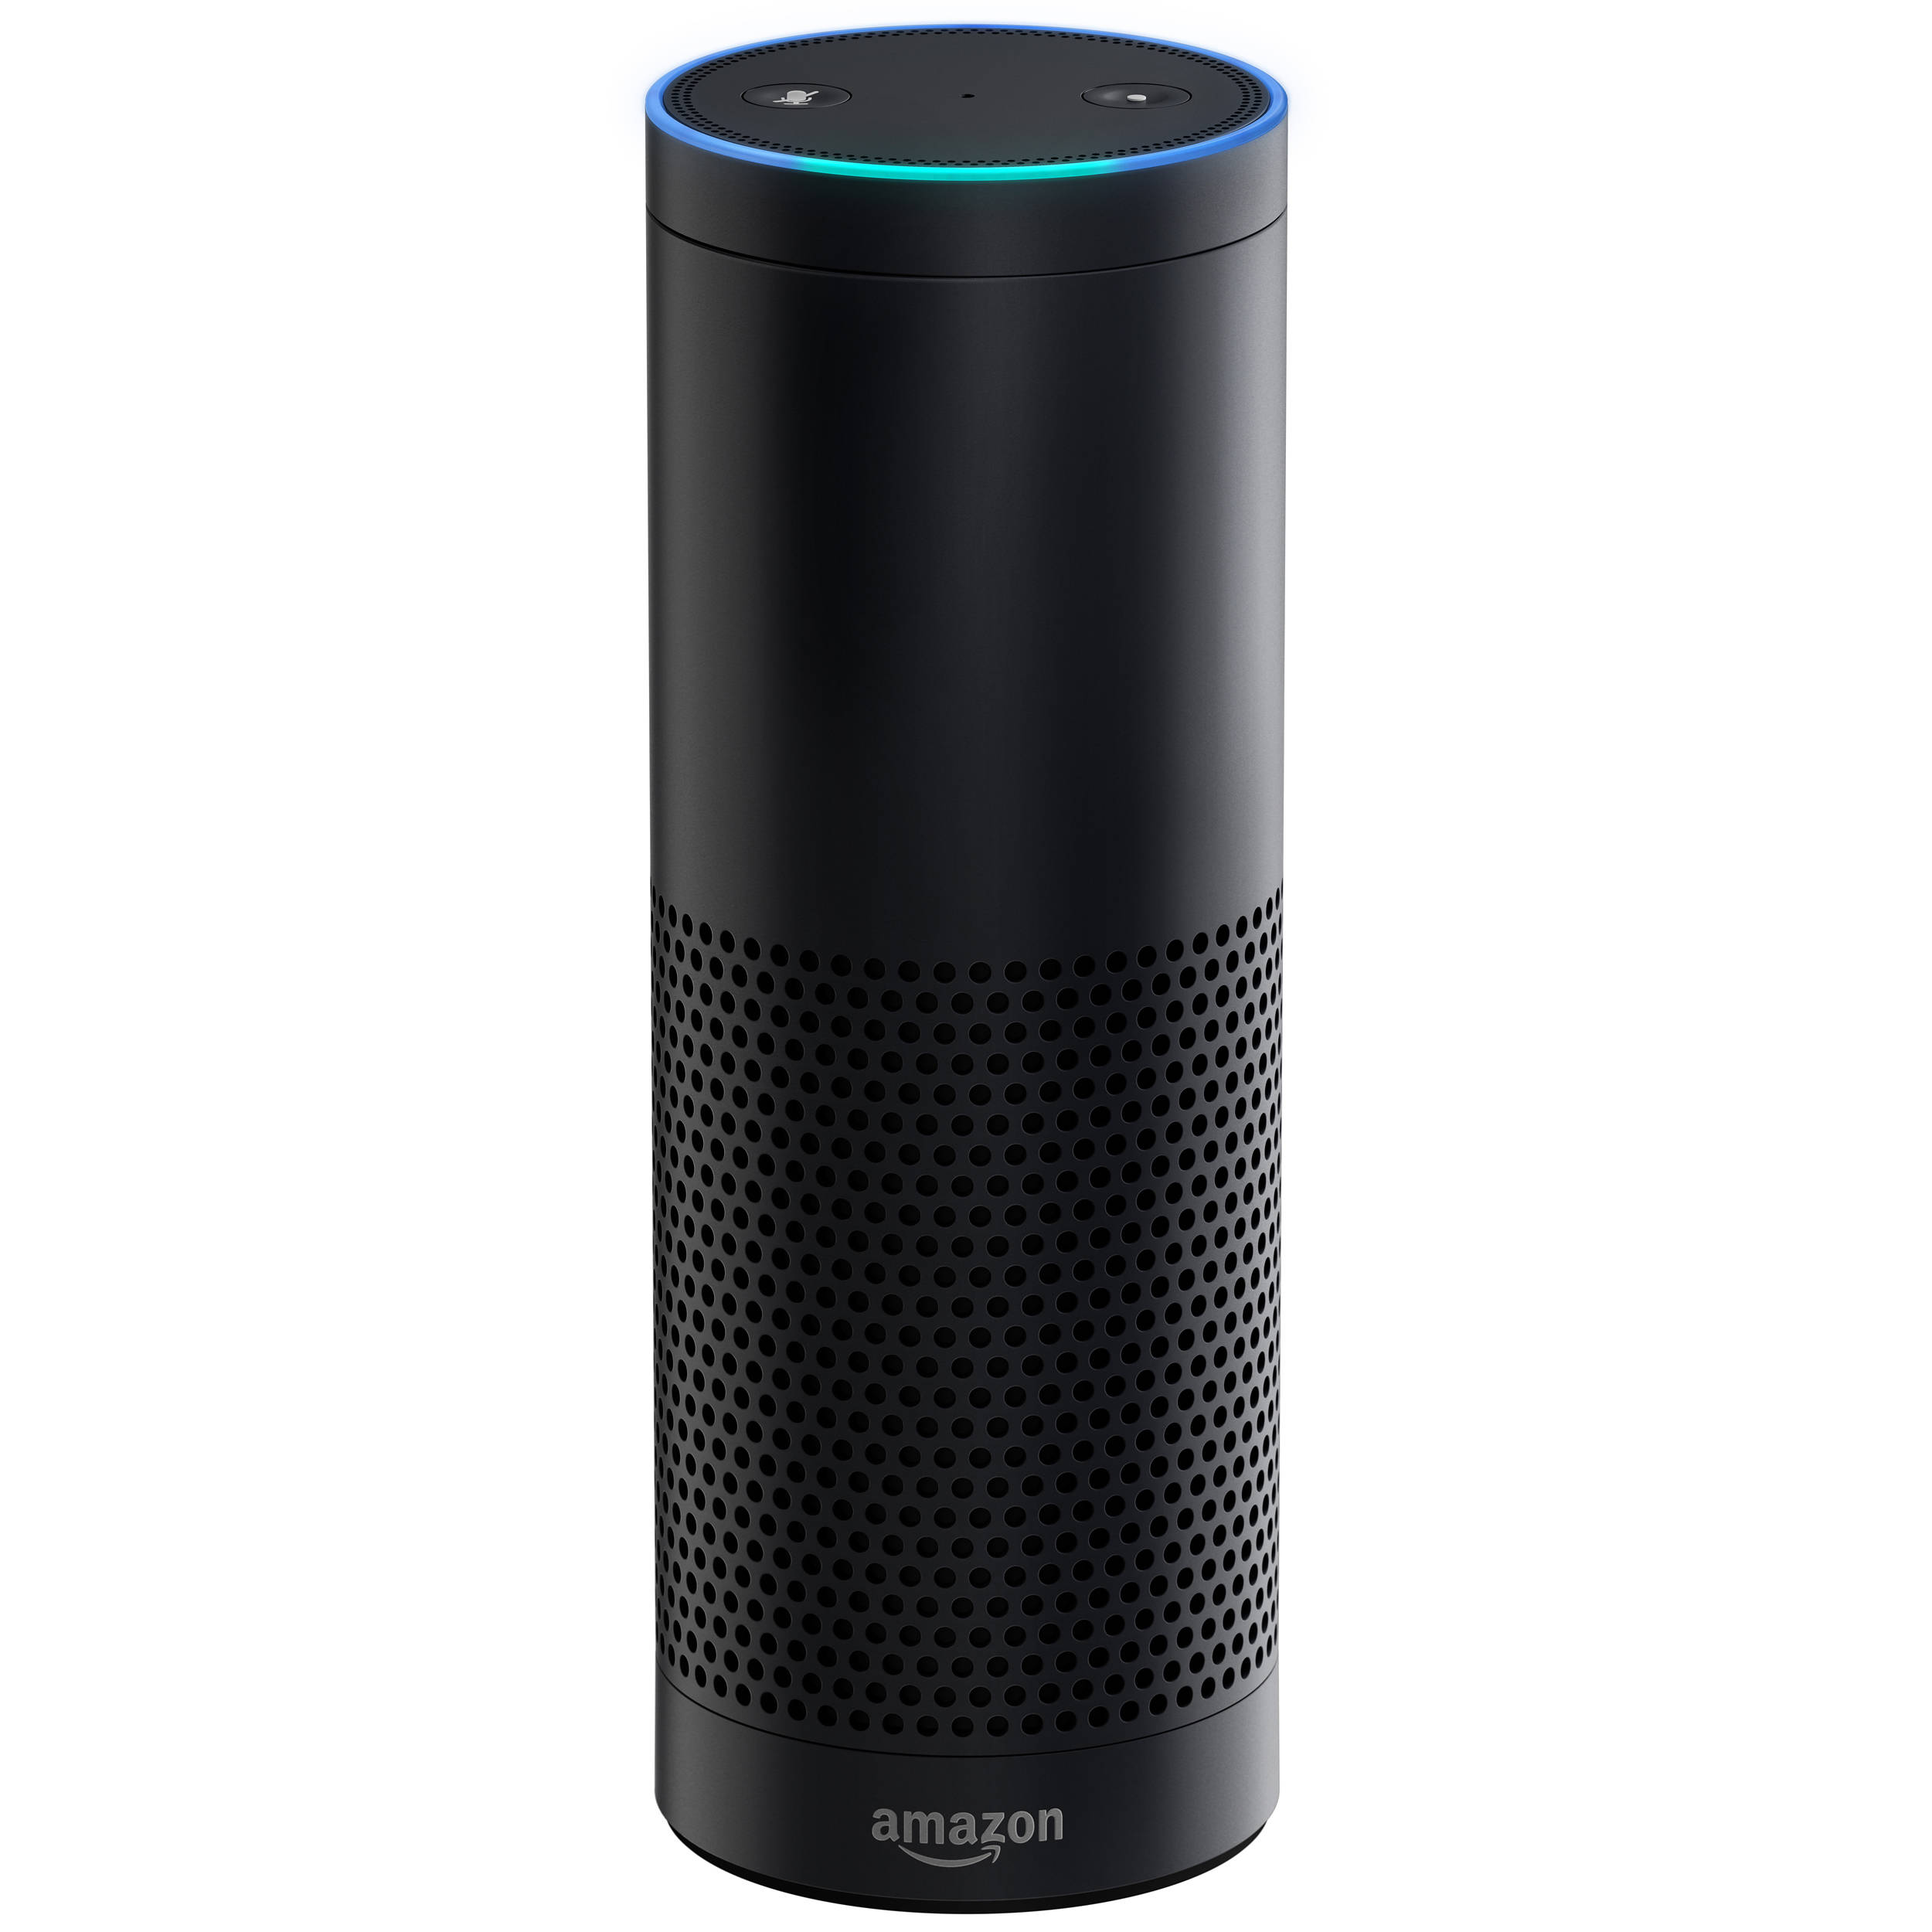
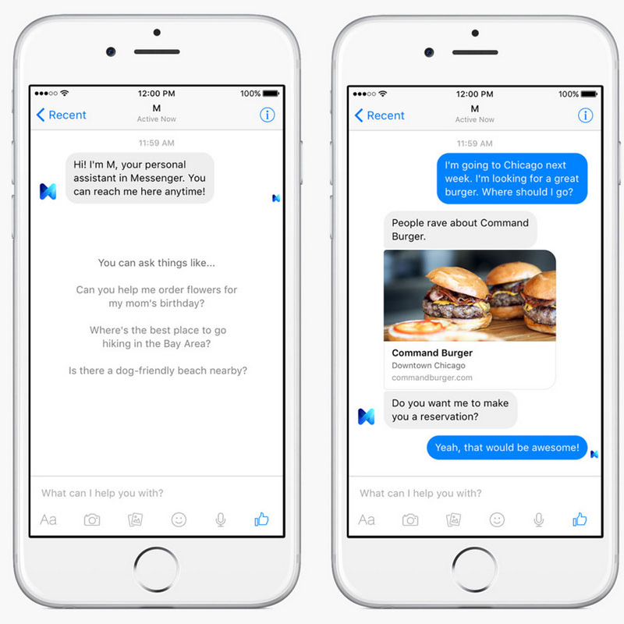
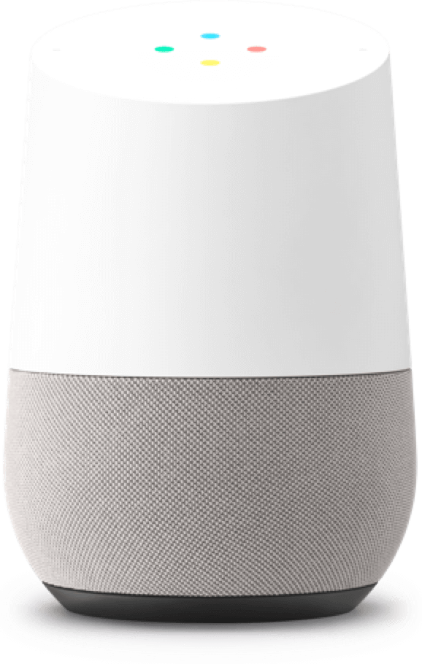
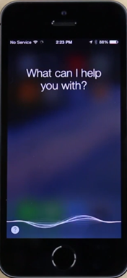
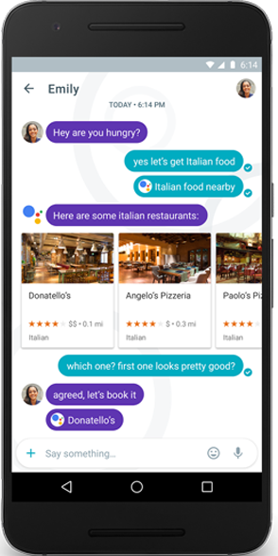
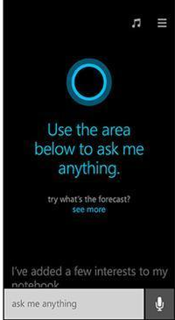
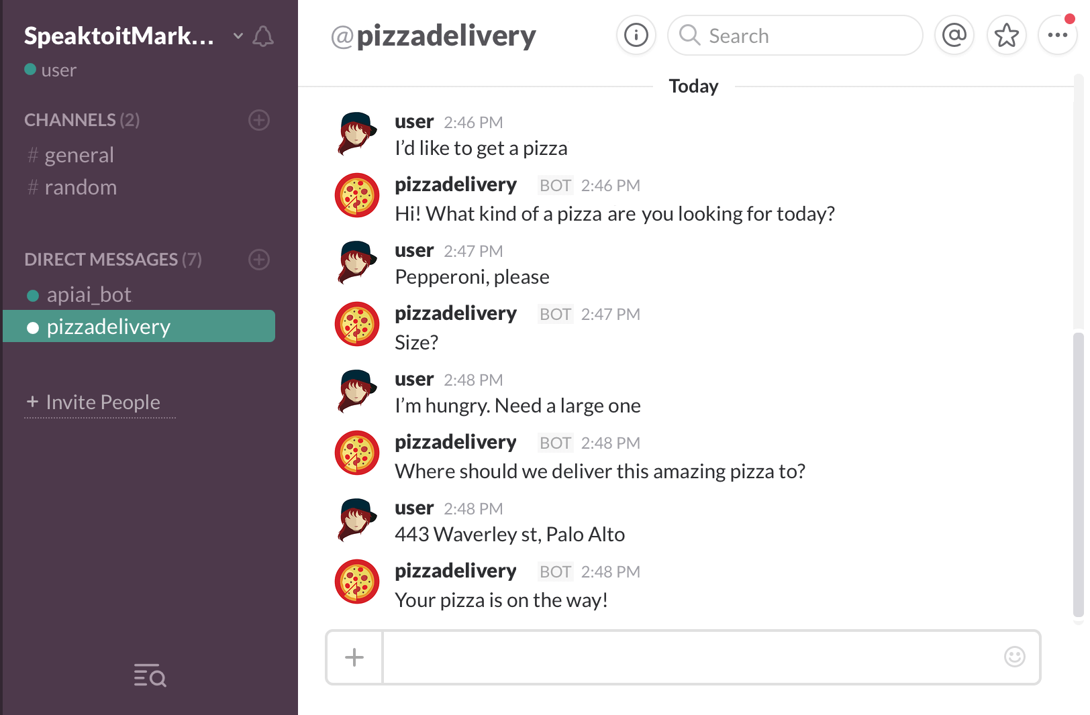
Conversational systems
Amazon Echo
2015
Google Home
2016
Facebook M
2015
Apple
Siri
2011
Google
Assistant
2016
Microsoft Cortana
2014
Slack Bot
2015

Slide 7
Google Duplex

Slide 8
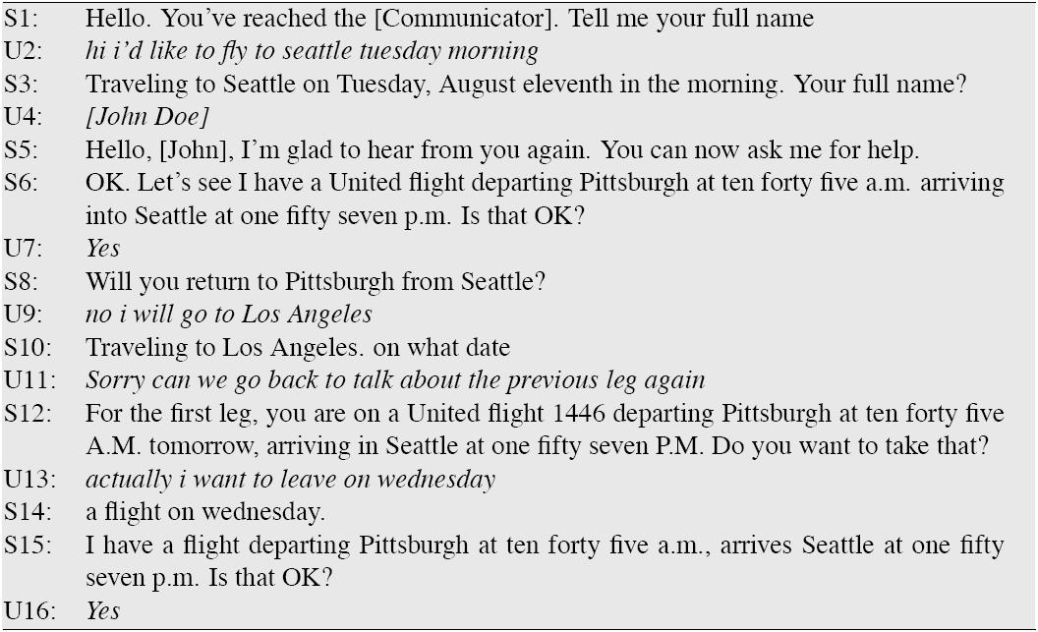
Travel Dialog Xu and Rudnicky (2000)

Slide 9
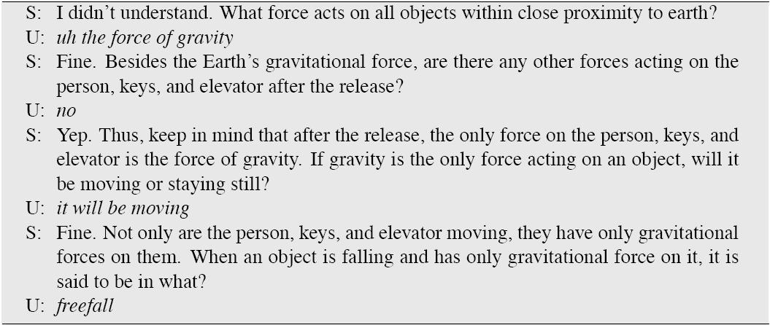
Tutorial dialogue: Litman and Silliman (2004)

Slide 10
Dialog Agent Design Issues
Time to response (Synchronous?)
Task complexity
What time is it?
Book me a flight and hotel for vacation in Greece
Interaction complexity / number of turns
Single command/response
“I want new shoes” What kind? What color? What size?
Initiative
User, System, Mixed
Interaction modality
Purely spoken, Purely text, Mixing speech/text/media

Slide 11
Spoken Synchronous Personal Assistants
Siri
Google Now
Microsoft Cortana
Amazon Alexa

Slide 12
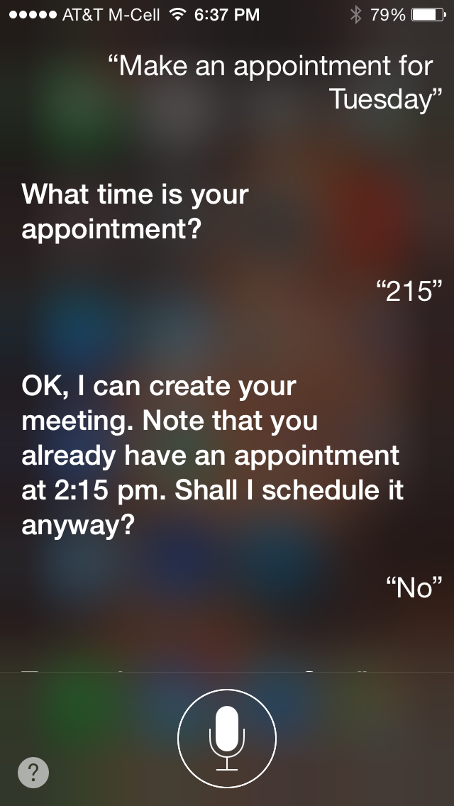

Slide 13
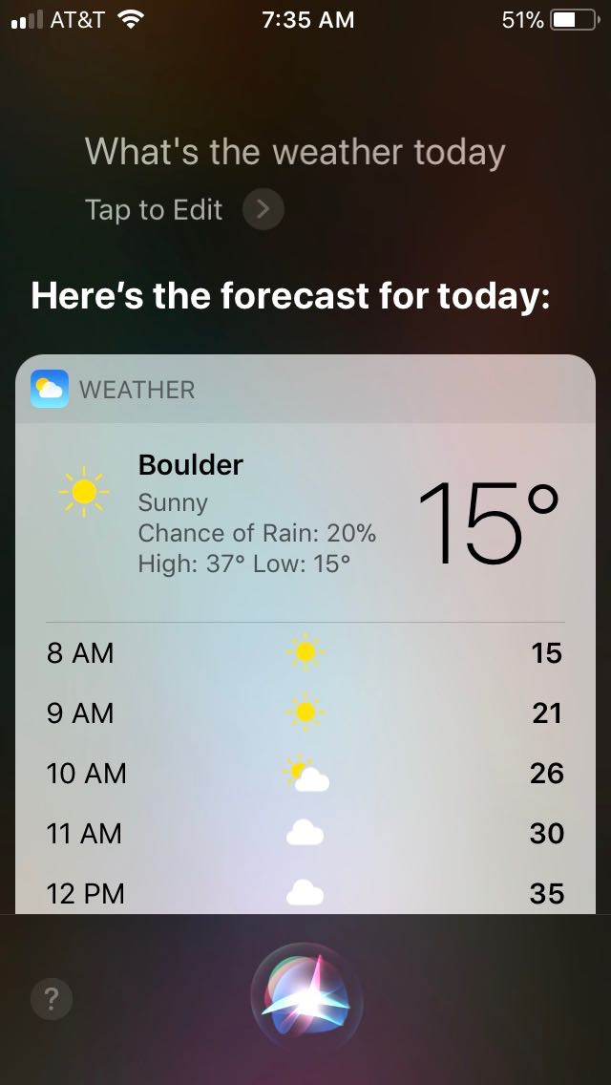
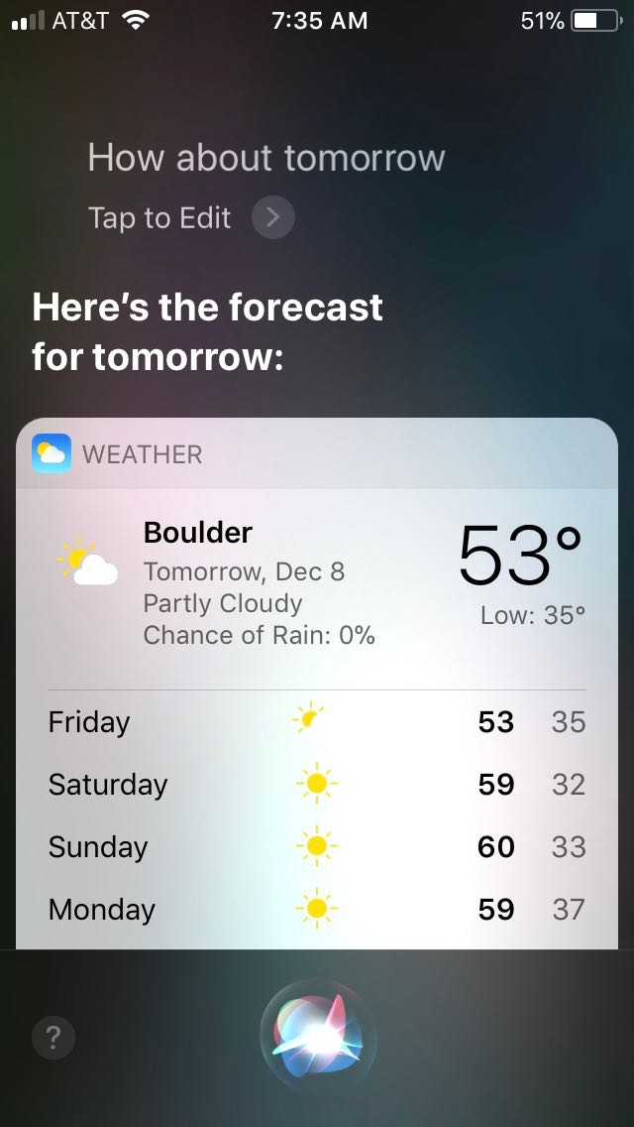

Slide 14
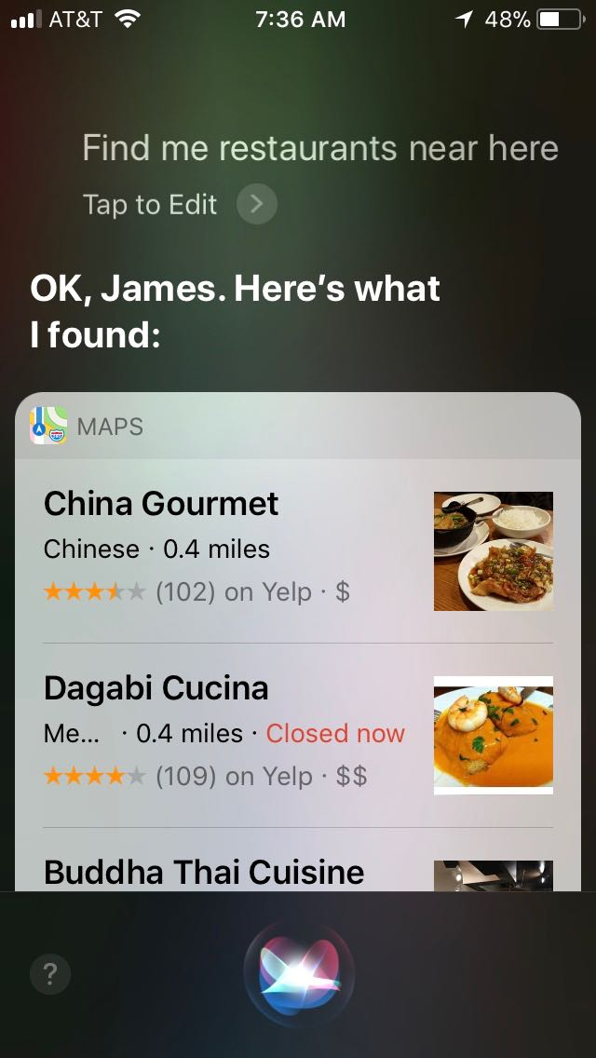
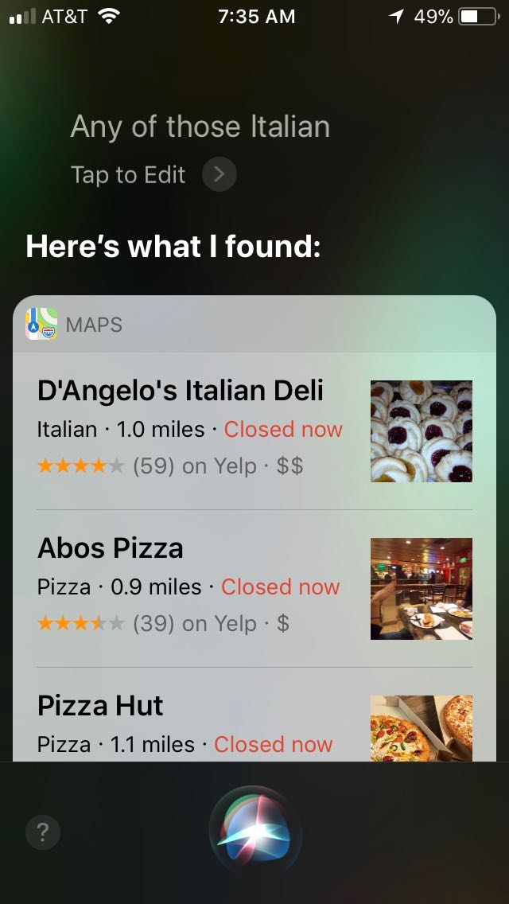

Slide 15
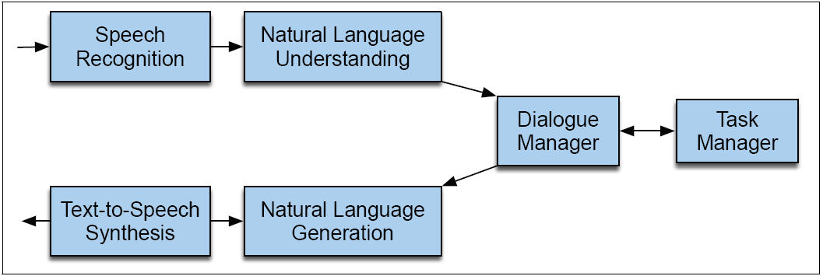
Dialogue System Architecture

Slide 16
Meaning Representation
There are many ways to represent knowledge of the application domain and the meaning of utterances in that domain
For speech dialogue systems, most common is “Frame and slot semantics”.
A simplified form of logic

Slide 17
Natural Language Understanding
For task-based agents
Classify the domain of the utterance
Weather, restaurants, flights, etc
Figure out the user’s intent
Make a dinner reservation
Fill the required slots
Dinner for 3 at 9PM

Slide 18
Frame Example
FLIGHT FRAME:
ORIGIN:
CITY: a city/airport
DATE: a date
TIME: temporal expression
DEST:
CITY: a city/airport
AIRLINE: airline

Slide 19
Frame Example
Show me morning flights from Boston to SF on Tuesday.
SHOW:
FLIGHTS:
ORIGIN:
CITY: Boston
DATE: Tuesday
TIME: morning
DEST:
CITY: San Francisco

Slide 20
Domains and Intents: Multiple Frames
Combine flights, hotels, rental cars
Flight legs: Each flight can have multiple legs, which might need to be discussed separately
Presenting the flights (If there are multiple flights meeting users constraints)
It has slots like 1ST_FLIGHT or 2ND_FLIGHT so user can ask “how much is the second one”
General route information:
Which airlines fly from Boston to San Francisco
Airfare practices:
Do I have to stay over Saturday to get a decent airfare?

Slide 21
Semantic Grammars
Context Free Grammar (CFG) where the non-terminals can be semantic categories:
LIST -> show me | I want | can I see|…
DEPARTTIME -> (after|around|before) HOUR | morning | afternoon | evening
HOUR -> one|two|three…|twelve (am|pm)
FLIGHTS -> (a) flight|flights
ORIGIN -> from CITY
DESTINATION -> to CITY
CITY -> Boston | San Francisco | Denver | Washington

Slide 22
Semantic Parse Trees

Slide 23
Semantic Parsing
System translates natural language into logical forms
System can act on structured logical forms
Modern approaches mix hand-engineered grammar generation with machine learning to map input text to output structured forms

Slide 24
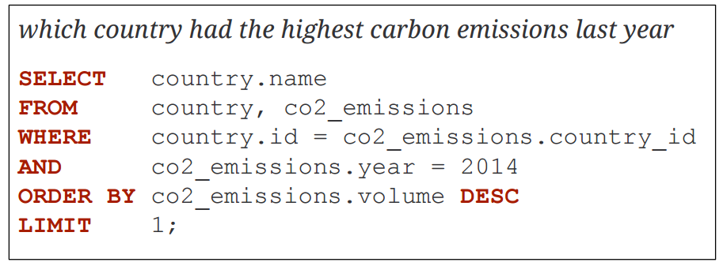
Semantic Parsing Database Query
Map natural language to database queries
Time consuming to build/train for a new schema, but a clean, clear formalism

Slide 25
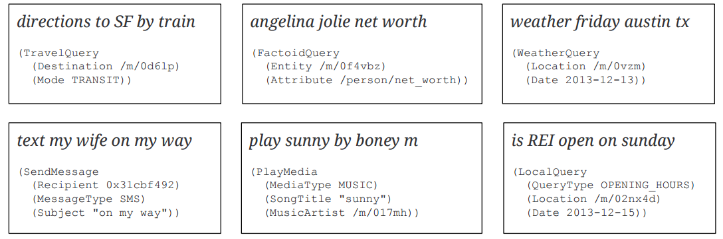
Semantic Parsing Intents and Arguments
Personal assistant voice commands are simple and need to scale to many domains
Simplicity helps with robustness and scale, just recognize what action and what required arguments for that action

Slide 26
Semantic Parsing Outline
Very active area of research
Define possible syntactic structures using a context-free grammar
Construct semantics bottom-up, following syntactic structure
Score parses with a (log-linear) model that was fit on training input, action/output pairs
Use external annotators to recognize names, dates, places, etc.
Grammar induction if possible, or lots of grammar engineering

Slide 27
Sequence Models for Semantics
Hidden units are slot names
ORIGIN
DESTCITY
DEPARTTIME
Observations are word sequences
on Tuesday
Train with IOB tagging

Slide 28
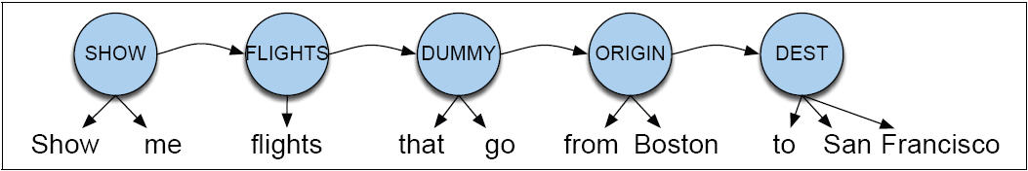
HMM Approach

Slide 29
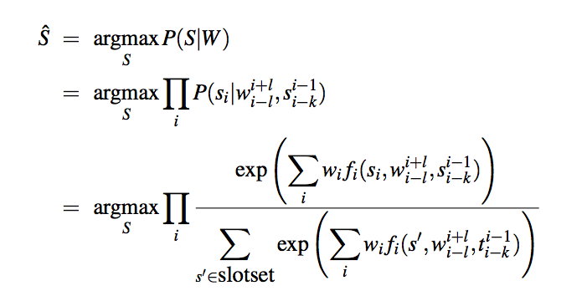
HMM Approach

Slide 30
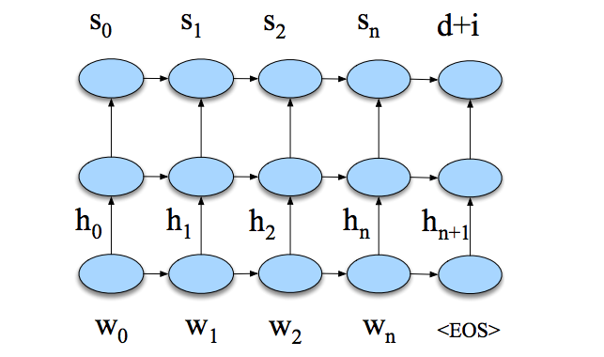
Neural Sequence Approach

Slide 31
Dialogue Manager
Controls the architecture and structure of dialogue
Takes input from ASR/NLU components
Maintains some sort of state in the form of frames/slots
Interfaces with Task Manager
Passes output to NLG/TTS modules
Primary task is to drive the interaction with the user to fill the slots needed to complete the task

Slide 32
Possible Architectures for Dialog Management
Finite State
Frame-based
Planning
Neural models

Slide 33
Finite State Dialog Management
Consider a trivial airline travel system:
Ask the user for a departure city
Ask for a destination city
Ask for a time
Ask whether the trip is round-trip or not

Slide 34
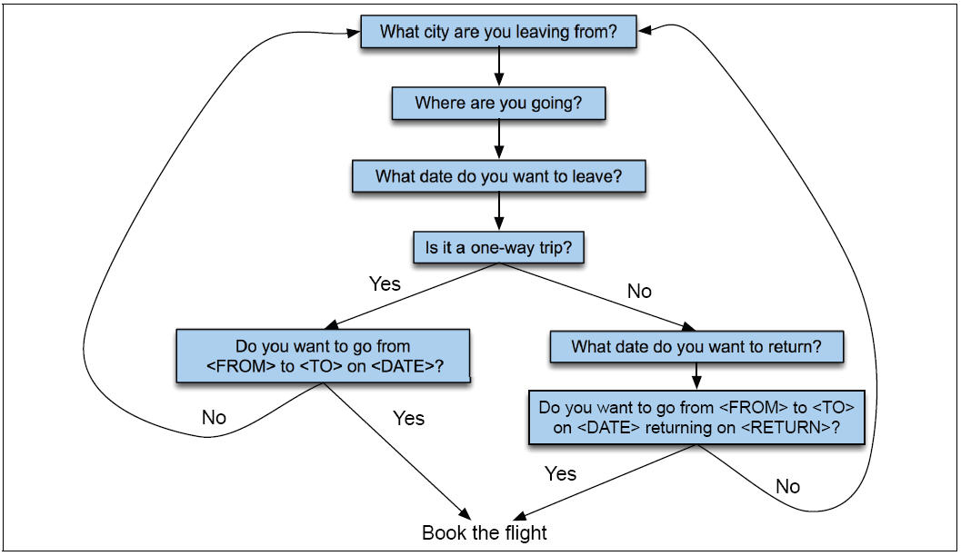
Finite State Dialog Manager

Slide 35
Finite State Dialog Managers
System completely controls the conversation with the user.
It asks the user a series of questions
Ignoring (or misinterpreting) anything the user says that is not a direct answer to the system’s questions

Slide 36
Dialogue Initiative
Systems that control conversation like this are system initiative or single initiative.
Initiative: who has control of conversation
In normal human-human dialogue, initiative shifts back and forth between participants.

Slide 37
System Initiative
System completely controls the conversation
Simple to build
User always knows what they can say next
System always knows what user can say next
OK for VERY simple tasks (entering a credit card, or login name and password)
Too limited for more complex interactions

Slide 38
Single Initiative + Universals
We can give users a little more flexibility by adding universals: commands you can say anywhere
As if we augmented every state of FSA with these
Help
Start over
Correct
Operator
This is included in many implemented systems
But still doesn’t allow user much flexibility

Slide 39
Problems with System Initiative
Real dialogue involves give and take!
In travel planning, users might want to say something that is not the direct answer to the question.
For example answering more than one question in a sentence:
Hi, I’d like to fly from Seattle Tuesday morning
I want a flight from Milwaukee to Orlando one way leaving after 5 p.m. on Wednesday.

Slide 40
User Initiative
User directs the system
Asks a single question, system answers
But system can’t:
ask questions back,
engage in clarification dialogue,
engage in confirmation dialogue

Slide 41
Mixed Initiative
Conversational initiative can shift between system and user
Simplest kind of mixed initiative: use the structure of the frame to guide dialogue

Slide 42
Mixed Initiative
Conversational initiative can shift between system and user
Simplest kind of mixed initiative: use the structure of the frame to guide dialogue
Slot Question
ORIGIN What city are you leaving from?
DEST Where are you going?
DEPT DATE What day would you like to leave?
DEPT TIME What time would you like to leave?
AIRLINE What is your preferred airline?

Slide 43
Frames Allow Mixed Initiative
User can answer multiple questions at once.
System asks questions of user, filling any slots that user specifies
When frame is filled, do database query
If user answers 3 questions at once, system has to fill slots and not ask these questions again!
Avoids strict constraints on order of the finite-state architecture.

Slide 44
Evaluation
Slot Error Rate for a Sentence
# of inserted/deleted/subsituted slots
# of total reference slots for sentence
End-to-end evaluation (Task Success)

Slide 45
Evaluation Metrics
“Make an appointment with Bobby at 10:30 in ECAD 104”
Slot | Filler
PERSON | Bobby
TIME | 11:30 a.m.
ROOM | ECAD 104
Slot error rate: 1/3
Task success: At end, was the correct meeting added to the calendar?

Slide 46
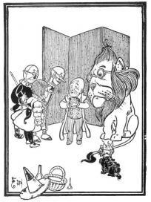
Design Issues
Specify/study proposed task and potential users
Prototype/gather data
WOZ studies
Deploy/test/iterate

