Slide 1
Natural Language Processing
CSCI 5832—Lecture 27
Jim Martin

Slide 2
Quiz 3 Readings
Semantics
Chapter 14
Skip 14.4.1, 14.4.2, 14.5
Chapter 18 (moodle link, not on web)
Just 18.1 and 18.2
Information Extraction
Chapter 17
Skip 17.2.5, 17.3, 17.4, 17.5
MT and Encoder/Decoder Networks
Koehn chapter: Focus on 13.5
Q/A
Chapter 23
Dialog
Chapter 24
Skip 24.3

Slide 3
Today
HW questions?
What exactly is being evaluated?
How can I improve?
What kinds of errors is your system making?
Sources
Pre-processing?
Smoothing issues?
Unknowns?
Tools
Recall/Precision/F1
Confusion Matrix

Slide 4
Today
What is question answering?

Slide 5
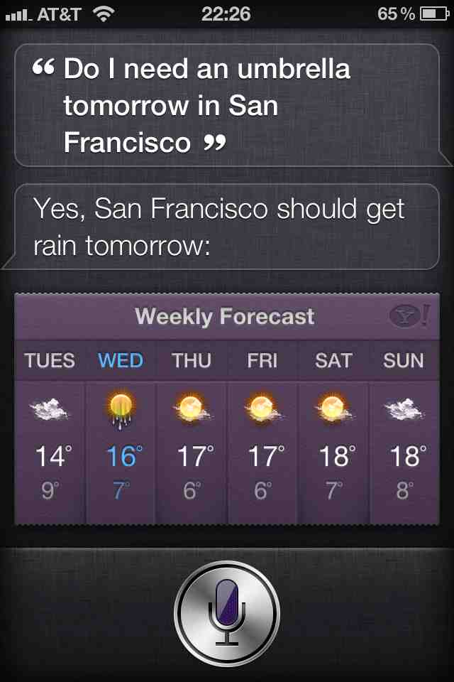
Apple’s Siri

Slide 6
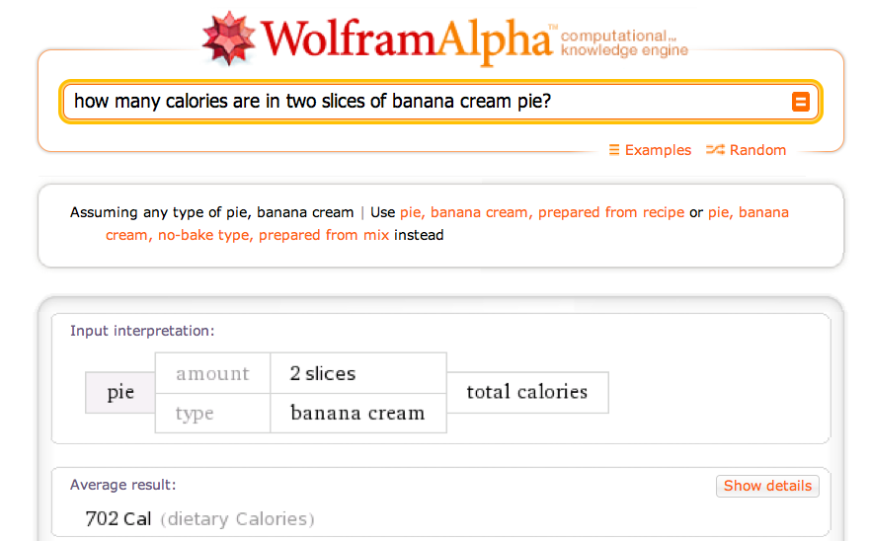
Wolfram Alpha

Slide 7
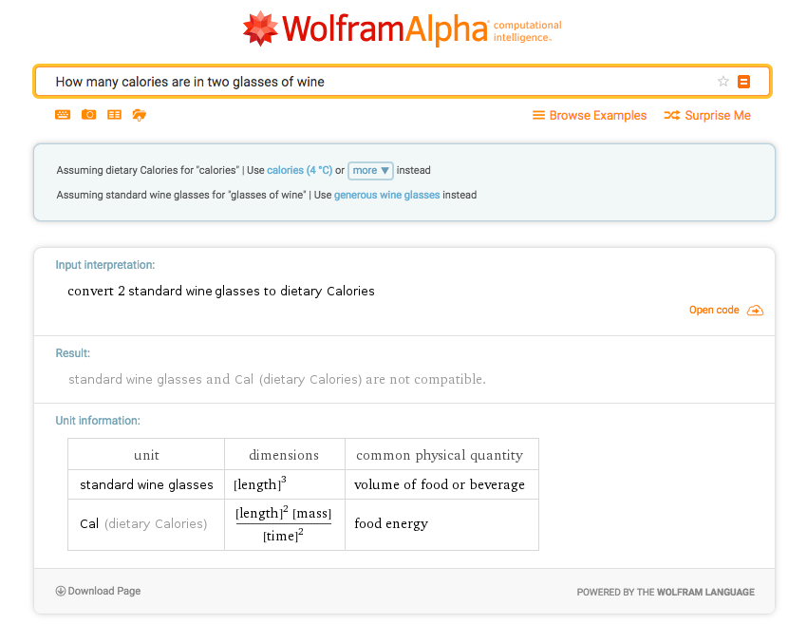
Wolfram Alpha

Slide 8
IBM’s Watson
Won Jeopardy on February 16, 2011!
WILLIAM WILKINSON’S
“AN ACCOUNT OF THE PRINCIPALITIES OF WALLACHIA AND MOLDOVIA”
INSPIRED THIS AUTHOR’S
MOST FAMOUS NOVEL
Bram Stoker

Slide 9
Video

Slide 10
Types of Questions
Factoid questions
Who wrote “The Universal Declaration of Human Rights”?
How many calories are there in two slices of apple pie?
What is the average age of the onset of autism?
Where is Apple Computer based?

Slide 11
Types of Questions
Complex narrative questions:
In children with an acute febrile illness, what is the efficacy of acetaminophen in reducing fever?
What do scholars think about Jefferson’s approach to dealing with pirates?

Slide 12
Paradigms for QA
IR-based approaches
TREC; IBM Watson; Google
Knowledge-based and Hybrid approaches
IBM Watson; Apple Siri; Wolfram Alpha;

Slide 13
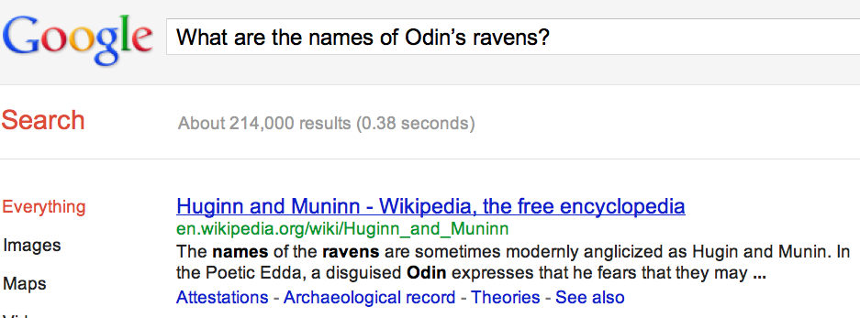
Web Search
a

Slide 14
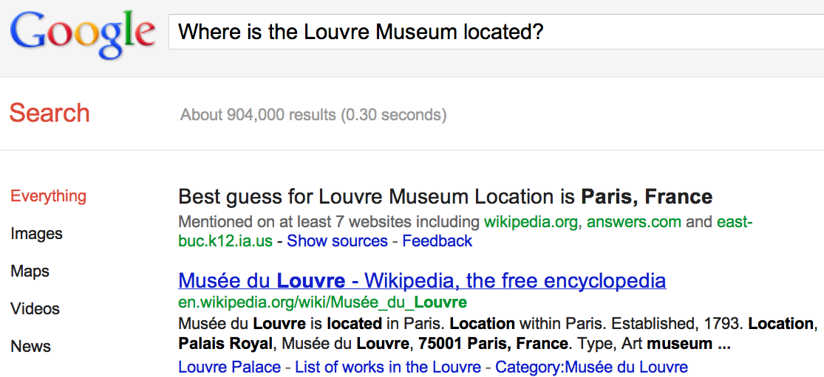
IR-Based QA

Slide 15
IR-Based Factoid QA

Slide 16
IR-Based Factoid QA
QUESTION PROCESSING
Detect question type, answer type, focus, relations
Formulate queries to send to a search engine
PASSAGE RETRIEVAL
Retrieve ranked documents
Break into suitable passages and rerank
ANSWER PROCESSING
Extract candidate answers
Rank candidates
using evidence from the text and external sources

Slide 17
Knowledge-Based Approaches Task-Oriented Slot-Fillers
Build a semantic representation of the query
Times, dates, locations, entities, numeric quantities
Map from this semantics to query structured data or resources
Geospatial databases
Ontologies (Wikipedia infoboxes, dbPedia, WordNet, Yago)
Restaurant review sources and reservation services
Scientific databases

Slide 18
Hybrid Approaches (IBM Watson)
Build a shallow semantic representation of the query
Generate answer candidates using IR methods
Augmented with ontologies and semi-structured data
Score each candidate using richer knowledge sources
Geospatial databases
Temporal reasoning
Taxonomical classification

Slide 19
Factoid Q/A

Slide 20
Question Processing
Answer Type Detection
Decide the named entity type (person, place) of the answer
Query Formulation
Choose query keywords for the IR system
Question Type classification
Is this a definition question, a math question, a list question?
Focus Detection
Find the question words that are replaced by the answer
Relation Extraction
Find relations between entities in the question

Slide 21
Question Processing
They’re the two states you could be entering if you’re crossing Florida’s northern border
Answer Type: US state
Query: two states, border, Florida, north
Focus: the two states
Relations: borders(Florida, ?x, north)

Slide 22
Answer Type Detection
Who founded Virgin Airlines?
PERSON
What Canadian city has the largest population?
CITY

Slide 23
Answer Type Taxonomy
6 coarse classes
ABBEVIATION, ENTITY, DESCRIPTION, HUMAN, LOCATION, NUMERIC
50 finer classes
LOCATION: city, country, mountain…
HUMAN: group, individual, title, description
ENTITY: animal, body, color, currency…

Slide 24
Answer Type Taxonomy

Slide 25
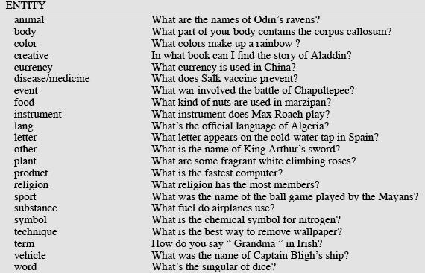
Answer Types

Slide 26
Answer Types in Jeopardy
he, country, city, man, film, state, she, author, group, here, company, president, capital, star, novel, character, woman, river, island, king, song, part, series, sport, singer, actor, play, team, show, actress, animal, presidential, composer, musical, nation, book, title, leader, game
2500 answer types in 20,000 Jeopardy question sample
The most frequent 200 answer types cover < 50% of data
40 most frequent Jeopardy answer types

Slide 27
Answer Type Detection
Hand-written rules
Machine Learning
Hybrids

Slide 28
Answer Type Detection
Regular expression-based rules can get some cases:
Who {is|was|are|were} PERSON
PERSON (YEAR – YEAR)
Other rules use the question headword:
(the headword of the first noun phrase after the wh-word)
Which city in China has the largest number of foreign financial companies?
What is the state flower of California?

Slide 29
Answer Type Detection
Most often, we treat the problem as machine learning classification
Define a taxonomy of question types
Annotate training data for each question type
Train classifiers for each question class using a rich set of features.
features include those hand-written rules!

Slide 30
Keyword Selection
1. Select all non-stop words in quotations
2. Select all NNP words in recognized named entities
3. Select all complex nominals with their adjectival modifiers
4. Select all other complex nominals
5. Select all nouns with their adjectival modifiers
6. Select all other nouns
7. Select all verbs
8. Select all adverbs
9. Select the QFW word (skipped in all previous steps)
10. Select all other words

Slide 31
Factoid Q/A

Slide 32
Passage Retrieval
Step 1: Search engine retrieves documents using query terms
Step 2: Segment the documents into shorter units
something like paragraphs
Step 3: Passage ranking
Use answer type to help rerank passages

Slide 33
Answer Extraction
Run an answer-type named-entity tagger on the passages
Each answer type requires a named-entity tagger that detects it
If answer type is CITY, tagger has to tag CITY
Can be full NER, simple regular expressions, or hybrid
Return the string with the right type:
Who is the prime minister of India (PERSON)
Manmohan Singh, Prime Minister of India, had told left leaders that the deal would not be renegotiated.
How tall is Mt. Everest? (LENGTH)
The official height of Mount Everest is 29035 feet

Slide 34
Ranking Candidate Answers
But what if there are multiple conflicting candidate answers?
Q: Who was Queen Victoria’s second son?
Answer Type: Person
Passage:
The Marie biscuit is named after Marie Alexandrovna, the daughter of Czar Alexander II of Russia and wife of Alfred, the second son of Queen Victoria and Prince Albert

Slide 35
Ranking Candidate Answers
But what if there are multiple candidate answers!
Q: Who was Queen Victoria’s second son?
Answer Type: Person
Passage:
The Marie biscuit is named after Marie Alexandrovna, the daughter of Czar Alexander II of Russia and wife of Alfred, the second son of Queen Victoria and Prince Albert

Slide 36
Machine Learning: Ranking
Answer type match: Candidate contains a phrase with the correct answer type.
Pattern match: Regular expression pattern matches the candidate.
Question keywords: # of question keywords in the candidate.
Keyword distance: Distance in words between the candidate and query keywords
Novelty factor: A word in the candidate is not in the query.
Apposition features: The candidate is an appositive to question terms
Punctuation location: The candidate is immediately followed by a comma, period, quotation marks, semicolon, or exclamation mark.
Sequences of question terms: The length of the longest sequence of question terms that occurs in the candidate answer.

Slide 37
IBM Watson Architecture
Won Jeopardy on February 16, 2011!
WILLIAM WILKINSON’S
“AN ACCOUNT OF THE PRINCIPALITIES OF WALLACHIA AND MOLDOVIA”
INSPIRED THIS AUTHOR’S
MOST FAMOUS NOVEL
Bram Stoker

Slide 38
Watson Architecture

Slide 39
Stage 1: Question Processing
Parsing
Named Entity Tagging
Relation Extraction
Focus Extraction
Answer Type
Question Classification

Slide 40
Lexical Answer Type
The semantic class of the answer
But for Jeopardy the TREC answer
type taxonomy is insufficient
DeepQA team investigated 20,000 questions
100 named entities only covered <50% of the questions!
Instead: Extract lots of words: 5,000 for those 20,000 questions

Slide 41
Extracting Answers from Documents
Fun fact: Jeopardy! answers are mostly the title of a Wikipedia document
If the document is a Wikipedia article, just take the title
If not, extract all noun phrases in the passage that are Wikipedia document titles

Slide 42
Answer Scoring
Build a classifier to take answers and a score vector and assign a probability
Train on datasets of hand-labeled correct and incorrect answers.

