Slide 1
LinkedIn Advertising Strategy for TechFlow Innovations
Performance Analysis & Strategic Recommendations
Automotive Industry
Generated by LinkedIn Ads Sales Agent

Slide 2
Executive Summary
Key Findings:
• Current monthly ad spend: $19,835 if current_perf else 'N/A'
• Revenue growth: -32.2% over analysis period
• ROAS vs industry benchmark: -37.6%
• 4 strategic recommendations identified
Opportunity: Potential to increase ROI by 25-35% through targeted optimizations
Primary Focus Areas:
• Audience targeting refinement
• Creative optimization for higher engagement
• Budget reallocation to high-performing segments

Slide 3
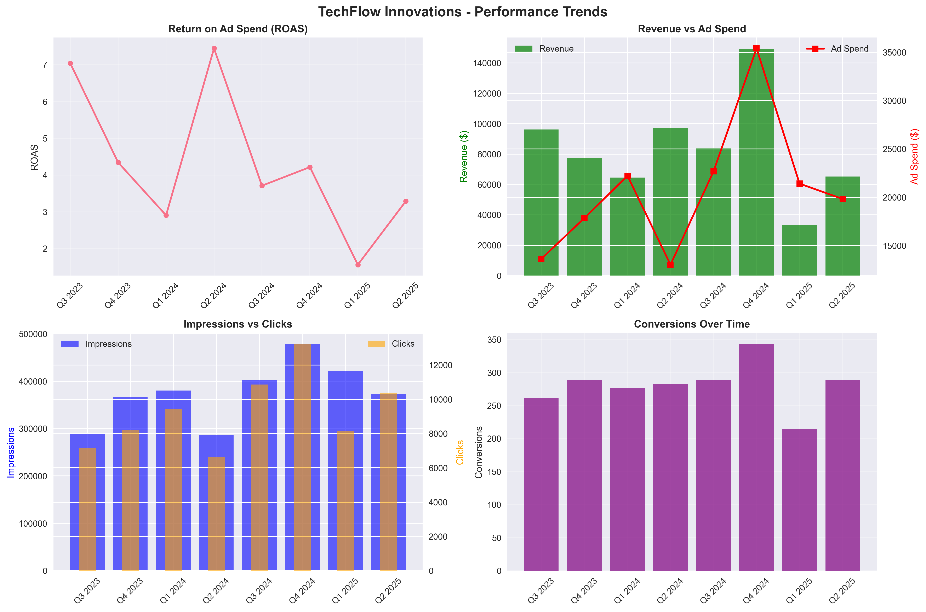
Performance Trends Analysis

Slide 4
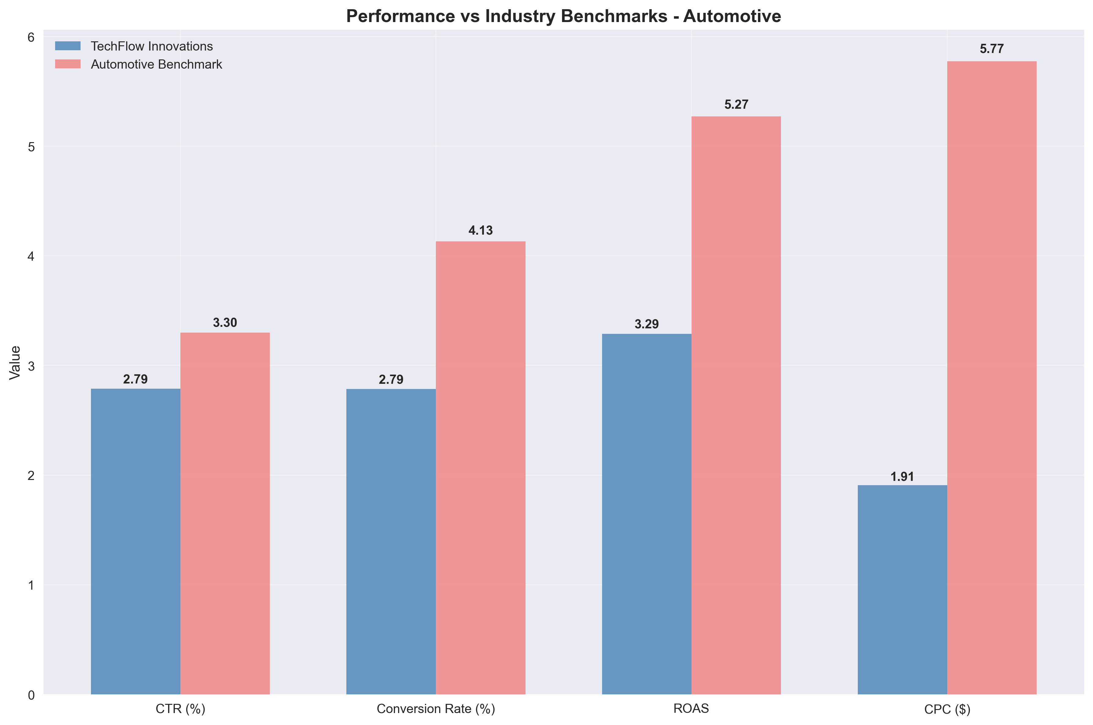
Performance vs Automotive Benchmarks

Slide 5
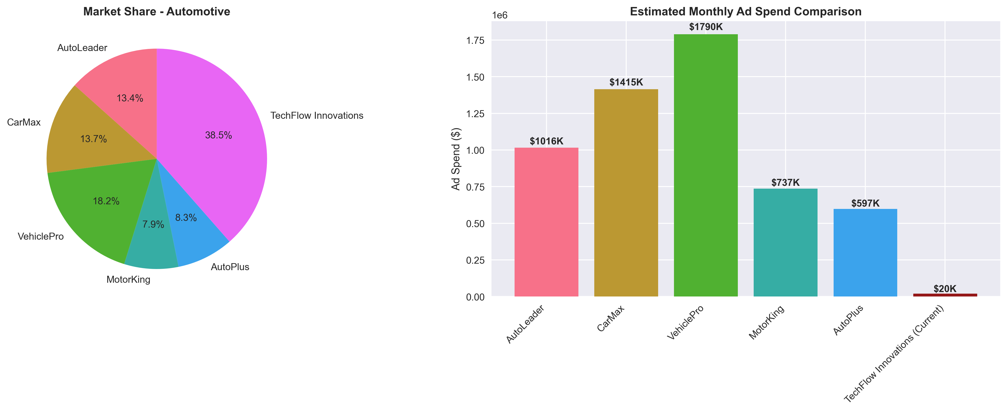
Competitive Landscape Analysis

Slide 6
Recommendation 1: Optimize Audience Targeting for Higher CTR
Priority: High
Description:
Refine your LinkedIn audience targeting by leveraging job titles, skills, and company sizes that align with your Car Buyers. Implement lookalike audiences based on your highest-converting prospects.
Expected Impact:
Increase CTR by 25-40% and improve conversion quality by reaching more qualified prospects.
Estimated ROI Increase: +30.0%
Implementation Timeline: 2-3 weeks

Slide 7
Recommendation 2: A/B Test Video and Carousel Ad Formats
Priority: High
Description:
LinkedIn video ads typically achieve 3x higher engagement. Test video testimonials, product demos, and carousel ads showcasing multiple value propositions to increase engagement rates.
Expected Impact:
Boost engagement rates by 45-60% and improve brand recall among target audience.
Estimated ROI Increase: +25.0%
Implementation Timeline: 3-4 weeks

Slide 8
Recommendation 3: Implement LinkedIn-Specific Landing Page Optimization
Priority: High
Description:
Create dedicated landing pages for LinkedIn traffic with B2B-focused messaging, social proof, and streamlined conversion forms. Implement LinkedIn Insight Tag for better attribution.
Expected Impact:
Increase conversion rates by 30-50% through better message matching and user experience.
Estimated ROI Increase: +35.0%
Implementation Timeline: 4-6 weeks

Slide 9
Recommendation 4: Reallocate Budget to High-Performing Campaigns
Priority: Medium
Description:
Based on performance analysis, increase budget allocation to campaigns targeting Car Buyers during peak engagement periods. Reduce spend on underperforming segments.
Expected Impact:
Improve overall ROAS by 20-30% through more efficient budget distribution.
Estimated ROI Increase: +22.0%
Implementation Timeline: 1 week

Slide 10
Next Steps & Implementation
Immediate Actions (Next 30 Days):
1. Schedule strategy review meeting to discuss recommendations
2. Prioritize implementation based on business impact and resources
3. Set up performance tracking for recommended optimizations
4. Begin A/B testing for creative and audience optimizations
LinkedIn Partnership Benefits:
• Dedicated account management support
• Access to beta features and advanced targeting options
• Regular performance reviews and optimization recommendations
• Industry benchmark reports and competitive insights
Contact your LinkedIn representative to begin implementation.

