Slide 1
Software Development Life Cycle (SDLC)
-sayali yadav

Slide 2
SDLC
Software Development Life Cycle (SDLC) is a systematic process used for developing software applications.
It provides a structured approach to software development, ensuring quality and efficiency in the development process.
The SDLC typically consists of several phases, each with specific deliverables and objectives.
Importance of SDLC:
Ensures a structured and disciplined approach to software development.
Improves the quality of the software and reduces risks.
Enhances communication and collaboration among team members and stakeholders.
Provides a framework for project management and resource allocation.

Slide 3
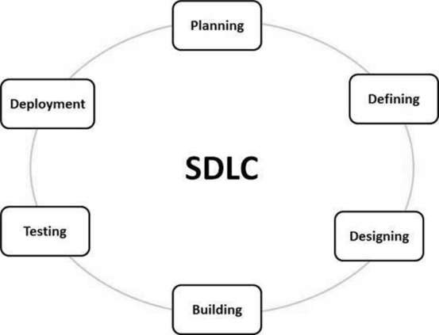

Slide 4

Phases Of SDLC
1.PLANNING
This phase involves defining the scope and objectives of the project.
It serves as the foundation for the entire software development process.
To establish a clear understanding of what the project aims to achieve, assess feasibility, and allocate resources effectively.
This ensures that everyone involved has a shared vision of the project.
2. Requirements Analysis
In this phase, the needs and expectations of stakeholders are gathered and documented.
This includes functional (what the system should do) and non-functional (how the system should perform) requirements.
To ensure that all stakeholder needs are understood and addressed.
This helps in minimizing misunderstandings later in the development process and ensures the final product meets user expectations.

Slide 5
Phases Of SDLC
3.DESIGN
The design phase translates the requirements into a blueprint for building the software.
This includes architecture, user interface design, and database design.
To create a detailed plan that guides developers on how to implement the software.
A good design helps ensure that the software is scalable, maintainable, and user-friendly.
4. Implementation (Coding)
This phase involves the actual development of the software, where programmers write code based on the design specifications.
To build the software application according to the defined requirements and design.
It involves translating the design into a functional software product.

Slide 6
Phases Of SDLC
5.TESTING
In this phase, the software is rigorously tested to identify and fix defects or bugs. Various types of testing (unit, integration, system, and user acceptance) are performed.
To ensure that the software is of high quality, functions as intended, and meets the requirements.
Testing helps to catch errors before the software is deployed, reducing the risk of failure.
6. Deployment
This phase involves releasing the completed software to the production environment where users can access and use it.
To make the software available to its intended audience.
Deployment may include installation, configuration, and training users on how to use the system.

Slide 7
Phases Of SDLC
7. MAINTENANCE
After deployment, the software enters the maintenance phase, where ongoing support, updates, and bug fixes are provided.
To ensure the software continues to operate effectively and remains relevant to user needs.
Maintenance includes addressing issues, implementing enhancements, and adapting the software to changing requirements.

Slide 8
SDLC MODELS
Waterfall Model:
Description: The Waterfall model is a traditional linear and sequential approach. In this model, the development process is divided into distinct phases (e.g., requirements gathering, design, implementation, testing, deployment, and maintenance). Each phase must be completed before the next begins, and there is no going back to previous phases once completed.
When to Use: It’s best suited for projects with well-defined and unchanging requirements, such as government or construction projects, where changes are unlikely.

Slide 9
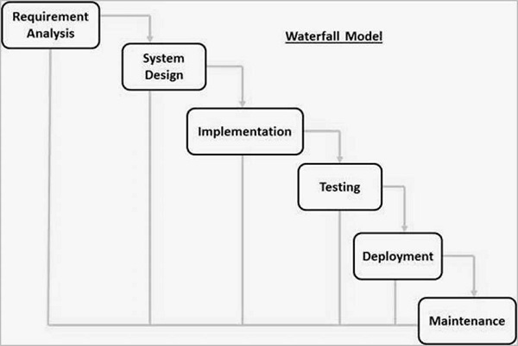

Slide 10
SDLC MODELS
Agile Model:
Description: Agile is an iterative and incremental approach that promotes flexibility, collaboration, and customer feedback throughout the development process. It breaks the project into smaller chunks called "sprints," each delivering a functional piece of software. After each sprint, feedback is gathered, and the product is refined accordingly.
When to Use: Ideal for projects where requirements are expected to evolve, such as startups or projects with dynamic customer needs.

Slide 11
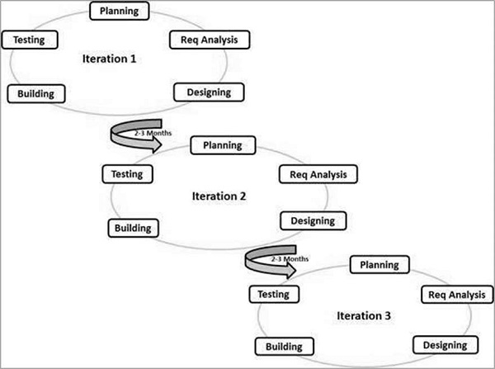

Slide 12
SDLC MODELS
Spiral Model:
Description: The Spiral model combines the iterative nature of Agile with the structured and systematic approach of Waterfall. It focuses on risk assessment by going through several development spirals or cycles. Each cycle includes planning, risk analysis, engineering, testing, and evaluation.
When to Use: Best for large, complex projects with high-risk factors (e.g., defense or aerospace applications).

Slide 13
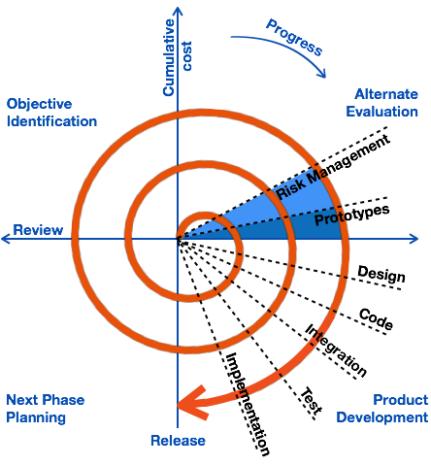

Slide 14
SDLC MODELS
V-Model (Verification and Validation Model):
Description: The V-Model is an extension of the Waterfall model that emphasizes testing and validation at each stage of development. Each development phase (such as design or implementation) has a corresponding testing phase (like unit testing or system testing), ensuring that verification and validation occur at every step.
When to Use: Ideal for projects where quality and reliability are paramount, such as safety-critical systems (e.g., medical devices, aviation software).

Slide 15
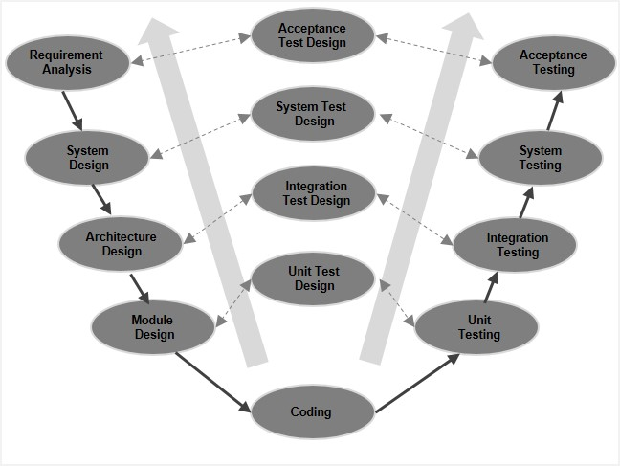

Slide 16
SDLC MODELS
Incremental Model:
Description: In the Incremental model, the software is developed and delivered in small, functional pieces or increments. Each increment is treated as a mini-project that goes through the Software Development Life Cycle (SDLC) phases. Over time, the full system is built by integrating these increments.
When to Use: Suitable for projects where the product can be broken down into smaller parts and delivered incrementally, such as web applications or e-commerce platforms.

Slide 17
