Slide 1
Employee Attrition
Analytics Platform
Predict who may leave, deploy the model, and act early
Sayali Chimbalkar
PRN: 2124UDSF2014
Notes:
Introduce the project: an end-to-end platform that predicts attrition and gives HR a dashboard and API.

Slide 2
Why attrition matters
1470
237
16.1%
Late
employees in the dataset
employees have left
attrition rate
HR learns after the resignation
Every exit costs recruiting, onboarding and lost productivity.
Goal: predict risk for every employee, group into Low / Medium / High, and let HR act before people leave.
Success: high recall on leavers, good ROC-AUC, an explainable score, and a deployed, retrained pipeline.
Notes:
Explain that attrition is costly and HR currently learns about it only after resignation. Dataset is the IBM HR Analytics sample.

Slide 3
HR analytics workflow
1
2
3
4
5
6
Collect
IBM HR dataset 1,470 rows
Prepare
clean, 5 new features, encode, scale
Model
7 models, 5-fold CV
Select
best CV AUC, tune threshold
Deploy
dashboard + REST API
Monitor
weekly retraining
Same feature code (hr_features.py) is used in training, dashboard and API, so scoring never disagrees with training.
Notes:
Walk through the six stages from data to monitoring.

Slide 4
Who leaves? Key insights
Overtime: 2.9x higher attrition. Tenure 0-2 years: 29.8% vs 8.1% after 11 years.
Lowest income quartile 29.3% vs top 10.3%. Single 25.5% vs married 12.5%. Sales Representatives 39.8%.
Notes:
Overtime, young age, short tenure and low pay stand out. Give the numbers from the chart.

Slide 5
Seven models compared
What we learned
Logistic Regression won on CV AUC (0.83).
Neural network (L2-regularised) close behind: no clear gain on 1,470 rows.
Random Forest and XGBoost did not beat the simpler model.
Naive Bayes: independence assumption broken by correlated features.
LDA / QDA: several features strongly skewed, so Gaussian assumption fails.
Notes:
Logistic regression had the best cross validated AUC. The neural network was close but harder to explain. Naive Bayes and discriminant analysis were weaker because their assumptions do not fit the data.

Slide 6
Bayesian classification and discriminant analysis
Naive Bayes
P(Left | x) ∝ P(x | Left) × P(Left)
Prior: 16.2% of employees leave.
Leavers have lower age, experience, job level and satisfaction, and longer commutes.
Recall 0.574 but low precision and the lowest AUC.
LDA and QDA
Assumes Gaussian classes
Skewness up to about 3 (StabilityScore): normality is violated.
Class covariances fairly similar (0.16 to 0.18), supporting LDA over QDA.
LDA test AUC 0.707, recall 0.234.
Kept as comparison, not deployed.
Notes:
Show the prior of 16 percent and how Naive Bayes updates it. Mention the assumption checks for LDA.

Slide 7
Final model and risk bands
Logistic Regression
0.6
0.596
0.808
selected model
decision threshold
recall
ROC-AUC
Threshold chosen to minimise expected cost: a missed leaver counts 5x an unnecessary stay conversation.
Tuned: precision 0.519, recall 0.596, F1 0.554.
Scores are out-of-fold, so no employee is scored by a model that saw them.
Notes:
Explain the threshold choice. Show that the high risk band leaves about eleven times as often as the low band.

Slide 8
Deployment architecture
GitHub
Streamlit Cloud
Render + FastAPI
GitHub Actions
code, model, history
dashboard + live prediction
REST API with /docs
weekly retraining
github.com/sayali150906/attrition-platform
attrition-platform-nisgtceckca5oum9fw7blv.streamlit.app
attrition-platform.onrender.com/docs
retrain.yml, runs every Monday
POST /predict takes raw HR fields and returns probability, risk band and prediction. GET /health checks the service.
Retraining replaces the model only if cross-validated AUC does not get worse.
If the server's scikit-learn version differs, the model rebuilds itself automatically.
Notes:
As instructed, Watson was replaced by free tools: Streamlit, FastAPI on Render and GitHub Actions.

Slide 9
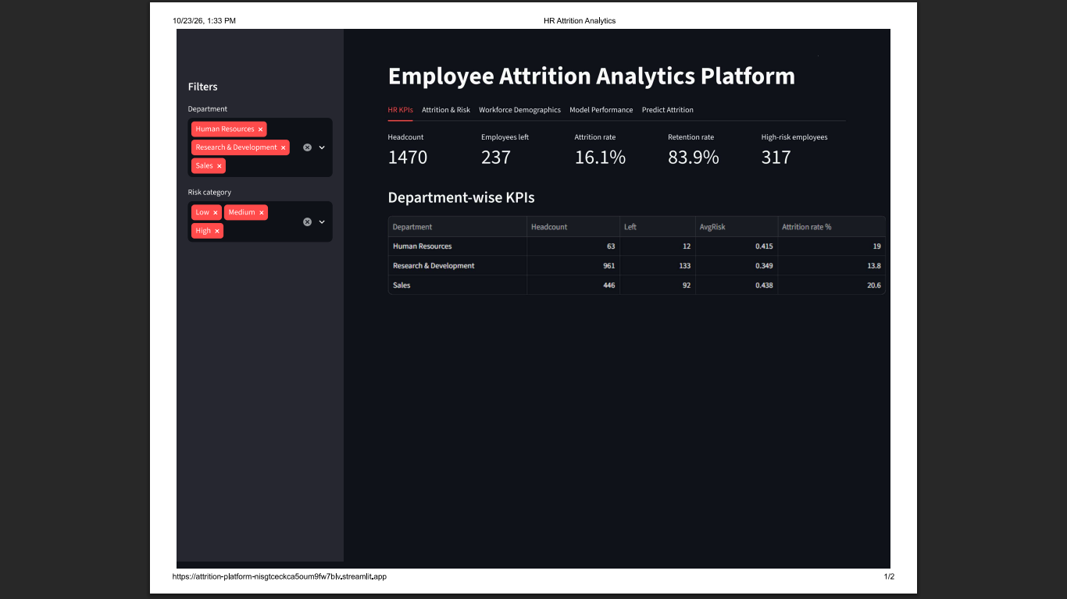
HR dashboard
Five tabs
HR KPIs: headcount, attrition and retention rate, high-risk count
Attrition & Risk: by department and role, risk donut, top 25 list
Demographics: age, gender, marital status, tenure, overtime, income
Model Performance: metrics, AUC chart, confusion matrix
Predict Attrition: form for a new employee
Attrition rate = left / headcount × 100
Notes:
Give a live demo of the dashboard: filters, KPIs, risk list, and the prediction form.

Slide 10
Recommendations and expected impact
Limit sustained overtime; rebalance workload in teams with many High-risk employees.
Strengthen the first two years: onboarding, mentor, 6-month stay check-in.
Review pay for Sales Representative and Laboratory Technician roles.
Extend stock options or retention bonuses to High-risk staff with none.
Reduce travel load for frequent travellers.
Monthly stay conversations from the High-risk list: support, never penalise.
317
High-risk employees flagged, about 148 of whom actually left
If 25% are retained: about 37 exits avoided
Illustrative: the 25% retention rate is an assumption.
Notes:
Link each recommendation to an insight. Be clear the saving is illustrative and based on stated assumptions.

Slide 11
Thank you.
Notes:
Be honest that about half of High-risk flags are false alarms, so the list starts conversations rather than decisions.

