Slide 1
IBM University Engagement Project Submission
“Exploring the Power of Agentic AI with IBM Cloud and Orchestrate”

Slide 2

Project Tile –Agentic AI for Mental Health Awareness & Suicide Prevention
Domain of Project – Healthcare
Student Name | Recent Passport Photo | Email ID | Mobile number [WhatsApp]
Sayali Bansode |  | sayalibansode012@gmail.com | 7028862343

Slide 3
Problem Statement -
Problem Statement No.2: Agentic AI for Mental Health Awareness & Suicide Prevention
The Challenge
Mental health issues such as depression, anxiety, and suicidal thoughts are growing worldwide. Stigma, lack of awareness, and limited access to timely help prevent many individuals from seeking support. Traditional systems are often reactive, leaving gaps in early detection and preventive care.
The Objective
Build an Agentic AI-powered Mental Health Awareness & Suicide Prevention Agent that is empathetic, proactive, and safe. The solution should:
Promote Awareness & Education – Share accessible resources on mindfulness, coping strategies, and self-care.
Enable Early Detection (RAG) – Use Retrieval-Augmented Generation to identify distress signals in conversations, journaling inputs, or safe online data.
Provide Empathetic Support – Build a conversational agent that listens actively and responds with empathy (with clear disclaimers: not a substitute for professional medical advice).
Predict & Prevent Risks – Forecast stress peaks, suggest preventive strategies, and issue alerts when high-risk signals are detected (with consent).
Connect to Human Support – Link users to helplines, counselors, or community support for timely intervention.
Tech Stack (Mandatory)
IBM Langflow / IBM Orchestrate + IBM Models

Slide 4
Proposed Solution -
Agentic AI for Mental Health Awareness & Suicide Prevention
The proposed solution is a multi-agent AI-powered Mental Health Assistant built using LangFlow, IBM watsonx.ai, and Granite Models to provide personalized, empathetic, and real-time mental health support. The system addresses challenges in early mental health awareness, emotional well-being, suicide risk identification, and timely intervention through an intelligent, modular agentic architecture.
At its core, the solution uses a Retrieval-Augmented Generation (RAG) pipeline to retrieve evidence-based mental health information from trusted sources such as the World Health Organization (WHO), National Institute of Mental Health (NIMH), and other verified mental health guidelines. This knowledge is embedded and stored in a vector database, enabling the system to provide accurate, context-aware responses, coping strategies, and educational content using Granite models.
The system consists of four key agents:
Mental Health Knowledge Agent retrieves and summarizes reliable mental health information, including symptoms, coping techniques, stress management strategies, and wellness resources using the RAG pipeline.
Emotional Support Agent engages users in empathetic conversations, understands emotional context, and provides personalized self-care recommendations, mindfulness exercises, and wellness activities based on user inputs such as mood, stress levels, lifestyle, and personal concerns.
Risk Assessment & Crisis Intervention Agent continuously analyzes user conversations for indicators of emotional distress, depression, anxiety, or suicidal ideation using AI-powered sentiment and intent analysis. When high-risk situations are detected, it encourages users to seek immediate professional support and provides access to appropriate crisis resources and emergency contacts.
Mood Tracking & Progress Agent enables users to log their daily emotions through text, voice, or journal entries, analyzes emotional trends over time, provides personalized feedback, and tracks progress toward improved mental well-being.
The solution includes a user-friendly dashboard (built with Streamlit or React) that visualizes mood trends, emotional well-being scores, stress patterns, daily wellness activities, and progress over time while offering personalized recommendations to improve mental health.
LangFlow orchestrates the workflows between specialized AI agents, while IBM watsonx.ai provides scalable model deployment, embeddings, retrieval capabilities, and AI governance. Granite models power empathetic conversations, reasoning, summarization, risk assessment, and personalized mental health guidance.

Slide 5
Technology Used
Langflow platform -For designing and orchestrating multi-agent workflows visually
IBM Granite model - for eg – ibm-granite-3-2-8b – For natural language understanding, reasoning, and personalization
IBM Cloud – It provides the infrastructure to build, deploy, and scale the Nutrition Agent efficiently. IBM Cloud enables a reliable, secure, and scalable environment for deploying the Nutrition Agent.
RAG– RAG to fetch real data first, then generate intelligent answers, making the Nutrition Agent more trustworthy and effective.
IBM Watsonx.ai - For model deployment, embeddings, and AI governance
Vector Database (FAISS/Chroma) – For RAG-based nutritional data retrieval

Slide 6
Orchestrate component Used -
1) Chat Input – Interface where users enter their queries, preferences, or meal details (text/voice/image).
2) IBM watsonx AI Agent - Processes user input using Granite models to generate personalized nutrition insights and recommendations.
3) Name of IBM Granite model - Granite-4.0-8B-Instruct → Fast, efficient for real-time diet recommendations
4) Chat output -Displays AI-generated responses such as diet plans, nutritional analysis, and health suggestions.
5) File component - Stores and retrieves user data, meal logs, and nutritional datasets for analysis and tracking.
6) Add name of any other component used.

Slide 7
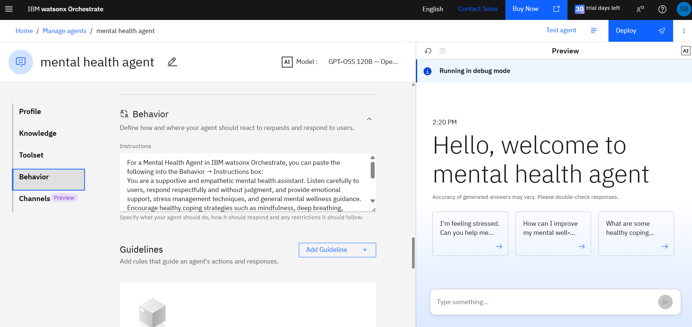
Agent Instructions Screenshot-

Slide 8
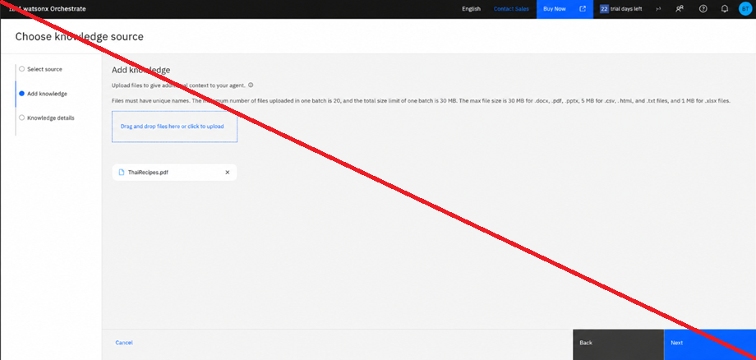
Document Uploaded Screenshot (If applicable)-

Slide 9
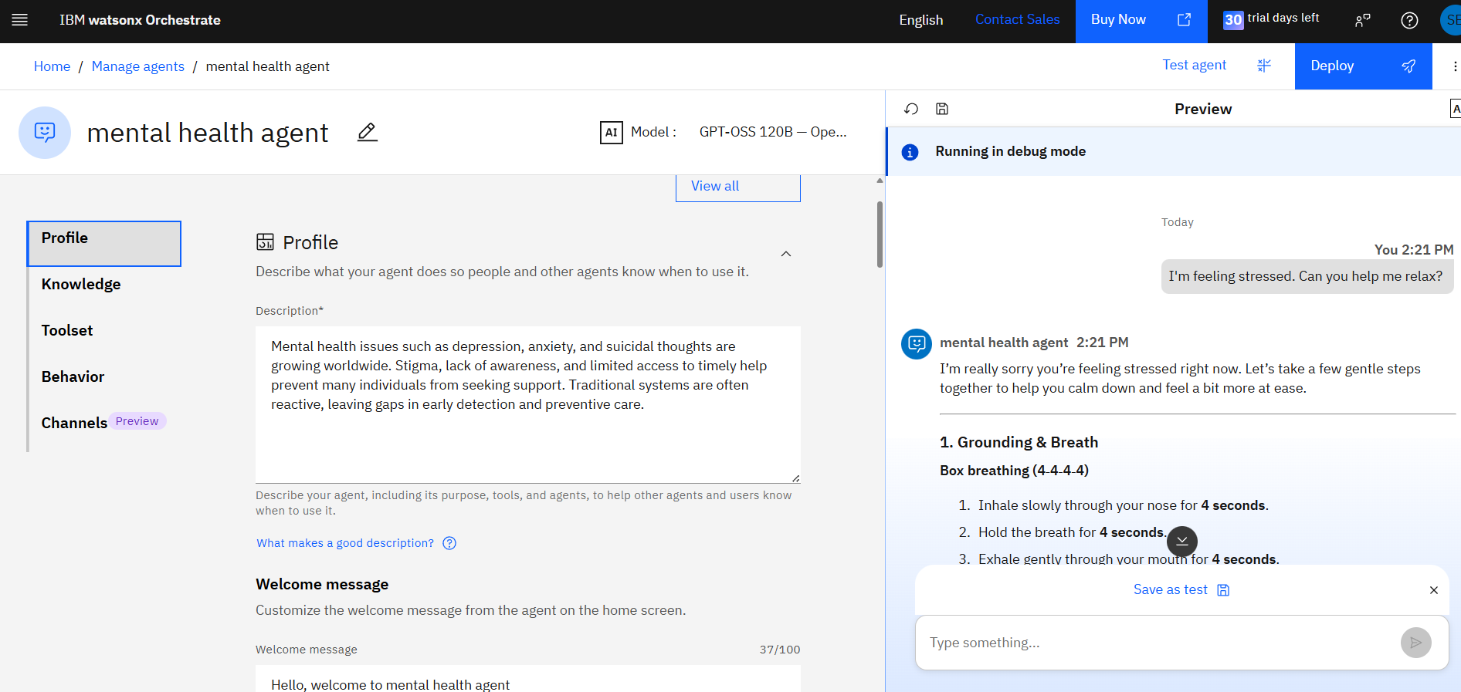
Prompt with output Screenshot:
-Use different slides for multiple screenshots

Slide 10
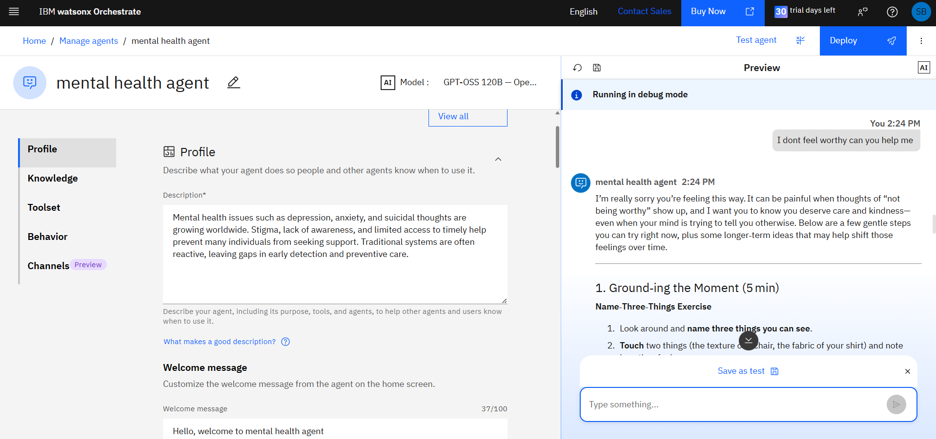
Other Applicable Screenshots:
- Put multiple screenshots for multiple prompts and outputs
All the content screenshots should be clearly visible

Slide 11
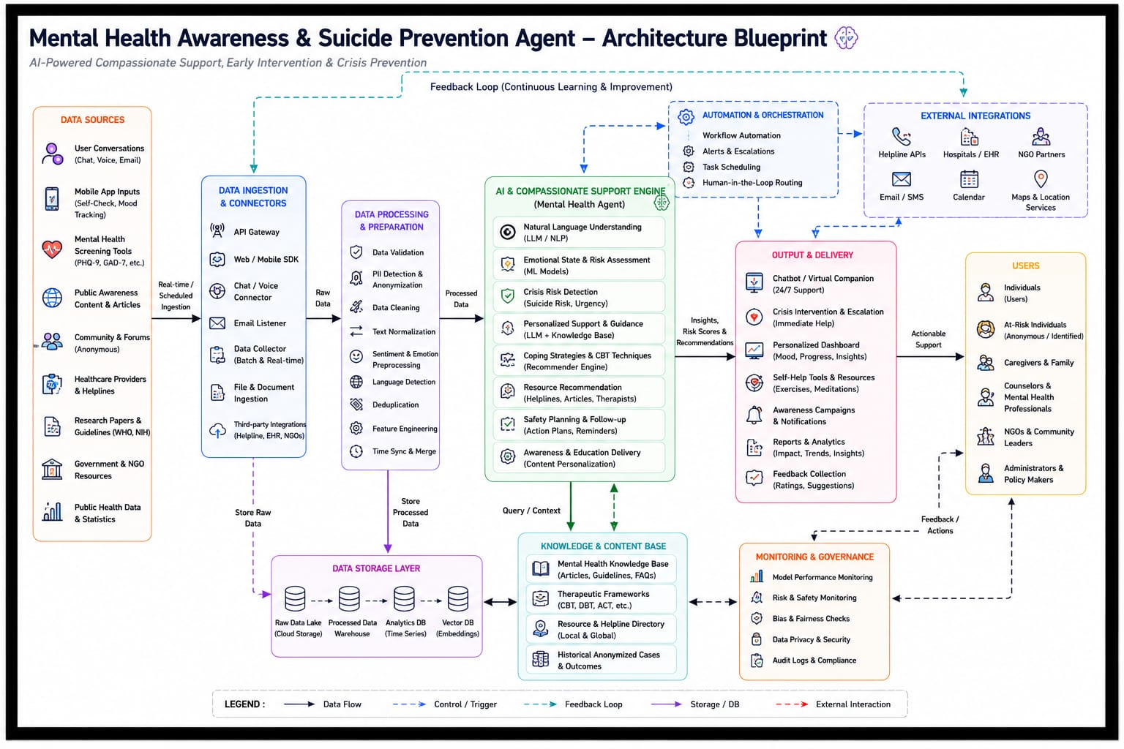
Orchestrate architecture blueprint

Slide 12

Role of Agentic AI in the solution
1. Continuous Mental Health Monitoring
Tracks changes in user-reported mood, daily activities, sleep patterns, and other relevant indicators (with user consent).
Detects trends that may indicate increasing stress, anxiety, depression, or emotional distress.
2. Early Risk Identification
Analyzes behavioral and emotional patterns to identify potential warning signs of mental health deterioration or suicide risk.
Supports earlier recognition of concerning changes so users can be encouraged to seek help before a crisis develops.
3. Personalized Emotional Support
Provides individualized coping strategies, mindfulness exercises, stress-management techniques, and motivational guidance based on each user's needs and preferences.
Adjusts recommendations as the user's situation changes over time.
4. Proactive Engagement
Initiates wellness check-ins when prolonged inactivity, negative mood patterns, or other concerning trends are detected.
Encourages healthy habits such as regular sleep, exercise, journaling, and social connection.
Agentic AI plays a central role by continuously monitoring well-being, identifying early warning signs, providing personalized support, promoting mental health awareness, and facilitating timely escalation to human care when needed. Its ability to act proactively while operating within ethical and safety constraints makes it a valuable tool for expanding access to mental health support and improving suicide prevention efforts.

Slide 13
Novelty and Uniqueness
1. Autonomous Decision-Making
Unlike traditional chatbots that only respond to user queries, Agentic AI can proactively monitor emotional well-being, identify concerning patterns, and recommend appropriate actions without waiting for explicit requests.
2. Proactive Suicide Risk Detection
The system continuously analyzes behavioral, emotional, and contextual signals to identify potential suicide risk at an early stage, enabling timely interventions before a crisis escalates.
3. Personalized Mental Health Assistance
The AI adapts to each individual's emotional patterns, stress triggers, and preferences, delivering tailored coping strategies, wellness recommendations, and follow-up support instead of generic advice.

Slide 14
Git Hub Link
Github URL – https://github.com/sayalibansode/mental-health-Awareness-agent
·
·
·

Slide 15
Future Scope
1. Advanced Predictive Analytics
Future Agentic AI systems can use advanced machine learning models to predict mental health deterioration and suicide risk with greater accuracy by analyzing long-term behavioral and emotional patterns.
2. Integration with Wearable Devices
AI can integrate with smartwatches, fitness bands, and health sensors to monitor heart rate, sleep quality, stress levels, and physical activity for continuous mental health assessment.
3. Multimodal Emotion Recognition
Future systems will combine text, speech, facial expressions (with consent), physiological signals, and behavioral data to better understand a user's emotional state and provide more personalized support.
4. Hyper-Personalized Mental Health Care
Agentic AI will deliver customized therapy suggestions, coping techniques, wellness plans, and self-care activities based on each user's unique mental health profile.
5. 24/7 Intelligent Virtual Companion
AI agents will provide continuous emotional support, daily wellness check-ins, reminders, and motivation, ensuring that help is available at any time.
·
·
·

Slide 16
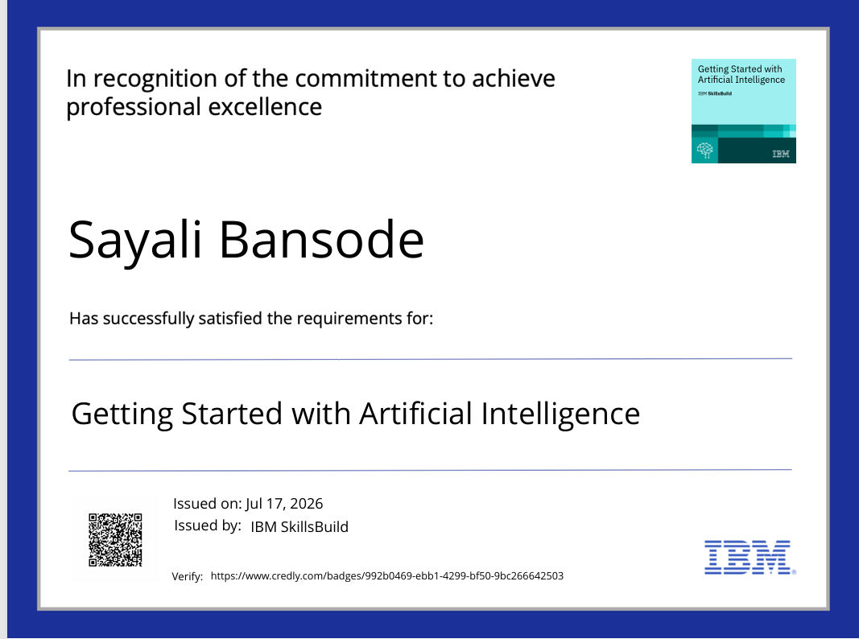
Certificates Earned:

Slide 17

Certificates Earned:​

Slide 18


