Slide 1


Online Banking system
Presented By-
Kunal P. Bhangale (233021)
Sayali R. Bodre (233024)

Slide 2
Project Introduction
The Banking Management System is a contemporary online platform revolutionizing the retail banking landscape.
Traditionally, acquiring financial services and products involved multiple intermediaries, limiting profitability for retailers. In response, this system establishes a direct connection between customers, employees, accounts, transactions, and bank branches.
This platform disrupts the status quo by facilitating direct interactions between customers and financial services, enabling retailers to secure products from bank branches with enhanced ease.
The integration of customer, employee, account, transaction, and bank branch functionalities empowers efficient, user-friendly experiences.

Slide 3
Objective (Purpose):
The objective of the Banking Management System project was two fold: to design and implement a functional banking application and to provide an immersive learning platform for students to grasp key concepts of software development, project management, and collaboration.

Slide 4
Scope:
This includes facilitating customer interactions, managing employee roles, administering accounts, processing transactions, and overseeing bank branch activities.
The scope further extends to creating a user-friendly interface for customers and employees, ensuring secure and accurate transaction processing, and enabling efficient management of account details and balances.
By centralizing these functionalities into a cohesive system, the project aims to enhance user experiences, improve operational efficiency, and provide administrators with robust oversight capabilities.

Slide 5
Technology Used:
Front End: React JS
Back End: Java Spring Boot API.
Database: MySQL

Slide 6
S/W and H/W Requirements
Server Side:
Processor: Intel core i5 or above
HDD: 500 GB or above
RAM: 4GB or above
Database: MySQL
Client Side (minimum requirement):
Processor: Intel Dual Core
HDD: Minimum 80GB Disk Space
RAM: Minimum 2GB
OS: Windows 7, Linux

Slide 7
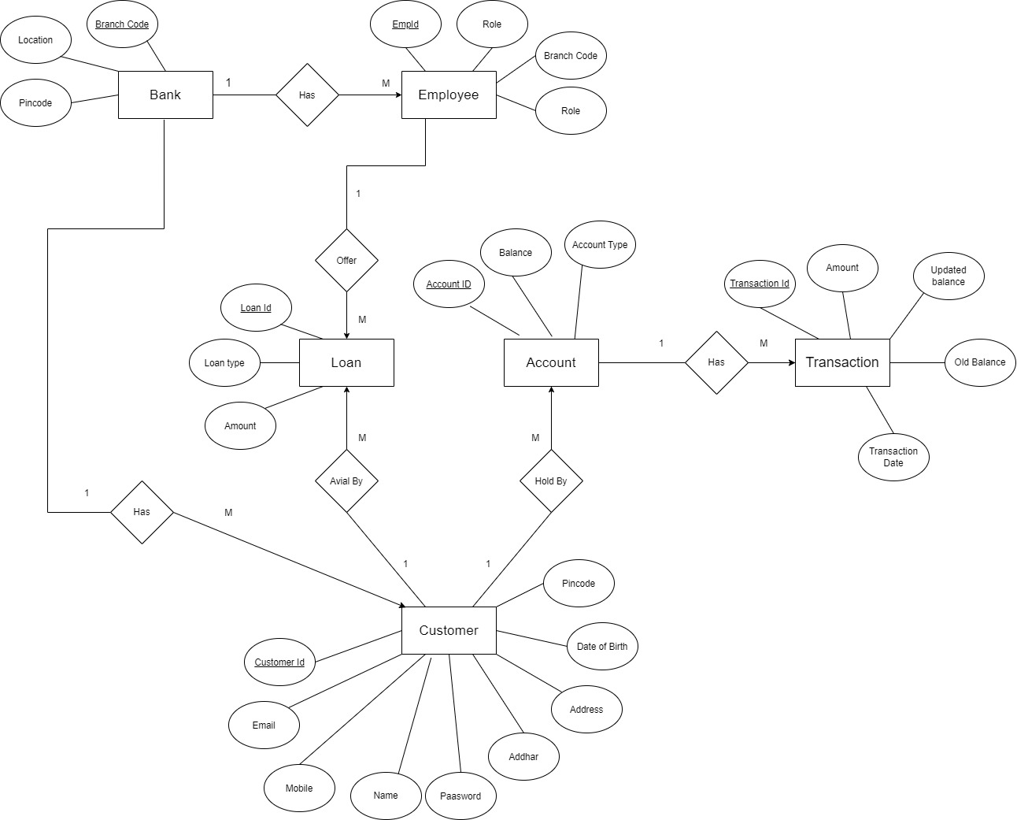
E-R Diagram:

Slide 8
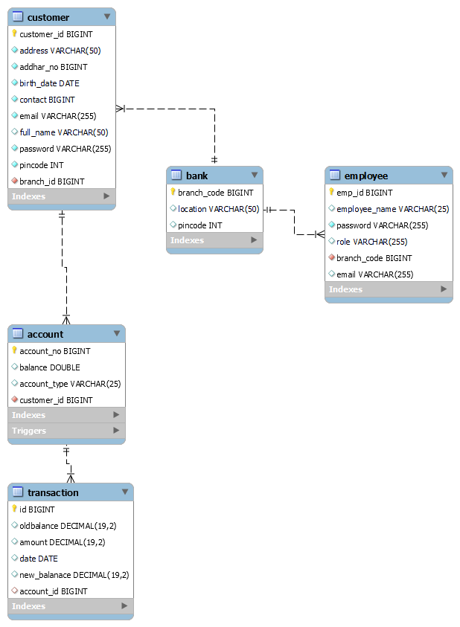
E-R Diagram(MySQL Auto generated)

Slide 9
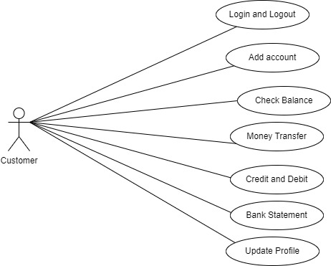
Customer Use Case :

Slide 10
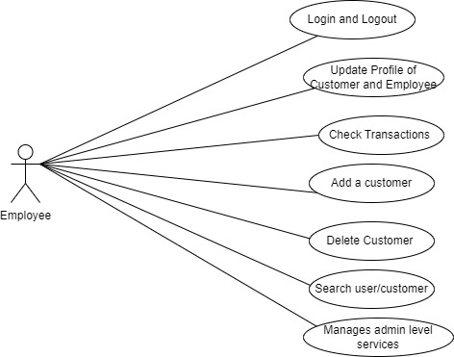
Employee Use Case :

Slide 11
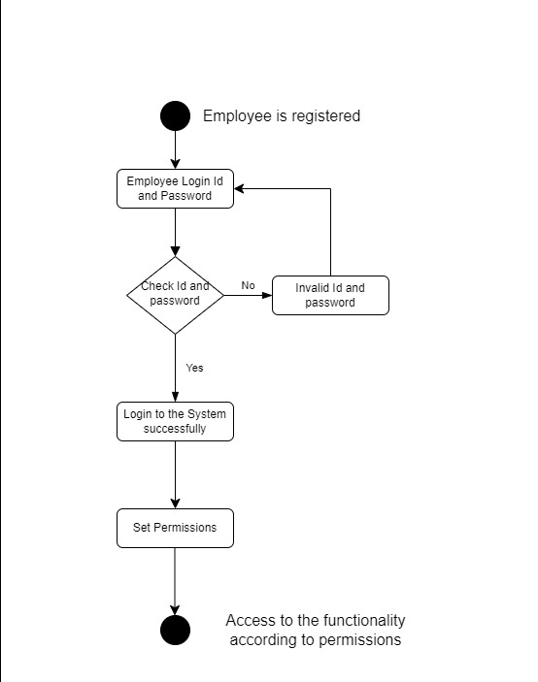
Activity Diagram Of Employee

Slide 12
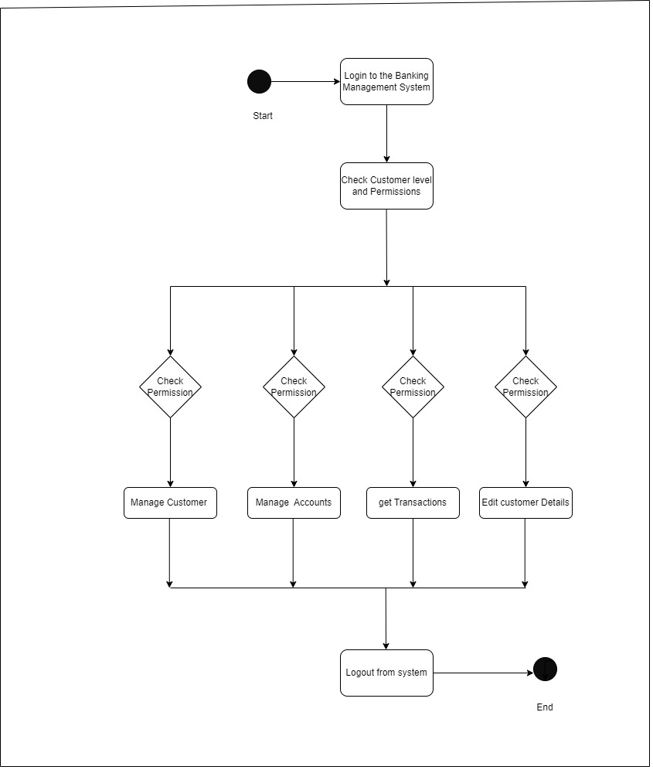
Activity Diagram Of Customer

Slide 13
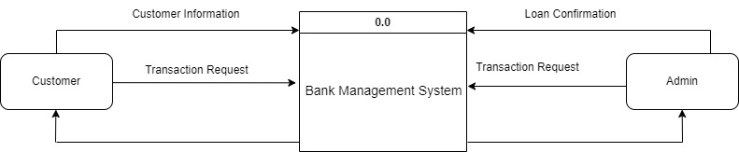
DFD diagrams 0 level

Slide 14
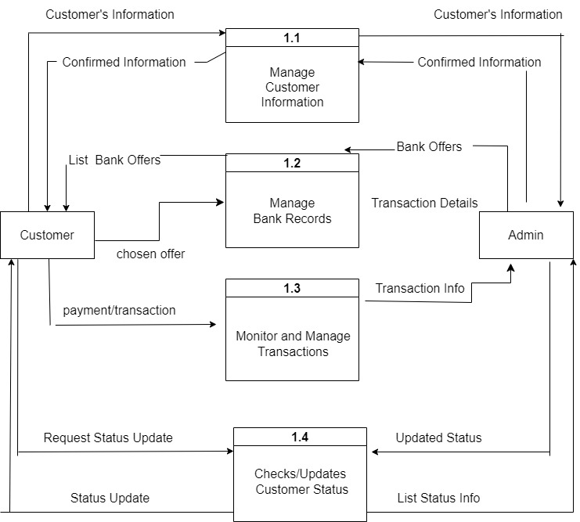
DFD diagrams 1 level

Slide 15
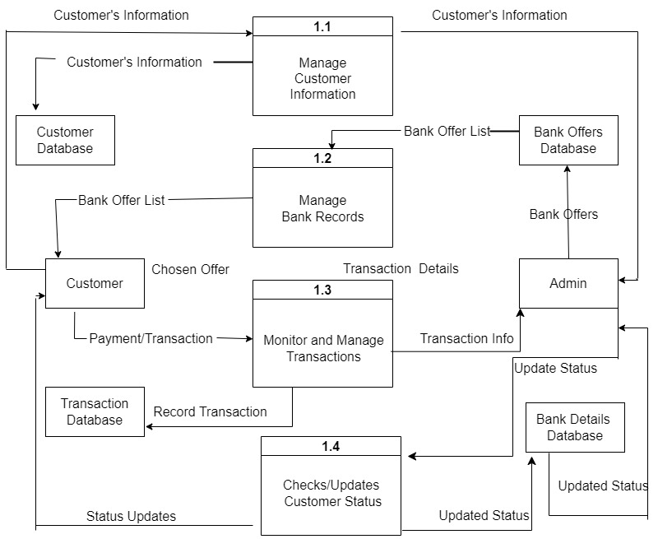
DFD diagrams 2 level

Slide 16
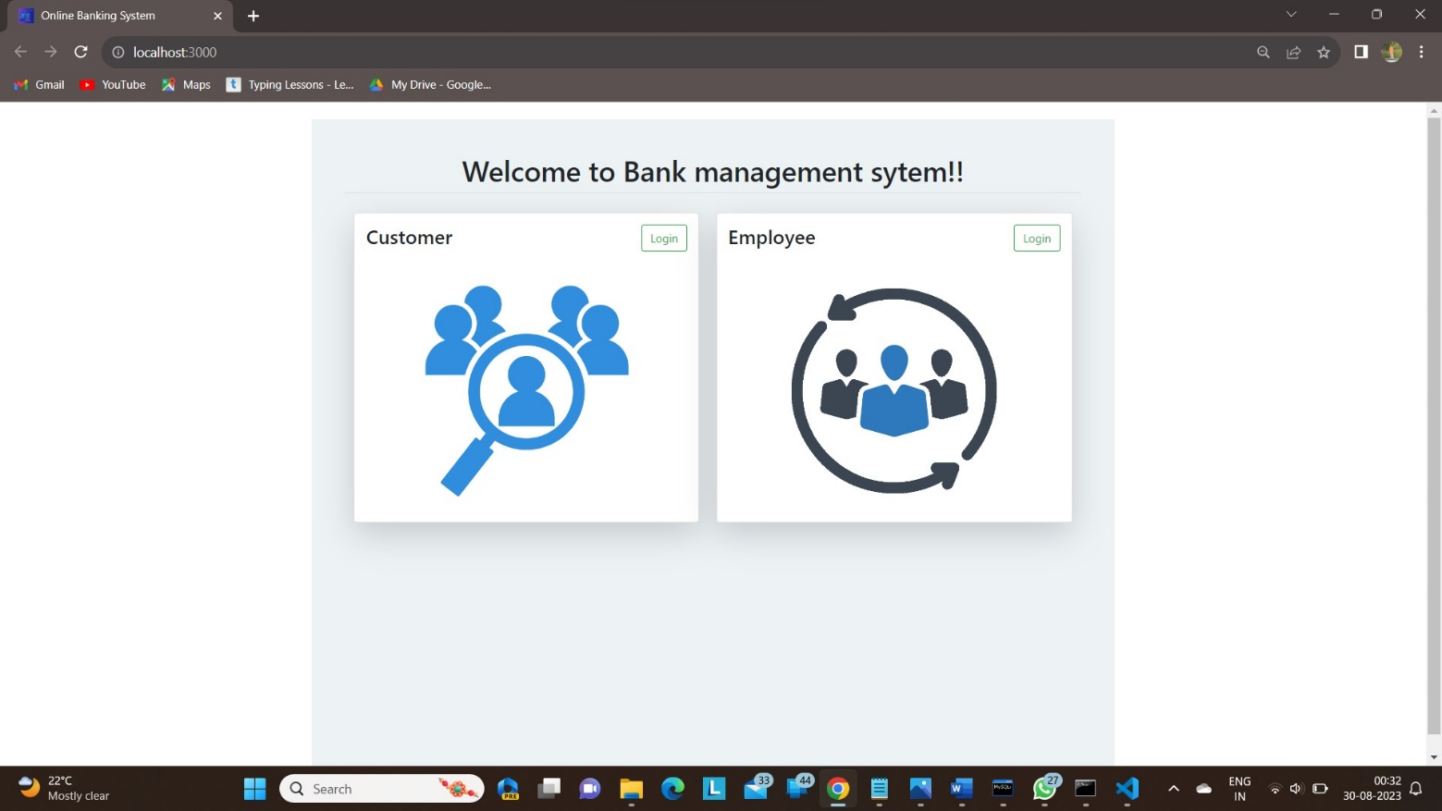
UI Screenshots

Slide 17
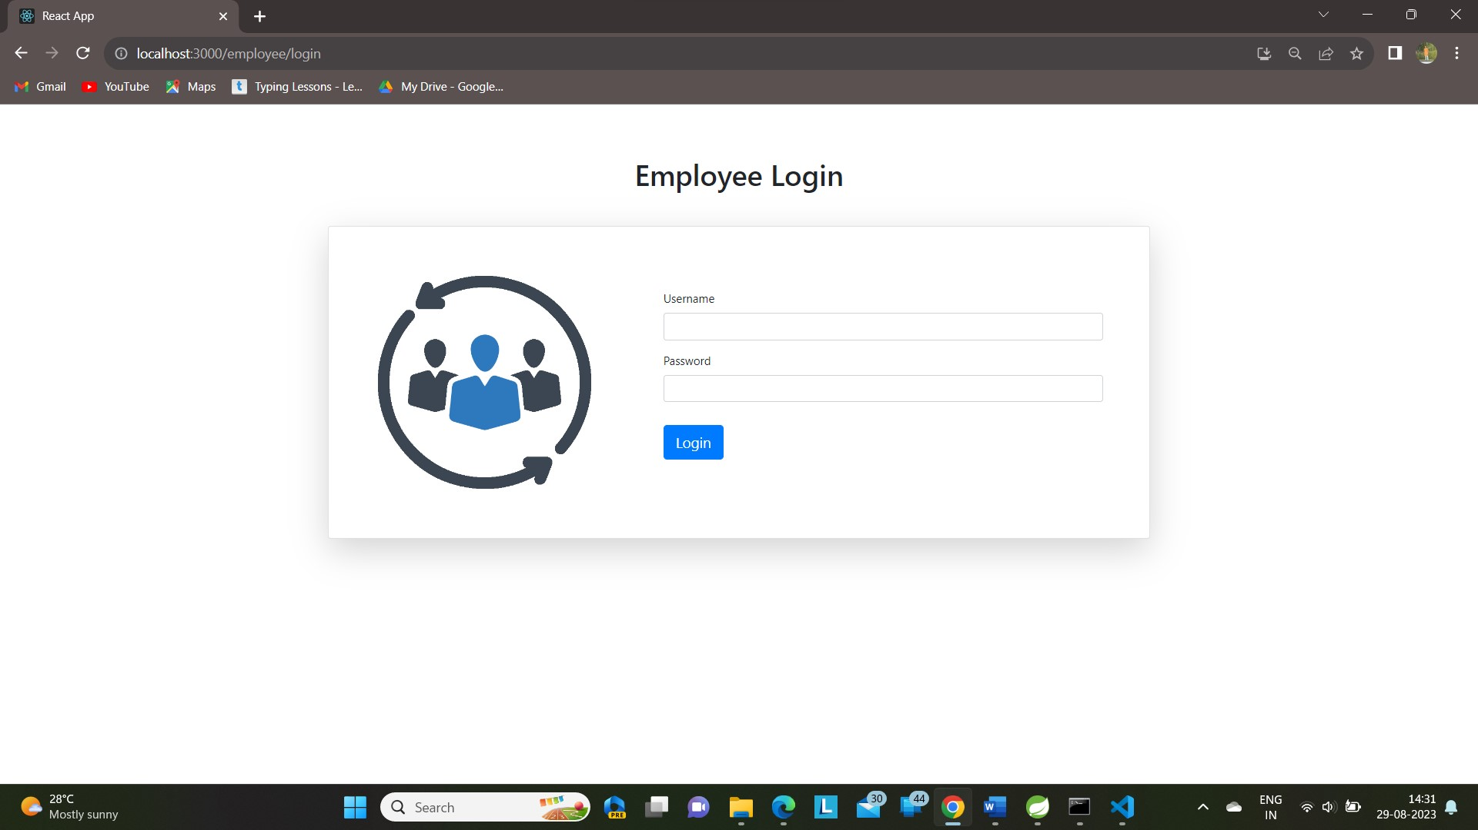

Slide 18
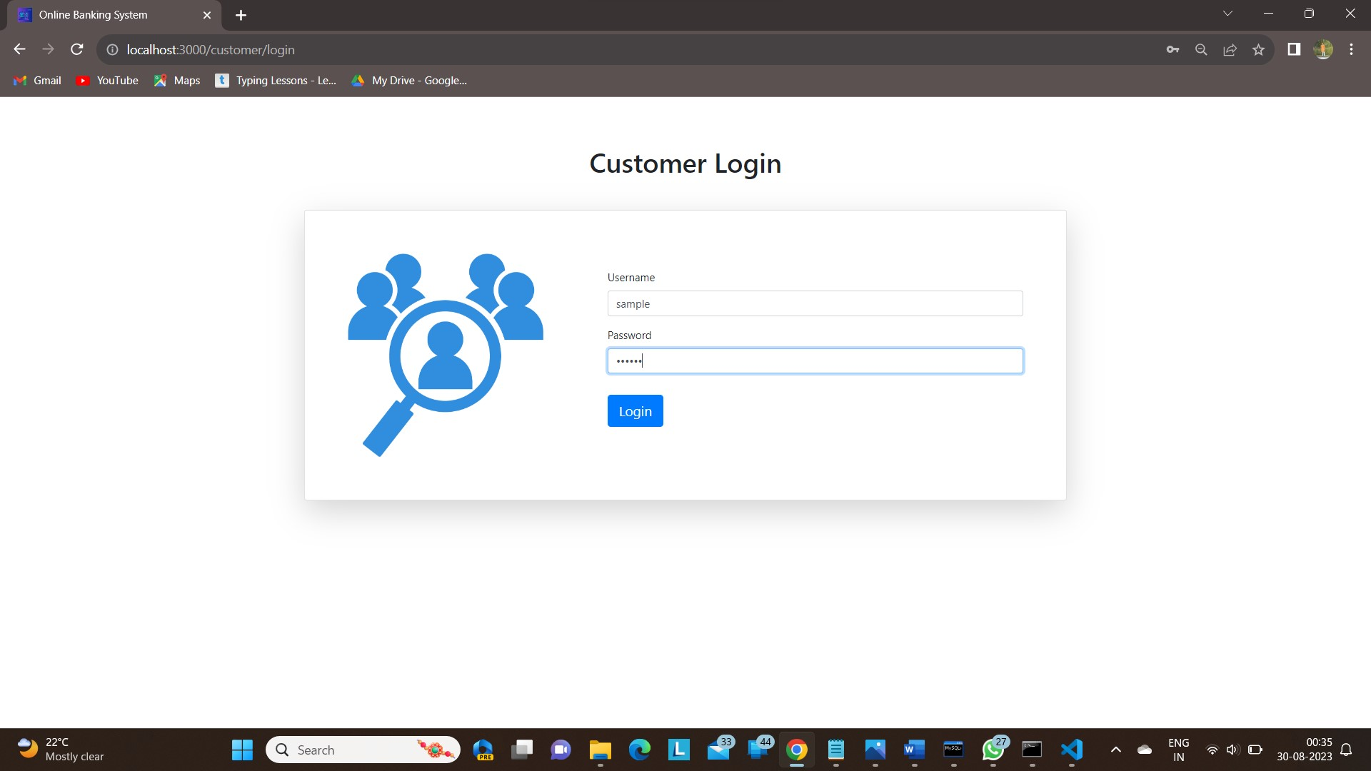

Slide 19
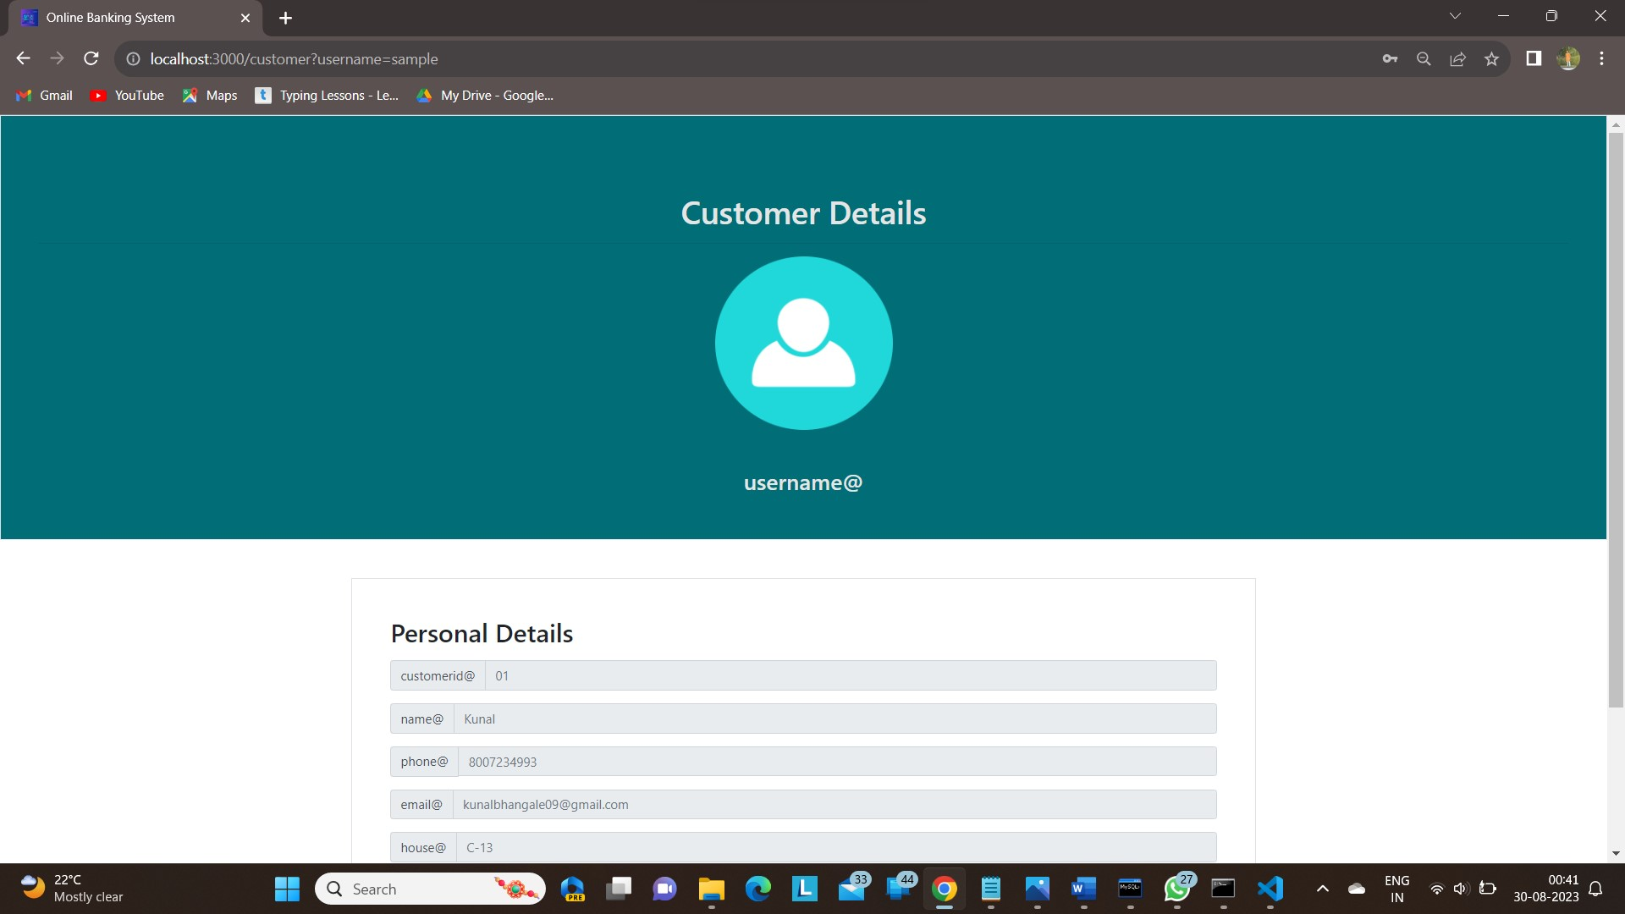

Slide 20
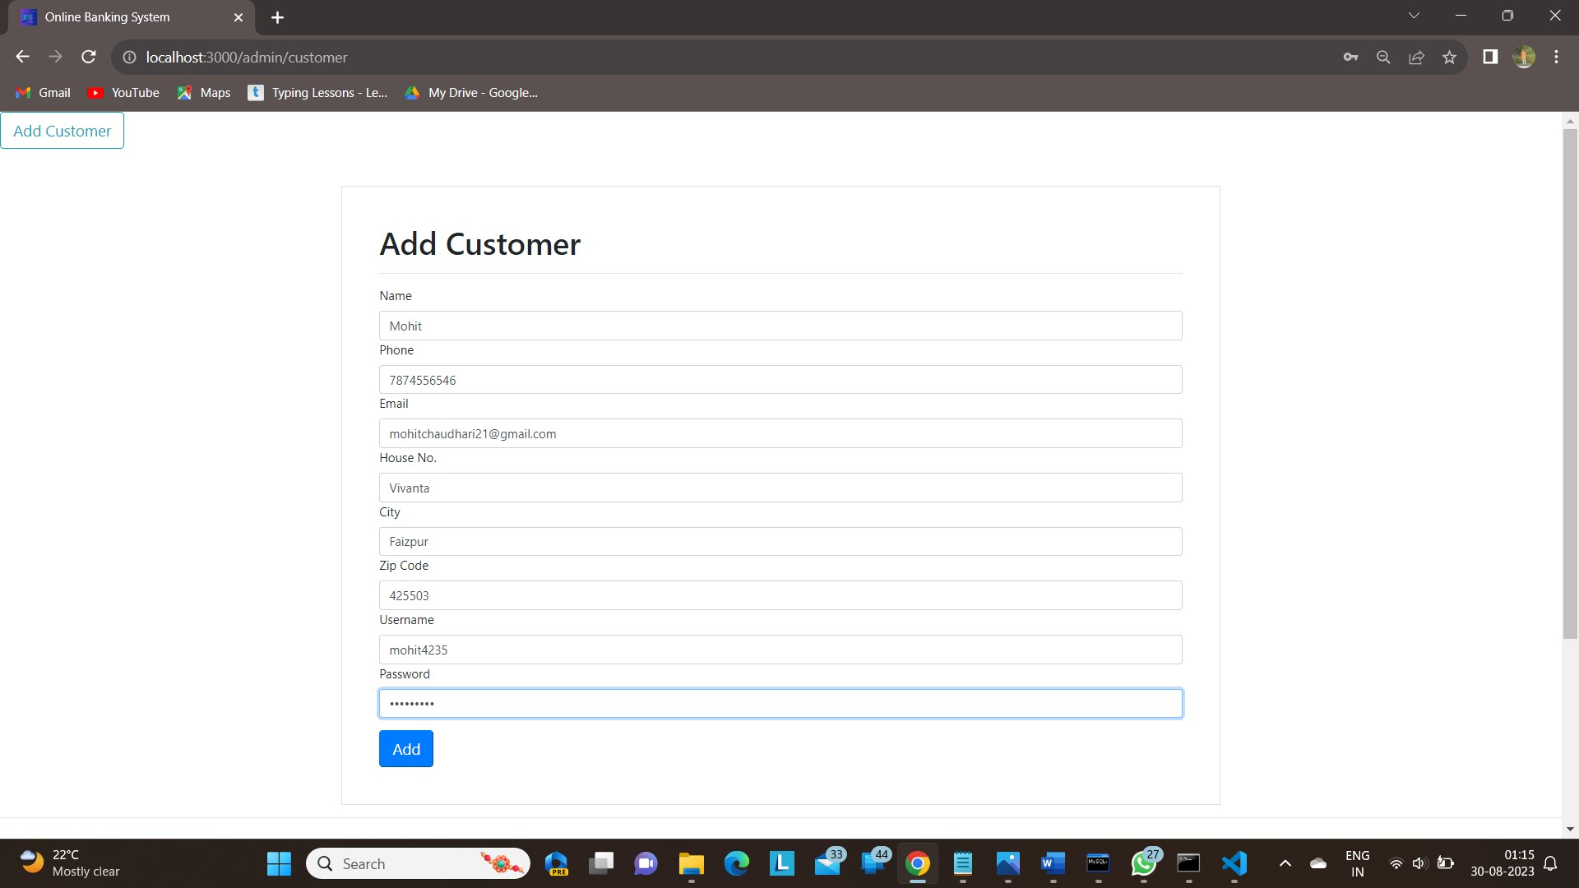

Slide 21
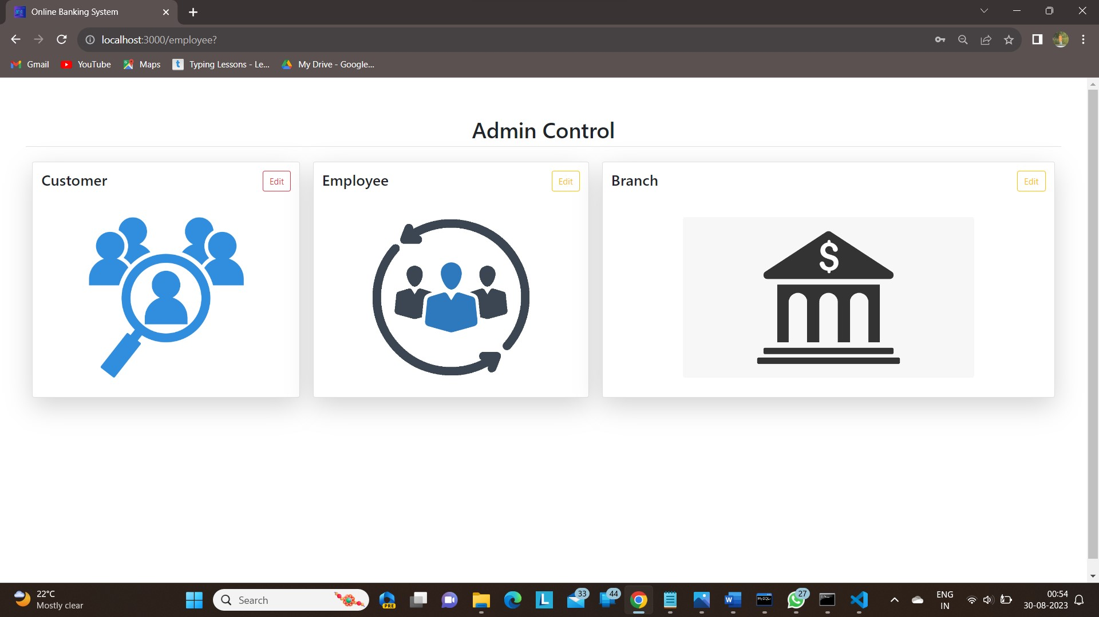

Slide 22
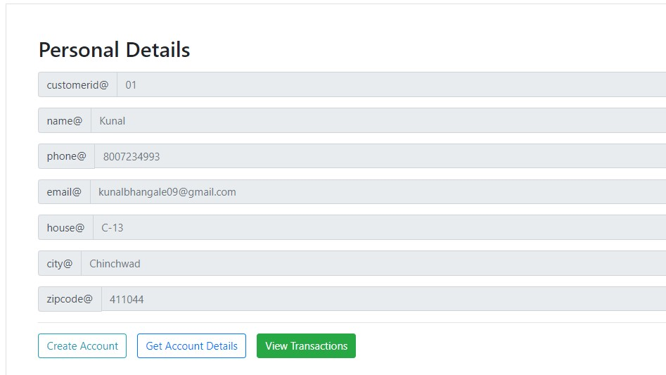

Slide 23
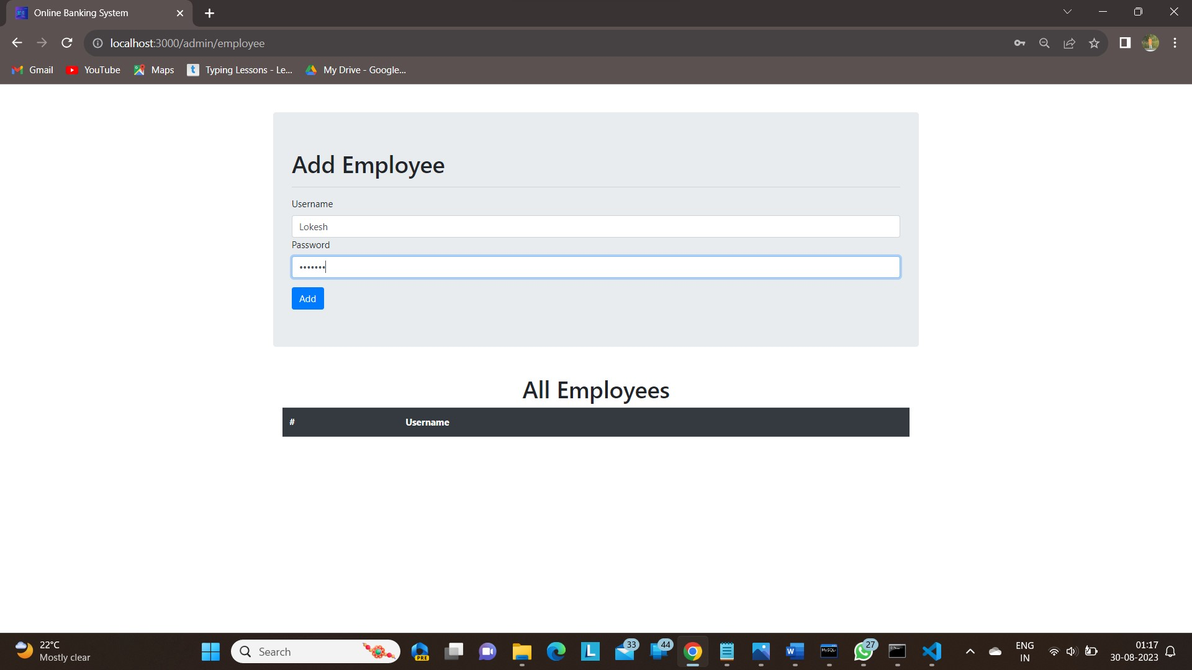

Slide 24
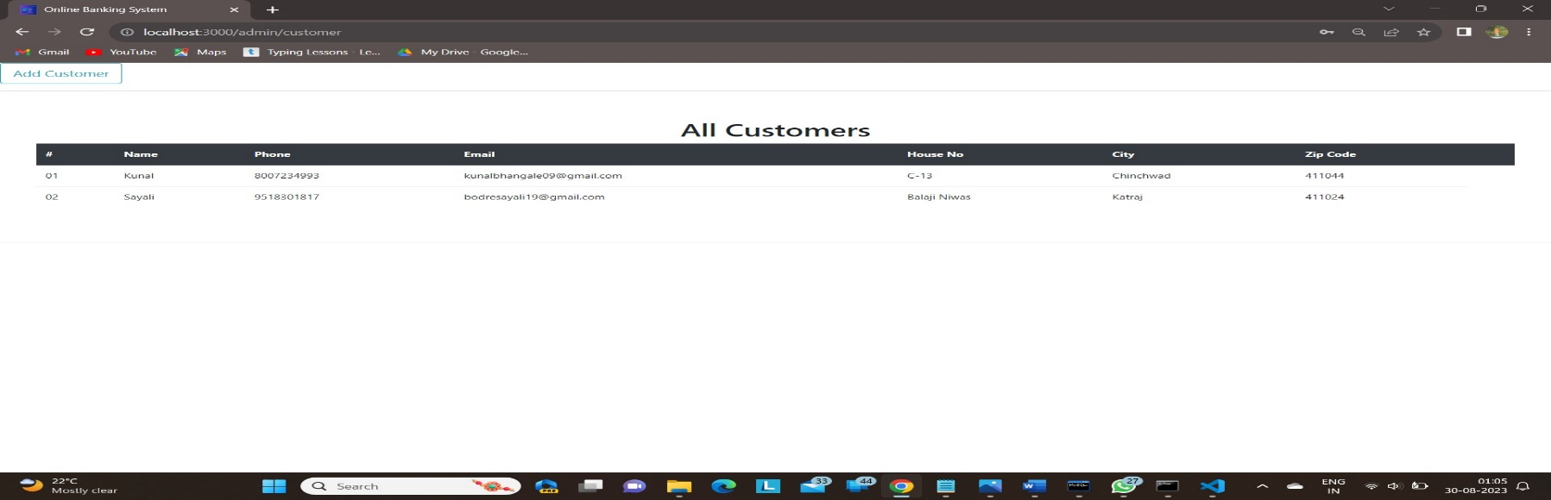
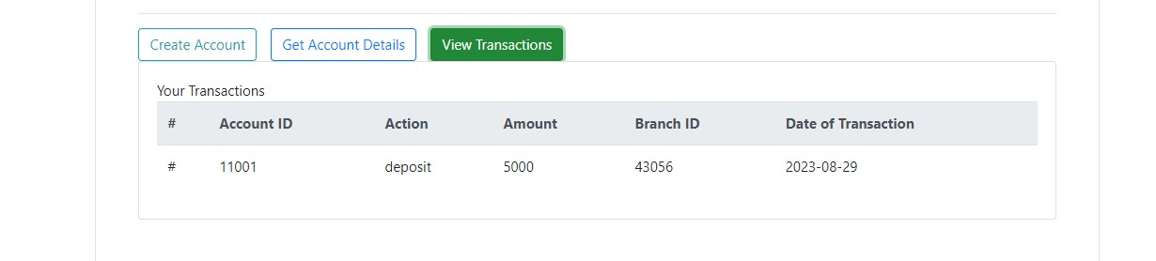
Customer List:
Transactions :

Slide 25
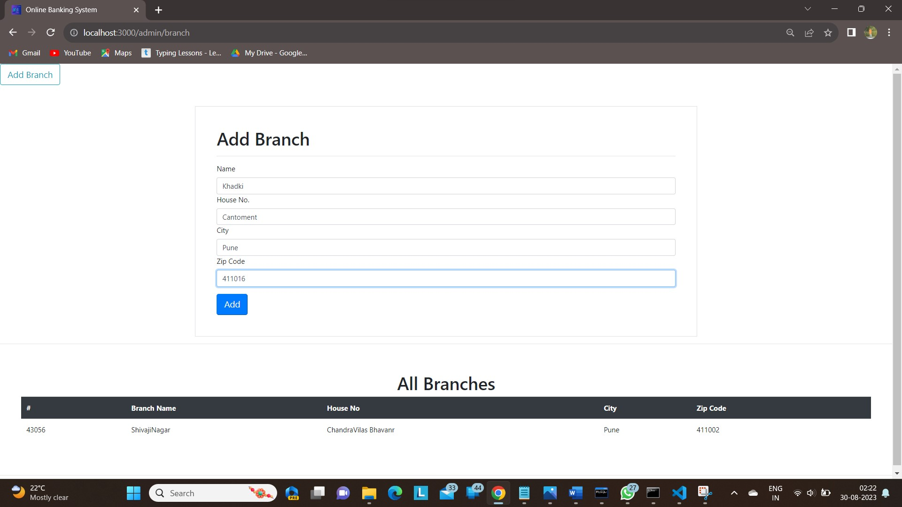

Slide 26
Conclusion:
the proposed banking system with modules for Employees, Customers, Accounts, Transactions, and Branches aims to provide a comprehensive and efficient platform for managing various banking operations.
Through role-based access control, secure authentication mechanisms, and robust transaction processing, the system ensures the integrity, confidentiality, and availability of customer data and financial activities.
With its user-friendly interfaces and extensive features, the banking system aims to enhance customer experience, streamline employee workflows, and contribute to the overall growth and success of the bank.
Future enhancements could include advanced analytics, AI-driven fraud detection, and expanded mobile banking capabilities to meet evolving customer needs and industry trends.

Slide 27
References
https://www.w3schools.com/
https://react-bootstrap.github.io/components/carousel/
https://www.geeksforgeeks.org/reactjs-tutorials/
https://javaee.github.io/javaee-spec/javadocs/
https://reactjs.org/docs/getting-started.html

Slide 28
Thank You

