Slide 1
Machine Learning with Energy Datasets
Team 8
Sayali Ambekar
Rishi Rajani
Komal Ambekar

Slide 2
Exploratory Data Analysis
It is an approach to analyze data sets to summarize
their main characteristics, often with visual methods.
EDA is for seeing what the data can tell us beyond the
ormal modeling. It is typically the first step of analysis.

Slide 3
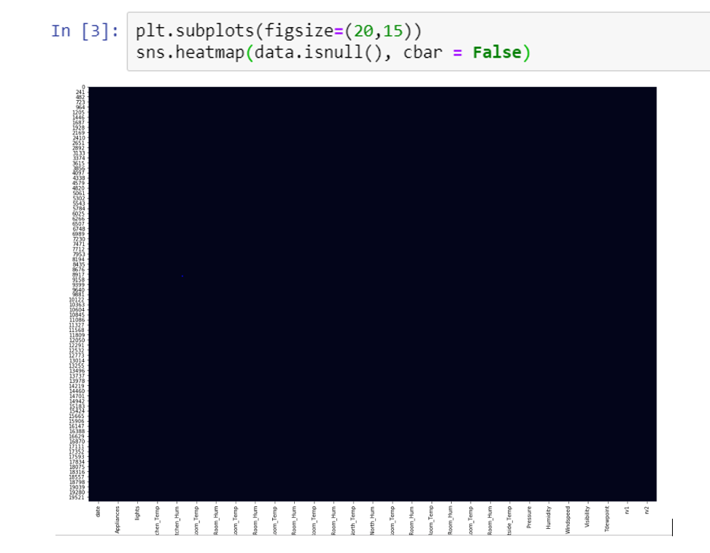
Null values
This is to check the null values in the energydata_complete file. It is achieved by using the seaborn library

Slide 4
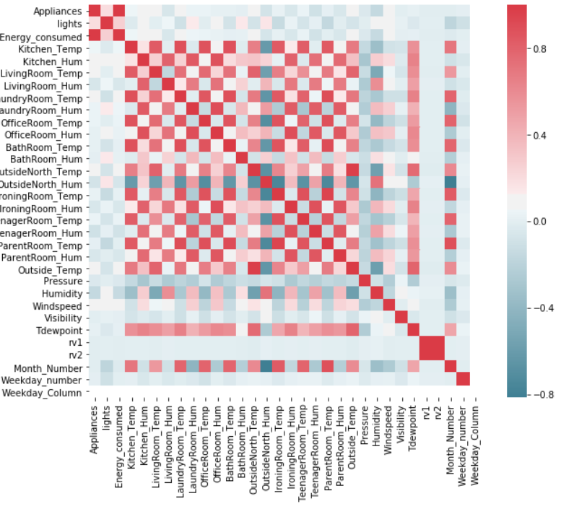
Correlation Matrix:

Slide 5
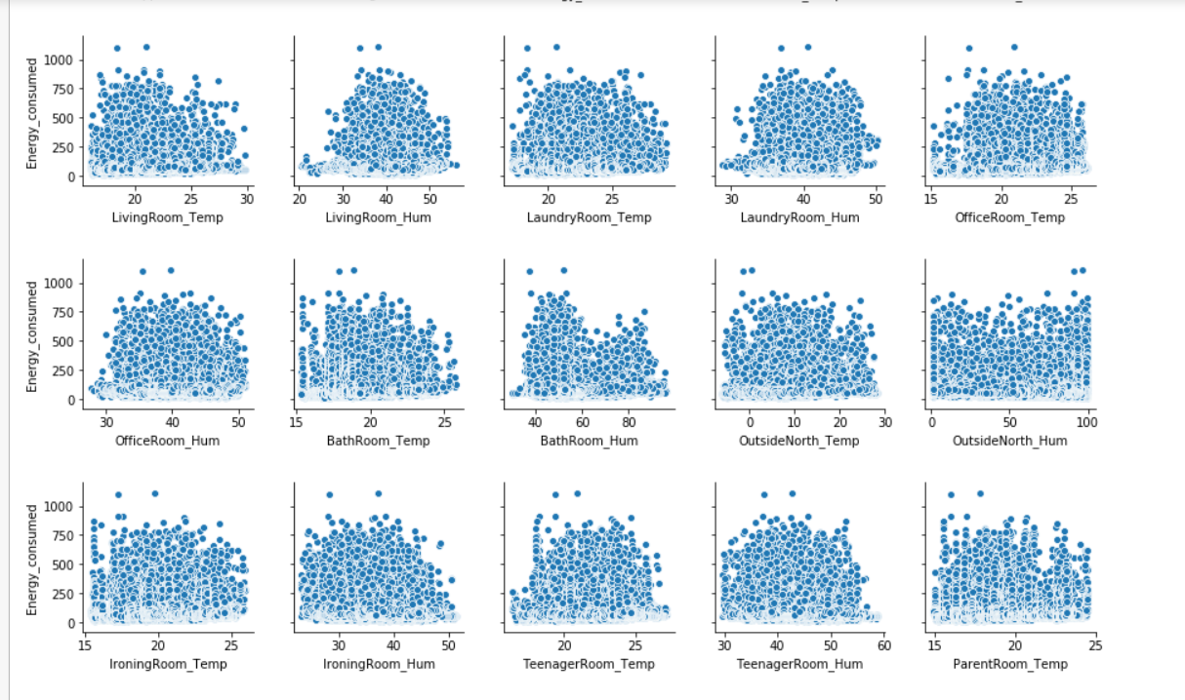
Scatter plot to determine the Energy consumed by all the appliances

Slide 6
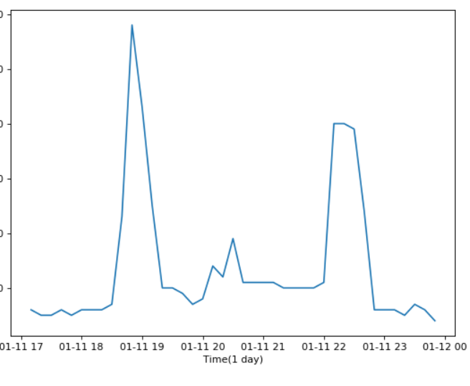
Line plot representing the daily energy consumption shows that the consumption was the highest on 01-11-19

Slide 7
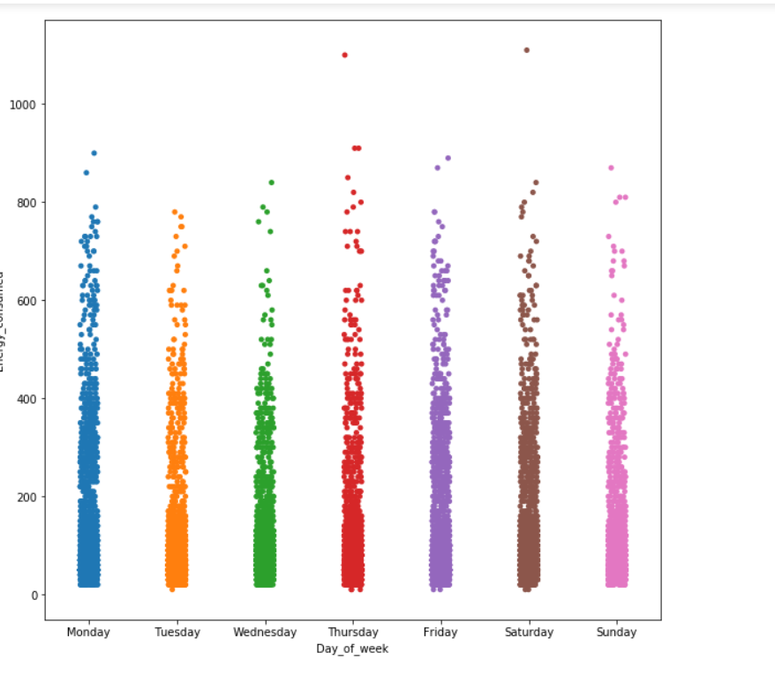
Energy consumption from Monday through Sunday

Slide 8
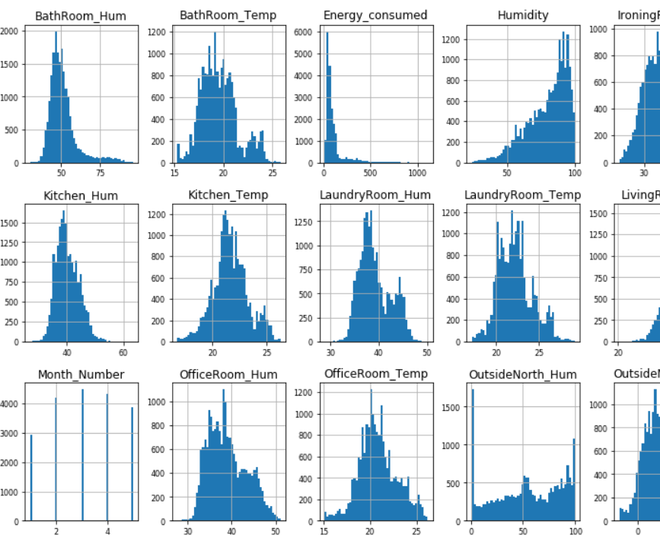
Histogram of numerical features

Slide 9
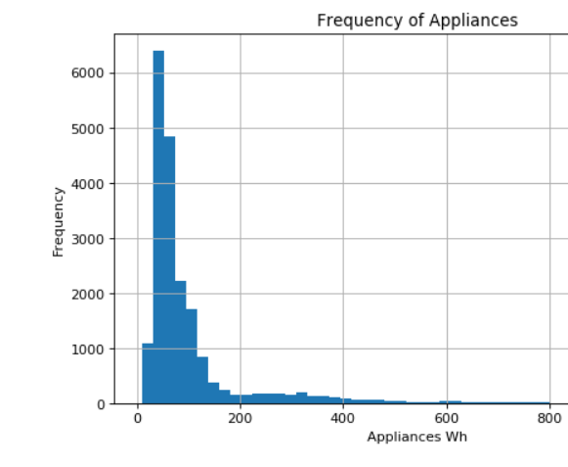
Frequency of Appliances used

Slide 10
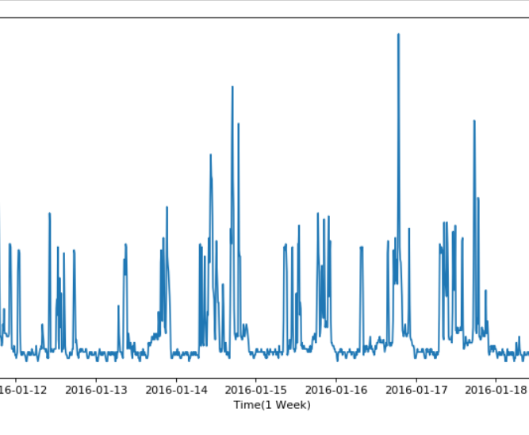
Appliances used in one week from 2016-01-12 to 2016-01-18

