Slide 1
Rescue Management System Application Engineering Development Sayali Borse Reema Dutta Komal Ambekar

Slide 2
Problem Statement
During an emergency, providing immediate help is of utmost importance to the victim/patient. The average time taken by the rescue teams to reach the victim’s site is approximately 10 minutes. This duration could be too long to save a person who has suffered major injuries and who needs immediate care.
For instance: for a person who suffered from cardiac arrest, if immediate help is not provided with 3-4 minutes, the patient most likely dies.
Thus if time is reduced and medical help is provided to the patient sooner, the chances of the patient’s survival increases to a large extend.

Slide 3
Proposed Solution
To solve this problem, we can create an “Ambulance drone” which gets triggered when the patient dials 911.
The Ambulance drone is an all-purpose medical toolkit that can be automatically flown to any emergency situation and is used to guide citizens to make non-technical lifesaving procedures.
The drone has an emergency medical kit which contains basic lifesaving technologies like the Automated External Defibrillator (AED), Cardiopulmonary Resuscitation (CPR), oxygen masks, medications, insulin injections etc which can be helpful for controlling the emergency situation by the time the ambulance arrives. The drone also has an inbuilt camera and audio system.
The average time taken by the drone to reach the emergency location is approximately one minute, thus increasing the patient’s chances of survival.

Slide 4
Actual working
The victim dials 911 in case of an emergency. The “Emergency Management System” representative attends the calls. The place where the emergency has occurred is fetched by the admin.
The admin determines the nearest 911 Emergency Department, where he can route the call to for quicker assistance.
Once the call is routed to the Emergency Department, then admin determines the nearest Drone Station with respect to the emeregncy location and alerts the active drone.
Once the drone gets activated, it determines the nearest hospital which has the speciality to attend the casualty.
The drone alerts the on call doctor of the hospital.
…continued in next slide

Slide 5
Actual working (..ctd)
Once the on call is alerted, the doctor gets connected to the drone via a camera and thus can view the live footage of the accidental location.
Once the doctor is connected the camera, the doctor can monitor the emergency situation and help the people at the accidental location to take actions. For instance: the doctor can assist the people to give CPR to patients who are unable to breathe.
When the drone alerts the hospital, it computes the shortest path for the ambulance to reach the emergency destination and sends this information to the hospital.
The hospital admin then identifies the available ambulance and passes this information to it, which helps the ambulance reach the destination at the earliest.

Slide 6
Actual working (..ctd)
If the emergency is of Accidental type, once the drone reaches the destination. It can scan the license plate of the accidental car and send it to the “Police department”.
The police department then runs through their registered car database and finds the person associated with the registered car. The police fetches the emergency contact information of the patient and sends an alert to the contact about the accident.
Once the ambulance reaches the destination, the drone becomes available again and returns to its station.

Slide 7
Key roles
Drone:
The rescue drone is a gadget which has an all-purpose medical toolkit that can be automatically flown to any emergency situation and is used to guide people to make non-technical lifesaving procedures.
Emergency Systems:
The Emergency Management System representative attends the emergency calls and helps to fetch the location where the emergency has occurred.
Patients/victims:
People in dire circumstances who need medical assistance. For e.g. if a hiker gets stuck in a remote area where the rescue teams will take time to reach then the drone will be of assistance with the medical aid and food.

Slide 8
Key roles
Hospital:
Once the drone gets activated it determines the nearest hospital which has the specialty to treat patient/victim’s illness and alerts them.
Doctors:
The drone alerts the on call doctor of the hospital, the doctor gets connected to the drone via camera and thus can view the live footage of the accidental location.
Rescue service:
The hospital admin identifies the available rescue team and passes this information to it which helps the rescue team to reach the destination at the earliest.

Slide 9
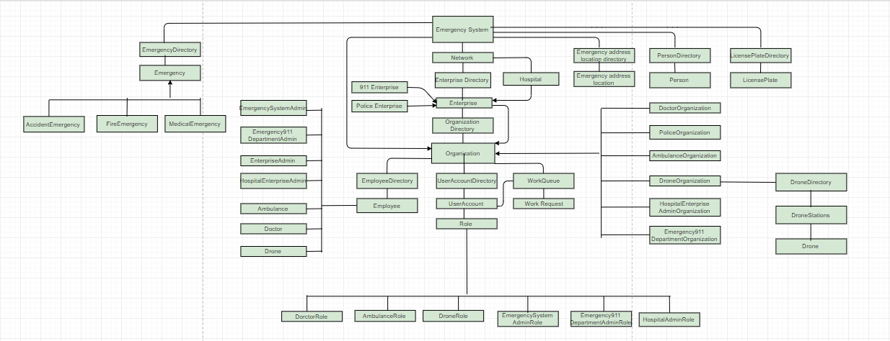
Object Model

Slide 10
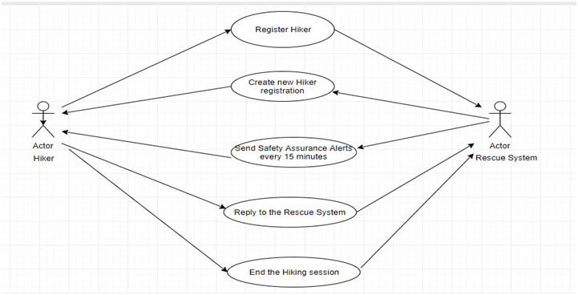
Usecase

Slide 11
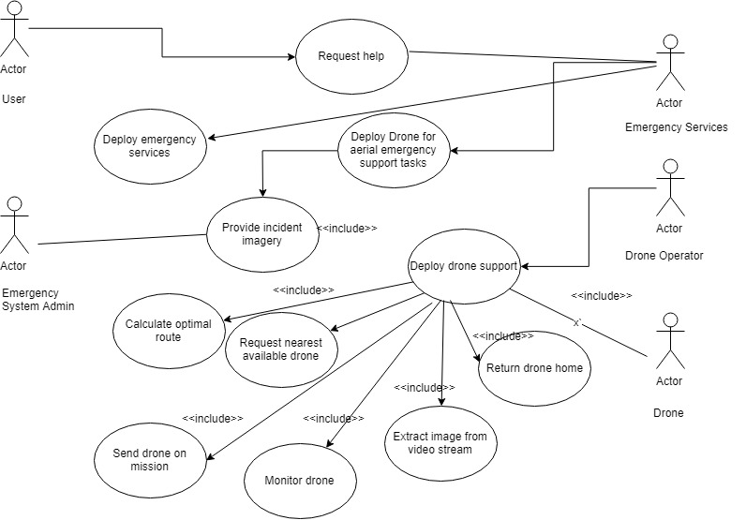
Usecase

Slide 12
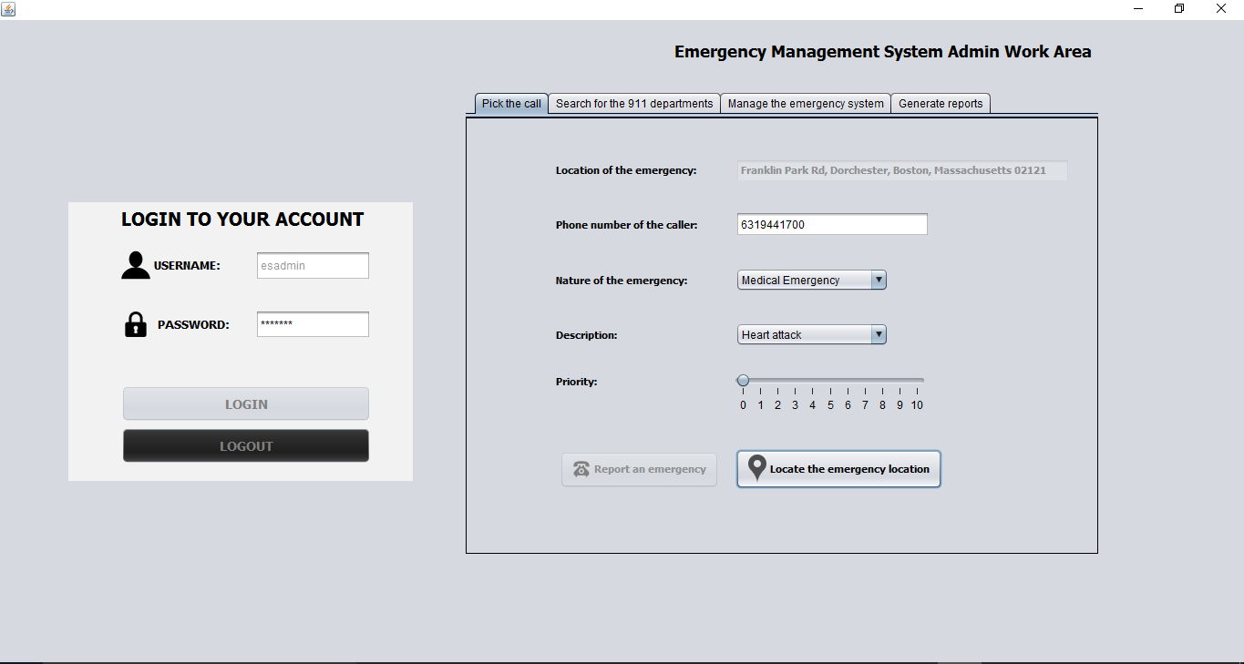
Screenshots

Slide 13
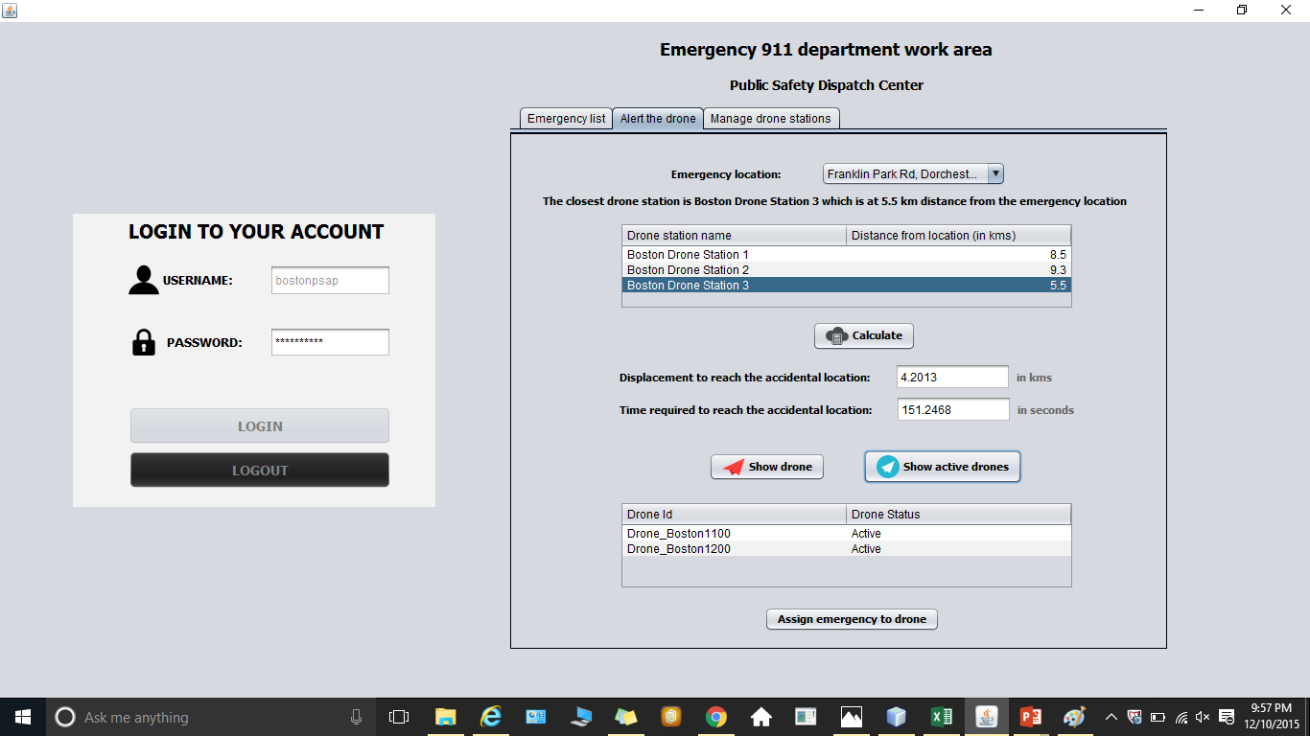
Screenshots

Slide 14
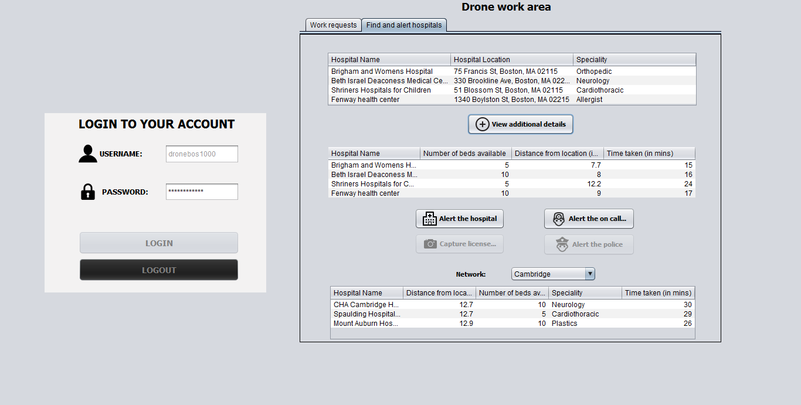
Screenshots

Slide 15
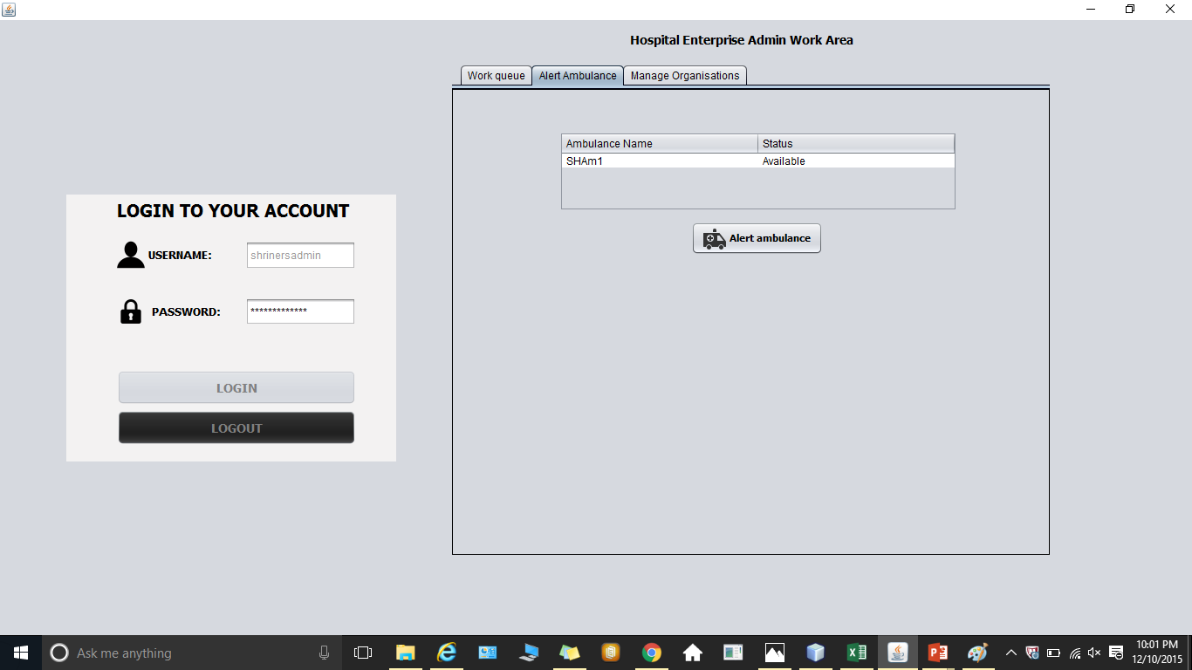
Screenshots

Slide 16
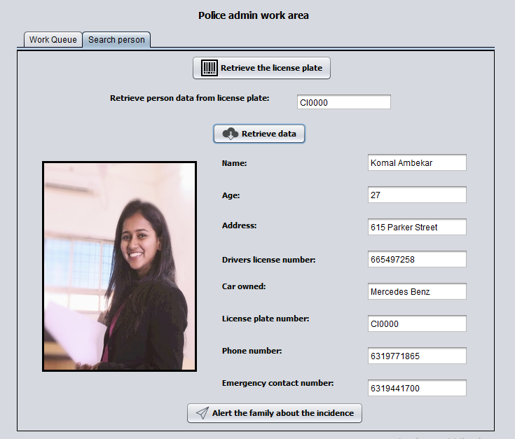
Screenshots

Slide 17
Thank You

