Slide 1

Computer Engineering Department
A.P. Shah Institute of Technology
G.B.Road,Kasarvadavli, Thane(W), Mumbai-400615
UNIVERSITY OF MUMBAI
Academic Year 2019-2020

Slide 2
A Project Report on
Chatbot – Pizza Ordering
Submitted in partial fulfillment of the degree of
Bachelor of Engineering(Sem-7)
in
Computer Engineering
By
Sayali Kamble(16102039)
Zahid Khan(16102051)
Vishal Jain(16102044)
Under the Guidance of
Prof. Archana Kotangale

Slide 3
1.Project Conception and Initiation

Slide 4
1.1 Abstract
Chatbots are computer programs that are developed using Artiﬁcial Intelligence for providing an easy interference between the computer and humans . The interaction can be textual or auditory depending upon the need. The technology at the core of the rise of the chatbot is Natural Language Processing(NLP). The project aims to develop a ’Pizza Ordering Chatbot’ for which We are going to develop a chatbot using dialogﬂow that incorporates machine learning expertise and products such as google cloud speech to text conversation . Chatbots can be used in Customer service , sales/marketing and also as a human resource .This pizza ordering Chatbot is beneﬁcial in many ways as it oﬀer mass communication service , improves customer satisfaction and reduces cost .

Slide 5
1.2 Objectives
Quick and easy to use interface for customers.
To support and scale up the business of a Pizza Restaurant .
Knowing the order patterns for frequent customers.

Slide 6
1.3 Literature Review
A. An Intelligent web-based voice chat bot
Salomon Jakob’s du Preez , Manoj Lall and Saurabh Sinha , An Intelligent Web-Based Voice Chat Bot, in EUROCON 2009, EUROCON ’09. IEEE, 2009, p. 386
The major technological enhancement in this research is integrating speech recognition and text to speech converter.
B. Chinese Intelligent Chat Robot Based on the AIML
Wei Yun-Gang, Sun Bo, Sun Ming-Chen, Zhao Cui-Yi, and Ma PeiZi, “Chinese Intelligent Chat Robot Based on the AIML language”, in Sixth International Conference on Intelligent Human-Machine Systems and Cybernetics, 2014, p. 368
This paper explains the language enhancement in the field of chatting bot .AIML can be used not only to develop bots in English Language but also in many other foreign languages such as Chinese and Japanese .

Slide 7
C. Development and Implementation of a chat bot in a Social Network
Salto Mart´ınez Rodrigo, Jacques Garc´ıa Fausto Abraham, Development and Implementation of a Chat Bot in a Social Network, in Ninth International Conference on Information Technology - New Generations, 2012, p. 751
This paper describes the linking of chat bot with social network like twitter to entertain the users.
D. Nsmav-Bot: Intelligent Dual Language Tutor System
Sambit Mohapatra ; Neeraj Shukla ; Simoni Jain ; Shweta Chachra 2018 Fourth International Conference on Computing Communication Control and Automation (ICCUBEA)
To deal with low literacy rate of developing countries the paper aims to develop a bot that’s going to act as a tutor of standard education for age groups.
E. Design of information system architecture for the recommendation of tourist sites in the city of Manta, Ecuador through a Chatbot
David Arteaga ; Juan Arenas ; Freddy Paz ; Manuel Tupia ; Mariuxi Bruzza 2019 14th Iberian Conference on Information Systems and Technologies (CISTI)
The current paper will present a solution for the recommendation of tourist places of the city of Manta, Ecuador.

Slide 8
1.4 Problem Definition
To Design and Develop a Chatbot for a pizza restaurant that would overcome the problems like unable to keep track of ordering patterns for frequent customers and customer feedback .

Slide 9
1.5 Scope
The Proposed chatbot will be useful in easy handling a pizza restaurant app . This chatbot will help a customer to order a pizza using a text or voice based chat . The customer will also be able to search for different variety of pizza options available using the chat console . The customer can also apply the coupons and then calculate the total payable amount for the pizza .

Slide 10
1.6 Technology stack
Dialogflow
Dialogflow is an end-to-end , build-once deploy-everywhere development suite for creating conversational interfaces for websites , mobile applications ,messaging platforms and IoT devices .
Android Studio
Development of an android application .

Slide 11
1.7 Benefits for Society
Accessible anytime
More time is been wasted till operators connect customers to a customer care executive. They are replacing live chat and other forms of slower contact methods such as emails and phone calls.
Handling Capacity
Unlike humans who can only communicate with one human at a time, chat bots can simultaneously have conversations with thousands of people. No matter what time of the day it is or how many people are contacting you, every single one of them will be answered immediately.

Slide 12
2. Project Design

Slide 13
2.1 Proposed System
The given system will be a chatbot that will be simply intergrated with a pizza ordering existing system . The process of ordering a pizza becomes much more simpler with the help of a bot . A customer can search for variety of pizzas , choose, customize and check for prices of the pizza using the chatting interface .

Slide 14
2.2 Design(Flow Of Modules)
Intents
Entities
Context

Slide 15
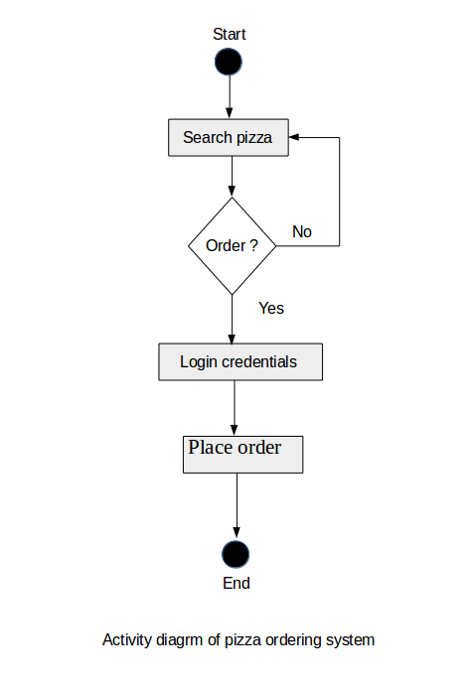
2.3 Activity diagram

Slide 16
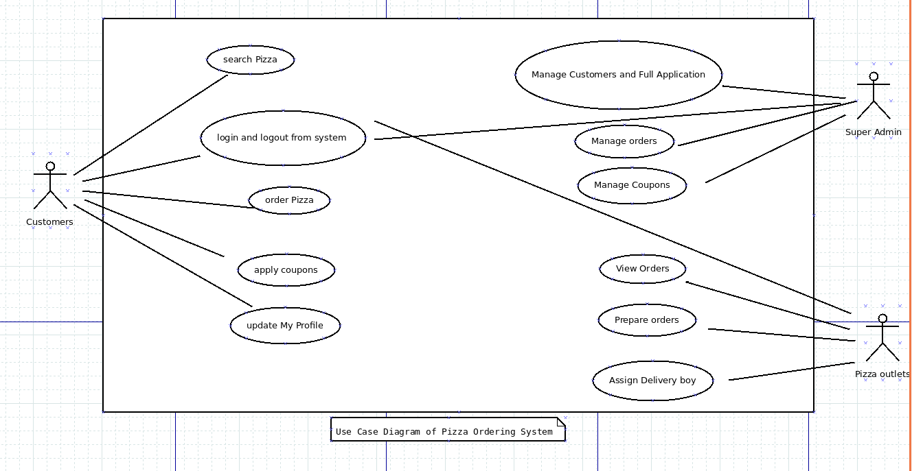
2.4 Use Case Diagram

Slide 17
2.5 Description Of Use Case
Customers can search for different type of pizzas , if they wants to order a pizza then they need to provide login id and password details and then the order gets placed . Customers can also check prices of the pizza , apply suitable coupons and update their profiles .
A pizza delivery outlet can see the placed orders , prepare for them and subsequently assign a delivery boy to drop the order .
A super admin can will have full control over the application .

Slide 18
2.6 Module-1 : Intents
Intents are the words that replace the entire sentence written by a end-user . Intents basically categories the users intentions behind a conversation . Dialogflow matches the end-user expression to the best intent in the given agent . This is also called as intent classification . Intents are defined are with a prefix ‘#’.
A basic intent contains the following :
Training Phrases : These are the sentences provides by the developer as a form of examples .
Actions : When an intent is match dialogflow performs the given action for that intent.

Slide 19
Parameters : When an intent is match dialogflow gives the values of the expression of the end-user as the parameter .
Responses : The defined text/speech form the response for the end-user’s queries .

Slide 20
Module-2 : Entities
Each intent parameter has a type called the entity type , which dictates exactly how data from and end-user sentence is extracted .Entities are nouns that we use in normal world .Entities are defined by the prefix ‘@’.
The further classification of entities can be :
Entity Type :Entity type defines the information that the system wants to extract from user input .
Entity Entry : Entity entry provides a set of words or phrases that are considered equivalent . Each entity type there are many entity entries.

Slide 21
Entity Reference Values and Synonyms : For each entity entries the system defines a reference value and one or more synonyms .
Dialogflow provides some system entities . System entities are pre-build entities that facilitates handling popular common concepts .
Some of the system entities are :
@sys.date-time
@sys.date
@sys.time
@sys.number

Slide 22
Module-3 : Contexts
Dialogflow contexts are similar to natural language context . Using contexts , one can control the flow of a conversation .
Configuration of context for an intent is done by setting input and ouput contexts. whenever an intent is matched , any configured output contexts for that intent become active .
Dialogflow will only match intents that are configured with input contexts that match the currently active contexts .

Slide 23
2.7 References
https://cloud.google.com/dialogflow/docs
https://chatbotslive.com
https://console.dialogflow.com

Slide 24
3.Planning for next semester

Slide 25
Planning
Implementation of the proposed modules and various other modules such as events and Integration will be done .
Direct interaction of Dialogflow’s API with user interface will mapped .
Since Dialogflow’s NLP is based on machine learning, training data will be added that helps the agent learns from and improve its performance.

Slide 26
Thank You

