Slide 1
A. P. Shah Institute of Technology
Project Guide Allotment
(PGA)
ICASTe-2018

Slide 2
- -GROUP MEMBERS- -
SAYALI KAMBLE
ZAHID KHAN
ASHISH KOTHARI
- -GUIDE- -
MARLIN JACCOB
ICASTe-2018

Slide 3
Point To Cover Presentation
Abstract
Introduction
Problem Statement / Problem Definition
Proposed System
Implementation / Technologies Used
ScreenShots of GUI/Code Snippets
Conclusion
ICASTe-2018

Slide 4
ABSTRACT
As part of Mumbai University curriculum, a student is normally required to undertake a research oriented project in their final year of study.
Aim of the final year project to develop student’s knowledge for solving technical problems through structure project research.
The project is very important component for students as it provides the students with the opportunity to design undertake or conduct an independent research or study related to their degree course.
Upon completion of Final year project, student should be able to Identify and describe the problem and scope of project clearly, collect, analyze and present data into meaningful information using relevant tools, select, plan and execute a proper methodology in problem solving, work independently and ethically, present the results in written and oral format effectively and identify basic entrepreneurship skills in project management.
ICASTe-2018

Slide 5
INTRODUCTION
Colleges, Universities or any Educational Institutes conduct projects for the better understanding of the practical approach towards the subject in the real world.
And the project involves a lot of tasks like abstract or synopsis evaluation, thesis correction and updating the proposed module with your guides.
Previously project tasks are done with no synchronization and in the traditional manner which consumes a lot of time and efforts.
And also the data related to project has no place to store at one place.
Also project tasks consist of Group formation, Project topic allotment, Guide allotment, Marks distribution etc.
It will help the students as well as their guides to evaluate the report of the projects from anywhere, anytime.
ICASTe-2018

Slide 6
PROBLEM STATEMENT
Creating Database and accepting the values from user.
Allotting the proper match of Domain of his/her interest with Faculty of same Domain of interest and Experience.
ICASTe-2018

Slide 7
PROPOSED SYSTEM
The PGA System will comprise of multiple module that will provides the user with a suitable project and interest
Modules in PGA
User Module
Faculty module
Domain module
ICASTe-2018

Slide 8
IMPLEMENTATION / TECHNOLOGIES
USED
HTML5
CSS3
PHP 7
MYSQL
JavaScript.
ICASTe-2018

Slide 9
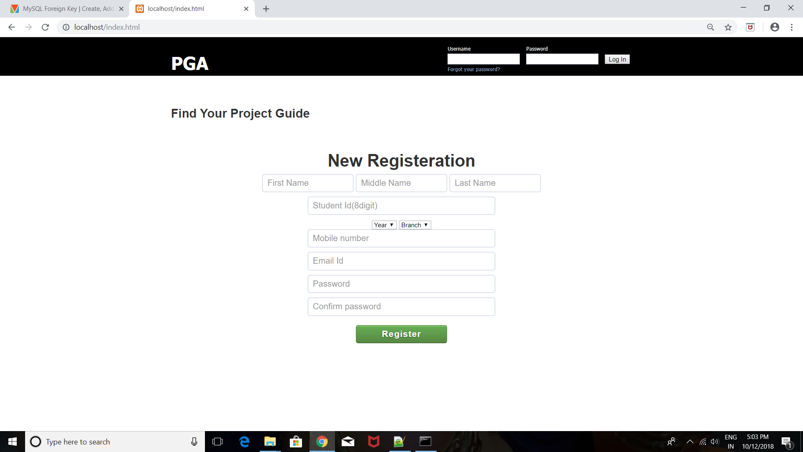
SCREENSHOTS OF GUI/CODE SNIPPETS
ICASTe-2018

Slide 10
CONCLUSION
The resulting Web Portal allots project to students according to domain, if the domain of teacher matches with the domain of students.
ICASTe-2018

Slide 11
Questions ?******
ICASTe-2018

Slide 12
“A Teacher/Guide are like candle- it consume itself to light the way for other”
THANK YOU!
.().
ICASTe-2018

Slide 13
ICASTe-2018

