Slide 1

Online Quiz Portal
Presented By :Sayali Kudale

Slide 2
OVERVIEW
The online Quiz portal is a 3-tier web-based application developed using Java, EJB, MySQL, Servlets, and Apache NetBeans IDE.
Using this system, students can login and give various programming languages quizzes.
Students can view the results of the previous quizzes.
Admin can login to the portal and manage the quizzes.
Admin can create or delete the quizzes.

Slide 3
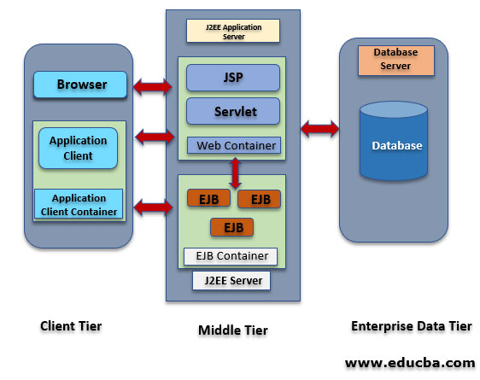
ARCHITECTUTRAL DESIGN

Slide 4
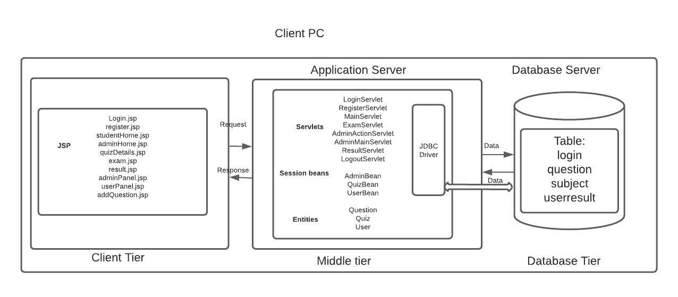
Implemented Architecture

Slide 5
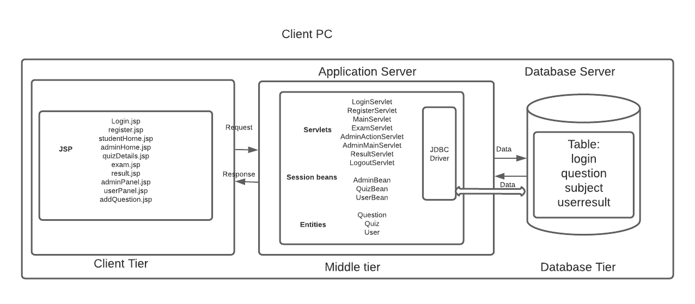

Slide 6
Project Status at the time of presentation
Completed features:
Student Login
Admin Login
View available Quizzes
Take quizzes
Evaluate the Result
View Previous quiz Results
To Do :
Create and delete tests for Admin
Add database server to virtual machine

Slide 7
Final Project Status
Completed features:
User Registration
User Login
Admin Login
View available Quizzes
Take quizzes
Evaluate the Result
View Previous quiz Results
Add questions to the test for Admin
View results of the all the students
database server to azure service

Slide 8

Thank you

