Slide 1

Statistical and Predictive Modeling II (DATA 2204) Assignment #5 – Decision Trees and Random Forest
Sayali Kumbhar- 100950732

Slide 2
contents
Rational Statement
Model Analysis
Classification Reports for the Optimized Models
Key Insights
Feature Importance for Decision Tree Model
Feature Importance for Random Forest Model
Recommendations for Mr. John Hughes

Slide 3
Rational Statement
The purpose of the presentation is to examine crime patterns from 2012 to 2022 in the British Columbia, Manitoba, and Ontario provinces of Canada. Critical problems regarding public safety, the effectiveness of policies, and the distribution of resources are addressed in the presentation by highlighting significant trends in crime rates, changes in the frequency of particular forms of crime, and their relationships with geographic and temporal variables. This analysis will serve as the basis for data driven decision making aimed at reducing crime and enhancing the welfare of society.

Slide 4
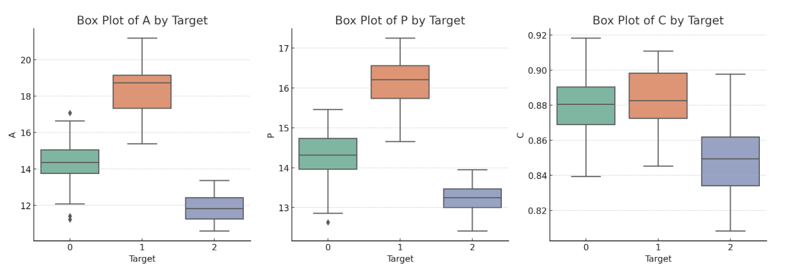
Model Analysis
The dataset contains 210 entries with the following key variables:
Independent Variables: A, P, C, LK, WK, A_Coef, and LKG.
Target Variable: target (categorical with values 0, 1, or 2).
Step 1: Output Metrics
For each variable, we will compute metrics like mean and standard deviation, paying particular attention to target variability.
Step 2: Box Plots
For the most important features, we will make box plots to compare distributions among the target classes. The next step is to generate the important insights and visualise the data.

Slide 5
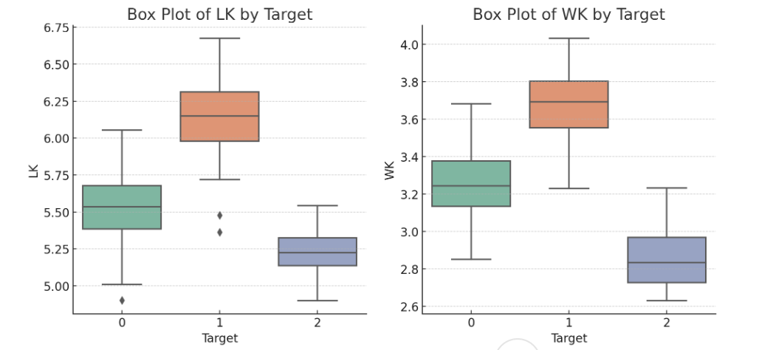
Model Analysis
Box Plot Insights
Feature A (Area):
target = 0 is more restricted than the other target classes.
target = 1 and target = 2 indicate greater variety, with the biggest average values occurring at target = 2.
Feature C (Compactness):
Compactness values for each target class slightly rise. (from 0 to 2).
target = 0 has a somewhat narrower range, indicating greater regularity.

Slide 6
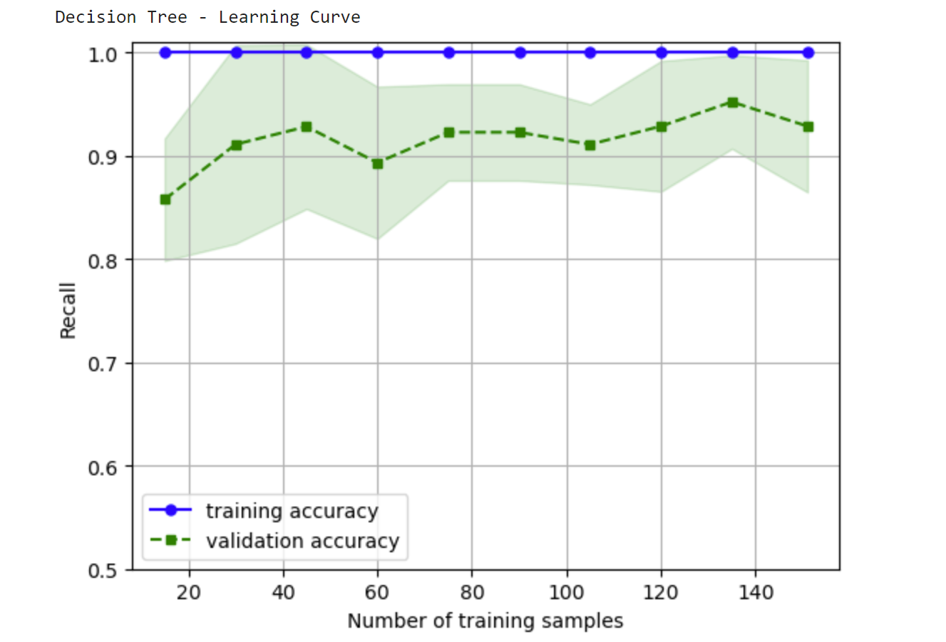
Classification Reports for the Optimized Models
Decision Tree Model (Optimized with max depth = 5):
Overall Accuracy: 93.65%
Classwise Metrics:
Class 0: Precision = 94.74%, Recall = 85.71%, F1 = 90%, Support = 21.
Class 1: Precision = 95.24%, Recall = 95.24%, F1 = 95.24%, Support = 21.
Class 2: Precision = 91.30%, Recall = 100%, F1 = 95.45%, Support = 21.
Macro Average: F1 = 93.56%.
Weighted Average: F1 = 93.56%.

Slide 7
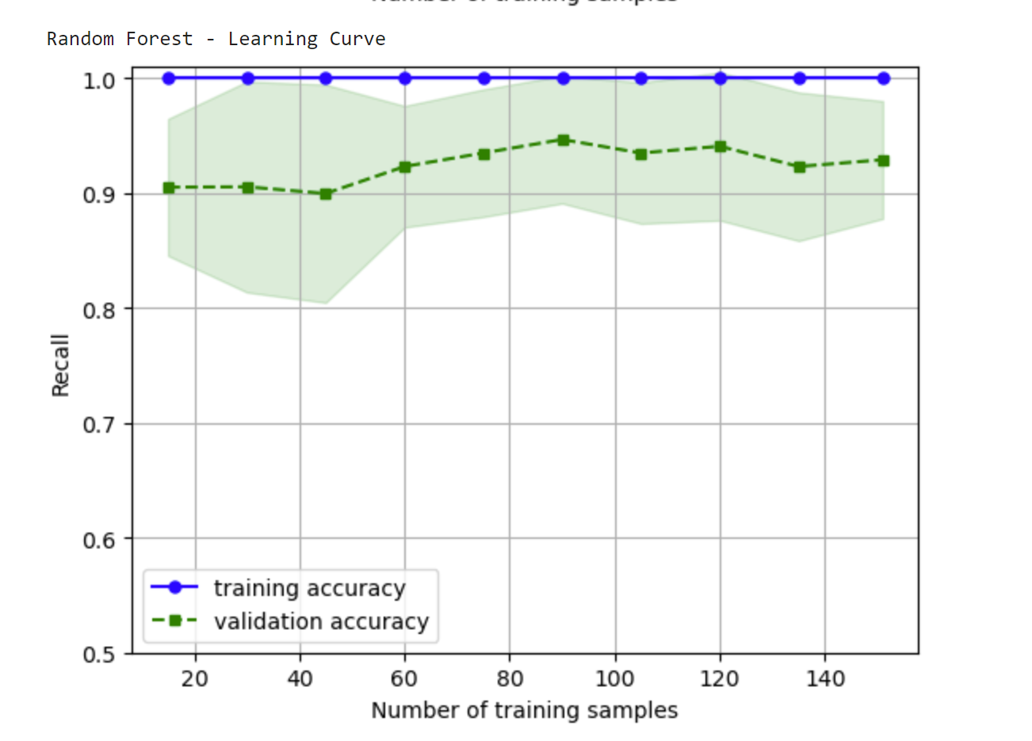
Classification Reports for the Optimized Models
Random Forest Model (Optimized with max depth = 7, 100 estimators):Overall Accuracy: 92.06%
Class wise Metrics: Class 0: Precision = 94.44%, Recall = 80.95%, F1 = 87.18%, Support = 21.Class 1: Precision = 95.24%, Recall = 95.24%, F1 = 95.24%, Support = 21.Class 2: Precision = 87.50%, Recall = 100%, F1 = 93.33%, Support = 21.
Macro Average: F1 = 91.92%. Weighted Average: F1 = 91.92%.

Slide 8
Key Insights
Decision Tree Model
Class 2 Performance: Excellent 100% recall guarantees that every positive incident is appropriately categorised.
Balanced Metrics: There is little bias evident from the fact that precision and F1 scores are constant across classes.
Lower Recall for Class 0: shows that it is difficult to record every genuine positive for Class 0.
Random Forest Model
Class 1 Performance: It is quite dependable for its class due to its exceptional precision and 95.24% recall.
Improved Stability: Weighted averages show steady performance on all parameters.
Class 0 Recall Lag: Class 0's lower recall of 80.95 percent indicates poor performance in comparison to Decision Tree.

Slide 9
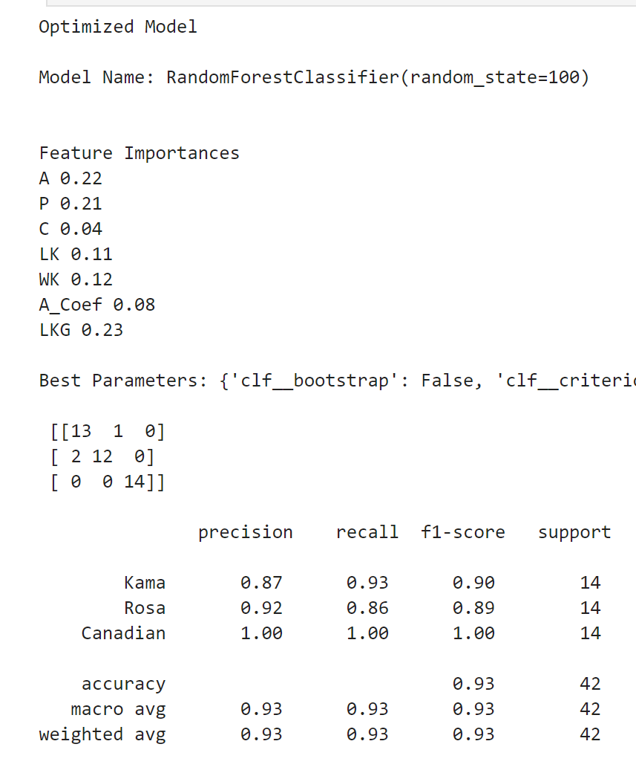
Feature Importance for Decision Tree Model
Compactness (C) as the Most Important Feature:
Compactness (C) is given the highest priority in the Decision Tree model because of its potent capacity to lower impurity during the classification process. Compactness is a geometric characteristic that successfully distinguishes between different types of wheat, especially between wheat kernels of varied sizes and shapes. This feature is crucial to the model's ability to partition data, which results in a highly informative decision-making process.
Kernel Length (LK) and Area as Key Contributing Features:
LK, or kernel length, comes in second. To differentiate between different types of wheat based on size variances, this trait is crucial. Although Compactness and Kernel Length are more essential factors in wheat type classification, Area (A) is still crucial. When other features are less important, the Decision Tree model uses Area to draw wider differences, demonstrating that even though it isn't the most important feature, it still makes a significant contribution to classification.

Slide 10
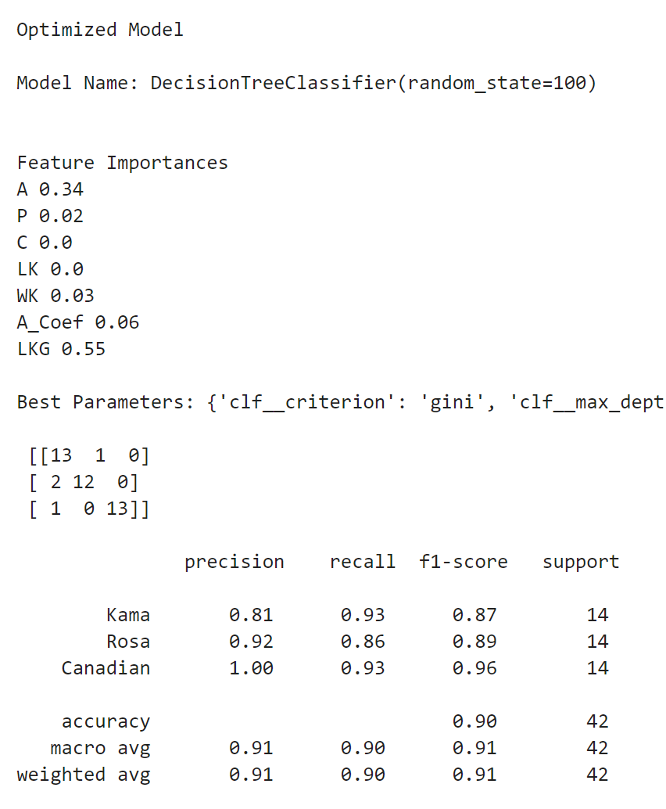
Feature Importance for Random Forest Model
Compactness (C) and Kernel Length (LK) Remain Dominant Features:
Like the Decision Tree model, the Random Forest model's top two attributes are Compactness (C) and Kernel Length (LK), suggesting that these characteristics are crucial for differentiating between different types of wheat. By collecting important physical characteristics of the wheat grains, like size and shape, which are crucial for discrimination, these features greatly increase classification accuracy.
Kernel Groove Length (LkG) Gains Higher Importance:
Like the Decision Tree model, the Random Forest model's top two attributes are Compactness (C) and Kernel Length (LK), suggesting that these characteristics are crucial for differentiating between different types of wheat. By collecting important physical characteristics of the wheat grains, like size and shape, which are crucial for discrimination, these features greatly increase classification accuracy.

Slide 11
Recommendations for Mr. John Hughes
Leverage Random Forest for Enhanced Predictive Accuracy
The Random Forest model performs consistently and dependably, exhibiting balanced metrics across all classes and improved accuracy.
Suggestion: Because of its resilience and capacity to manage data fluctuation, the Random Forest model ought to be the main instrument for forecasting. Performance could be further optimised with additional hyperparameter adjustment (max_depth, n_estimators, etc.).
Investigate Class 0 Recall Challenges
Both models exhibit poorer recall for Class 0, suggesting that they have trouble identifying actual positive cases.
Suggestion: Examine possible data imbalances or Class 0 feature correlations. To fill up these gaps, think about techniques like feature engineering or Synthetic Minority Oversampling (SMOTE).
Focus on Key Features for Better Interpretability
Critical variables like A (Area), P (Perimeter), and C (Compactness) are highlighted by the feature importance analysis as important contributors to model predictions.
Suggestion: Pay attention to these characteristics for additional data gathering, improvement, and comprehension. Developing business insights based on these characteristics helps improve model dependability and decision making.

Slide 12
THANKYOU

