Slide 1

Statistical and Predictive Modeling II (DATA 2204) Assignment #3 – Discriminant Analysis
Submitted by: SAYALI KUMBHAR

Slide 2
CONTENTS
Rational Statement
Two Key Insights
Confusion Matrix/Classification Report for the Optimized LDA and QDA
Comparison of Optimized LDA vs. QDA Models
Three Key Insights from the Comparison
Recommendations for Mr. John Hughes

Slide 3

Rational Statement
Based on the study and dataset, this presentation discusses important issues and insights related to the production of wheat. Understanding patterns, trends, and possible inefficiencies in wheat yield and related variables is the goal. This entails examining a number of variables, including the volume of wheat produced, its geographic distribution, and any observable long-term trends. The report also identifies important areas where productivity gains could have an effect on market economics and the supply chain. The ultimate objective is to extract useful information for improved agricultural sector decision-making, with a particular emphasis on streamlining the procedures involved in wheat production and distribution.

Slide 4

Two Key Insights
Insight 1: Distribution of Wheat Yield Values
The distribution of wheat yield across various locations exhibits a notable skew, as seen by the Pandas Profiling Report. Just a tiny fraction of the regions achieve noticeably better yields, with the bulk of the data being concentrated around lower yield levels. This points to an imbalance in wheat output, most likely brought on by regional variations in resource availability, technology, and the environment. This realisation necessitates a closer examination of the areas with lower yields as well as possible initiatives to raise production through improved farming methods, the use of technology, or the distribution of resources.
Explanation:
What is noticed? There is a concentration of lower yield values and a small number of areas with very high productivity in the unequal distribution of wheat output. Why is that relevant? It draws attention to the underperforming regions' potential for major improvements, which could result in higher wheat output overall.

Slide 5
Two Key Insights
Insight 2: Missing Data Patterns
The report also identifies important variables with missing values. Due to the possibility that they are associated with areas or times when data collection is inconsistent or lacking, these missing data points could add bias into the analysis. In order to make sure that the analysis results are reliable and representative of real trends, it is essential to understand where and why this data is lacking. To close these gaps, targeted data collection initiatives or data imputation may be required.
Explanation: What can be seen? The dataset has a nontrivial quantity of missing data for several variables. For what reason is it important? Inaccurate findings might result from missing data, which can compromise the analysis's validity. Finding these gaps guarantees that judgements made in the future are supported by accurate and comprehensive data and aids in the dataset's refinement.

Slide 6
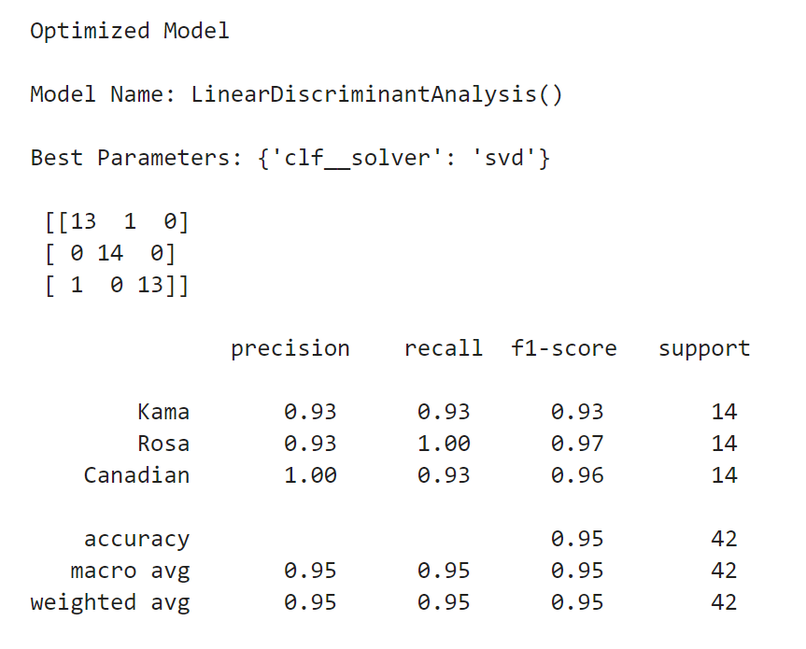
Optimized LDA model
Three Key Insights for LDA:
High Precision for all classes – Canadian wheat, interestingly, receives a precision score of 1.00, indicating that every prediction assigned to it was accurate.
Perfect Recall for Rosa class (1.00) - False negatives were avoided in the accurate identification of every Rosa sample.
Balanced F1-scores (~0.95 across all) – This implies that each class exhibits consistent performance due to a well-balanced recall and precision.

Slide 7
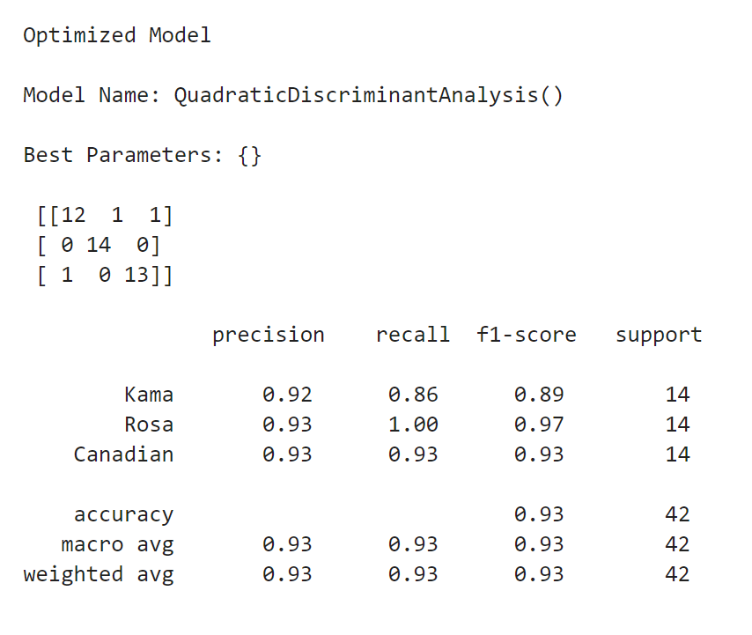
Optimized QDA Model
Three Key Insights for QDA:
Slightly Lower Recall for Kama (0.86) – In comparison to the LDA model, the recall of some Kama samples was reduced due to incorrect classification.
Consistent High Precision across classes (~0.92-0.93) – This demonstrates that accurate positive predictions may still be made using the QDA model.
Balanced Accuracy and Macro Average (~0.93) – When compared to LDA, QDA performs well but a little less consistently; little misclassifications have an impact on total accuracy.

Slide 8
Comparison of Optimized LDA vs. QDA Models
Metric | LDA | QDA
Accuracy | 0.95 | 0.93
Kama (Precision) | 0.93 | 0.92
Kama (Recall) | 0.93 | 0.86
Rosa (Precision) | 0.93 | 0.93
Rosa (Recall) | 1.00 | 1.00
Canadian (Precision) | 1.00 | 0.93
Canadian (Recall) | 0.93 | 0.93
Macro Avg. Precision | 0.95 | 0.93
Macro Avg. Recall | 0.95 | 0.93
Macro Avg. F1-Score | 0.95 | 0.93

Slide 9
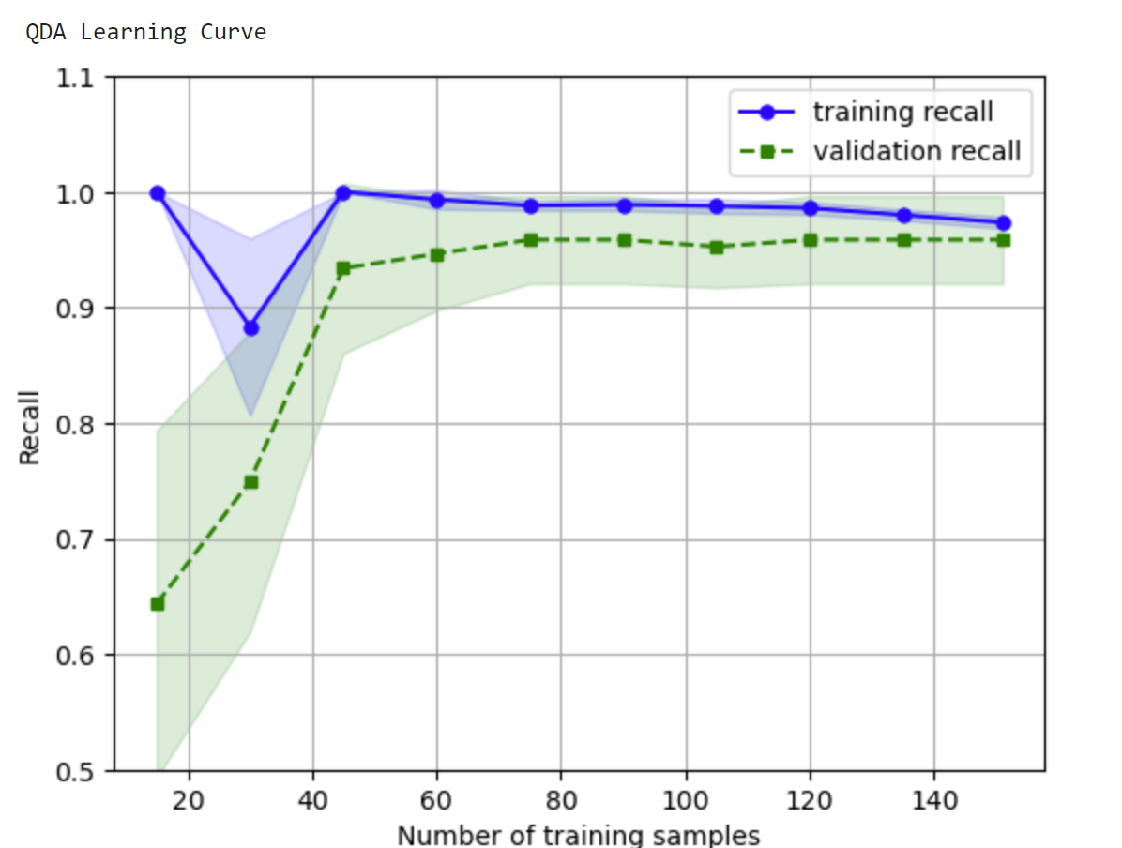
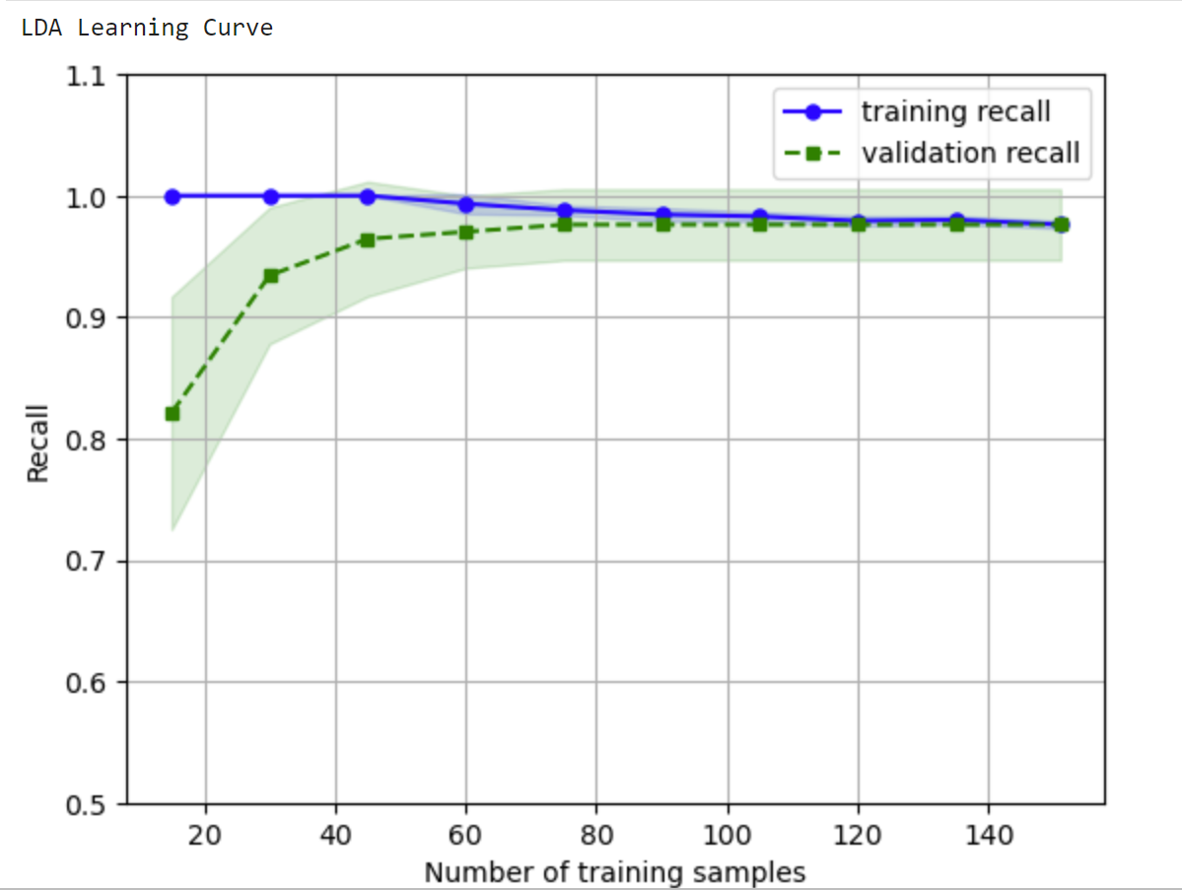
Three Key Insights from the Comparison
Accuracy and Consistency: LDA outperforms QDA somewhat more accurate at 95% than QDA's 93%. This suggests that the LDA model has less classification mistakes overall.
Recall for Kama Wheat: With a higher recall of 0.93 for Kama, LDA is able to properly identify 93% of Kama samples. However, QDA's recall is lower at 0.86, meaning that more Kama samples were incorrectly identified.
Precision for Canadian Wheat: LDA obtains perfect precision of 1.00 for Canadian wheat, indicating that all of the Canadian predictions were accurate. By contrast, the precision of QDA is marginally lower at 0.93, leading to a small number of false positives for wheat from Canada.

Slide 10
recommendations for Mr. John Hughes
Recommendation 1: Focus on Addressing Data Imbalance and Missing Values
The Pandas Profile Report found missing data in important variables and an imbalance in the distribution of wheat yield. It is advised that Mr. John Hughes look into the following issues more thoroughly: Afterwards: Where there are gaps in the data, work with stakeholders to fill them in. To fill in the missing variables, apply data imputation techniques or carry out focused surveys. Furthermore, investigate the causes of yield imbalances, such as geographical variations in agricultural methods or technological accessibility, and suggest customised actions to boost output.

Slide 11
recommendations for Mr. John Hughes
Recommendation 2: Leverage LDA for Better Predictive Accuracy
The comparison between the LDA and QDA models reveals that LDA performs somewhat better overall in terms of prediction, especially when it comes to precision and F1score. In light of this, it is advised that Mr. John Hughes give the LDA model top priority for next forecasts: Afterwards: For supply chain planning, resource allocation, and wheat production forecasting, use the LDA model. As new data becomes available, add it to the model and use feature engineering to further enhance its prediction potential.

Slide 12
THANK YOU

