Slide 1

Statistical and Predictive Modeling II (DATA 2204) Final Project
Sayali Kumbhar (100950732)
Date: December 10, 2024

Slide 2
Contents
Problem statement
3 Key Insights
Logistic Regression Learning Curve
Naive Bayes Learning Curve
Classification Reports and ROC/AUC for Logistic Regression and Naive Bayes
Ensemble Voting Model Results
Next Steps to Enhance Usability

Slide 3
Problem statement
A wireless telecommunications company's client turnover is something that Mr. John Hughes wants to understand. Building a prediction model that pinpoints the main causes of customer attrition and assesses their effects is the aim, using the dataset that has been supplied. The collection consists of 3,333 records that contain information about the customer's account term, service consumption metrics, charges, call behaviors, and whether or not the client has churned. The principal aim is to forecast the probability of client attrition and offer practical insights to improve customer retention tactics.

Slide 4
3 Key Insights
1. Feature Importance and Correlation: Higher customer service calls are a substantial predictor of churn, as evidenced by the large correlation between the feature Customer Service Calls (CustServCalls) and churn. Frequent support interactions may increase the likelihood of customer attrition, maybe as a result of unsolved issues.
2. The aspect of data usage versus churn Data usage reveals a divide: greater turnover rates are seen among customers who use either very little or a lot of data. According to this pattern, churn may be caused by a lack of a data plan or discontent with the services provided.
3. Impact of Contract Renewal: One essential component is contract renewal. The importance of customer retention tactics during contract renewal periods is shown by the noticeably higher likelihood of churn among customers who chose not to renew their contracts. By skipping the summary page and concentrating on the in-depth portions of the Pandas Profiling report, such as feature interactions, correlations, and variable importance plots, these insights are obtained.

Slide 5
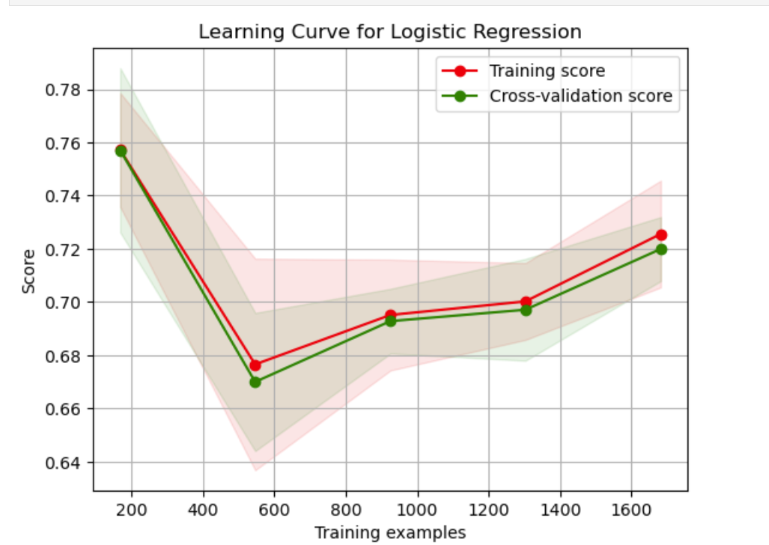
Logistic Regression Learning Curve
Overfitting Observed:
Indicating overfitting, the training score is noticeably greater than the validation value. Because logistic regression fits the training data too well, it has trouble generalising.
Performance Plateaus with More Data:
The accuracy of validation is not considerably increased by adding more training instances. Based on the available features and hyperparameters, this suggests that the model has learnt as much as it can.

Slide 6
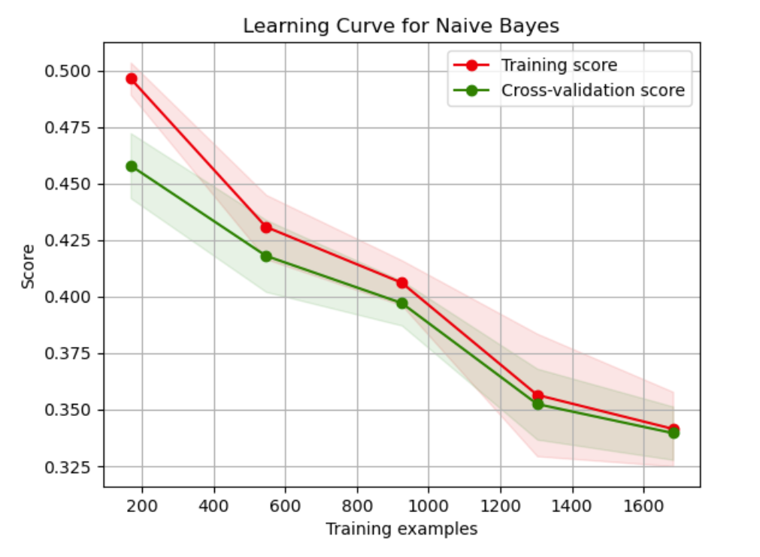
Naive Bayes Learning Curve
High Bias:
The ratings for training and validation are both rather low and near one another. A high-bias model is indicated by the Naive Bayes algorithm's underfitting of the data.
Consistent Generalization:
All training sizes show a minimal difference between training and validation scores. Even with sparse data, this demonstrates that Naive Bayes generalises reliably, however it might miss intricate correlations in the data.

Slide 7
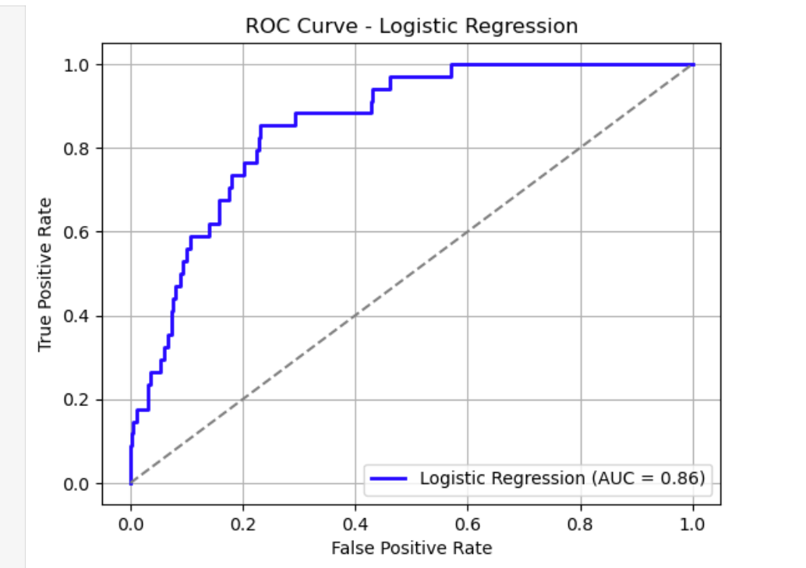
Classification Reports and ROC/AUC for Logistic Regression
Classification Report:
Precision for churn (class 1): 0.16 , Recall for churn (class 1): 0.88 , F1-Score for churn (class 1): 0.28 , Weighted accuracy: 70%. ROC/AUC: AUC = 0.72
Key Insights for Logistic Regression:
High Recall for Churn Class: A large percentage of churners are accurately identified by logistic regression (recall = 0.88). Because of this, it is useful for reducing missed churn cases.
Low Precision for Churn Class: For class 1, the precision is just 0.16, which indicates that many predicted churners are not real churners. Resource waste on clients who are mistargeted for retention initiatives may result from this.

Slide 8
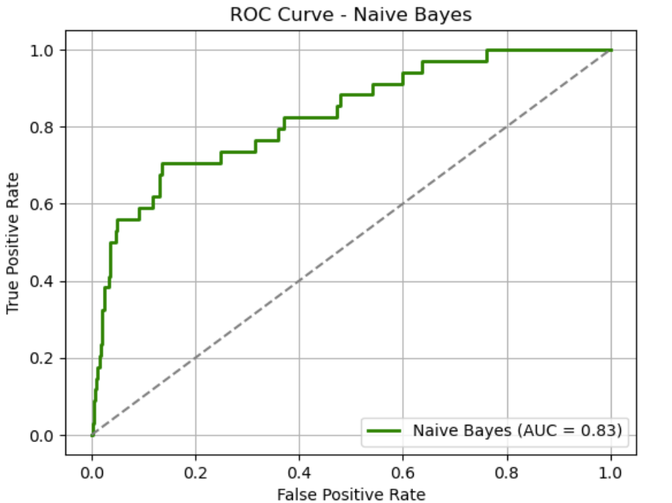
Classification Reports and ROC/AUC Naive Bayes
Classification Report:
Precision for churn (class 1): 0.09, Recall for churn (class 1): 0.97, F1-Score for churn (class 1): 0.16 , Weighted accuracy: 35%. ROC/AUC: AUC = 0.65
Key Insights for Naive Bayes:
High Recall for Churn Class: With a recall of 0.97, Naive Bayes captures almost all churners, just as Logistic Regression. This helps in cases where it would be very harmful to miss churners.
Poor Overall Precision and Accuracy: Because Naive Bayes misclassifies a large percentage of non-churners as churners, it is less dependable for actionable predictions, with a low overall accuracy (35%) and precision for churn of 0.09.

Slide 9
Ensemble Voting Model Results
Ensemble Voting Classifier 1 (Logistic Regression + Gradient Boosting):
Accuracy: 0.95
Key Insight: At 95% accuracy, this ensemble model has outstanding performance. The combination of Gradient Boosting and Logistic Regression enables it to efficiently utilise the advantages of both models, with Gradient Boosting improving performance on more intricate patterns.
Ensemble Voting Classifier 2 (Naive Bayes + Bagging):
Accuracy: 0.41
Key Insight: With an accuracy of just 41%, this model performs poorly, suggesting that the Naive Bayes model does not mix well with bagging. The significant bias of Naive Bayes restricts the model's capacity for effective learning, particularly when bagging is used.

Slide 10
Ensemble Model Insights
Ensemble Voting Classifier 1 proves that combining Logistic Regression with Gradient Boosting is effective, outperforming both Logistic Regression and Naive Bayes in terms of accuracy.
Ensemble Voting Classifier 2, Even though it is an ensemble, it performs significantly worse than Logistic Regression, indicating that using Naive Bayes and Bagging together is not advantageous in this situation.
Since it handles the complexity of the dataset better and has higher accuracy, the Voting Classifier 1 (Logistic Regression + Gradient Boosting) is the model that is most advised for Mr. John Hughes.

Slide 11
Recommended Model: Voting Ensemble (Logistic Regression + Gradient Boosting)
Based on the results and analysis of the models, the Voting Ensemble Classifier that combines Logistic Regression and Gradient Boosting is the most recommended model for Mr. John Hughes.
Justification:
Superior Accuracy: With the maximum accuracy of 95%, this ensemble model outperforms both Naive Bayes (35%), and Logistic Regression (70%).
Balanced Performance: Combining the linear model of Logistic Regression with the potent non-linear learning of Gradient Boosting allows the ensemble model to leverage the advantages of both, producing predictions that are dependable and strong, particularly when dealing with intricate data patterns.
Better Generalization: Compared to individual models, the ensemble approach is probably going to generalise better, which lowers the possibility of overfitting that was noted in logistic regression.

Slide 12
Next Steps to Enhance Usability
Hyperparameter Tuning and Model Optimization:
Next Step: Apply grid search or random search for hyperparameter optimisation to the ensemble's gradient boosting and logistic regression. The performance of the model can be further enhanced by adjusting parameters such as learning rate, regularisation strength (C for Logistic Regression), number of estimators, or tree depth for Gradient Boosting.
Reasoning: By adjusting the model's hyperparameters, it can improve prediction accuracy and lessen overfitting and underfitting. By taking this step, the model's performance in production will be even greater.
Data Balancing and Feature Engineering:
Next Step: Address class imbalance in the churn prediction problem by using strategies like under sampling or SMOTE (Synthetic Minority Over-sampling Technique). To increase the prediction potential of the model and exclude features that are highly linked or irrelevant, execute feature engineering or selection.
Reasoning: The model's performance may be distorted by an imbalance in the data, particularly when it comes to churn prediction. The model will perform better since it will be better able to learn from all classes if the dataset is balanced. Additionally, feature engineering guarantees that only the most significant and pertinent features are taken into account, enhancing the accuracy and efficiency of the model.

