Slide 1
Statistical and Predictive Modeling II (DATA 2204) Assignment #2 –Logistical Regression
Submitted by: SAYALI KUMBHAR

Slide 2
CONTEXT
Rational Statement
Learning Curve for the Logistical Regression standard model
Confusion Matrix/Classification Report
ROC/AUC Curve (Optimized Model)
Two recommendations

Slide 3
Rational Statement
The dataset provided contains key features related to wheat grains, which can be analyzed to gain insights into their characteristics and classification. Finding patterns in the data can help in effectively classifying the various types of wheat. This is the main goal of data analysis. Here are a few issues that come up:
1. Data Completeness and Quality: Preprocessing actions like addressing missing values and standardizing formats are necessary since the dataset may contain missing or inconsistent data points.
2. Feature Selection: Selecting which features are most crucial for prediction or classification might be difficult when there are many features. It could be essential to use feature engineering or reduction.

Slide 4
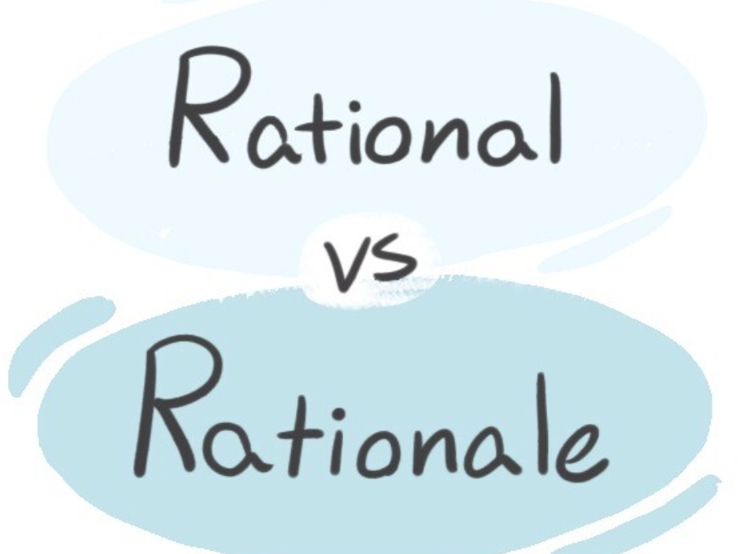
Rational Statement
3. Classification and Clustering: Our goal is to appropriately group or classify the wheat elements in the dataset, which most likely consists of multiple groups. To segment the data depending on parameters like kernel size or shape, it is important to select the appropriate algorithm (e.g., KMeans clustering, decision trees).
4. Model Evaluation: After classification models are constructed, it is necessary to assess how well they are working. Difficulties include making sure the model performs well in the absence of data and choosing the right metrics (such as accuracy, precision, and recall).
5. Results Interpretability: Effective communication of the final results is required. This involves realizing which elements are most important for categorization and how these might guide choices in practical applications like grain quality management.

Slide 5
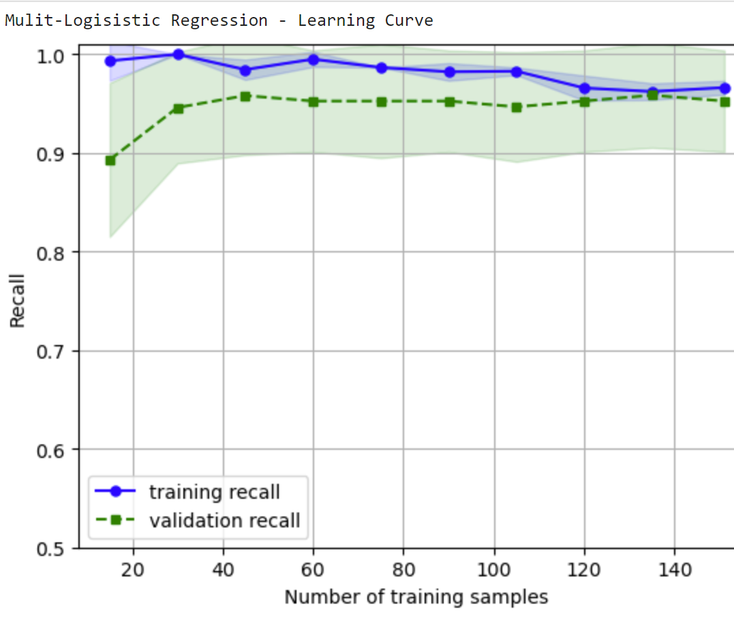
Learning Curve for the Logistical Regression standard model

Slide 6
Learning Curve for the Logistical Regression standard model
Training Recall: Initial overfitting decreases with increasing data, as seen by the fact that it starts high (~1.0 or 100%) with small training volumes and stabilizes at 0.96 (96%) with bigger datasets.
•Validation Recall: Rises to roughly 0.95 (95%) as training data accumulates, indicating increased generalization, from about 0.90 (90%) at modest training sets.
•Key Metrics: Training Recall at the End: about 0.96 (96%) Recall for Final Validation: around 0.95 percent (~0.95) Recall from Initial Validation: about 0.90 percent (~0.90)

Slide 7
Key insights on Learning Curve
Understanding the Learning Curve: The learning curve shows how a machine learning model's performance increases with increasing exposure to training data. The size of the training dataset is typically displayed against performance indicators like as accuracy, loss, or error.
Training versus Validation Performance: Two significant tendencies are evident in the learning curve: Performance of the model on the training set of data is shown by its training score. Model's ability to generalise to previously undiscovered data (validation set) is shown by the validation score. When additional data is utilised, a well-performing model will show better generalisation as the validation and training scores converge.
Inadequate and Excessive Fit: Excessive complexity and noise capture in the training data may indicate that the model is overfitting if the training score is high but the validation score stays low. Underfitting: A model is termed underfitting if it is too simplistic and fails to adequately represent the complexity of the data. This is indicated by poor scores for both training and validation.

Slide 8
Key insights on Learning Curve
4. The learning curve illustrates how a larger training set of data minimises overfitting. This is the fourth effect of data size. After a significant amount of data is used, the difference in scores between training and validation becomes smaller, improving the performance of the model.
5. Important Learnings: The initial stages First, both training and validation performance improve significantly with additional data. Diminishing returns: The performance of the model improves less when additional data is added beyond a certain point. This indicates the possibility of the need to take into account additional elements like feature engineering or model complexity. Ideal intricacy of the model: In order to prevent underfitting and overfitting, a balance needs to be struck between the amount of data and the complexity of the model.
The practical implications of learning curves can be used to inform decisions regarding the need for additional training data or the need to modify the model's complexity. A visual representation of the model's behaviour during training is also offered, which aids in diagnosing problems like inadequate generalisation.

Slide 9
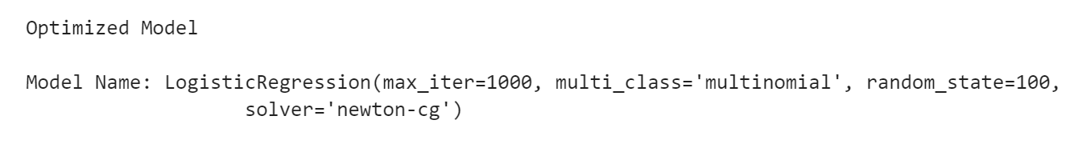
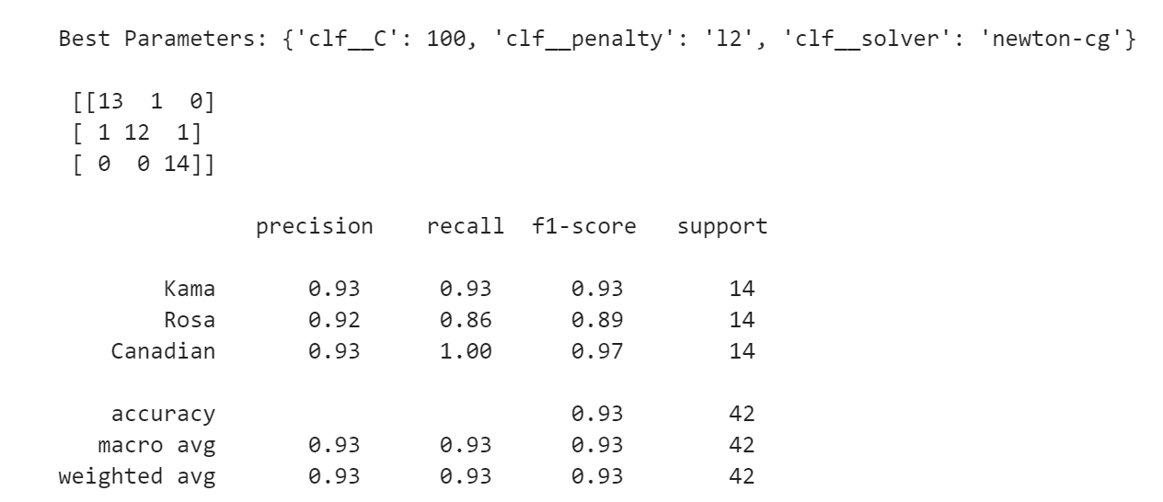
Analysis of Classification Report

Slide 10
Analysis of Classification Report
High Precision: With precision scores of 0.93, 0.92, and 0.93 for Classes 0 (Kama), 1 (Rosa), and 2 (Canadian), respectively, it is evident that the model is precise in its affirmative forecasts.
Recall Concerns: Compared to classes 0 and 2, which have recalls of 0.93 and 1.00 respectively, class 1 (Rosa) has a recall of 0.86. This implies that there may be a class imbalance because the model has trouble identifying some cases of the Rosa class.
Robust F1 scores: with a weighted F1-score of 0.93, the F1-scores are robust, ranging from 0.89 for class 1 to 0.97 for class 2. Based on precision and recall across classes, this indicates a well-balanced model.

Slide 11
Analysis of Classification Report
The classification report's main conclusions:
1. Precision: Precision indicates the proportion of correctly predicted observations for a given class.
Few false positives are associated with high precision.
2. Recall: Recall shows that all positive examples can be identified by the model. Few false negatives are associated with high recall.
3. F1-Score: The F1-score strikes a compromise between recall and accuracy. When minimising false positives as well as false negatives is crucial, it is helpful.

Slide 12
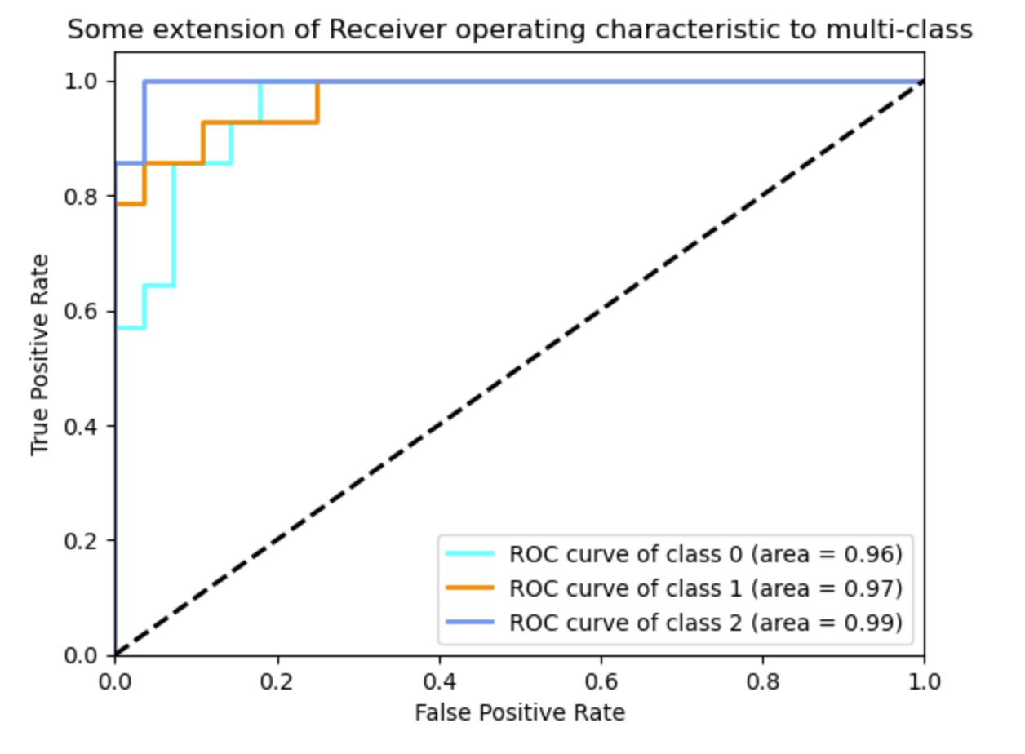
ROC/AUC Curve (Optimized Model)

Slide 13
ROC/AUC Curve (Optimized Model)
Excellent Performance in Differentiating Wheat Classes: The model has a 93% chance of accurately identifying positive examples, as indicated by its high AUC value of roughly 0.93.
Effective Class Separation: Class 1 (Rosa) has somewhat lower rates than classes 0 (Kama) and 2 (Canadian), indicating a need for improvement in class identification. The ROC curve indicates high true positive rates for these two classes.
In conclusion, there is a significant classification capacity of the optimised logistic regression model, especially when it comes to differentiating between Kama and Canadian wheat varieties. The correct identification of class 1 (Rosa) may be improved, though, and this is something that future investigations ought to pursue.

Slide 14
Two recommendations
1. Adjust the model's hyperparameters to improve it Why? By adjusting its hyperparameters, the performance of the existing model can probably be improved. Variables that greatly affect the model's accuracy and generalisability include learning rate, maximum depth (in tree-based models), and regularisation terms. Finding the ideal parameters may be aided by a grid search or random search, since the model results in the classification report may indicate areas for improvement in accuracy, precision, recall, or F1score. Reasons for Importance of This: By enhancing decision-making and decreasing false classifications, the model's fine-tuning may result in a more robust and trustworthy wheat quality forecast. With this strategy, the model is guaranteed to function well with a variety of data inputs.

Slide 15
Two recommendations
2. Collect and Incorporate Additional Data to Boost Model Robustness Why? The model's performance may be enhanced by gathering more varied and high-quality data. The dataset may not include every potential variation of wheat or every external factor that could affect the classification of wheat at this time. To improve generalisation and classification accuracy, adding additional samples will decrease prediction variance and bias. Reasons for Importance of This: A bigger dataset will help the model generalise better to new, undiscovered wheat kinds, improve accuracy, and lessen overfitting. Mr. John Hughes will also receive more trustworthy insights as a result of projections remaining relevant even as agricultural conditions alter over time.

Slide 16
THANK YOU

