Slide 1

Statistical and Predictive Modeling II (DATA 2204) Assignment #1 –Regression
Submitted by: SAYALI KUMBHAR

Slide 2
CONTEXT
Rational Statement
Regression Model
Multivariate Regression Model Output
R2 , MAE, RMSE metrics for the model

Slide 3

Rational Statement
We have been given a dataset called diamonds, and we have to perform OneHotEncoding to it and then create a multi linear regression model.
This dataset includes 9 Independent variables(carat , cut, color, clarity, x , y, z, depth, table and 1 dependent variable(Price).
This presentation will first convert the value using onehotencoding and then present the written form of regression and will present the regression model output.
This presentation will also give two recommendations for improving the performance of this model.

Slide 4
Regression Model
The general equation for a linear regression model is:
\[ Y = \beta_0 + \beta_1 X_1 + \beta_2 X_2 + \ldots + \beta_n X_n + \epsilon \]
Where: \( Y \) is the dependent variable (the outcome you want to predict).
\( \beta_0 \) is the intercept of the regression line (the value of \( Y \) when all \( X \) values are 0).
\( \beta_1, \beta_2, \ldots, \beta_n \) are the coefficients for each independent variable \( X_1, X_2, \ldots, X_n \) (these represent the change in \( Y \) for a one-unit change in the corresponding \( X \)).
\( X_1, X_2, \ldots, X_n \) are the independent variables (features or predictors).
\( \epsilon \) is the error term (the difference between the observed and predicted values of \( Y \), accounting for the variability in \( Y \) that cannot be explained by the linear relationship).
For a simple linear regression with one independent variable, the equation simplifies to: \[ Y = \beta_0 + \beta_1 X + \epsilon \]
Interpretation - Intercept (\( \beta_0 \)): The expected value of \( Y \) when \( X \) is 0.
Slope (\( \beta_1 \)): The change in \( Y \) for a one-unit increase in \( X \).
Multiple Linear Regression
For multiple independent variables, the model reflects the combined effect of all predictors on the dependent variable, allowing for a more complex relationship to be captured.
This linear regression equation is foundational in statistical modeling and machine learning, providing insights into relationships between variables and enabling predictions.

Slide 5
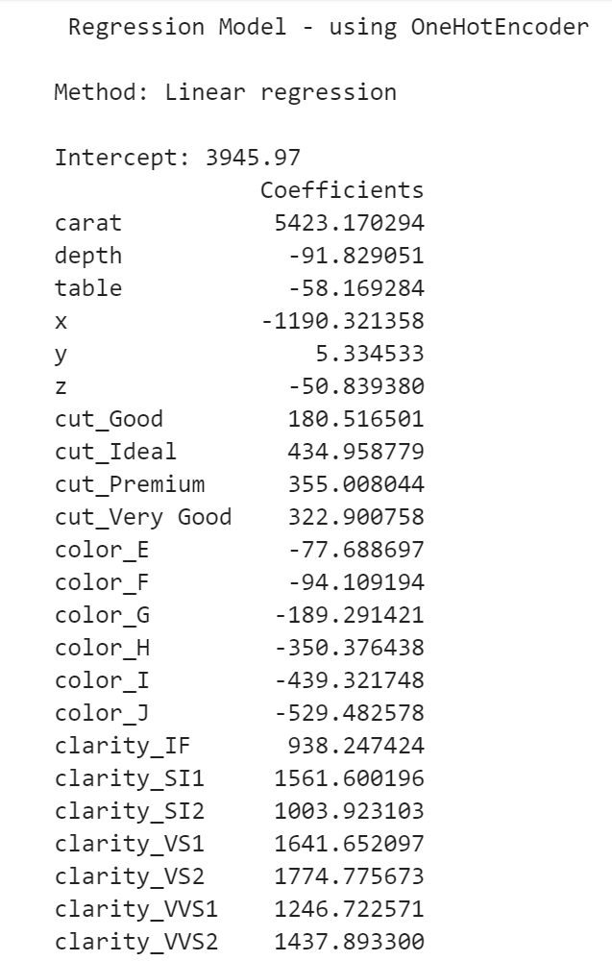
Multivariate Regression Model Output
The intercept is estimated value of the dependent variable when all independent variables are set to zero in this case it is 3945.97.
For example, if there is any change in carat assuming all other independent variable remains constant there would be a change of increase of 5423.170294 in the price.
Depth will change around -91.829051 in price if there’s any change in it. Clarity_VVS2 would change 1437.893300 value in the price.

Slide 6
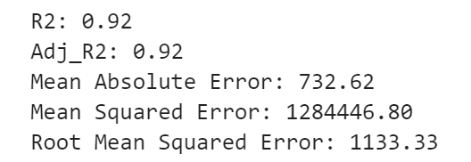
R2 , MAE, RMSE metrics

Slide 7
R2 , MAE, RMSE metrics
Adjusted Rsquare: 0.92, takes into accounts the number of independent variable and adjusts the R2 value. Here the adjusted R2 in this case is 92%
Mean Absolute Error(MAE) is 732.62 which indicates the difference between the predicted price and the actual prices.
Mean Square Error(MSE) is 1284446.80 is average square difference between the predicted price and the actual prices.
Root Mean Squared Error(RMSE) is 1133.33, the square root of the MSE and provides a measure of the average magnitude of the predictive errors.

Slide 8
Ways to Improve the Performance
Feature Engineering: Feature engineering involves examining the current features and generating additional ones that could exhibit a stronger correlation with the target variable (price).
For instance, a potential approach is to create a composite feature, such as the carat value , by combining relevant variables like cut_good and the clarity_IF.
This process aims to discover new features that capture important aspects of the data and enhance the model's predictive power.
Experimenting with various algorithms is recommended as linear regression, although simple and interpretable, may not effectively capture complex relationships present in the data.
By exploring alternative algorithms such as decision trees, random forests, gradient boosting, or neural networks, you introduce greater flexibility into the modelling process.
These algorithms can potentially reveal intricate patterns and interactions that may enhance the model's ability to make accurate predictions.

Slide 9
THANK YOU

