Slide 1

Statistical and Predictive Modeling II (DATA 2204) Assignment #4 – Regularization
Sayali Kumbhar (100950732)
Date: November 8, 2024

Slide 2
Contents
Rational Statement
LASSO Model Insights
Ridge Model Insights
Elastic Net Model Insights
Next Steps to Enhance Model Usability

Slide 3
Rational Statement
The presentation ought to cover important topics pertaining to energy use, data analysis in domestic heating, and environmental impact. Data on different energy sources, usage metrics, and any inefficiencies are included in the "EnergyUse-Heating.csv" dataset, which offers information on heating system energy consumption. This information is essential for comprehending consumption trends, pinpointing locations in need of development, and assisting with energy-saving projects. In the meanwhile, the HTML file has assignment-related content, perhaps including methods or analysis findings pertinent to energy data.
The primary goal of this presentation is to provide an overview of the issues related to excessive energy use, including greenhouse gas emissions, high operating costs, and environmental effects. The presentation can also go over data-driven strategies for increasing productivity and reducing energy waste while taking ecological and economic considerations into account. This study would help to emphasise how crucial precise data collection and analysis are to guiding energy policy, maximising resource utilisation, and lowering carbon footprints in homes.

Slide 4
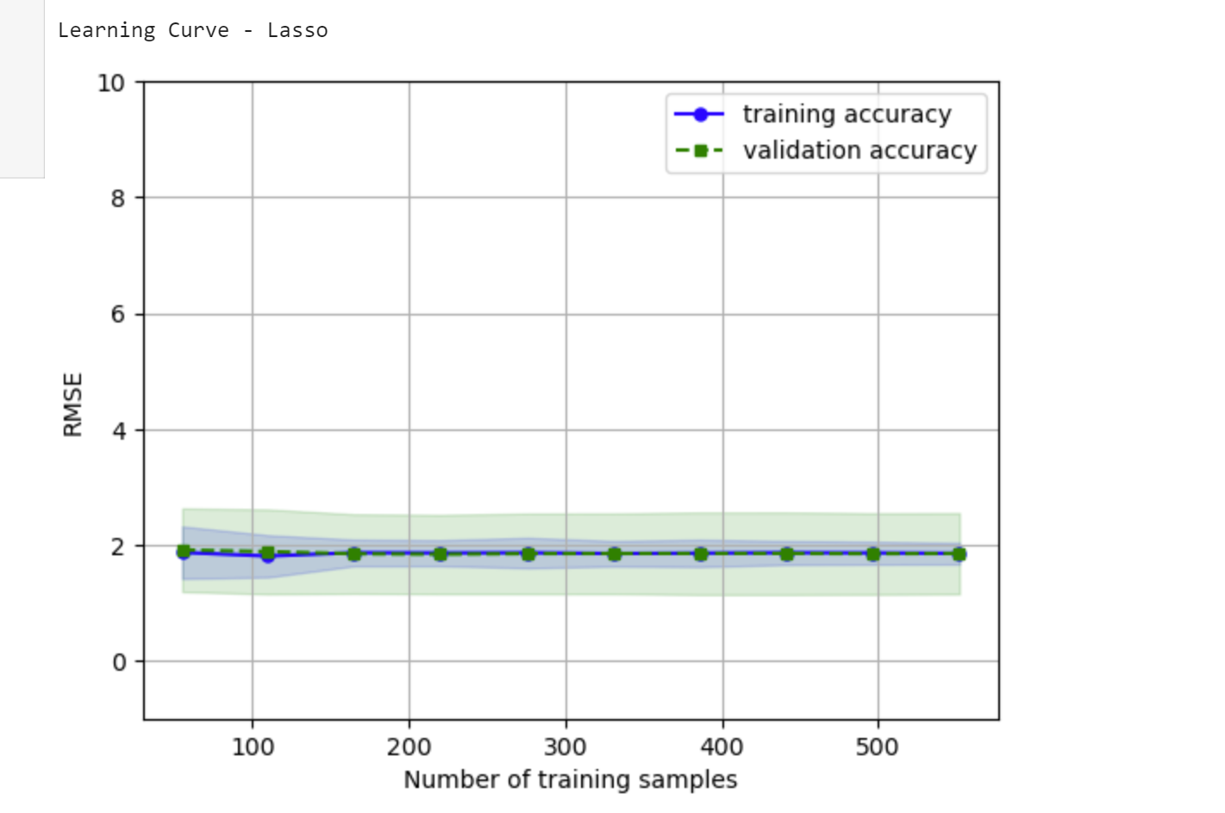
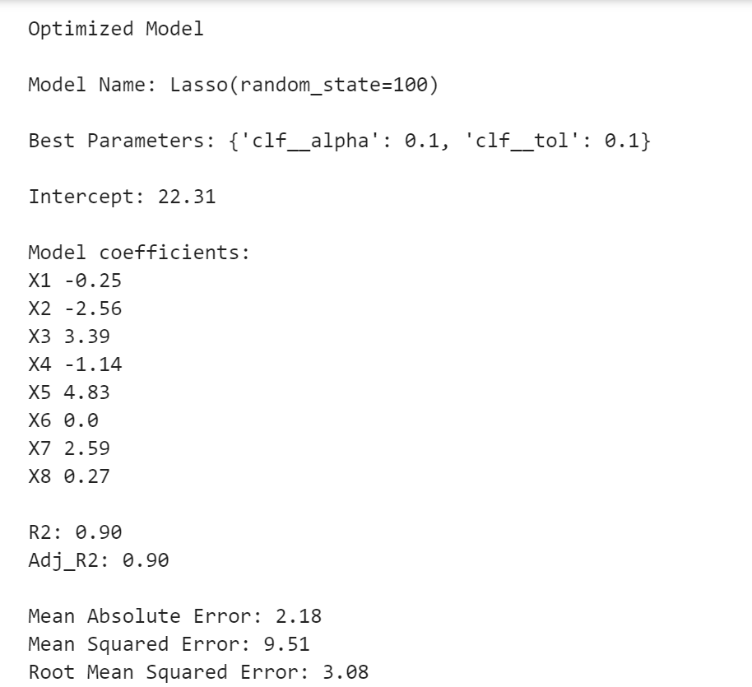
LASSO Model Insights
Adjusted R²: After penalising less significant predictors, the model's explanatory power is measured by the Adjusted R2 in LASSO, which lowers overfitting. A high Adjusted R2 indicates that the model effectively strikes a compromise between predictability and simplicity, retaining important predictors while eliminating those with little bearing.
MAE: The MAE in LASSO averages the absolute disparities between the observed and projected values, providing a clear picture of prediction mistakes. The model's ability to accurately anticipate results and control outliers by reducing the coefficients of less significant variables to zero is demonstrated by a lower MAE.
RMSE: Because RMSE penalises higher deviations, it sheds light on how sensitive the model is to larger errors. A reduced LASSO RMSE would show that the model can produce consistent and trustworthy estimates by minimising both moderate and severe errors in its predictions.

Slide 5
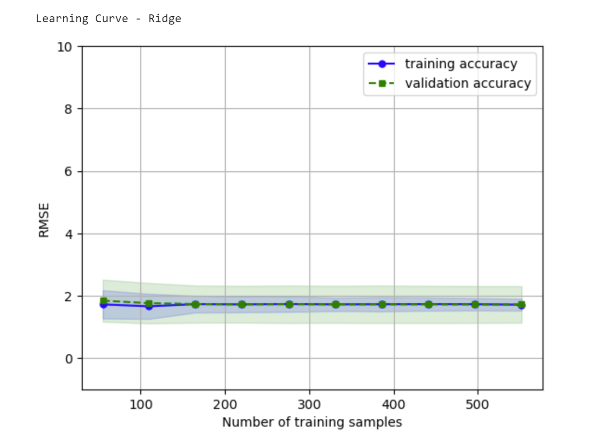
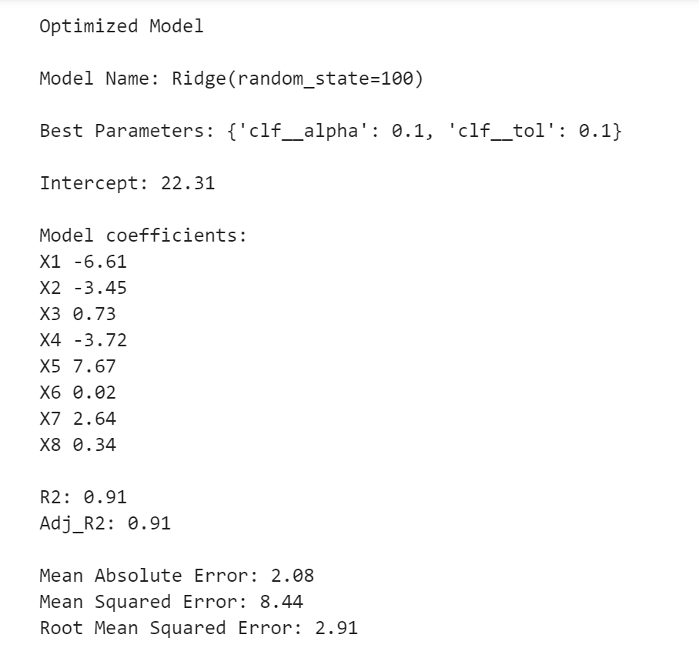
Ridge Model Insights
Adjusted R²: When there is multicollinearity between predictors, ridge regression helps. With a high Adjusted R2 in Ridge, the model is able to manage highly correlated predictors by lessening their influence on the model, retaining complexity without overfitting itself.
MAE: When utilising Ridge, MAE evaluates the model's ability to manage prediction mistakes without unduly concentrating on any one variable. Here, a reduced MAE indicates Ridge's ability to manage predictor effects and reduce total error, which makes it a good fit for datasets with correlated features.
RMSE: A reduced RMSE indicates that the model may successfully decrease both minor and severe mistakes because ridge regression penalises big coefficients without completely eliminating them. Because of this, it is especially good at making reliable predictions across a dataset with different predictor influences.

Slide 6
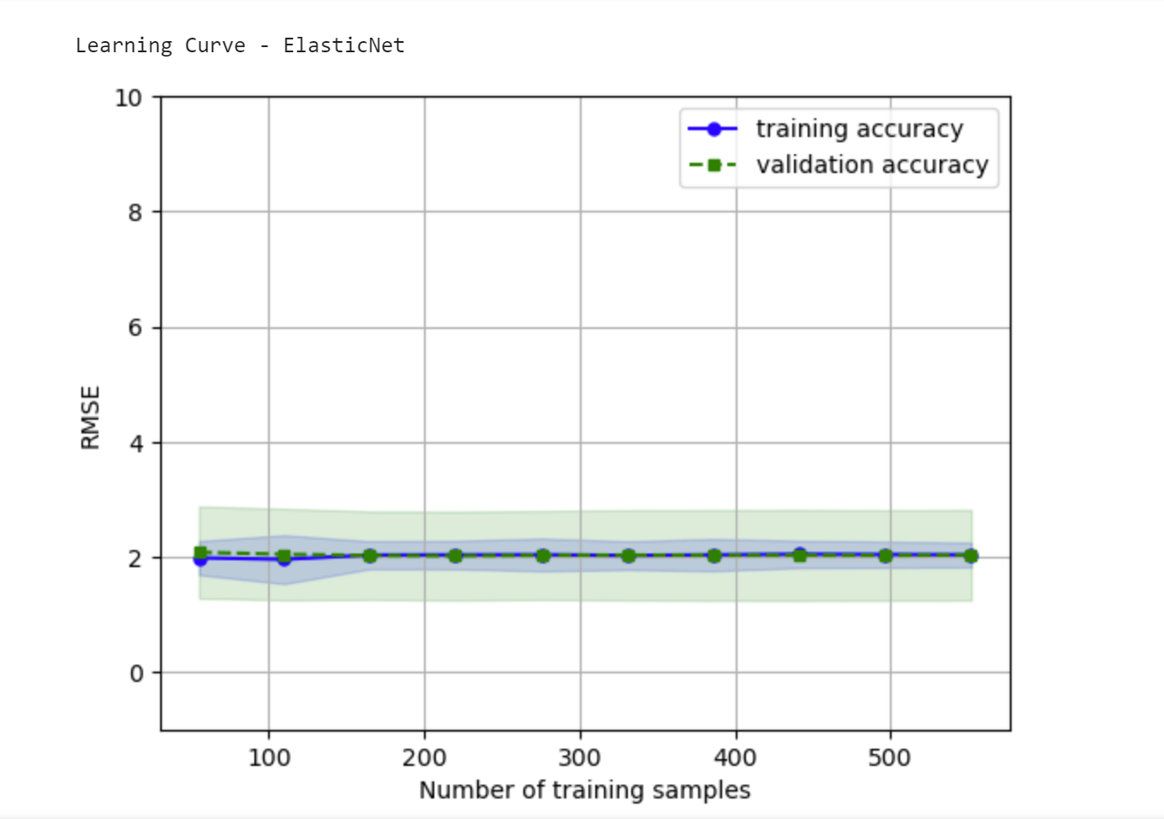
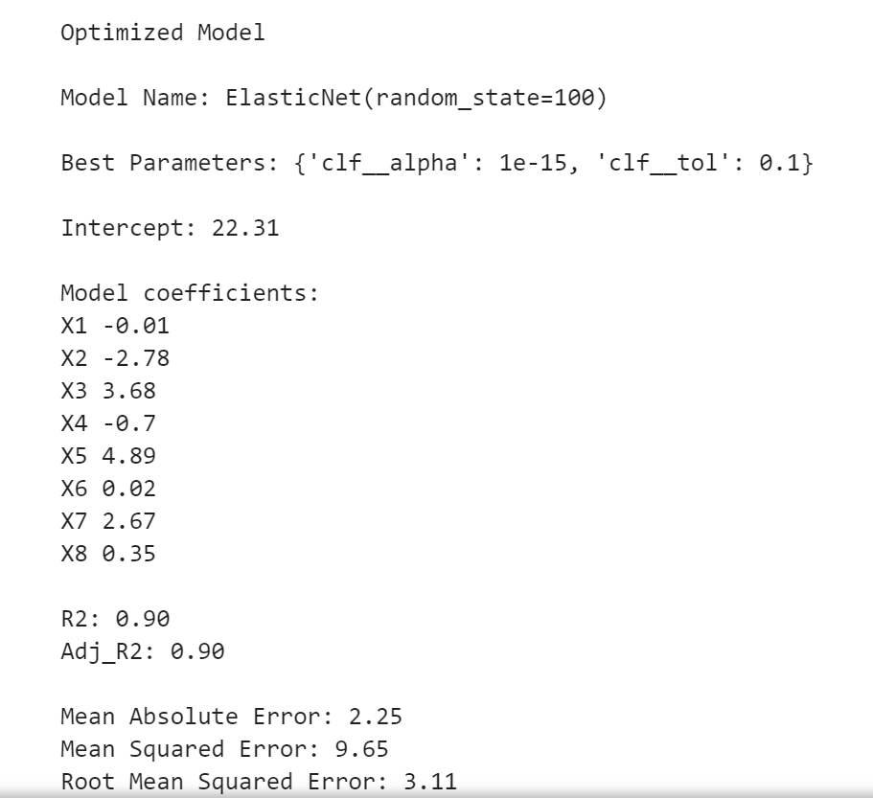
Elastic Net Model Insights
Adjusted R²: LASSO and Ridge penalties are combined in Elastic Net to balance multicollinearity management and variable selection. A model that has a higher Adjusted R2 is one that is well-calibrated and manages complexity and correlation while ideally including significant predictors.
MAE: Elastic Net strikes a balance between multicollinearity management and variable selection by combining LASSO and Ridge penalties. A model with a higher Adjusted R2 is one that is well-calibrated and incorporates significant predictors in the best possible way while controlling for complexity and correlation.
RMSE: Elastic Net's RMSE assesses the model's robustness to significant mistakes by combining elements of the Ridge and LASSO features. The model's ability to balance bias and variance, minimise extreme errors, and capture important predictor effects is demonstrated by a decreased RMSE.

Slide 7
Next Steps to Enhance Model Usability
According to the facts and research, Elastic Net might be the best model for Mr. John Hughes to use.
Elastic Net is ideally suited to situations requiring variable selection and multicollinearity since it combines the advantages of both LASSO and Ridge. Because of this balance, it can efficiently manage complicated datasets by identifying important predictors and lessening the influence of highly correlated features without completely removing them. For datasets whose predictors may be associated, such as those pertaining to energy use, this makes Elastic Net resilient and adaptable.
1. Refine Model Parameters through Cross Validation
Mr. Hughes might perform more thorough cross validation, adjusting the Elastic Net's lambda (regularisation strength) and alpha (mixing parameter) parameters to further improve the model's accuracy and usefulness. By determining the ideal ratio of LASSO to Ridge penalties, this method would enhance the model's performance and guarantee that it captures important features without overfitting. Additionally, cross-validation can reveal how well the model generalises across various data subsets, increasing its dependability for practical uses.
2. Integrate Domain Specific Features for Enhanced Interpretability
Adding domain-specific knowledge as more elements to the model, like weather patterns, building materials, or seasonal fluctuations, would be a further step. By adding these factors, Mr. Hughes will be able to make the model easier to understand and draw conclusions that are more directly related to patterns in energy consumption. These contextual elements can improve Elastic Net's forecasts and make them more applicable, providing a useful basis for well-informed energy management decision-making.

Slide 8
THANK YOU

