Slide 1
Hiding in the Clouds: Secret Management with OpenStack Barbican
Sayali Lunkad, Johannes Grassler, Ade Lee

Slide 2
Overview

Slide 3
Talk contents
What is Barbican?
Packages for RDO (RPM Distribution of OpenStack) and SOC SUSE Openstack Cloud available now
What are all these services about? - barbican-retry, barbican-keystone-listener, barbican-worker
Use cases: Encrypted cinder volumes, Magnum Cluster certificates, LBaaS

Slide 4
What is Barbican?
Getting key material into instances in a secure manner
Secure Storage for key material (passwords, keys, certificates, arbitrary binary data)
Provisioning: Interaction with CAs

Slide 5
More packages available now
Packages for RDO (RPM Distribution of OpenStack) available
Packages for SOC (SUSE OpenStack Cloud) available
Packages for Ubuntu already available

Slide 6
Barbican Services 101
barbican-api: interaction with users and instances
barbican-worker: handles communication with external CAs
barbican-retry: legacy service used for TLS certificate generation
barbican-keystone-listener: cleans up Barbican resources upon Keystone user deletion

Slide 7
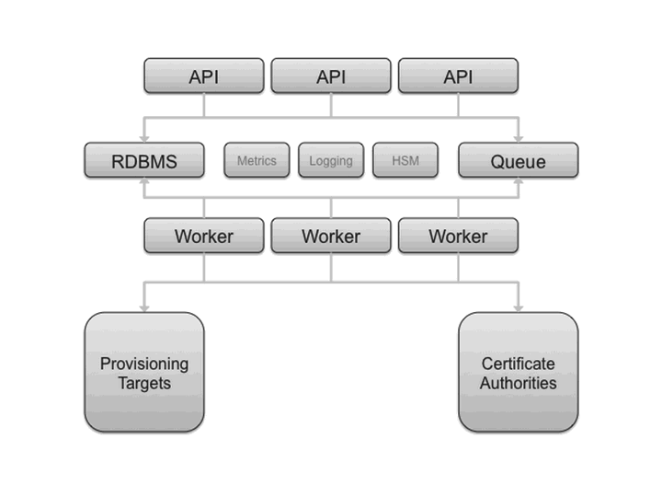
Barbican Architecture

Slide 8
Use Cases

Slide 9
Use case: Encrypted Cinder Volumes

Slide 10
Use case: Magnum Cluster Certificates

Slide 11
Use case: Load Balancer as a Service

Slide 12
Questions?

