Slide 1

Supply Chain Performance
&
Customer Insights Dashboard
Presented By : Sayali Padle
Date: 1/06/2026

Slide 2

Supply chain organizations generate large amounts of data related to sales, customers, products, orders, and deliveries.
However, identifying business trends, delivery risks, customer behavior, and product performance from raw data is difficult.
The objective of this project is to transform supply chain data into an interactive Power BI dashboard that provides actionable insights for decision-making.
Problem Statement :

Slide 3
Supply Chain Managers
Monitor delivery performance and shipping efficiency.
Sales Managers
Analyze sales trends and market performance.
Business Analysts
Identify patterns and generate insights.
Operations Team
Track late deliveries and operational bottlenecks.
Senior Management
View KPIs and business performance at a glance
Who can use this Dashboard?

Slide 4
To Monitor overall sales and profitability.
To Analyze customer and product performance.
To Track delivery efficiency and late delivery risks.
To Evaluate shipping modes and order status.
To Identify high-performing markets and categories.
To Support data-driven business decisions.
Objective

Slide 5
Data source
Kaggle
Dataset Size
Rows: ~1,80,000
Columns: ~21
Time Period : 2015-2018
Key Fields Used
Order Date
Sales
Order Profit Per Order
Customer ID
Product Name
Category Name
Market
Customer Segment
Delivery Status
Shipping Mode
Order Region
Type (Payment Type)
Data Overview :

Slide 6
Power Query Steps:
Checked and corrected data types.
Converted Order Date and Shipping Date into Date/Time format.
Removed unnecessary columns.
Checked null values.
Data Transformation.

Slide 7
Total Sales =
SUM(DataCoSupplyChainDataset[Sales])
Total Profit =
SUM(DataCoSupplyChainDataset[Order Profit Per Order])
Total Orders =
DISTINCTCOUNT(DataCoSupplyChainDataset[Order Id])
Total Customers =
DISTINCTCOUNT(DataCoSupplyChainDataset[Customer Id])
Profit Margin % =
DIVIDE([Total Profit],[Total Sales],0)*100
Average Order Value =
DIVIDE([Total Sales],[Total Orders])
Late Deliveries =
CALCULATE(
DISTINCTCOUNT(DataCoSupplyChainDataset[Order Id]),
DataCoSupplyChainDataset[Late_delivery_risk]=1
)
DAX

Slide 8
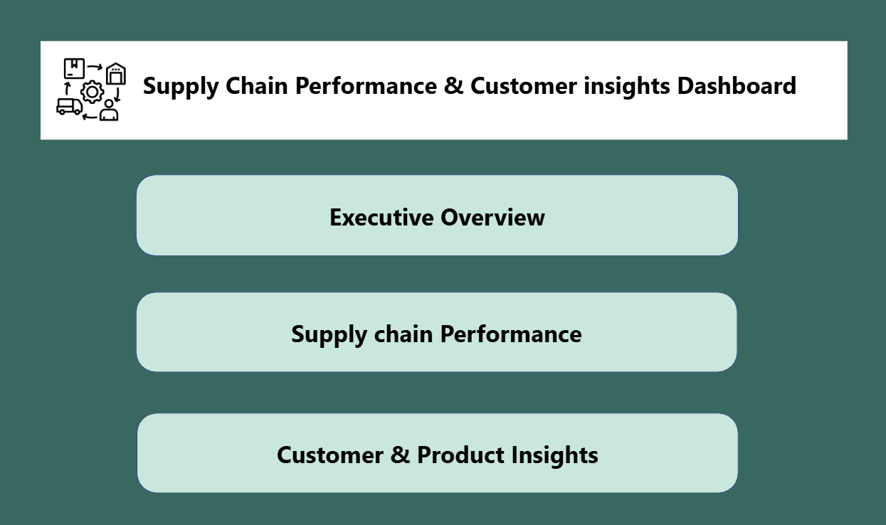
This is the Home Page of the dashboard.
It is used only for navigation.
Buttons are provided to move to:
-Executive Overview
- Supply Chain Performance
- Customer And Product Insights
This makes the dashboard easy to use.

Slide 9
Key measures
Page 1:
Total Sales (36.78M) :
Total revenue generated from all orders.
Total Orders (66K) :
Total number of orders placed by customers.
Total Profit (3.97M) :
Total profit earned by the business.
Profit Margin % (10.78%): Percentage of profit earned from sales.
Page 3:
Total Products (118):
Total unique products sold.
Total Quantity Sold (384K):
Total units/products sold.
Total Customers (21K):
Total unique customers.
Average Order Value (559.45):
Average amount spent per order.
Page 2:
Late Delivery % (19.97%)/;
Percentage of orders at risk of delay.
Late Deliveries (36K)
Total delayed orders.
Average Shipping Days (3.50):
Average time taken to deliver orders

Slide 10
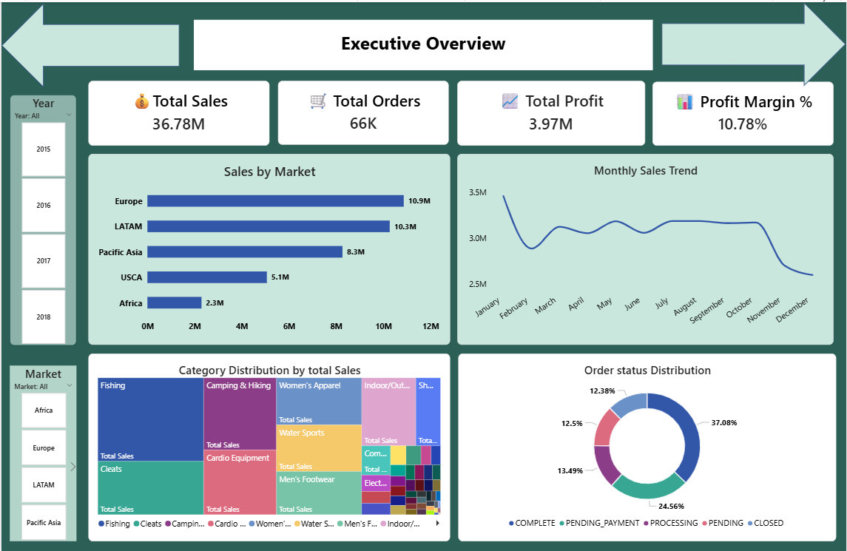

Slide 11
Executive Overview Dashboard Explanation
Sales by Market
(Bar chart)
Europe generated the highest sales of 10.9M.
LATAM followed closely with 10.3M sales.
Africa recorded the lowest sales at 2.3M.
Europe and LATAM together contributed more than 57% of total sales
2. Monthly Sales Trend
(Line chart)
Sales peaked at approximately 3.5M in January.
Sales remained relatively stable between 3.0M–3.2M during most months.
A significant decline was observed in November and December, dropping to nearly 2.6M.
Sales performance shows seasonal fluctuations throughout the year.
Sales Distribution by Category (Tree map)
Fishing category generated the highest sales among all categories.
Drill-down functionality allows analysis from Category → Department → Product level.
The hierarchy helps identify top-performing products within each department.
4. Order Status Distribution(Donut chart)
Complete Orders: 37.08% (largest share)
Pending Payment: 24.56%
Processing: 13.49%
Pending: 12.50%
Closed: 12.38%
Business Insight:
Most orders are successfully completed.
Nearly one-fourth of orders are awaiting payment, indicating potential revenue realization opportunities.

Slide 12
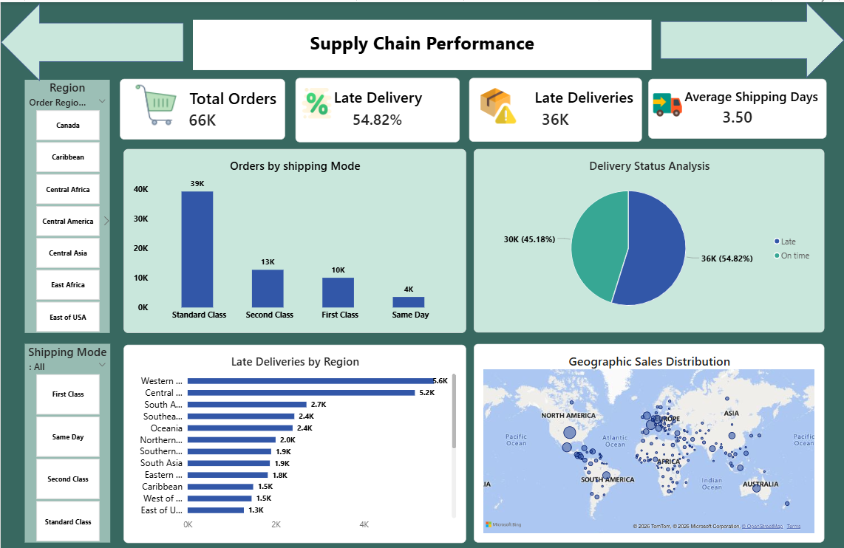

Slide 13
Supply Chain Performance Dashboard Explanation
1. Orders by Shipping Mode(Column chart)
Standard Class handled 39K orders, making it the most preferred shipping method.
Second Class processed 13K orders.
First Class accounted for 10K orders.
Same Day delivery was least used with only 4K orders.
Customers strongly prefer cost-effective shipping options.
2. Delivery Status Analysis(Pie chart)
Late Deliveries: 36K orders (54.82%)
On-Time Deliveries: 30K orders (45.18%)
More than half of all deliveries were delayed.
Delivery performance requires operational improvement.
3.Late Deliveries by Region(Bar chart)
Western Europe recorded the highest late deliveries (5.6K).
Central America followed with 5.2K late deliveries.
South America reported 2.7K delayed orders.
Delivery delays are concentrated in specific regions
4. Geographic Sales Distribution
Sales are distributed globally across North America, Europe, Asia, Africa, and South America.
Europe and North America show strong sales concentration.
Business has a broad international customer base.

Slide 14
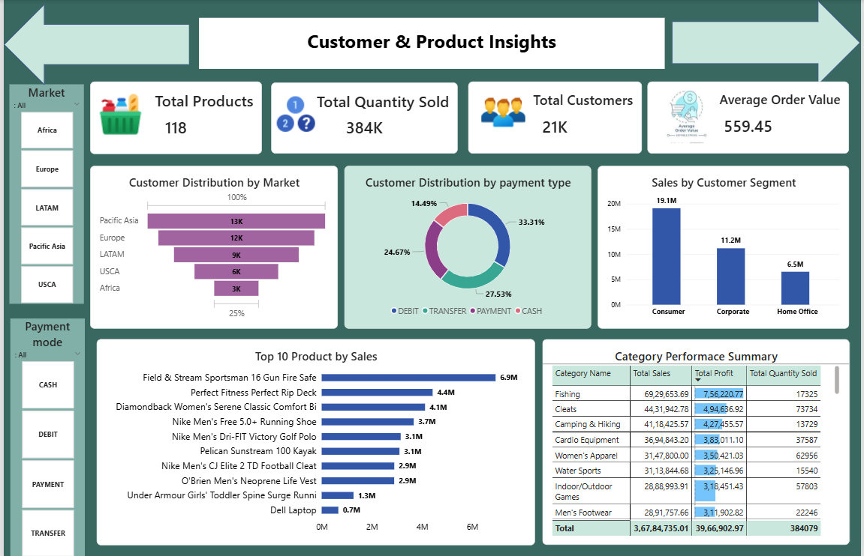

Slide 15
Supply Chain Performance Dashboard Explanation
Customer Distribution by Market(funnel chart)
Pacific Asia holds the largest customer base (13k)
Europe contributes (12k) of customers.
LATAM accounts for 9k.
Africa has the smallest customer share 3k.
Nearly one-third of customers are located in Pacific Asia.
2. Sales by Customer Segment(Column chart)
Consumer Segment: 19.1M sales (highest)
Corporate Segment: 11.2M sales
Home Office Segment: 6.5M sales
Consumer customers generate more than half of total revenue.
Home Office contributes the lowest revenue.
3. Customer Distribution by Payment Type(Donut chart)
Debit: 33.31% (most preferred)
Transfer: 27.53%
Payment: 24.67%
Cash: 14.49% (least preferred)
Customers prefer digital payment methods over cash transactions
4. Top 10 Products by Sales(Bar chart)
Field & Stream Sportsman 16 Gun Fire Safe generated the highest sales of 6.9M.
Perfect Fitness Perfect Rip Deck recorded 4.4M sales.
5. Category Performance Summary
Fishing achieved the highest sales (6.93M) and profit (756K).
Cleats generated 4.43M sales and 495K profit.

Slide 16
Overall Dashboard Insights
Total Sales reached 36.78M with 3.97M Profit.
Europe emerged as the top-performing sales market.
Consumer customers contributed the highest revenue.
Standard Class was the preferred shipping method.
More than 54% of deliveries were delayed, highlighting supply chain challenges.
Debit cards were the most preferred payment method.
Fishing category and Field & Stream Sportsman 16 Gun Fire Safe were the top performers.
The business maintains a strong global presence across multiple markets.

Slide 17
Forecast future sales trends.
Add predictive analytics for late deliveries.
Integrate real-time supply chain data.
Develop customer churn analysis.
Add inventory management KPIs.
Create automated alerts for delivery risks.
Future Enhancement:

Slide 18
The Supply Chain Performance Dashboard transforms raw operational data into meaningful business insights.
The dashboard enables organizations to monitor sales, profitability, customer behavior, shipping performance, and delivery efficiency through interactive visualizations and KPIs.
It supports data-driven decision-making and helps improve overall business performance.
Conclusion:

Slide 19
Thank You

