Slide 1
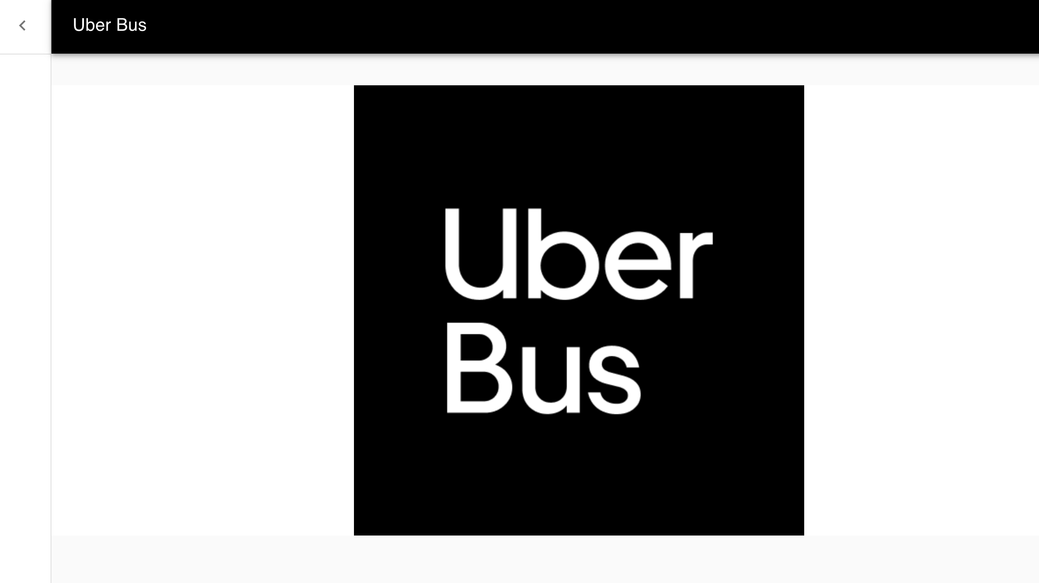
Group6
Sayali Pathare
Vaibhav Dhoke

Slide 2
Application Specification
 | Application Stack | Production Server
Frontend | React-JS | Nginx
Backend | Python | Gunicorn
Database | MongoDbAtlas
AWS Automatic Deployment using Terraform Provisioning
AWS instance creation
EIP association
AWS Security group creation
VPC, Subnet, Internet Gateway setup
Route table, Rote table association
Provisioning script
Git cloning of the Frontend and Backend repository
Installation of all dependencies for React, Nginx, Python, Gunicorn
Run application on production server

Slide 3
Key Functionalities:
Customer Bus Booking
Retrieving Bookings List
Key Validations:
Username validation email only
Source and Destination City cannot be same
Same booking cannot be done
All fields required for booking

Slide 4
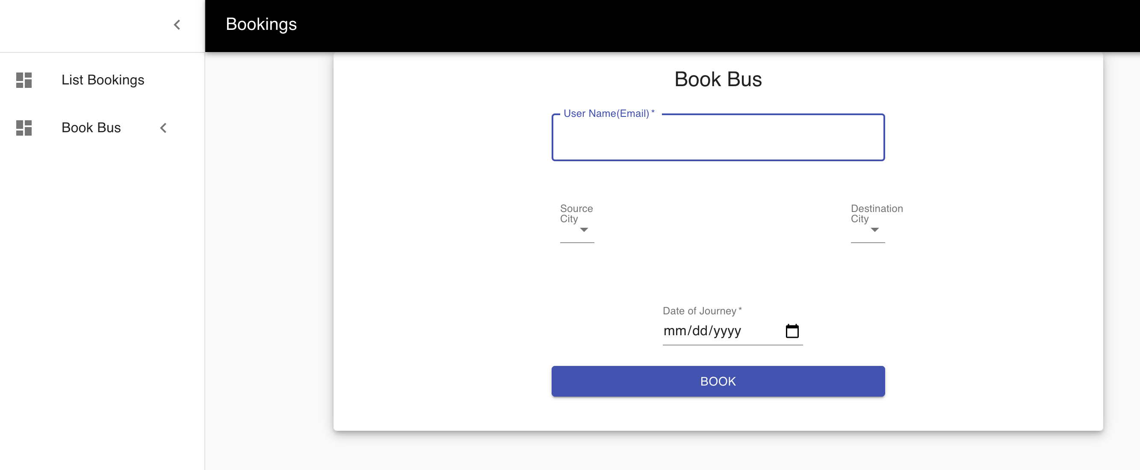
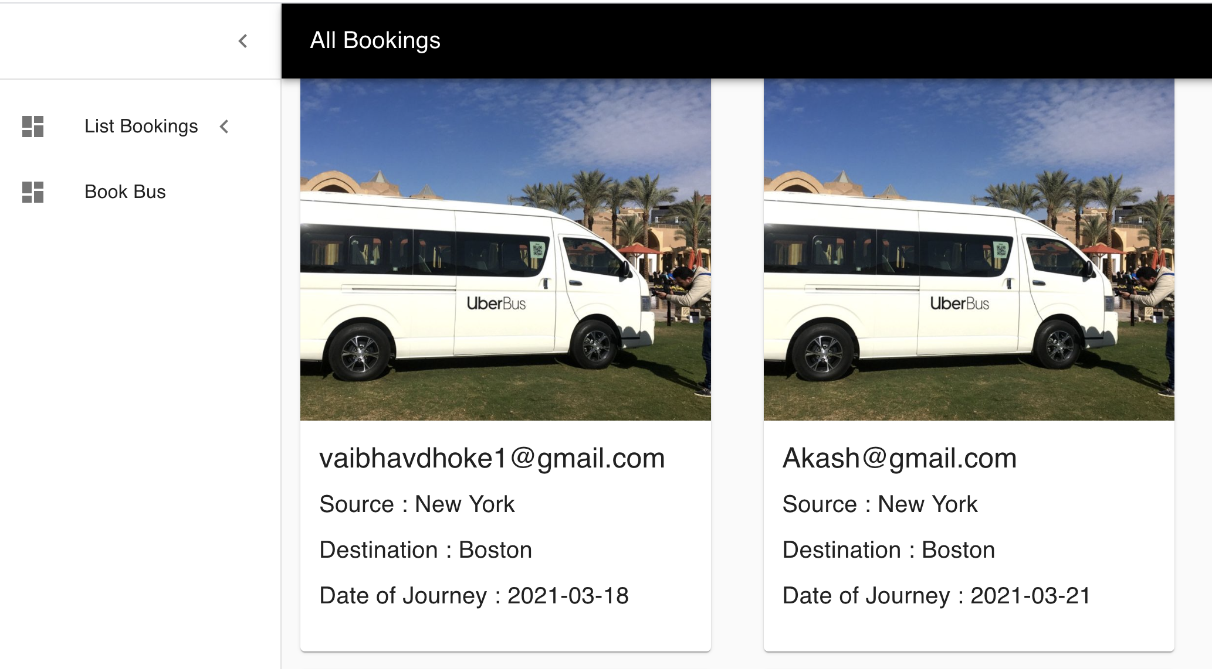
Snapshot of the application

Slide 5

Thank you

