Slide 1
RESEARCH PRESENTATION
VERIFY
Fake News Detection
& Real-Time Verification
Retrieve evidence.
Assess claims.
Show uncertainty.
A full-stack platform combining machine learning, web evidence retrieval, and language-model-assisted analysis
Sayali Ravindra Shardul
Master of Computer Engineering | Nashik, India
ML • Search • LLM • Web App

Slide 2
Project Overview
From text classification to evidence-oriented news verification
01 ML Classification
02 Live Verification
03 Full-Stack Platform
Combines article title and body text, applies TF–IDF features, and predicts Real or Fake using a Passive-Aggressive Classifier.
Retrieves relevant web results and asks a language model to assess support, contradiction, context, or uncertainty.
React interface, Django REST APIs, PostgreSQL persistence, user accounts, analytics, and admin management.
Research focus: integrate classification and live evidence inspection while clearly separating system outputs from independently verified factual truth.
2

Slide 3
Problem Statement & Objectives
Why combine a classifier with source-based verification?
PROBLEM
OBJECTIVES
Online claims spread faster than manual verification can scale.
A binary label alone provides little evidence or context.
New events and changing language can challenge static models.
Classify submitted article text.
Retrieve potentially relevant public web evidence.
Present source links and uncertainty-aware outcomes.
Maintain history, analytics, and secure user/admin workflows.
3

Slide 4
System Architecture
A layered client-server design with two distinct inference paths
React.js Frontend
News input • results • history • analytics • bookmarks
↓
Django REST Framework
Validation • JWT auth • API orchestration • permissions
↓
Inference Services
TF–IDF + Passive-Aggressive | Tavily + Qwen2.5 3B / Ollama
↓
PostgreSQL Database
Users • prediction records • timestamps • saved items
4

Slide 5
Methodology I: ML Classification
Content-based baseline
Input
Vectorization
Classifier
Output
Combine title + article text
→
TF–IDF converts text into sparse numeric features
→
Passive-Aggressive Classifier predicts a binary label
→
Real / Fake label and model decision score
Important: a raw classifier decision score is not automatically a calibrated probability that a claim is true.
5

Slide 6
Methodology II: Real-Time Verification
Retrieval-assisted evidence analysis
Submit a news claim or source URL.
Tavily retrieves potentially relevant public web results.
Ollama runs Qwen2.5 3B locally to assess the claim against retrieved evidence.
Sources and evidence relationships are returned to the interface.
SUPPORTED
Evidence is consistent with the claim.
CONTRADICTED
Evidence is inconsistent with the claim.
MIXED EVIDENCE
Sources or details are conflicting.
INCONCLUSIVE
Available evidence is insufficient.
6

Slide 7
Application Features
Reported feature set across user and administrator workflows
User Features
History & Reporting
Admin Features
Registration/login, editable profile, password change, personal statistics, history, bookmarks, help and fact-checking pages.
Search, filtering, deletion/restoration, PDF/CSV export, prediction distribution and activity/trend charts.
User/prediction management, dashboard metrics, analytics, role/status handling, admin profile and password controls.
Additional reported capabilities: PostgreSQL integration, Gmail SMTP support, responsive mobile layout, dark mode, protected routes, and JWT-based authentication.
7

Slide 8
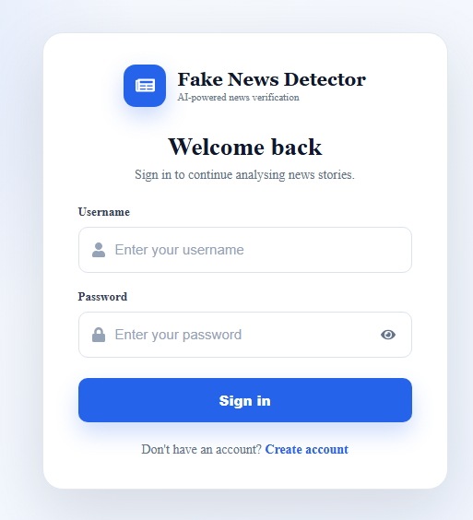
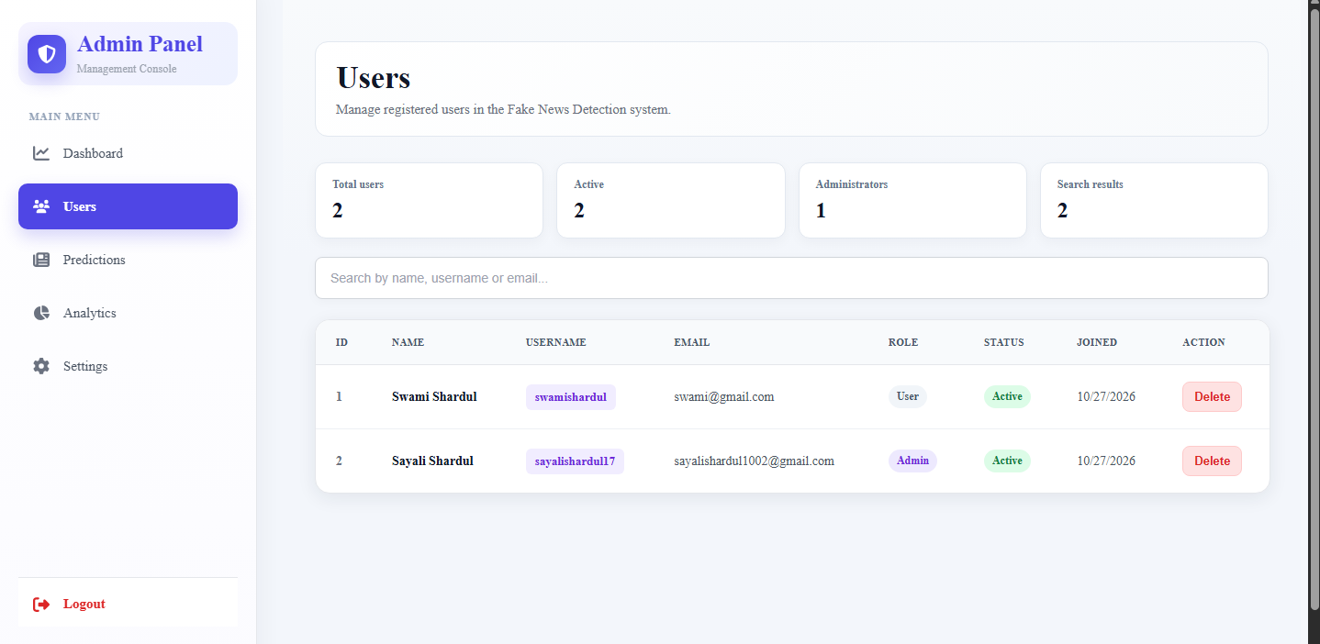
Application Screenshots: Authentication & Administration
Screenshots show interface layout, not independent proof of backend behavior
Login Interface
Admin User Management
Authenticated entry point for the platform.
User metrics, roles, account status, and management actions.
8

Slide 9
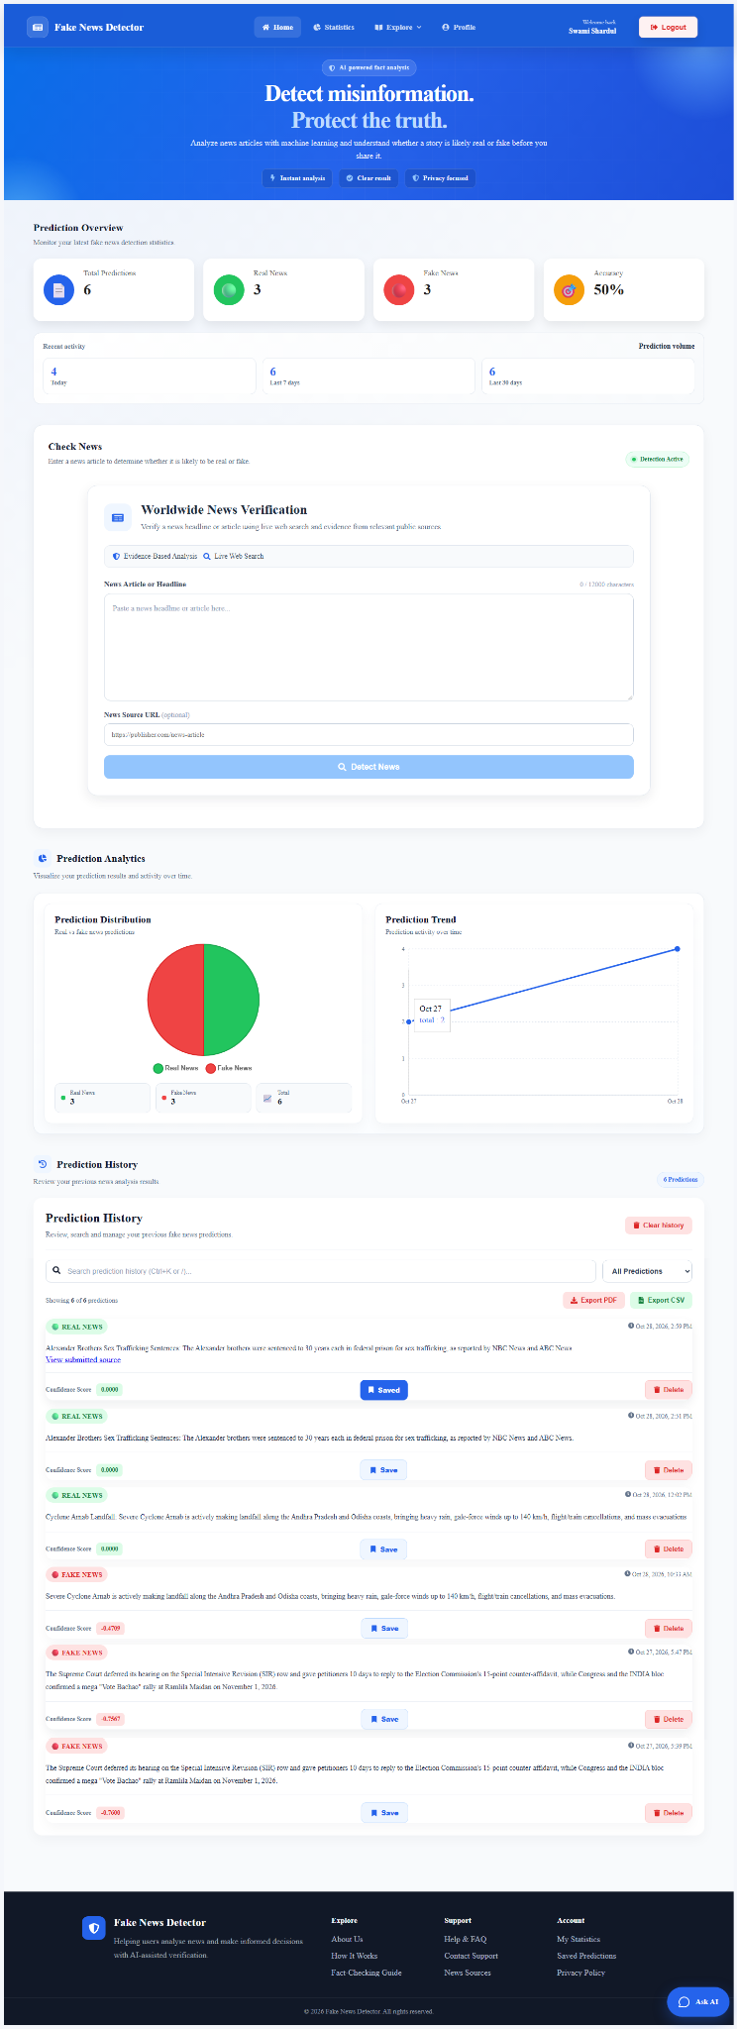
Application Screenshot: Main Dashboard
Prediction overview, verification form, analytics, and history
Figure: Main dashboard captured from the local application.
9

Slide 10
Results & Evaluation Status
Separate reported implementation features from measured outcomes
Reported ML Result
Live Verifier
Application
Development notes report 99.47% accuracy for TF–IDF + Passive-Aggressive. Reproducible rerun is required.
Designed to return supported, contradicted, mixed, or inconclusive outcomes with source details.
Feature inventory reports history, analytics, export, accounts, admin controls, and persistence.
Metrics still needed for a rigorous evaluation
Classifier: precision, recall, F1-score, confusion matrix, split details, duplicate-leakage checks.
Live verifier: labeled claim benchmark, source quality review, coverage, and response latency.
10

Slide 11
Limitations & Responsible Use
A verification assistant, not an absolute truth oracle
Search results may be incomplete, duplicated, outdated, or low quality.
Language models can misinterpret evidence or produce confident but incorrect explanations.
The reported 99.47% classifier accuracy is not independently reproducible from the current details.
Classifier score is not necessarily a probability; live verification requires separate evaluation.
Changing events, satire, opinions, mixed claims, and source conflicts require careful handling.
JWT permissions, database operations, email delivery, and exports need end-to-end testing.
11

Slide 12
Future Work
From working prototype to reproducible research system
Build a labeled and diverse benchmark of true, false, mixed, and inconclusive claims.
Reproduce classifier metrics and compare with Naive Bayes or Logistic Regression baselines.
Assess source credibility, independence, publication dates, and evidence coverage.
Measure latency, robustness across topics, and user understanding of uncertainty.
Test authorization, cross-user isolation, secret management, and production deployment.
Explore calibrated scores, explainability, temporal evaluation, and multilingual verification.
12

Slide 13
Conclusion
The project integrates a text-classification baseline, live web evidence retrieval, language-model-assisted analysis, and a full-stack user/admin application.
Key principle: show the evidence, communicate uncertainty, and validate performance before making accuracy claims.
Thank you • Questions?

