Slide 1

Machine Learning-Based Network Intrusion Detection on UNSW-NB15
Comparing Logistic Regression, Decision Tree and Random Forest
Mini Project | Machine Learning
Notes:
Introduce yourself and the project: a machine learning experiment that tries to tell normal network traffic from attack traffic. Say that it uses a public benchmark dataset, UNSW-NB15, and compares three models.

Slide 2
Index
1
Problem Statement
9
Results
2
Objectives
10
Findings
3
Dataset: two files, two jobs
11
What is New in this Project
4
What is inside the dataset
12
Limitations
5
Literature Review (five papers)
13
Conclusion
6
Research Methodology and Workflow
14
Future Work
7
What is a Parameter? Parameters used
15
References
8
Data Analysis
Notes:
Quickly walk through the order of the presentation. Say that each part answers one question: why, what data, what others did, how, what parameters, what we found, what is new, what are the limits, and what next.

Slide 3
Problem Statement
Hand-written rules only catch attacks someone has already described.
One network connection
42 measured features
New attacks and small variations slip through
Machine Learning can learn patterns from labelled traffic
But how reliable is it? How many false alarms? Which attacks are missed?
Machine Learning model
NORMAL
ATTACK
Notes:
Explain the problem simply. Signature rules only catch attacks someone has already described. We ask whether a model can learn the difference between normal and attack traffic from labelled data, and how reliable it is, including false alarms and missed attacks.

Slide 4





Objectives
Inspect the real data
Build a leakage-safe pipeline
Train 3 models and a baseline
shape, quality, class balance
no test information in training
same conditions for all
Evaluate with security metrics
Analyse errors
State limitations honestly
not accuracy alone
by attack type and by feature
what the results do not prove
Research question: How well do Logistic Regression, Decision Tree and Random Forest classify traffic as normal or attack, and how do false alarms and missed attacks differ across attack types?
Notes:
Read the six objectives. Then read the research question. Stress that the project is about measuring honestly, not about claiming a perfect detector.

Slide 5

Dataset: Two Files, Two Jobs
TRAINING FILE
TESTING FILE
175,341
82,332
records, 45 columns
records, 45 columns
Used to LEARN
Used for the FINAL EXAM, once
Fit the preprocessing (impute, scale, encode)
5-fold cross-validation and tuning
Train the final models
Never used to fit or tune anything
Metrics and confusion matrices
Error analysis by attack category
68.06% attack, 31.94% normal
55.06% attack, 44.94% normal
Both are the official partitioned UNSW-NB15 files created at UNSW Canberra. The full dataset (about 2.54 million records in four raw files) was not used.
Notes:
UNSW-NB15 comes as an official training file and an official testing file. The training file is used to learn and tune. The testing file is the final exam and is used only once. The full dataset has about 2.54 million records in four raw files, which we did not use.

Slide 6
What Is Inside the Dataset
45 columns = one row per network connection
The 42 features come in six groups
42 input features
39 numeric + 3 categorical
Size and time
Time to live
dur, spkts, dpkts, sbytes, dbytes
sttl, dttl
id
dropped (only a row number)
Speed, loss, jitter
TCP details
sload, dload, sloss, dloss, sjit
swin, dwin, tcprtt, synack, ackdat
attack_cat
excluded (it gives away the answer)
label
TARGET: 0 normal, 1 attack
Connection counts
Categories
ct_state_ttl, ct_srv_src, ct_dst_ltm ...
proto, service, state
Notes:
Each row is one network connection. There are 45 columns: 42 features, an id, the attack category, and the label. The label is the target: 0 for normal and 1 for attack. We drop id and we do not use attack_cat as an input because it gives away the answer. Of the 42 features, 39 are numbers and 3 are categories.

Slide 7
Inside the Data: 10 Traffic Classes
Normal
Generic
Exploits
Fuzzers
DoS
Legitimate everyday traffic
Works against any block cipher
Abuses a software bug
Random junk to crash a service
Makes a service unavailable
56,000 in training
40,000 in training
33,393 in training
18,184 in training
12,264 in training
Reconnaissance
Analysis
Backdoor
Shellcode
Worms
Scans to gather information
Port scans and web probes
Hidden remote access
Payload that opens a command shell
Self-copying, spreads to other machines
10,491 in training
2,000 in training
1,746 in training
1,133 in training
130 in training
Green = normal traffic. Red = nine attack types (label 1). Rarest: Worms. Hardest to detect: Fuzzers.
Notes:
The label column says normal or attack. The attack category column says which of nine attack types it is. Generic and Exploits are the biggest. Worms is the smallest, with only 130 training records.

Slide 8
Normal vs Attack: What the Features Show
Feature | Normal record | DoS attack record
Duration (s) | 0.661656 | 0.000009
Protocol / service / state | tcp / http / FIN | encap / - / INT
Packets sent / received | 10 / 10 | 2 / 0
Bytes sent / received | 804 / 1,330 | 200 / 0
sttl (time to live) | 62 | 254
label | 0 (normal) | 1 (attack)
Typical tendencies of attacks
Size and duration: floods use very short connections and tiny packets
Time to live: tools start from different values
Speed and timing: floods change rate and jitter
TCP and counts: scans create many similar connections
Protocol and service: some attacks target one service
Real records from the training file (ids 95745 and 49000).
The difference is spread over several columns. These are tendencies, not rules: the model combines all 42 features, and no single column decides.
Notes:
Two real records from the training file show how normal and attack traffic differ. The normal HTTP record lasts about 0.66 seconds with 10 packets each way, and its time to live is 62. The DoS record lasts a few microseconds, sends 2 packets and receives none, and its time to live is 254. No single value separates the classes on its own, which is why the model combines all 42 features. The right-hand box lists the tendencies by feature group; they are not fixed rules, the models learn which ones are useful from the data.

Slide 9
Literature Review: Five Papers
# | Paper | Data and models | Key information
1 | Moustafa and Slay (2015) | Creates UNSW-NB15; no models | Older benchmarks are outdated; real normal plus synthetic attack traffic
2 | Kasongo and Sun (2020) | Official split; SVM, kNN, LR, ANN, DT | Feature selection: DT accuracy 88.13% to 90.85%; sttl dominant
3 | Ngo et al. (2023, preprint) | Official split; DT, RF, kNN, MLP, NB | Normal class weaker; Analysis and Backdoor rarely named (multiclass)
4 | Layeghy and Portmann (2022, preprint) | 4 datasets in NetFlow form; 7 models | No model generalised across all datasets
5 | Hossain et al. (2026, preprint) | UNSW-NB15 + TON_IoT; RF, LR, NB | RF 95.08% on own random split; below 40% across datasets
Paper 1 is the dataset paper that must be cited. Papers 3 to 5 are arXiv preprints.
Notes:
These are the five papers. Paper 1 created the dataset. Papers 2 and 3 compare classifiers on the official split. Papers 4 and 5 test whether results carry over to other datasets. Three of them are preprints on arXiv, so say that if asked.

Slide 10

What the Papers Teach Us
What researchers did
Problems that keep appearing
Where this project fits
Compared standard classifiers on UNSW-NB15
Reduced the number of features
Tested across different datasets
Scores depend on how data is split
Rare attack types are missed
Good benchmark scores do not transfer
Small reproduction on the official split
Honest, detailed evaluation
No new algorithm is claimed
Notes:
Summarise the three columns. Researchers mainly compared classifiers and reduced features. The problems that keep appearing are that the data split changes the score, rare attacks are missed and results do not transfer. Our project reproduces a small part and evaluates honestly, without claiming a new algorithm.

Slide 11
Research Methodology
Quantitative, experimental and comparative design (CRISP-DM style phases)
1
Problem understanding
2
Literature review
3
Dataset selection
4
Data understanding
5
Data preparation
6
Modelling
7
Evaluation
8
Reporting
Independent variables
Dependent variables
Controlled variables
features, model type, hyperparameters
predicted class and the metrics
same data, split, seed (42), preprocessing, tuning
Notes:
The design is quantitative, experimental and comparative, organised in phases like CRISP-DM. We use a public secondary dataset, no personal data. The independent variables are the features, the model and the hyperparameters. The dependent variable is the predicted class judged by metrics. The controlled variables are the same data, split, seed, preprocessing and tuning.

Slide 12
Project Workflow (Flowchart)
1 Load
2 Inspect
3 Clean
4 Pipeline
official train and test CSVs
rows, quality, class counts
fix types; split X and y
impute, scale, encode
8 Report
7 Analyse
6 Evaluate
5 Tune
findings and limits
categories, gap, features
test once, official file
5-fold CV, training file only
System layers: Data > Preparation > Pipeline > Model > Evaluation > Output
Mnemonic: LICPTEAR = Load, Inspect, Clean, Pipeline, Tune, Evaluate, Analyse, Report
Notes:
Read the flow left to right on the top row, then right to left on the bottom row: Load, Inspect, Clean, Pipeline, then Tune, Evaluate, Analyse, Report. The test file is touched for the first time at the Evaluate step. A handy way to remember it is the word LICPTEAR.

Slide 13

Experimentation Design
E1
Baseline
what does learning nothing score?
Same rules for every model
E2
Model comparison
LR vs DT vs RF
Same data and same split
Same random seed (42)
Same 5 cross-validation folds
Same scoring rule (F1 of attack class)
Same evaluation code
Test file used ONCE, never to tune
E3
Detection per attack type
which attacks are missed?
E4
Overfitting check
CV vs train vs test scores
E5
Random-split contrast
random split vs official test
E6
Feature importance
what does the model use?
Notes:
We ran six experiments. E1 baseline, E2 model comparison, E3 detection per attack category, E4 overfitting check, E5 random split contrast and E6 feature importance. All models get the same data, seed, folds, scoring rule and evaluation code, so the comparison is fair. The test file never fits or tunes anything.

Slide 14

What Is a Parameter?
Parameter
Hyperparameter
Training setting
Threshold
Learned BY the model from data
Chosen BY US before training
Controls how the run behaves
Cut-off that turns a probability into a class
Example: regression weights, tree split points
Example: max_depth, C, n_estimators
Example: random seed = 42, 5 folds
Example: above 0.5 means ATTACK
Study analogy: how many hours you decide to study = hyperparameter. What you actually learn from studying = parameter.
Notes:
Four words that students mix up. A parameter is learned by the model from data, for example regression weights or tree split points. A hyperparameter is chosen by us before training, for example max_depth. A training setting controls the run, like the random seed. The threshold is the cut-off that turns a probability into the class attack. The study analogy: deciding how many hours to study is the hyperparameter; what you actually learn is the parameter.

Slide 15
Parameters Used in This Project
Model | Hyperparameter | Tried | Chosen
Logistic Regression | C | 0.1, 1, 10 | 10
Decision Tree | max_depth | 5, 10, 20, None | 20
 | min_samples_leaf | 1, 5, 20 | 1
Random Forest | n_estimators | 100 | 100
 | max_depth | 15, None | None
 | min_samples_leaf | 1, 5 | 1
 | max_features | sqrt | sqrt
42
5
random seed
stratified CV folds
F1
0.5
tuning score
decision threshold
Tuning time: LR 85.8 s, DT 221.2 s, RF 1,076.5 s (about 18 min).
Preprocessing: median imputation, scaling (LR only), one-hot encoding. Test file used once. Duplicates kept.
Notes:
Left table: the hyperparameters we searched and what cross-validation chose. Several chosen values sit at the edge of the grid, so a wider search might choose differently. Right side: the fixed settings. The test file was used once, and duplicates were kept.

Slide 16
Data Analysis: Class Balance
What this tells us
Attacks are the MAJORITY: 68.06% of training, 55.06% of testing
Normal traffic is the minority in training
The two files have a different mix, so the model sees slightly different traffic at test time
Imbalance is moderate, so no resampling was used
Notes:
The chart shows the share of normal and attack records. Attacks are the majority in both files, but the share falls from 68.06 percent in training to 55.06 percent in testing. That means the two files have a different traffic mix. The imbalance is moderate, so we did not use resampling.

Slide 17
Data Analysis: Attack Categories
What this tells us
Generic and Exploits are the biggest attack types
Worms: only 130 training records (0.07%)
Exploits shrinks from 19.04% to 13.52% in test
Rare types give uncertain detection results
Notes:
Attack categories are very unequal. Generic and Exploits are large, while Worms has only 130 training records. Exploits and Fuzzers shrink in the test file. Rare categories give uncertain results, so we treat their detection rates carefully.

Slide 18
Data Analysis: Quality and Patterns
0
0
42.2%
10.37%
missing values
infinite values
duplicate rows in training
test rows identical to a training row
Strongest correlation with the label
What this tells us
sttl (time to live) is most linked to the label
Correlation = association, NOT cause
Duplicates were kept; they may make cross-validation scores look better
The test file also has 2 states (ACC, CLO) never seen in training
Notes:
No missing or infinite values. But a large share of rows are duplicates: 42.2 percent of training and 34.5 percent of testing. About one tenth of test rows have the same feature values as some training row. We kept duplicates because the official files were used as released, and we report the effect as a limitation. Correlation shows association only, not cause.

Slide 19
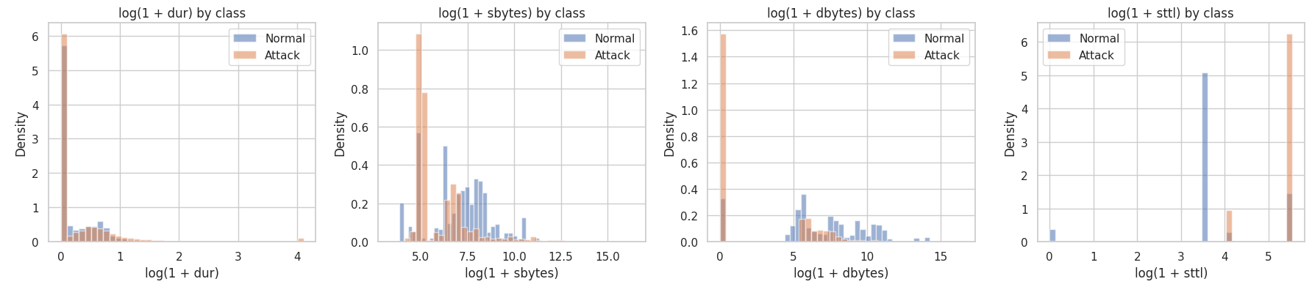
Data Analysis: Feature Behaviour (1 of 2)
HOW IT WAS MADE
Histograms of log(1+x) per class on the training file, as densities. The log scale tames heavy skew.
WHY WE DID IT
To see which features separate normal from attack before modelling. Overlapping curves cannot separate alone.
WHAT IT SHOWS
sttl splits best: attacks mostly at the top TTL value, normal at lower values.
dur overlaps almost fully.
Many attacks have zero return bytes (dbytes).
Notes:
This is the first row of the feature distribution plot from the notebook. HOW: histograms of log(1+x) for each class on the training file, normalised as densities so Normal and Attack can be compared. The log scale is used because the features are very skewed. WHY: to see before modelling which features separate the classes. Features where the two curves differ can help the model; overlapping curves cannot separate the classes alone. RESULT: sttl separates the classes best. Most attack flows sit at the highest TTL value while normal flows sit at lower values. Duration overlaps almost completely. Many attack flows have zero bytes coming back (dbytes). This is association, not cause.

Slide 20
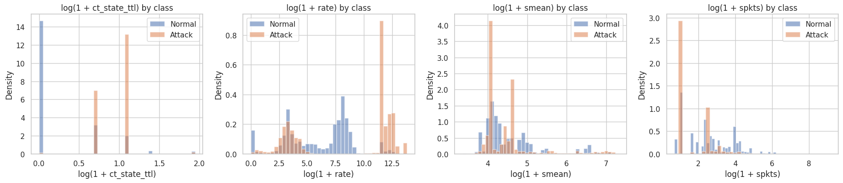
Data Analysis: Feature Behaviour (2 of 2)
HOW IT WAS MADE
Same method: log(1+x) histograms per class on the training file, shown as densities.
WHY WE DID IT
Confirms the correlation results visually and shows which features give the models something to learn from.
WHAT IT SHOWS
ct_state_ttl: normal mostly 0, attack mostly 1 to 2.
rate: attacks pile up at very high rates.
smean and spkts overlap much more.
Notes:
This is the second row of the feature distribution plot. Same method: log(1+x) histograms per class on the training file. RESULT: ct_state_ttl is mostly 0 for normal flows and mostly 1 to 2 for attacks. Attack flows also pile up at very high packet rates, roughly 100,000 packets per second or more, while normal flows have a bump near 3,000. Mean packet size (smean) and packet count (spkts) overlap much more. These patterns agree with the correlation values: sttl 0.693 and ct_state_ttl 0.578. This is association, not cause.

Slide 21
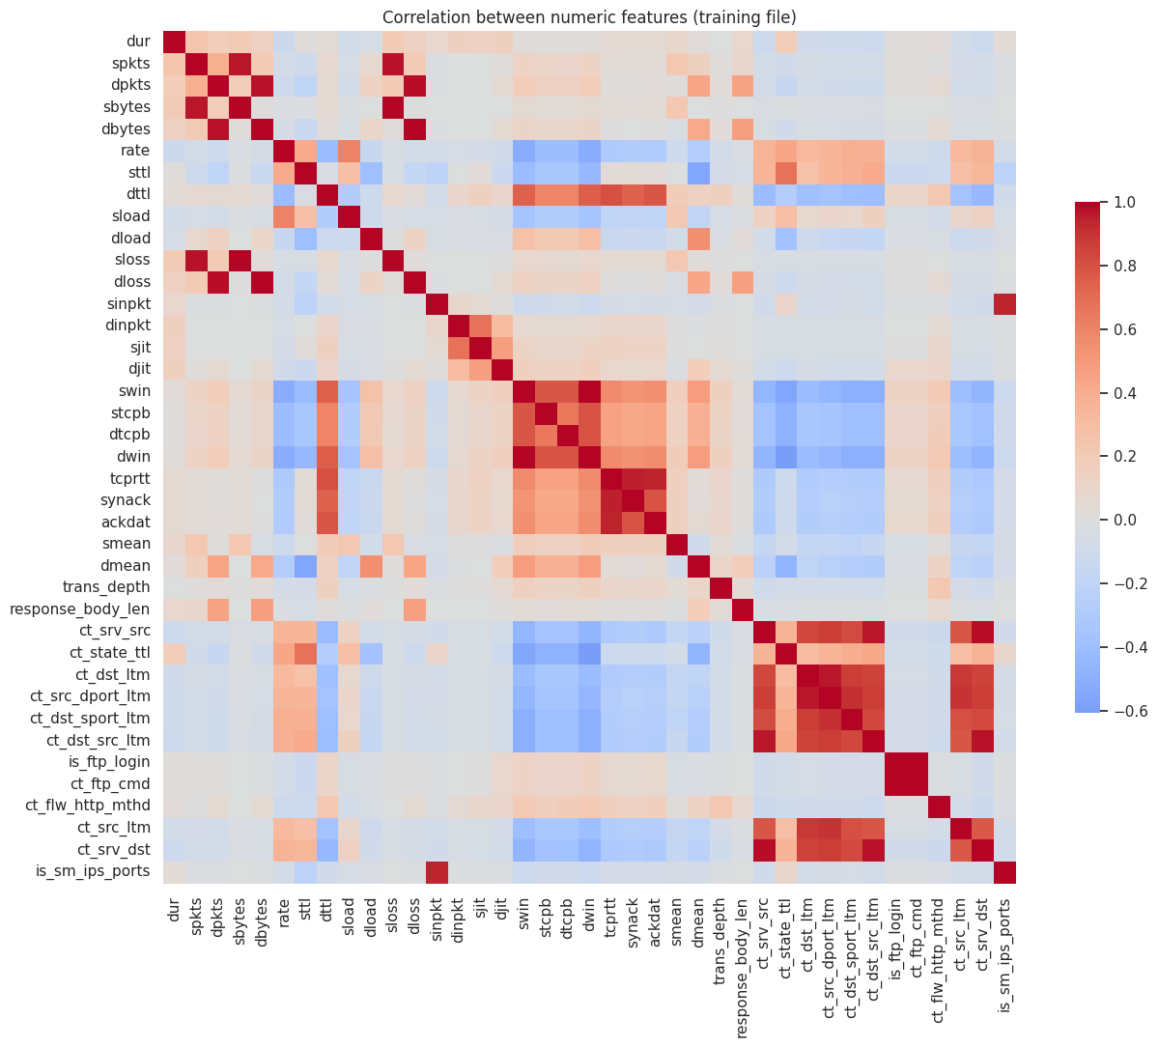
Data Analysis: Correlation Heatmap
HOW IT WAS MADE
Pearson correlation between all numeric features of the training file (id and label excluded), plus each feature against the label.
WHY WE DID IT
To find features that move with the label, and groups of features that carry the same information.
WHAT IT SHOWS
Strongest with the label: sttl 0.693, ct_state_ttl 0.578, dload -0.394.
Red blocks = redundant groups (ct_* counts, swin/dwin, tcprtt/synack/ackdat). Association, not cause.
Notes:
This is the full correlation heatmap from the notebook. HOW: Pearson correlation between all numeric features of the training file, excluding id and label. WHY: to spot features that move with the label, and groups of features that carry the same information. RESULT: the strongest link with the label is sttl at 0.693, then ct_state_ttl at 0.578 and dload at minus 0.394. The red blocks show groups of redundant features, for example the ct_ connection counts, swin with dwin, and tcprtt with synack and ackdat. That redundancy is one reason the two importance methods later disagree. Correlation is association, not cause.

Slide 22
How the Results Are Measured
Accuracy
(TP + TN) / all flows
(44,664 + 27,118) / 82,332 = 0.8719
Share of all flows classified correctly. Can mislead.
Precision
TP / (TP + FP)
44,664 / (44,664 + 9,882) = 0.8188
Of flows flagged as attacks, how many really were.
Recall
TP / (TP + FN)
44,664 / (44,664 + 668) = 0.9853
Of real attacks, how many were caught.
F1-score
2PR / (P + R)
2 x 0.8188 x 0.9853 / (0.8188 + 0.9853) = 0.8944
Balance of precision and recall. Used to tune.
False-positive rate
FP / (FP + TN)
9,882 / (9,882 + 27,118) = 0.2671
Normal traffic wrongly flagged: false alarms.
False-negative rate
FN / (FN + TP)
668 / (668 + 44,664) = 0.0147
Attacks missed: the dangerous error.
Random Forest on the test file: TP 44,664 | TN 27,118 | FP 9,882 | FN 668 Attack = positive class
Notes:
This slide explains HOW every number in the results section is calculated, using the Random Forest confusion matrix as the worked example. Attack is the positive class. TP = attack caught (44,664), TN = normal passed (27,118), FP = false alarm (9,882), FN = missed attack (668). We report six numbers instead of accuracy alone because the two kinds of mistake cost different things in security: a missed attack is dangerous, a false alarm wastes analyst time. All six values for Random Forest can be reproduced by hand from the four counts.

Slide 23
Results: Model Comparison
Model | Accuracy | Precision | Recall | F1 | FPR | FNR | ROC-AUC
Baseline | 0.5506 | 0.5506 | 1.0000 | 0.7102 | 1.0000 | 0.0000 | 0.5000
Logistic Regression | 0.8110 | 0.7549 | 0.9725 | 0.8500 | 0.3869 | 0.0275 | 0.9562
Decision Tree | 0.8693 | 0.8300 | 0.9590 | 0.8899 | 0.2407 | 0.0410 | 0.8970
Random Forest | 0.8719 | 0.8188 | 0.9853 | 0.8944 | 0.2671 | 0.0147 | 0.9783
FPR: false-positive rate: normal traffic wrongly flagged (lower is better)
FNR: false-negative rate: attacks missed (lower is better)
Shaded: best value among the three models
Notes:
All numbers are on the official test file, with attack as the positive class. The baseline gets 0.5506 accuracy because it calls everything an attack, so its false positive rate is 1.0. Random Forest has the best F1, recall and AUC. The Decision Tree has the lowest false positive rate. Logistic Regression is weakest.

Slide 24
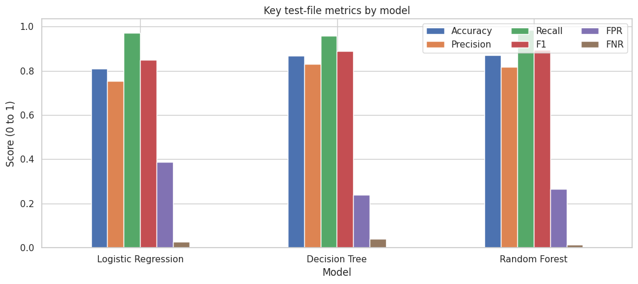
Results: Key Metrics by Model
HOW IT WAS MADE
Six metrics computed for each tuned model on the official test file, attack as the positive class. The test file was used once, after all tuning was finished.
WHY WE DID IT
Accuracy alone hides which mistake is made. Putting all six bars side by side shows the trade-off: catching more attacks vs raising fewer false alarms.
WHAT IT SHOWS
Recall is high for all models (0.959 to 0.985). The false-positive rate is the weak bar: 0.24 to 0.39.
Accuracy: LR 0.811, DT 0.869, RF 0.872.
Notes:
This is the bar chart from the notebook (Section 9). HOW: for each tuned model we computed six metrics on the official test file, which was used only once. WHY: to see the trade-off in one picture instead of trusting accuracy alone. RESULT: accuracy is 0.811 for Logistic Regression, 0.869 for Decision Tree and 0.872 for Random Forest. Recall is high for all three (0.959 to 0.985), so most attacks are caught. The weak bar is the false-positive rate, 0.24 to 0.39, which means a lot of normal traffic is flagged.

Slide 25
Results: Errors That Matter
Random Forest on the test file
27,118
9,882
normal correctly passed
FALSE ALARMS
668
44,664
ATTACKS MISSED
attacks caught
Few attacks missed (1.47%), but over a quarter of normal traffic is flagged.
Notes:
The chart compares F1, false positive rate and false negative rate. On the right is the Random Forest confusion matrix: 27,118 normal flows correctly passed, 9,882 false alarms, 668 missed attacks and 44,664 attacks caught. The key message: very few attacks are missed, but many false alarms are raised.

Slide 26
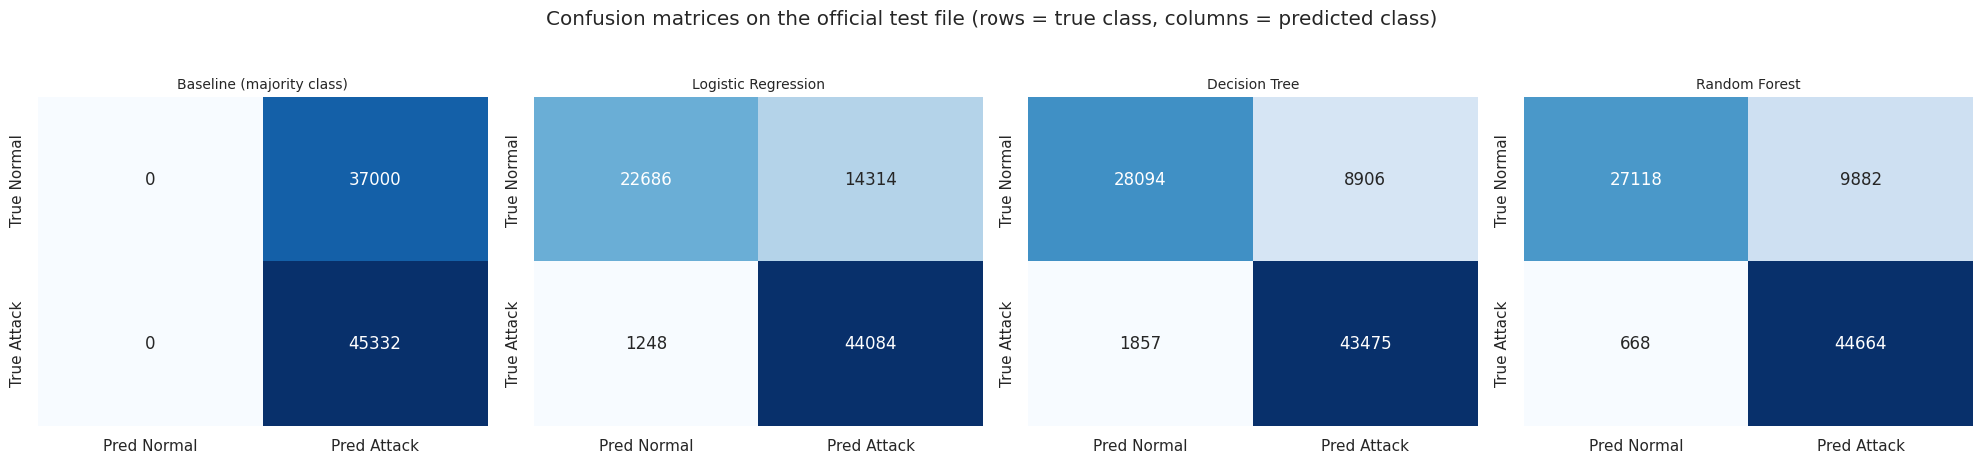
Results: Confusion Matrices
HOW IT WAS MADE
Each model classified the 82,332 test flows at a 0.5 threshold. Rows = true class, columns = predicted class.
WHY WE DID IT
Accuracy hides which error is made. A missed attack and a false alarm cost different things.
WHAT IT SHOWS
Missed attacks: RF 668, LR 1,248, DT 1,857.
False alarms: DT 8,906, RF 9,882, LR 14,314.
Baseline flags all 37,000 normal flows.
Notes:
These are the four confusion matrices from the notebook. Rows are the true class, columns are the predicted class. HOW: each model classified the 82,332 test flows at the 0.5 threshold, and we counted the four outcomes. WHY: accuracy hides which mistake is made, and in security a missed attack and a false alarm cost different things. RESULT: Random Forest misses the fewest attacks (668). Decision Tree raises the fewest false alarms (8,906) but misses 1,857 attacks. Logistic Regression raises the most false alarms (14,314). The baseline catches every attack only because it flags all 37,000 normal flows too.

Slide 27
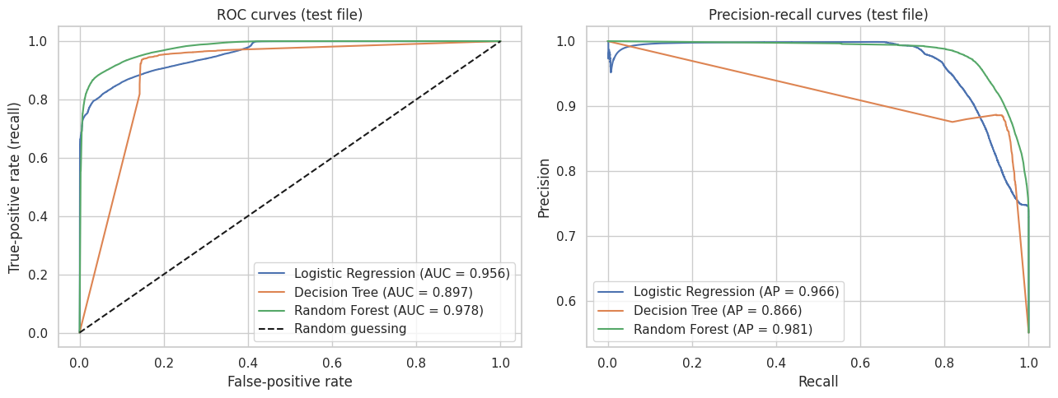
Results: ROC and Precision-Recall Curves
HOW IT WAS MADE
Threshold swept from 0 to 1 on each model's attack probability. ROC: recall vs false-alarm rate. PR: precision vs recall.
WHY WE DID IT
Judges ranking quality without the 0.5 cut-off, and shows what a different threshold could give.
WHAT IT SHOWS
RF is highest (AUC 0.978), then LR (0.956), then DT (0.897). DT's straight segments come from coarse tree probabilities.
Notes:
These are the ROC and precision-recall curves from the notebook. HOW: we swept the decision threshold from 0 to 1 using each model's probability of attack, and plotted recall against false-positive rate (ROC) and precision against recall (PR). WHY: this judges how well each model ranks attacks above normal traffic, independent of the 0.5 cut-off, and it shows what a different threshold could achieve. RESULT: Random Forest is highest (AUC 0.978, AP 0.981), then Logistic Regression (0.956, 0.966), then Decision Tree (0.897, 0.866). The tree's curve is a few straight lines because a single tree gives only coarse probabilities. Logistic Regression ranks better than the tree even though its F1 at 0.5 is lower, which suggests a better threshold could help it.

Slide 28
Results: Detection by Attack Type
What this tells us
Fuzzers are the hardest: 77.9% (DT), 89.9% (RF), 93.0% (LR)
Normal traffic passed only 61% to 76% of the time
Tiny classes (Worms: 44 test records) give uncertain estimates
Notes:
The chart shows the share of each category that was flagged as an attack. For the Normal row it is the share correctly passed. Fuzzers are the hardest attack type, with 77.9 percent for the Decision Tree, 89.9 percent for Random Forest and 93.0 percent for Logistic Regression. Normal traffic is correctly passed only 61 to 76 percent of the time. Tiny classes like Worms rest on few records.

Slide 29
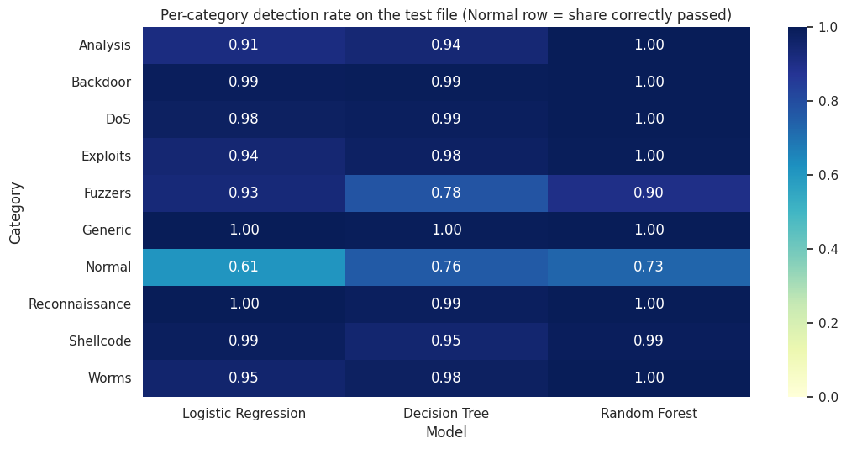
Results: Detection Heatmap by Attack Type
HOW IT WAS MADE
For each category in the test file: share predicted as attack. For Normal: share correctly passed.
WHY WE DID IT
A binary score hides which attack types slip through. This shows exactly where each model fails.
WHAT IT SHOWS
Generic, Reconnaissance, Backdoor: 0.98 or higher for all models.
Fuzzers hardest: DT 0.78, RF 0.90, LR 0.93.
Normal passed only 0.61 to 0.76.
Worms: just 44 test records, so uncertain.
Notes:
This is the per-category heatmap from the notebook. HOW: for every category in the test file we computed the share of records predicted as attack. For the Normal row it is the share correctly passed. Darker means better. WHY: a binary score hides which attack types slip through, and the question is which attacks are missed. RESULT: Generic, Reconnaissance and Backdoor are 0.98 or higher for every model. Fuzzers are the hardest attack type, 0.78 for the Decision Tree, 0.90 for Random Forest and 0.93 for Logistic Regression. Normal traffic is passed only 0.61 to 0.76 of the time. Worms has only 44 test records, so its numbers are uncertain.

Slide 30
Results: Training vs Test Scores
0.9702 vs 0.8944
Random Forest F1: random split inside training file vs official test file
Gap is about 0.10 for ALL three models, even the simple one
So it is probably not just overfitting: the files differ
A random split looks too good, so the official split is more honest
Notes:
The chart compares the cross-validation F1, the F1 on the whole training file and the F1 on the official test file. The test score is about 0.10 lower for every model, even for simple Logistic Regression, so it is probably not only overfitting. A likely reason is that the testing file differs from the training file, and duplicates may add to it. That is a likely explanation, not a proven one. A random 80/20 split inside the training file gave 0.9702, far above 0.8944.

Slide 31
How We Find the Deciding Features
1
2
3
4
Correlation
Impurity importance
Permutation importance
Logistic Regression weights
Link of each numeric feature with the label
Split quality credited to each feature in the 100 trees
F1 drop when one feature is shuffled
Size and sign of each standardised weight
sttl 0.693
ct_state_ttl 0.578
dload -0.394
sttl about 0.10
ct_state_ttl about 0.08
then dload, rate, dttl
service about 0.016
ct_dst_src_ltm, sbytes,
synack, dmean
dload about -26
state_RST +17
proto_igmp -14
Answer: no single feature decides. sttl and ct_state_ttl are the strongest signals, but the models combine all 42 features. To confirm, drop a feature, retrain and measure the loss (future work).
Notes:
Question: which features decide whether a connection is normal or an attack, and how can we find out? We used four methods on the trained models. Correlation shows which columns move with the label: sttl 0.693. Impurity importance shows which columns the Random Forest splits on most: sttl and ct_state_ttl. Permutation importance shuffles one column on test data and measures the F1 drop: service, ct_dst_src_ltm and sbytes, but the largest drop is only about 0.016. Logistic Regression weights can be read directly: dload, state_RST. The methods agree that sttl and ct_state_ttl are strong signals but disagree on the order, and no single feature decides. The direct confirmation is to remove a feature, retrain and measure the loss; we have not done that yet, so it is listed as future work.

Slide 32
Results: Which Features Matter?
Impurity importance
Permutation importance
1
sttl
1
service
2
ct_state_ttl
2
ct_dst_src_ltm
3
dload
3
sbytes
4
rate
4
synack
5
dttl
5
dmean
6
sload
6
tcprtt
No single column decides. Best correlation 0.693, top impurity importance about 0.10, largest permutation drop only about 0.016. The two methods disagree; importance is association, not cause.
Notes:
Two methods were used on the Random Forest. Impurity importance ranks sttl, ct_state_ttl, dload, rate, dttl and sload highest. Permutation importance, which measures how much F1 drops when a feature is shuffled on a test sample, ranks service, ct_dst_src_ltm, sbytes, synack, dmean and tcprtt highest. They disagree because many features carry overlapping information. Importance shows what the model uses, not what causes an attack. No single column decides: the strongest correlation with the label is 0.693, the highest impurity importance is about 0.10 and the largest permutation drop is only about 0.016.

Slide 33
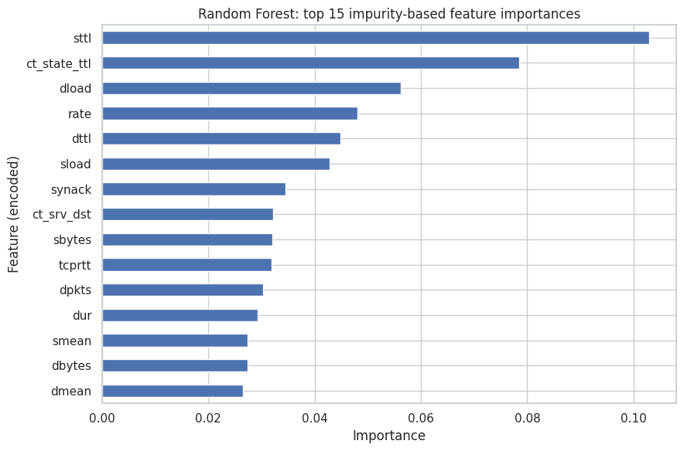
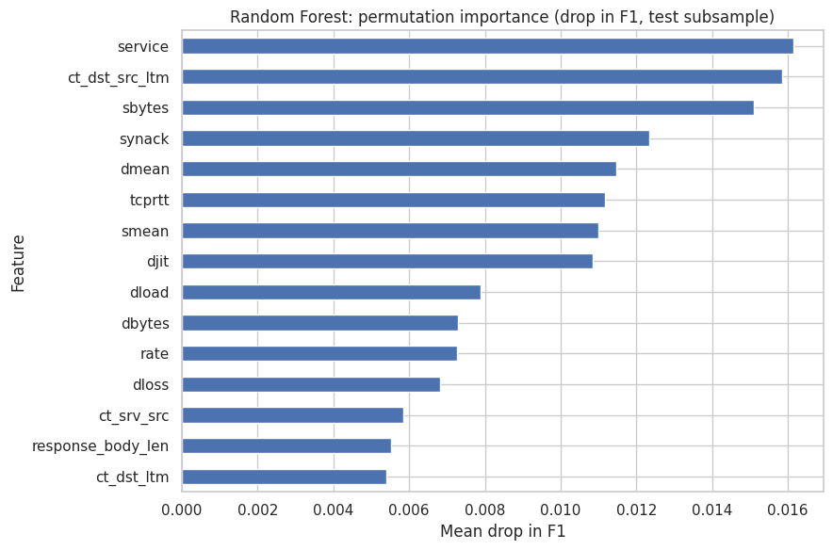
Results: Importance in the Random Forest
IMPURITY IMPORTANCE: HOW AND RESULT
HOW: summed impurity reduction per feature across 100 trees. RESULT: sttl (about 0.10) and ct_state_ttl (about 0.08) lead, then dload, rate, dttl, sload.
PERMUTATION IMPORTANCE: HOW AND RESULT
HOW: shuffle one feature on a 10,000-row test sample, measure the F1 drop. RESULT: service, ct_dst_src_ltm, sbytes lead; largest drop only about 0.016.
Notes:
These are the two feature importance charts from the notebook, both for the Random Forest. HOW: impurity importance adds up how much each feature reduced impurity across the 100 trees. Permutation importance shuffles one feature at a time on a 10,000-row test sample, three repeats, and measures the drop in F1. WHY: to see what the model actually uses. We use two methods because impurity importance can favour features with many distinct values, while permutation importance measures reliance on unseen test data. RESULT: impurity ranks sttl, ct_state_ttl, dload, rate, dttl and sload highest. Permutation ranks service, ct_dst_src_ltm, sbytes, synack, dmean and tcprtt highest, and sttl is not in its top 15. A likely reason is that correlated features cover for each other. The biggest drop is only about 0.016, so no single feature breaks the model. Importance shows what the model uses, not what causes an attack.

Slide 34
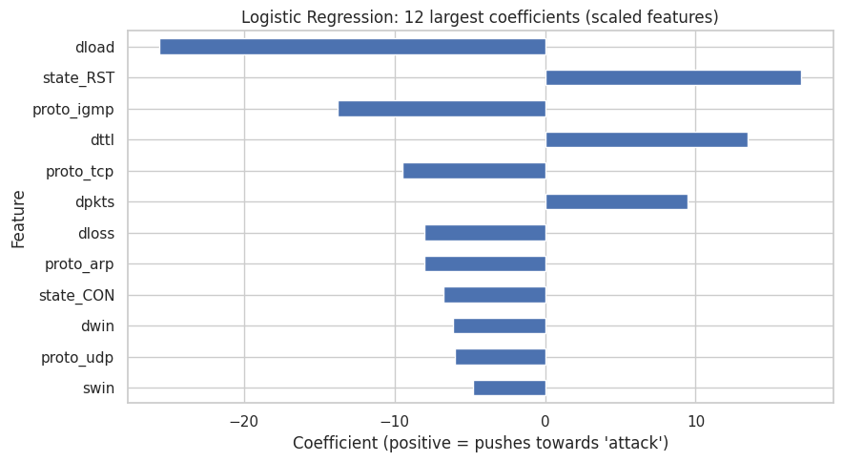
Results: Logistic Regression Coefficients
HOW IT WAS MADE
Coefficients of the tuned model (C = 10) on standardised features. Positive pushes towards attack.
WHY WE DID IT
A linear model can be read directly, so we can compare what it relies on with the forest.
WHAT IT SHOWS
Largest weights: dload (about -26), state_RST (+17), proto_igmp (-14), dttl (+13.5).
Different top features from the forest; weights are not directly comparable across models.
Notes:
This is the Logistic Regression coefficient chart from the notebook. HOW: the coefficients of the tuned model with C = 10 on standardised features. A positive value pushes the prediction towards attack, a negative value towards normal. WHY: Logistic Regression is a linear model, so its weights can be read directly, and we can compare what it relies on with the forest. RESULT: the largest weights are dload (about minus 26), state_RST (about plus 17), proto_igmp (about minus 14) and dttl (about plus 13.5). The top features differ from the forest's, and sttl is not among them. Scaling, one-hot categories and correlated features all change the weights, so they are not directly comparable across models. Importance is association, not cause.

Slide 35
Why Did We Get These Results?
Random Forest misses the fewest attacks
Many trees vote, so one tree's mistake is outvoted: 668 misses vs 1,857 (DT) and 1,248 (LR). Evidence: confusion matrices.
1
Decision Tree raises the fewest false alarms
One deep tree (max_depth 20) makes hard rules: 8,906 false alarms but 1,857 misses, and coarse probabilities give the lowest AUC (0.897). Evidence: ROC curve.
2
Logistic Regression is weakest at 0.5
A straight-line boundary cannot fit every attack type: 14,314 false alarms. Its AUC (0.956) beats the tree's, so a better threshold may help.
3
Test F1 is about 0.10 below CV F1 for all three
Even Logistic Regression drops 0.105, so it is probably not only overfitting. The files differ: 55% vs 68% attack, two unseen states, 10.37% repeated rows. Likely, not proven.
4
Fuzzers and normal traffic are the hard cases
Fuzzers are caught 78% to 93% and normal traffic passed 61% to 76%. Possible reason: they look alike in the features (not tested). Worms has only 44 records.
5
Notes:
This slide connects each result to a likely reason and to the chart that shows it. Be careful with wording: these are reasonable explanations from the evidence, not proven causes. Row 4 is the most important: the 0.10 gap between cross-validation and the official test file shows up even for simple Logistic Regression, so it is probably not only overfitting. Row 5 gives a possible reason for the Fuzzers result; that reason was not tested in this project.

Slide 36
Findings
All 3 models beat the baseline
accuracy 0.81 to 0.87 vs 0.55
Random Forest best overall
F1 0.8944, only 668 missed attacks; lead over Decision Tree just 0.0045
1
2
False alarms are the main weakness
24% to 39% of normal traffic flagged
A trade-off exists
RF misses fewest attacks; DT raises fewest false alarms
3
4
Fuzzers are the hardest attack
detected 77.9% to 93.0%
A random split looks too good
0.9702 vs 0.8944 on the official test
5
6
Notes:
Read the six findings. The most important ones: all models beat the baseline; Random Forest is best overall but only narrowly; false alarms are the main weakness; and a random split looks better than the official test, so the official split is more honest.

Slide 37
What Is New in This Project
Aspect | In the reviewed papers | In this project
Evaluation split | Random split in one study; official split in others | Official split for the result; random split only as a contrast
Baseline | Not a stated focus | Majority-class baseline included
Error measures | Accuracy is prominent | False-alarm and miss rates next to F1 and AUC
Error analysis | Per-class results in one paper | Detection rate per attack type for every model
Data quality | Not covered in parts I read | Duplicates and train/test overlap counted
Reproducibility | Not covered in parts I read | Fixed seed, saved versions and settings
Not new: no new algorithm, no feature selection, no cross-dataset test.
Notes:
Be honest here. We did not invent a new algorithm. What is different is the way the evaluation is done compared with the emphasis of the papers we reviewed: official split for the main result and a random split only as a contrast, a baseline, false positive and false negative rates, detection per attack type, duplicate counts, and saved settings. What is not new: the models, the dataset, feature selection and cross-dataset tests, which other authors did.

Slide 38

Limitations
One dataset from 2015: lab data, synthetic attacks
Many duplicate rows (42.2% of training) were kept
Offline benchmark experiment: not tested in real time, not production-ready
Binary task only; small tuning grids; single run
High false alarms: 24% to 39% of normal traffic
No test on other datasets or unseen attacks
Results are a benchmark, not proof of real-world performance
Notes:
Read these calmly and honestly. Say that the experiment is offline, meaning records are classified after being collected, so it is a benchmark experiment and not a real-time or production-ready system. Admitting limits makes the project more credible.

Slide 39
Conclusion
0.8944
668
26.7%
Random Forest F1 on the test file
attacks missed out of 45,332
of normal traffic falsely flagged
All three models clearly beat the baseline
Random Forest best overall; Decision Tree raises fewer false alarms
Main weaknesses: false alarms and the Fuzzers category
One 2015 lab dataset: a starting point, not a deployable detector
Notes:
Summarise in four points. All models beat the baseline. Random Forest was best overall with F1 0.8944 and only 668 missed attacks. The main weakness is false alarms, and Fuzzers are hardest. The results come from one 2015 laboratory dataset, so they do not prove real-world performance.

Slide 40

Future Work
1
Remove duplicates, re-run and compare results
2
Tune the probability threshold to cut false alarms
3
Wider hyperparameter search and repeated runs
4
Add gradient boosting (XGBoost)
Next steps
5
Multiclass: predict the attack type too
6
Test on another dataset
7
Build a small input-to-output web demo
Notes:
These are the next steps. Remove duplicates and compare, tune the threshold to reduce false alarms, widen the search, add boosting, move to multiclass, test on another dataset, and build a small input and output demo.

Slide 41
References
[1] N. Moustafa and J. Slay, "UNSW-NB15: a comprehensive data set for network intrusion detection systems," MilCIS 2015, pp. 1-6. doi:10.1109/MilCIS.2015.7348942
[2] S. M. Kasongo and Y. Sun, "Performance analysis of intrusion detection systems using a feature selection method on the UNSW-NB15 dataset," Journal of Big Data, vol. 7, art. 105, 2020. doi:10.1186/s40537-020-00379-6
[3] V.-D. Ngo, T.-C. Vuong, T. V. Luong and H. Tran, "Machine Learning-Based Intrusion Detection: Feature Selection versus Feature Extraction," arXiv:2307.01570, 2023 (preprint).
[4] S. Layeghy and M. Portmann, "On Generalisability of Machine Learning-based Network Intrusion Detection Systems," arXiv:2205.04112, 2022 (preprint).
[5] M. Z. Hossain et al., "Assessing Generalisation Capability of Machine Learning Models for Intrusion Detection," arXiv:2605.04407, 2026 (preprint).
[6] UNSW Canberra Cyber Range Lab, The UNSW-NB15 dataset: research.unsw.edu.au/projects/unsw-nb15-dataset
Notes:
Mention that the dataset paper must be cited, and that three of the five papers are arXiv preprints.

Slide 42

Thank you
Questions?
Random Forest was best overall (F1 0.8944), but false alarms must be solved before any live use.
Notes:
Close with the one-line takeaway and invite questions.

