Slide 1

Internship Project
TITLE PAGE
Problem Statement : Health Insurance Cost Prediction
Domain : Data Analytics and Machine Learning Approach
Team Members:
Kartiki Pansare (4618)
Sakshi Shinde (4646)
Snehal Sonawane (4650)
Sayali Sonule (4652)

Slide 2
PROBLEM STATEMENT
Health insurance cost depends on multiple user and health-related factors, making manual estimation inefficient and error-prone.
Traditionally, the insurance industry uses rule-based and actuarial methods, which rely on fixed formulas based on age, gender, medical history, and lifestyle.
Statistical models such as linear regression, logistic regression, and generalized linear models analyze historical data to estimate risk and cost.
However, these traditional approaches lack flexibility and often struggle to capture complex and non-linear patterns in data.

Slide 3
INTRODUCTION
Better Approach: Machine Learning Solution
Historical insurance data is collected and preprocessed to handle missing values and encode categorical features.
Machine learning model is trained to learn patterns between user/health factors and insurance costs.
The model is deployed to predict costs accurately for new users, making estimation fast and error-free.
Applications of ML in other fields: Healthcare, finance, retail, transportation, and agriculture for prediction, optimization, and automation.

Slide 4
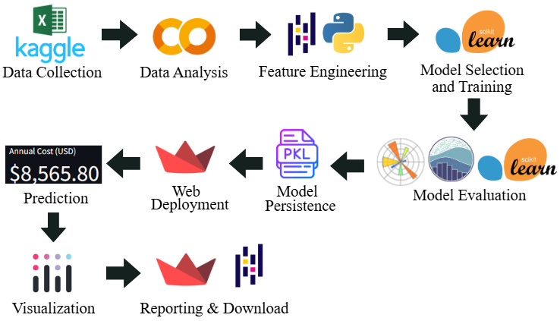
SYSTEM ARCHITECTURE
Data Collection & Analysis (Kaggle, Excel, Google Colab / Jupyter Notebook): Gather historical insurance data, clean it, handle missing values, and explore patterns
Feature Engineering (Python / Pandas): Encode categorical variables and create new features if needed
Model Selection & Training (Scikit-learn): Choose suitable ML algorithm and train the model on historical data
Model Evaluation (Matplotlib, Seaborn, Scikit-learn): Validate model performance using metrics like MAE, RMSE, R² and visualize errors
FIG: System Architecture
Model Persistence (Pickle .pkl): Save the trained model for future use without retraining
Web Deployment & Prediction (Streamlit / app.py, Streamlit UI, Plotly): Build interactive app, take user input, predict insurance cost, and display results
Reporting & Download (Streamlit, Pandas): Generate downloadable summaries or reports for users

Slide 5
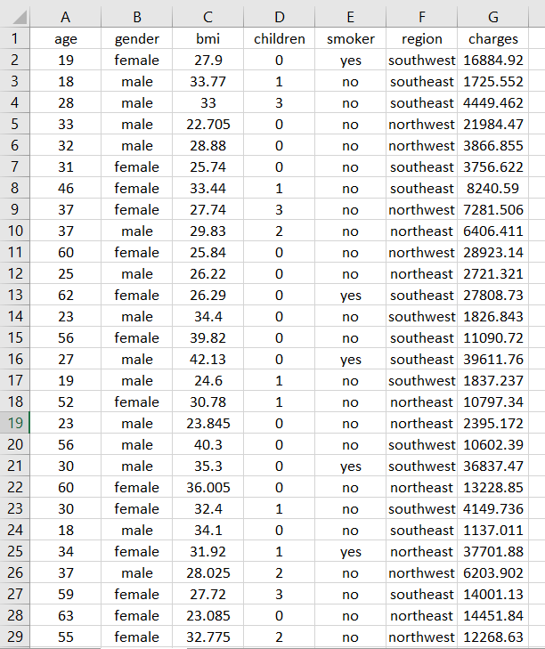
DATASET & PREPROCESSING
Origin:
Based on U.S. health insurance data and is a synthetic dataset derived from U.S. census data
Dataset source: Kaggle – US Health Insurance Dataset, originally from Machine Learning with R (3rd edition)
Features:
Dataset contains 1338 records with 7 features (age, gender, BMI, children, smoker, region) and insurance charges as the target
Data is stored in CSV format and contains no missing values
Categorical features are encoded into numerical values for modeling
Dataset is split into training and testing sets (80–20)
FIG: Dataset

Slide 6
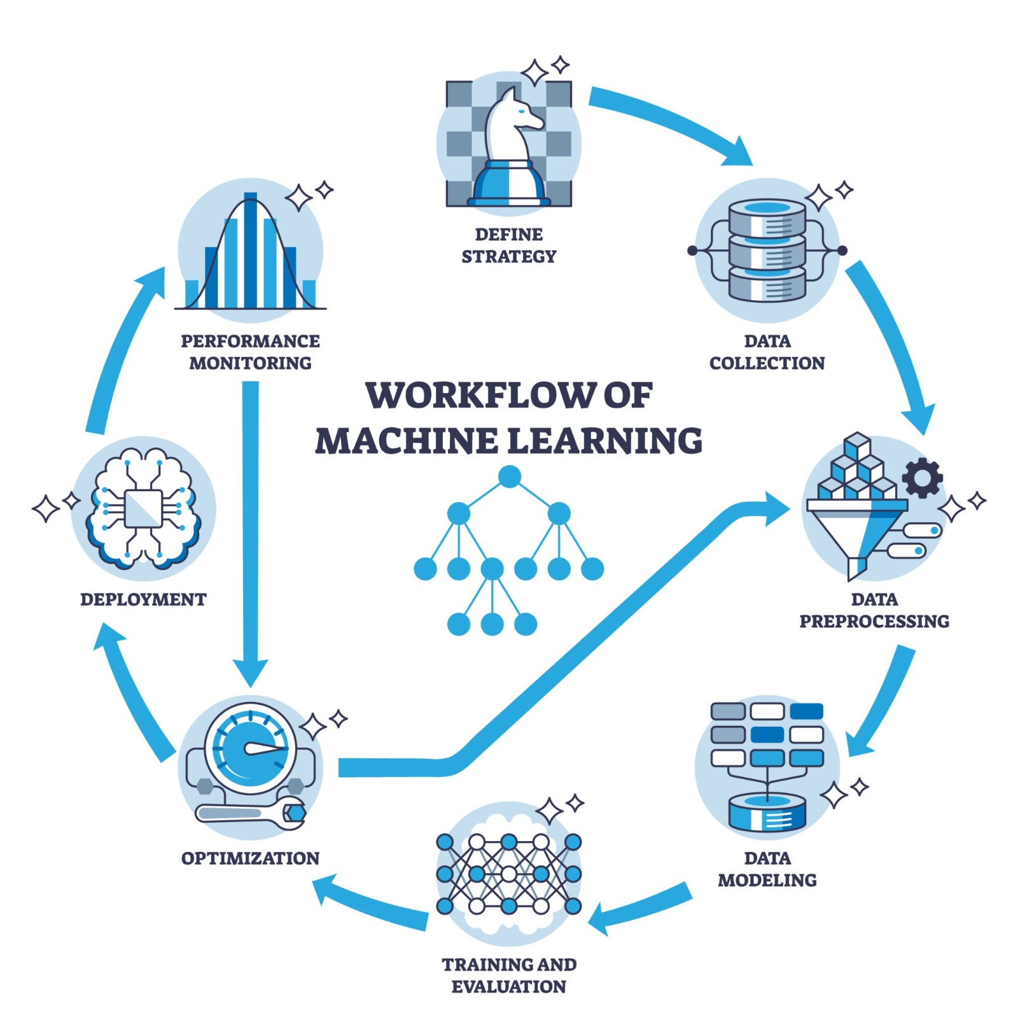
MODEL TRAINING
Machine Learning Models Implemented
Linear Regression
Simple baseline model
Assumes linear relationship between features and cost
Random Forest Regressor
Ensemble of decision trees
Handles non-linear data effectively
Gradient Boosting Regressor
Boosting-based ensemble technique
Combines weak learners for better accuracy
Hyperparameter tuned for optimal performance
Reason for Multiple Models
To compare accuracy and select the best-performing model

Slide 7
DEPLOYMENT & PREDICTION
Model Deployment
Trained model saved using Pickle (.pkl)
Integrated into a Flask-based web application
Working of Prediction System
User enters personal and health details
Data sent to backend Flask server
ML model predicts insurance cost
Result displayed on the web interface
Technologies Used
Python
Flask
HTML, CSS, JavaScript
Scikit-learn

Slide 8
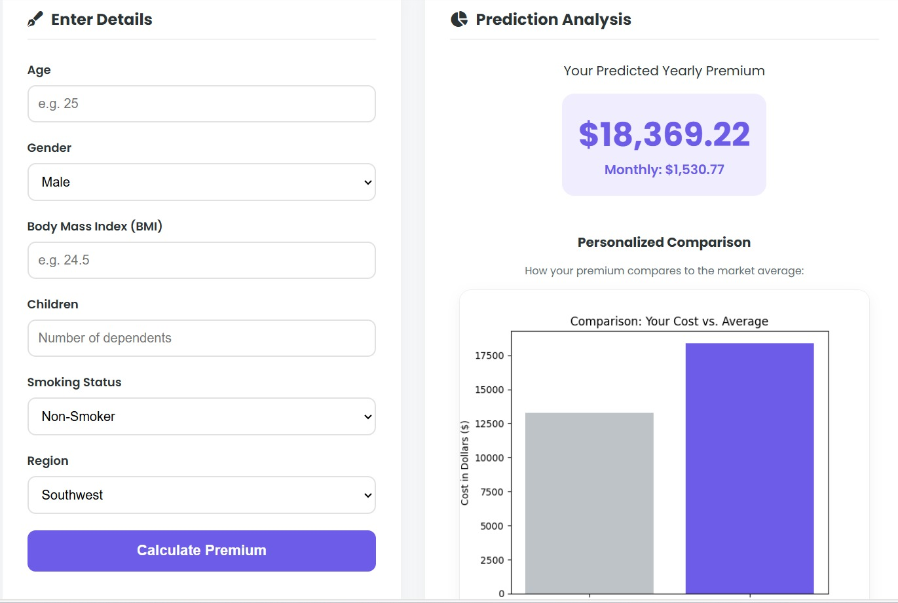
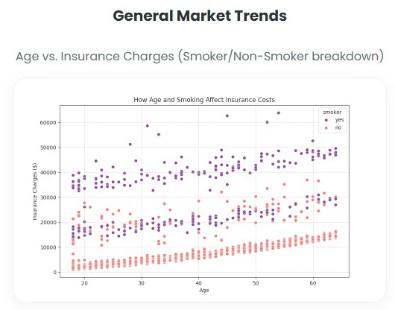
RESULT
Evaluation Metrics Used
Mean Absolute Error (MAE = ( |Actual − Predicted| ) / n)
Root Mean Squared Error (RMSE = √[ (Actual − Predicted)² / n ])
R² Score(R² = 1 − ( Error / Total Variation ))
Performance of Gradient Boosting Regressor
MAE ≈ 2410
RMSE ≈ 4314
R² Score ≈ 0.88
Result
Gradient Boosting performed better than Linear Regression
Captures complex and non-linear relationships
Selected as final model
Accurate insurance cost prediction
Fast and automated estimation
User-friendly web interface

Slide 9
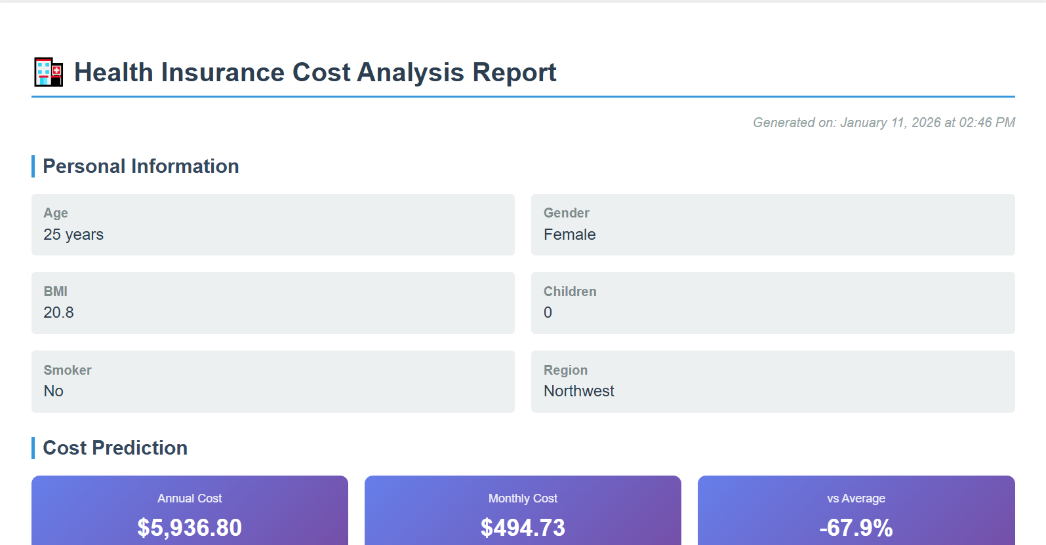
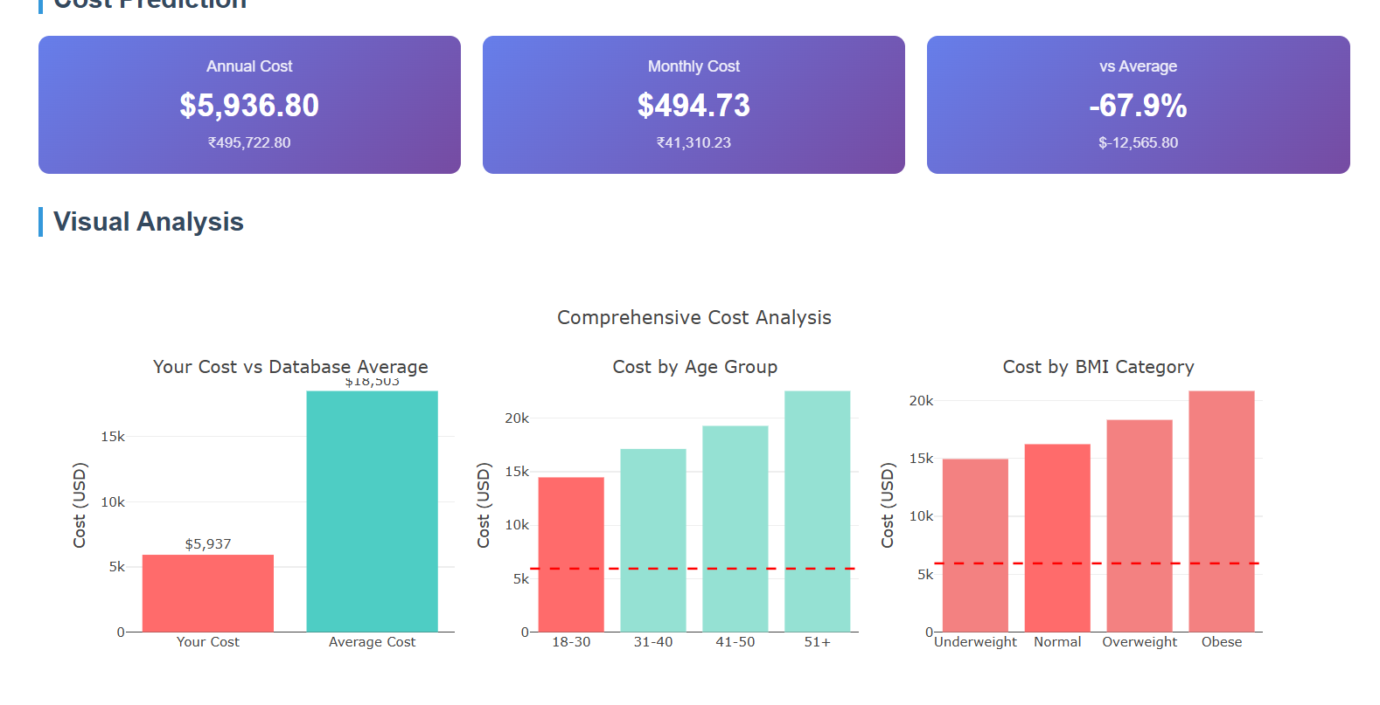
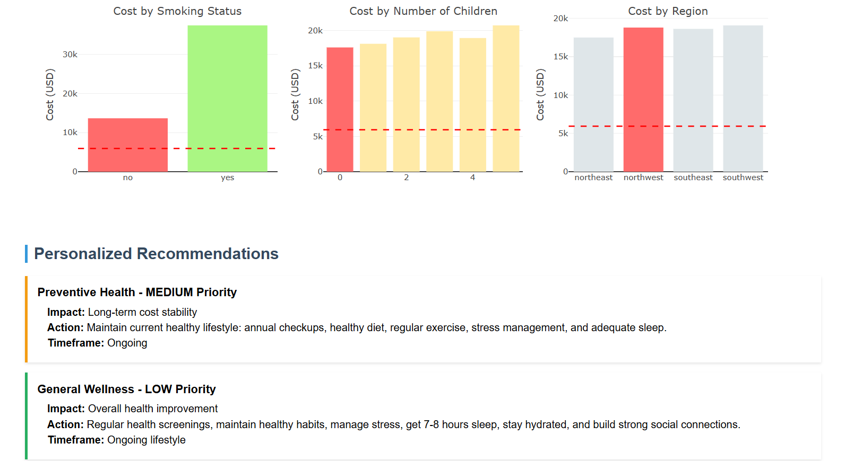
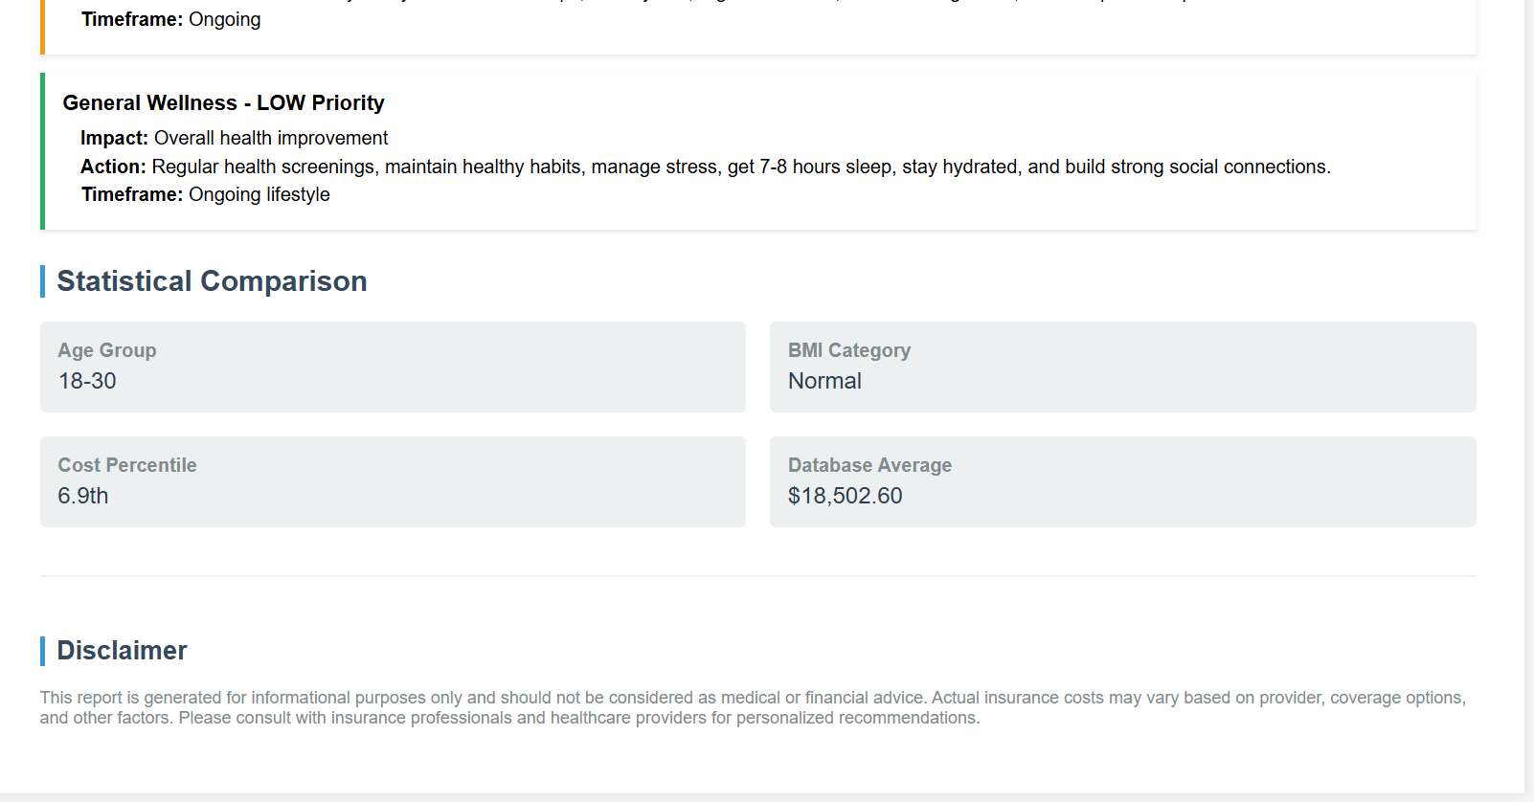
RESULT

Slide 10
ADVANTAGES & DISADVANTAGES
Advantages
Provides accurate insurance cost prediction
Saves time and manual effort
Reduces human calculation errors
Handles large datasets efficiently
Fast and real-time prediction
User-friendly web interface
Easily scalable and upgradable
Useful for insurance analytics and decision making
Disadvantages
Prediction depends on quality of dataset
Limited to predefined input features
Does not consider policy-specific rules
Model accuracy may decrease with outdated data
Requires retraining for new trends
Not suitable for all geographical regions
Cannot replace human expert judgment

Slide 11
Improve prediction accuracy using advanced machine learning models
Include more real-world features such as:
Medical history
Income level
Lifestyle habits
Train the model on larger and updated datasets
Deploy the application on cloud platforms for public access
Add user authentication and data security features
Provide region-specific insurance predictions
Integrate the system with real insurance company databases
Convert the web application into a mobile application
Use deep learning techniques for enhanced prediction performance
FUTURE SCOPE

