Slide 1
FLIGHT DELAY PREDICTION
GROUP MEMBERS – Roshni Bhirad (PC-07)
Sayali Parulekar (PC-09)
Sanchita Biswas (PC-14)
Aarushi Gupta(PC- 23)
Shruti Gupta (PC- 38 )

Slide 2
PROBLEM STATEMENT
Flying for business is full of uncertainty. For travelers with a tight connection window or an arrival time close to an important meeting, even a short flight delay can cause serious anxiety.
We want to help our customers mitigate these scenarios by predicting flight delays prior to their trips.
To develop a model aimed at predicting flight delays at take-off. The purpose is not to obtain the best possible prediction but rather to emphasize on the various steps needed to build such a model.

Slide 3
DATASET
No. of Rows =5819079
No. of Columns = 31
Datasets used are –
airports.csv
airlines.csv
flights.csv
The flight delay and cancellation data was collected and published by the DOT's Bureau of Transportation Statistics, which we accessed at Kaggle
https://www.kaggle.com/usdot/flight-delays

Slide 4
LET’S HAVE A CLOSER LOOK AT THE DATASETS…

Slide 5
flights.csv
YEAR, MONTH, DAY, DAY_OF_WEEK: dates of the flight
AIRLINE: An identification number assigned by US DOT to identify a unique airline
ORIGIN_AIRPORT and DESTINATION_AIRPORT: code attributed by IATA to identify the airports
SCHEDULED_DEPARTURE and SCHEDULED_ARRIVAL : scheduled times of take-off and landing
DEPARTURE_TIME and ARRIVAL_TIME: real times at which take-off and landing took place
DEPARTURE_DELAY and ARRIVAL_DELAY: difference (in minutes) between planned and real times
DISTANCE: distance (in miles)
We reduced the dataset to 469969 rows of the dataset.

Slide 6
airlines.csv
IATA_CODE : Airline Identifier
AIRLINE : Airport’s name
airports.csv
IATA_CODE : Location Identifier
AIRLINE : Airport’s name
CITY : Atlanta
STATE : Georgia
COUNTRY : Country name of the airport
LATITUDE : Latitude of the airport
LONGITUDE : Longitude of the airport

Slide 7
DATA PREPROCESSING TECHNIQUES
Here are the steps we have followed :
Dropping missing values.
Label Encoding- Namely, one hot encoding which is the technique to convert categorical values into a 1-dimensional numerical vector

Slide 8
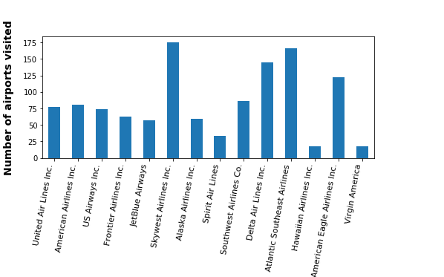
DATA VISUALIZATION TECHNIQUES
The data visualization techniques we used are-
Bar plots

Slide 9
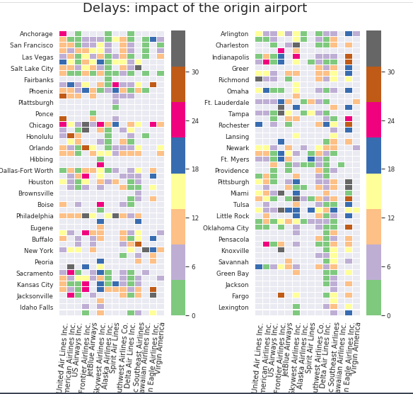
Heat map

Slide 10
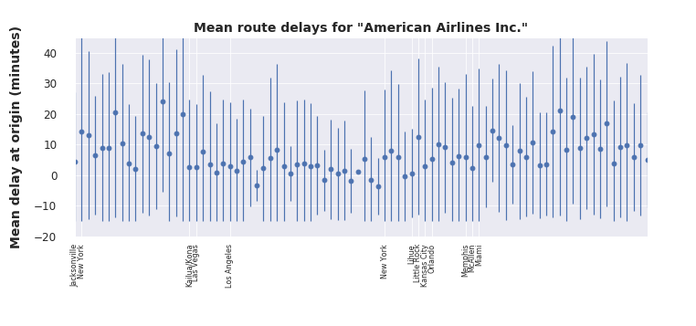
Error Bar

Slide 11
DATA MINING TECHNIQUE USED
REGRESSION-
In statistics, linear regression is a linear approach to modeling the relationship between a scalar response (or dependent variable) and one or more explanatory variables (or independent variables).
At first we used linear regression model.
As a result, the model underestimated the large delays..

Slide 12
POLYNOMIAL REGRESSION
Polynomial Regression is a form of linear regression in which the relationship between the independent variable x and dependent variable y is modeled as an nth degree polynomial.
So, we extended the previous fit by using a polynomial rather than a linear function.
We observed that a polynomial fit improved the MSE score slightly.
Then we used Ridge Regularization for better accuracy

Slide 13
RIDGE REGULARIZATION
It is particularly useful to mitigate the problem of multicollinearity in linear regression, which commonly occurs in models with large numbers of parameters.
There is a risk of overfitting and the free parameters of the model will be biased. Hence, the model will not allow a good generalization. In what follows, we therefore split the data in order to train and then test the model. The purpose will be to determine the polynomial degree which allows the best generalization of the predictions.

Slide 14
DATA ACCURACY
We used the values of Mean Square Error to find out the accuracy of our predictions.
According the final value, our MSE was approximately equal to 60.98 which is exactly 7.81 minutes of error in prediction.

Slide 15
THANK YOU!!!

