Slide 1

🏠 PROPERTY PRICE PREDICTION USING MACHINE LEARNING

Slide 2
INTRODUCTION
The real estate industry depends heavily on property pricing for buying, selling, and investment decisions. Predicting property prices manually can be difficult because prices depend on multiple factors such as location, area, number of rooms, and property type.
Machine Learning provides a smart solution by analyzing historical property data and predicting prices accurately.
This project focuses on building a machine learning model that predicts property prices and provides real-time predictions through a Streamlit web application.

Slide 3
PROBLEM STATEMENT
Property buyers and sellers often face challenges in determining the correct market value of properties

Slide 4
OBJECTIVES
Analyze real estate datasets
Identify important price influencing factors
Perform data preprocessing
Train machine learning models
Predict property prices accurately
Build an interactive Streamlit application

Slide 5
DATASET INFORMATION
Property Type
Area Size
Number of Bedrooms
Number of Bathrooms
Parking Availability
Furnishing Status
Location
Property Price

Slide 6
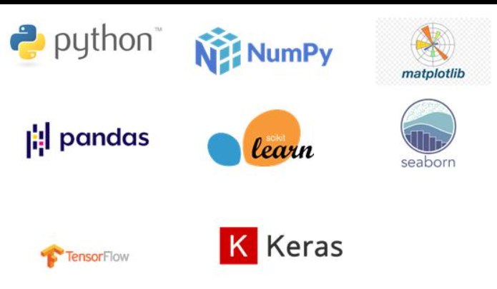
TECHNOLOGIES USED

Slide 7
DATA PREPROCESSING
✅ Handling Missing Values ✅ Removing Duplicate Records ✅ Encoding Categorical Data ✅ Feature Scaling ✅ Train-Test Splitting

Slide 8
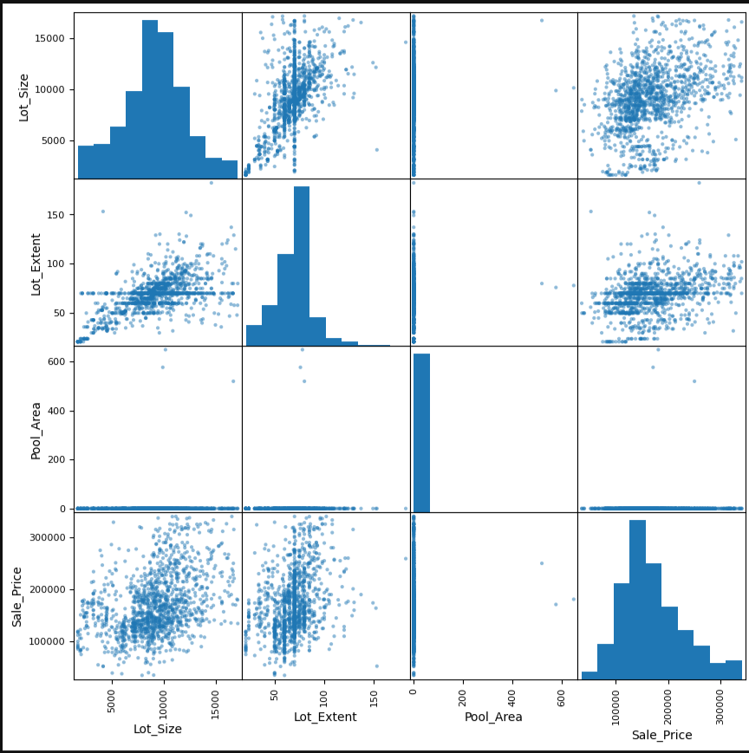
EXPLORATORY DATA ANALYSIS
Price distribution analysis
Area vs Price relationship
Bedrooms vs Price analysis
Correlation analysis
Feature relationship analysis

Slide 9
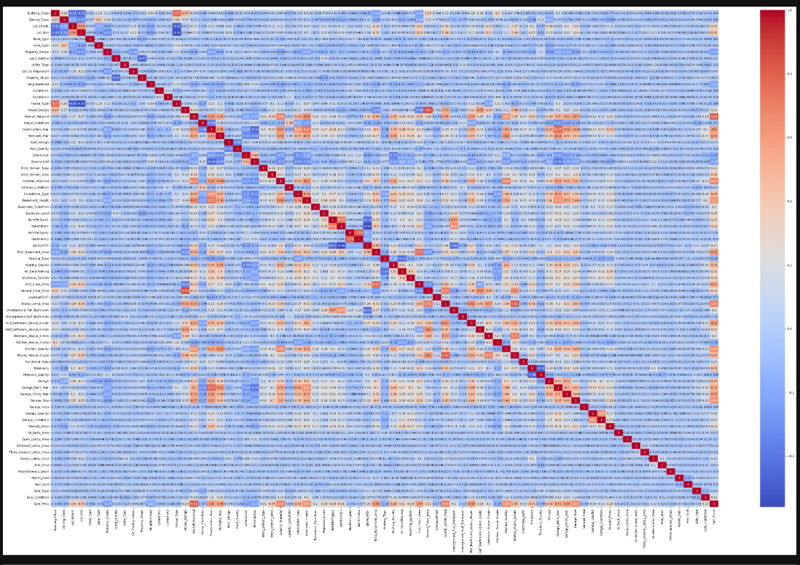
CORRELATION HEATMAP

Slide 10
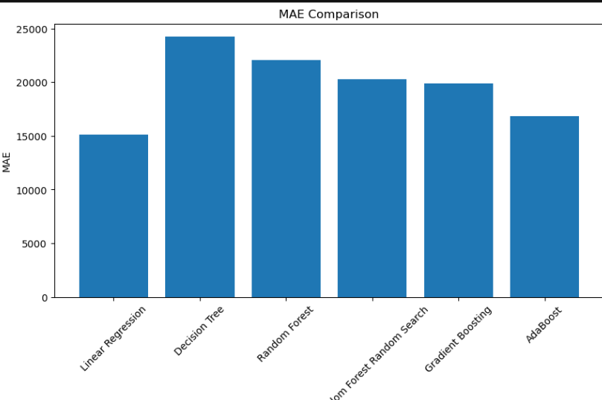
MACHINE LEARNING MODELS
Linear Regression
Decision Tree Regressor
Random Forest Regressor

Slide 11
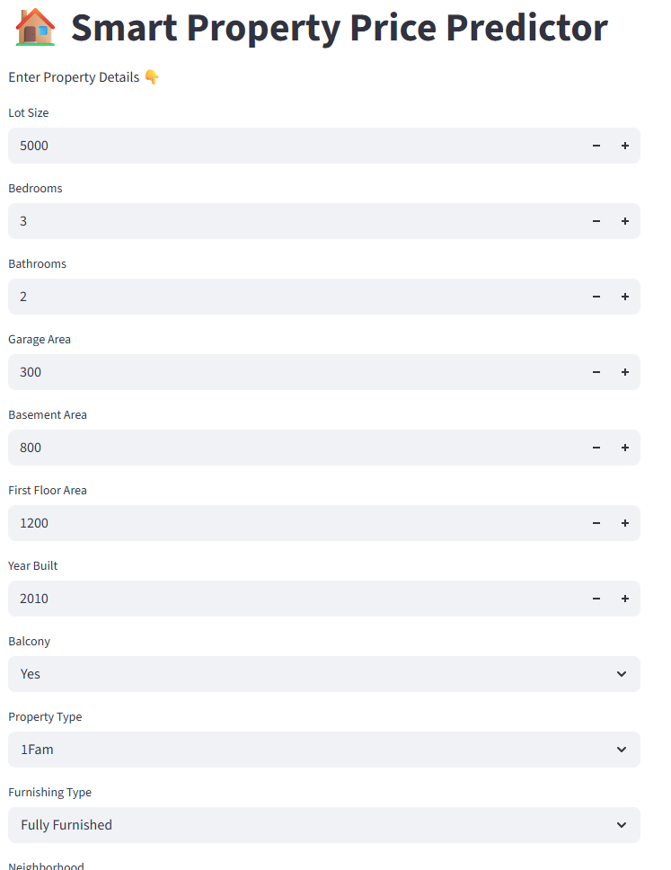
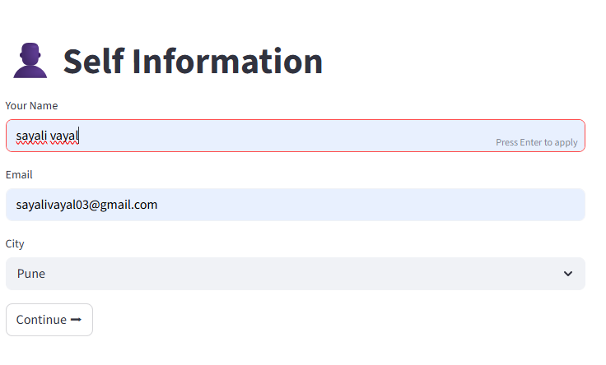
Proposed Solution:
Develop a Machine Learning system that predicts property prices automatically using historical real estate data.

Slide 12
You can now view your Streamlit app in your browser. Local URL: http://localhost:8501 Network URL: http://192.168.31.52:8501

Slide 13
CONCLUSION
This project demonstrates how Machine Learning can help predict property prices efficiently using historical real estate data.

Slide 14
THANK YOU

