Slide 1

Department of Information Technology
A.P. Shah Institute of Technology
G.B.Road,Kasarvadavli, Thane(W), Mumbai-400615
UNIVERSITY OF MUMBAI
Academic Year 2019-2020

Slide 2
A Project Report on
E-commerce Based Sales Prediction Framework
Submitted in partial fulfillment of the degree of
Bachelor of Engineering(Sem-8)
in
INFORMATION TECHNOLOGY
By
Tejal Tandel(16104047) Sayali Wagal(17204016) Nisha Singh(17204011)
Under the Guidance of
Project Guide: Rujata Chaudhari Project Co- guide: Vishal Badgujar

Slide 3
1.Project Conception and Initiation

Slide 4
1.1 Abstract
The retail sector has widely adapted different inventory management applications and some retail chains even employ prediction software to analyze future sales.
However, a lot of day-to-day shopping in India happens through local shops. The owners of such mom-and-pop shops do not necessarily have the capital to invest in proprietary applications for setting up an inventory management system and a sales predicting software.
As a result, many of the shopkeepers end up hoarding a lot of irrelevant and nonprofitable products that lead to financial losses.
A very cost-effective and accessible solution for this problem is a web application that provides all the features of a pointof-sale system as well as gives future sales insights.
It will enable shopkeepers to manage their current product purchases and invoicing. The predictive sales analysis will help them to modify their investments on products and supplies thereby ensuring maximum profits.

Slide 5
1.2 Objectives
To help retailers stock appropriate products based on the in-demand product sale.
To help retailers make product-wise decisions like reordering or discarding the product.
To generate a report on monthly sales so that retailers can analyse their expenses.

Slide 6
1.3 Literature Review
Paper Title: : Performance prediction using modified techniques for retail.
Authors: Ezhilarasan C, Ramani S.
Publication details : Published on IEEE 2016
Findings:
Performance evaluation is based on the website traffic and conversion rates.
These attributes are given as cluster inputs and evaluation is done using Fuzzy logic.
Advantages:
Fuzzy logic is efficient in prediction and sales analysis for particular clusters.
Project can be hosted in any domain and it can used in real-time environment.
Disadvantages:
Small amount of data cannot be computed.
Precise transaction data is required everytime to predict the performance.

Slide 7
1.3 Literature Review
Paper Title: Demographic Transformation clustering of transactional data for sales prediction of convenience stores.
Authors: Xiaojun Zhang, Jisheng Pei, Xiaojun Ye.
Publication details : Published on IEEE 2016
Findings:
Extracting customer characteristics through transactional data.
Two different data attributes, customer type proportion and category profit score, and two different algorithms, k-means and EM, to cluster.
Advantages:
Provides prediction results per category.
Market Basket Analysis can be easily integrated with the model.
Disadvantages:
We can not forecast sales of a commodity precisely just according to its category .

Slide 8
1.3 Literature Review
Paper Title: Profit prediction using regression model for travel agents.
Authors: Rahmatika Santi, Masayu Leylia Khodra.
Publication details : Published on IEEE 2018
Findings:
Model evaluation using linear regression
Advantages:
The model uses independent variables to estimate profit as per the travel agent’s required factor.
This can give the cost estimation to travel agent to describe the value for target completion.
Disadvantages:
The model uses cumulative data of variable to generate results.
It is focused of transactional data.

Slide 9
1.4 Problem Definition
Retailers face a loss in revenue due to improper investment and management activities. Many incur loses because their customer reach is limited. They cannot properly identify the demand of products and therefore end up buying limited products. On the other hand they can underestimate the growth of some products and remove them from their shop.
All these cases lead to a financial loss and stagnate the shop's growth. If the shopkeepers are equipped with tools and applications that give them insights of their sales and recommend products to them, the shopkeepers can improve their finances.

Slide 10
1.5 Scope
This project will be beneficial to bigger supermarkets as well, having vivid range products. It will save them the extra expenditure of purchasing a third party sales prediction software.
The project can be expanded on Android and iOS platforms to make it more easy to use and thereby reduce the hardware space.
This project can be exported as a bundle which can be installed privately into indvidual shops.

Slide 11
1.6 Technology stack
Frontend:
Bootstrap, HTML5, CSS3, JavaScript
Backend:
MySQL
Algorithms:
Classification: Linear Regression

Slide 12
1.7 Benefits for environment & Society
This system will enhance the small businesses of small retailers with the support of the sales forecast.
The local customer reaches increments with this system as now the retailer estimates their customer needs.
Because of its easy-to-use nature, the staring, a small business can get a new system by which they can earn more profit!

Slide 13
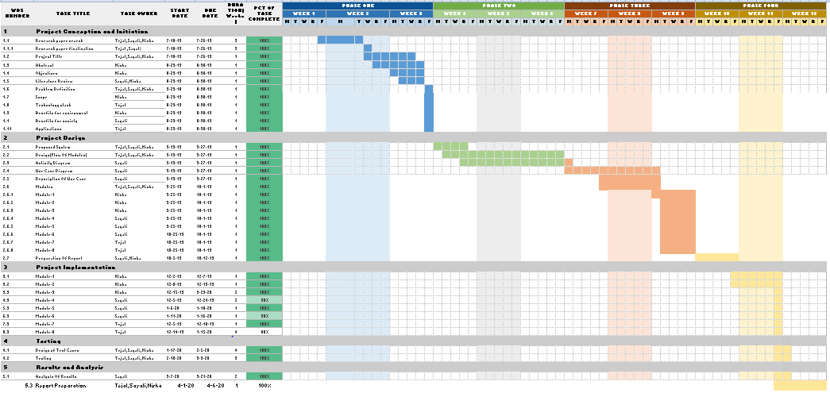
1.8 Project Timeline Chart

Slide 14
2. Project Design

Slide 15
2.1 Proposed System
A crucial part in this mobile app is sales prediction. This can be achieved by employing data mining algorithms on the customer data collected as well as the temporal data fed in by the shopkeepers. The best suited algorithm for the same is Regression Analysis.
A collective analysis of the said reports will help retailers make business decisions which are convenient and cost effective.
In this system they can add more description about product. It will product description should impress them without making them spend much time. Another important element of catalog that can help seller to increase their sales by adding there product in the right category and sub-category .

Slide 16
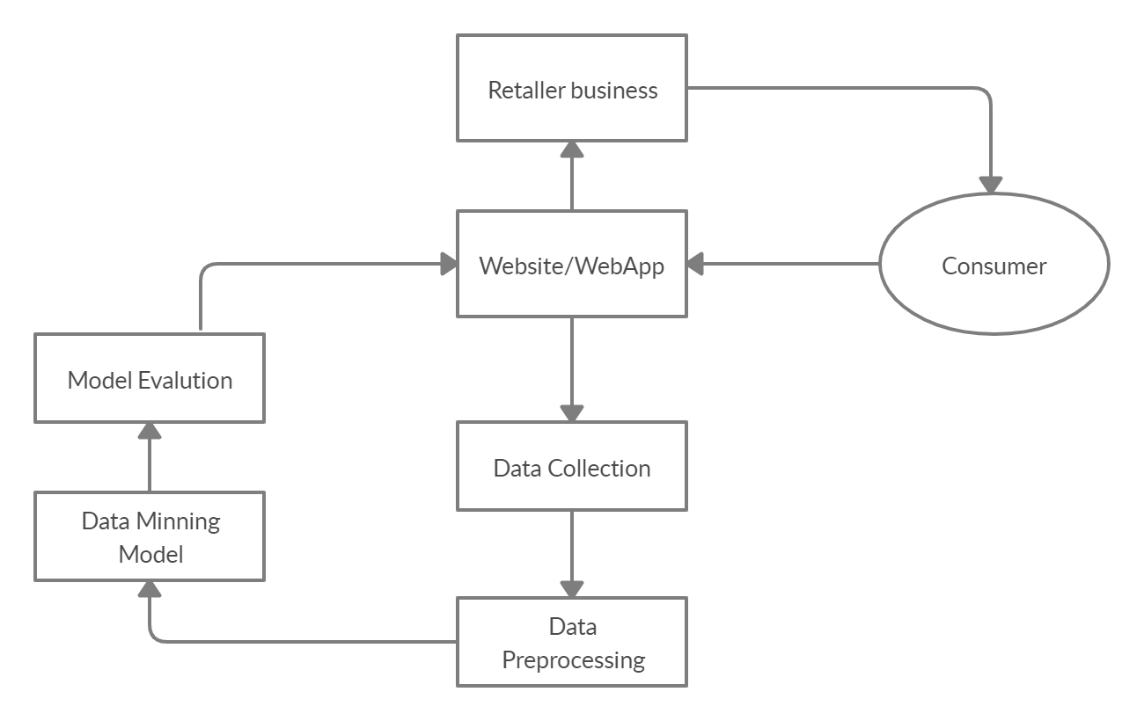
2.2 Design(Flow Of Modules)

Slide 17
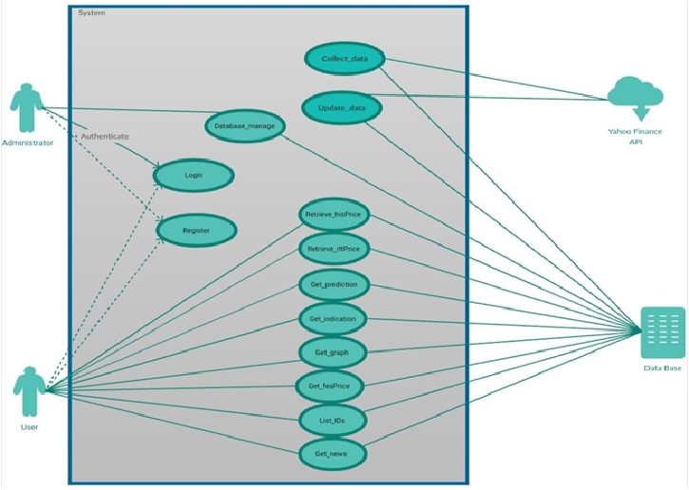
2.3 Description Of Use Case

Slide 18
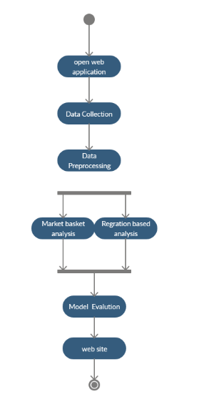
2.4 Activity diagram

Slide 19
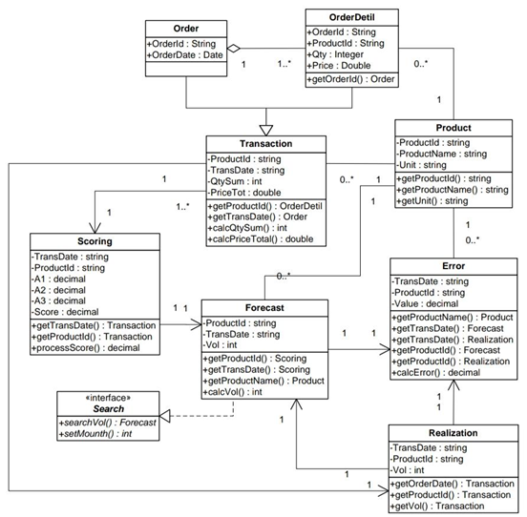
2.5 Class Diagram

Slide 20
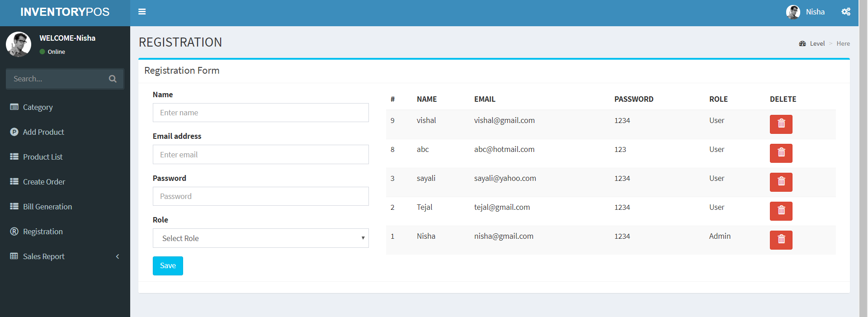
2.6 Module-1
Registration :
Registration is one of the primary modules in any data management system.
Registration is the process by which the retailer identically creates their account.
Registered users normally provide some sort of credentials (such as a username or e-mail address, and a password) to the system in order to prove their identity.

Slide 21
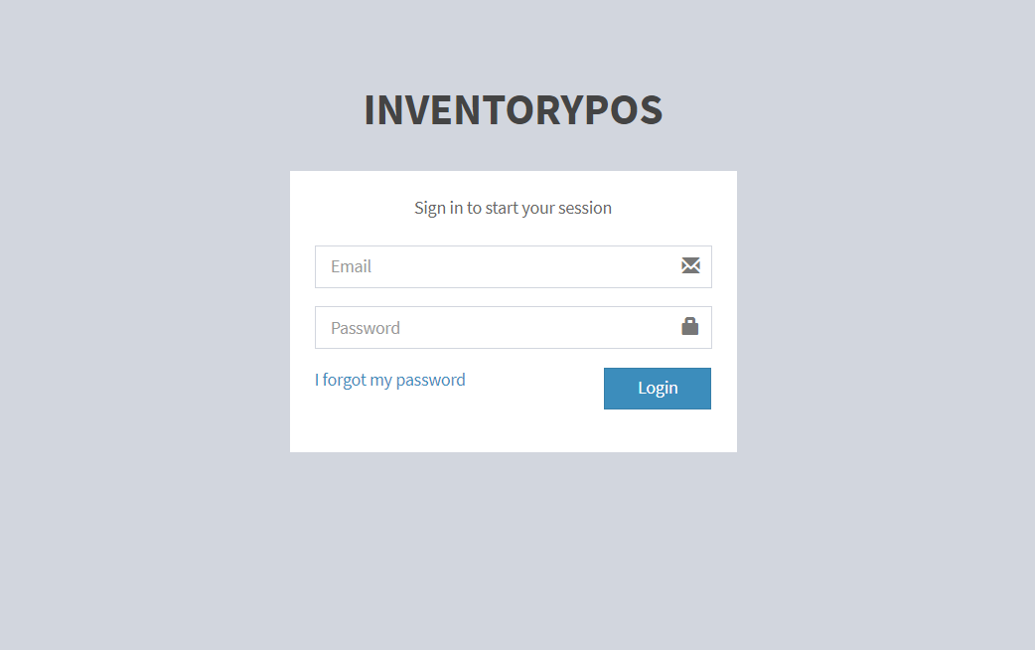
Module-2
Login :
Every store has their login credentials. This ensures segregation of data.
If the login credentials are incorrect access is denied.
Sessions are managed through these credentials.

Slide 22
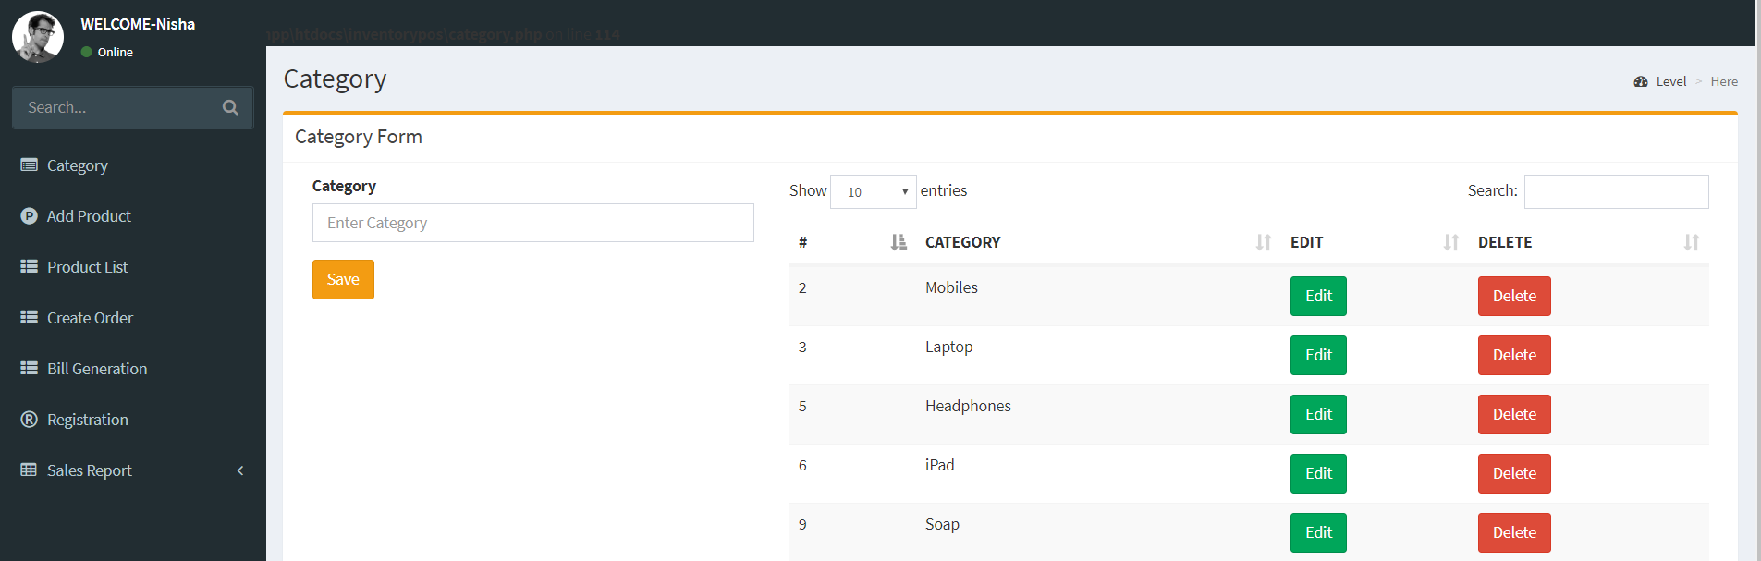
Module-3
Category :
A category is a module by which the retailer can add a different category to sort their products.
They can add or delete the category as they want.
This feature is helpful for them to easy search of any product detail.

Slide 23
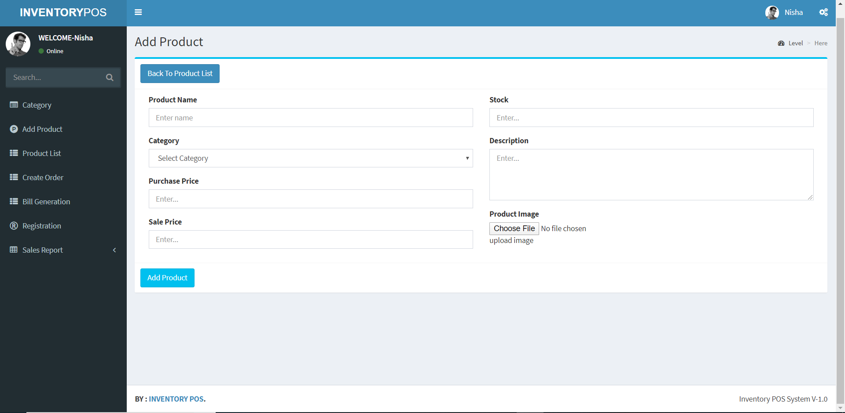
Module-4
Add Product :
Add product is the field by which the user can add their product detail to the system.
The user can add the product detail such as name, category, prices price, sale price, stock, description, image.

Slide 24
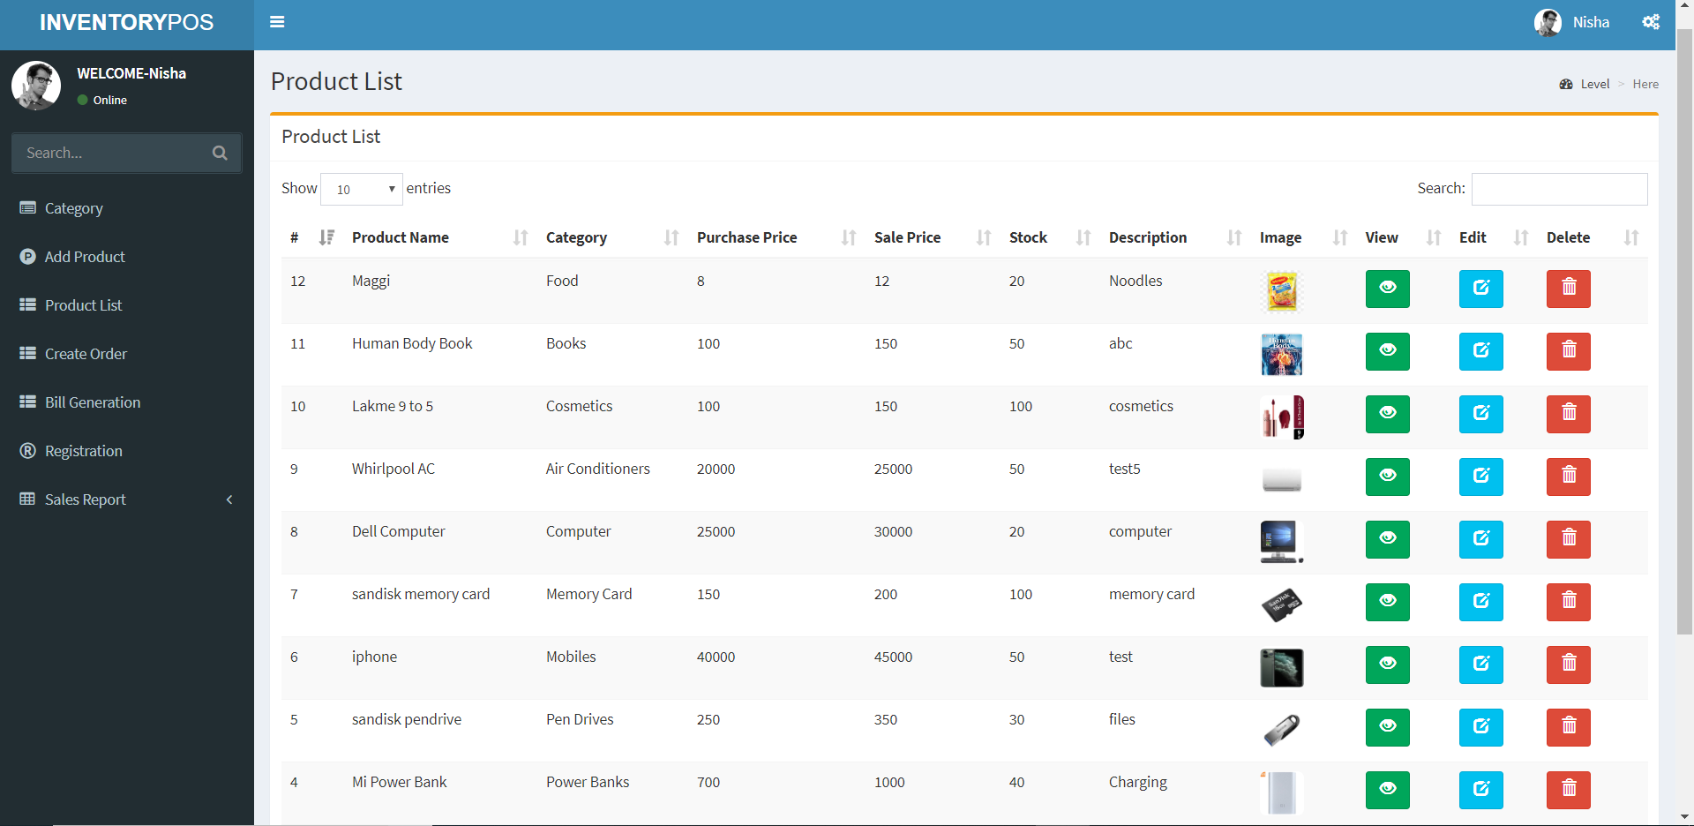
Module-5
Product List :
It is the main display of the product which is added by the user.
Here user can check their products, add or delete them.
They can edit the product if they want to.

Slide 25
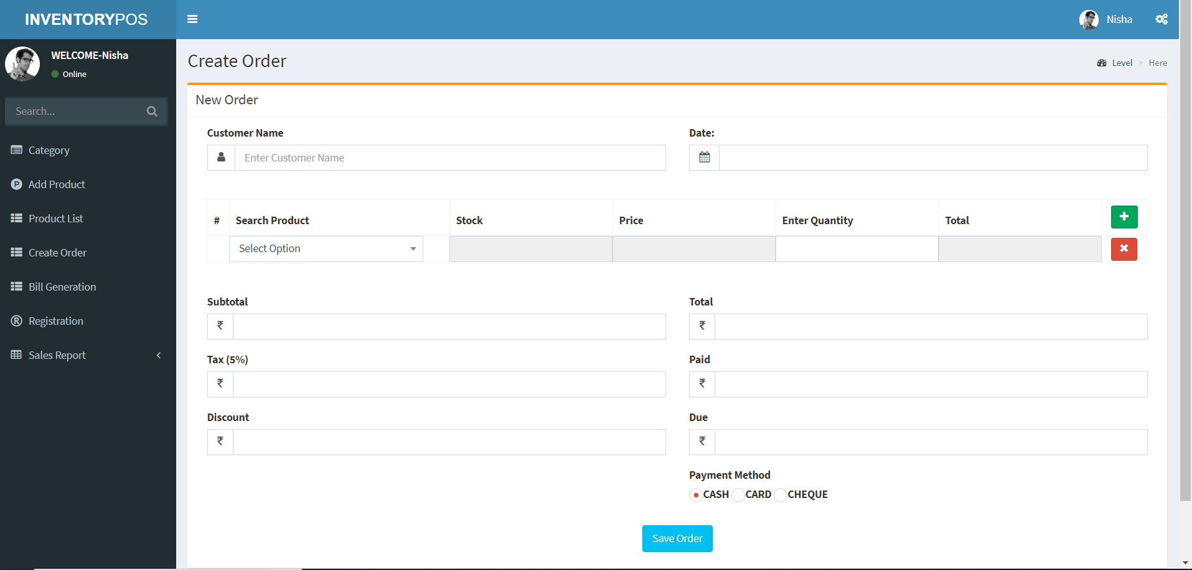
Module-6
Create Order :
This tab takes input for incoming purchases.
The owners can keep a record of their inventory items through this tab.
It has date filters to sort inventory items.

Slide 26
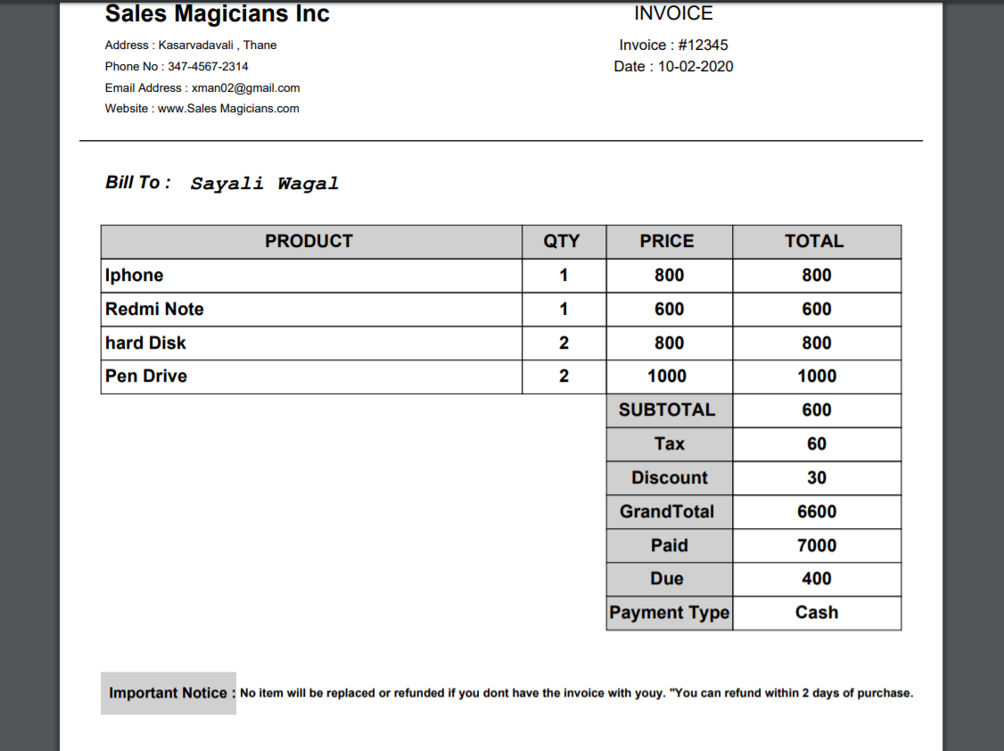
Module-7
Bill Generation :
The shopkeepers can generate bills by adding product name and quantity.
The generated bill can be printed if required.
The purchase details of customers can be viewed through this tab.

Slide 27
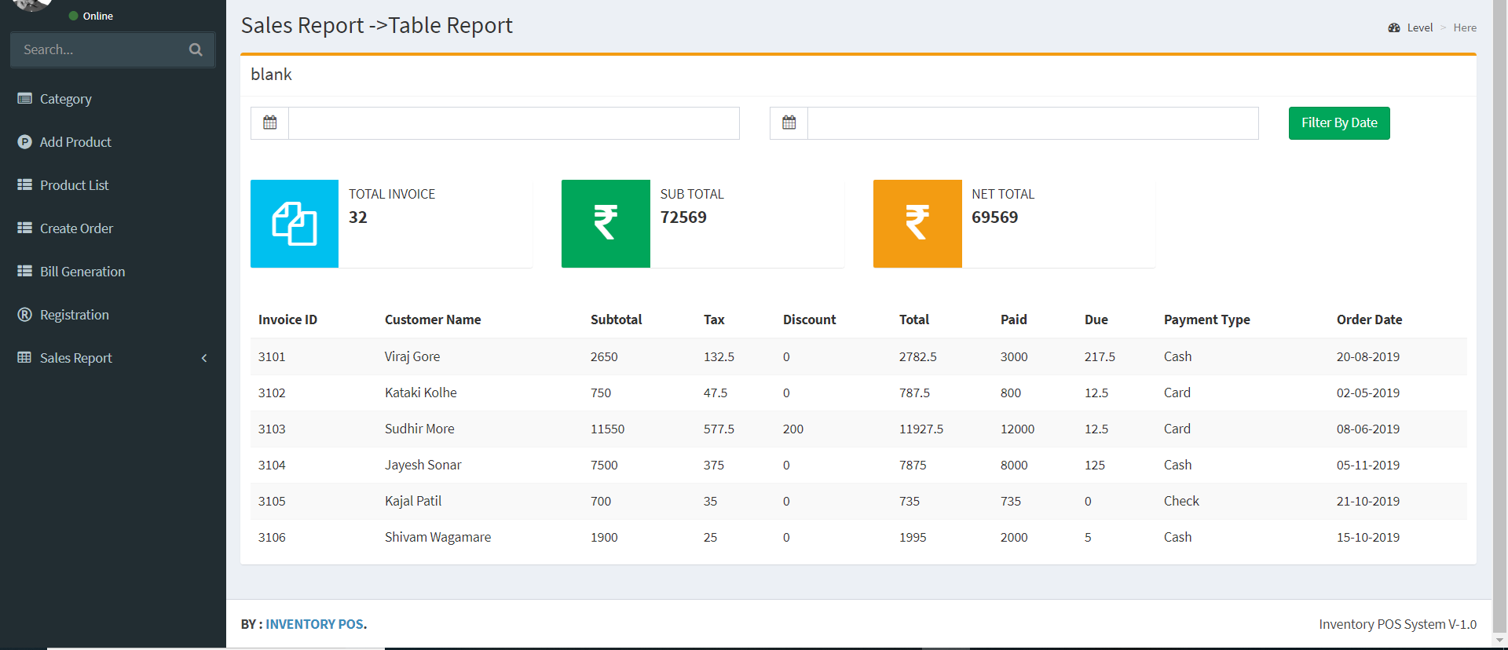
Module-8
Sales Report :
In this tab, there are two different views of the monthly sales of the shopkeeper's sales.
First, It will show the table report of his sales in the targeted month.
Second is by a graphical view of their sales data.
Sales prediction is viewed through the line graph.
Product analysis is given through PHPCharts.

Slide 28
2.7 Future Scopes
We can extend this project into an Android or ios application.
Also, we can extend this project as a cloud service.

Slide 29
2.8 Conclusion
This platform is a cost-effective method to assist the local shopkeepers. With sales analysis readily accessible, local businesses can explore different strategies.
A well managed and easily retrievable purchase record will help them analyze customer purchasing patterns.

Slide 30
2.9 References
C. Ezhilarasan and S. Ramani, "Performance prediction using modified clustering techniques with fuzzy association rule mining approach for retail," 2017 International Conference on Intelligent Computing and Control (I2C2), Coimbatore, 2017
Xiaojun Zhang, Jisheng Pei and Xiaojun Ye, "Demographic transformation and clustering of transactional data for sales prediction of convenience stores," 2016 IEEE International Conference on Cloud Computing and Big Data Analysis (ICCCBDA), Chengdu, 2016
Xiaojun Zhang, Jisheng Pei and Xiaojun Ye, "Demographic transformation and clustering of transactional data for sales prediction of convenience stores," 2016 IEEE International Conference on Cloud Computing and Big Data Analysis (ICCCBDA), Chengdu, 2016
A. Setiawan, G. S. Budhi, D. H. Setiabudi and R. Djunaidy, "Data Mining Applications for Sales Information System Using Market Basket Analysis on Stationery Company," 2017 International Conference on Soft Computing, Intelligent System and Information Technology (ICSIIT), Denpasar, 2017

Slide 31
2.10 Publication
Tejal Tandel, Sayali Wagal, Nisha Singh, Prof. Rujata Chaudhari, Prof. Vishal Badgujar, “Case Study on an Android App for Inventory Management System with Sales Prediction for Local Shopkeepers in India,” 2020 6th International Conference on Advanced Computing and Communication Systems (ICACCS 2020).

Slide 32
Thank You

