Slide 1

Department of Information Technology
A.P. Shah Institute of Technology
G. B. Road, Kasarvadavli, Thane(W), Mumbai- 400615
University of Mumbai
Academic Year 2019-2020

Slide 2
A Project Report on
E-commerce Based Sales Prediction Framework
Submitted in partial fulfillment of the degree of
Bachelor of Engineering(Sem-7) in
INFORMATION TECHNOLOGY
Tejal Tandel(16104047)
Sayali Wagal(17204016)
Nisha Singh(17204011)
Under the Guidance of
Project Guide: Prof. Rujata Chaudhari
Project Co- guide: Prof. Vishal Badgujar

Slide 3
1. Project Conception and Initiation

Slide 4
1.1 Abstract
Data mining is a strong new technology with great potential to help companies to focus on the most important information in their data warehouses. This will help in marketing and sales.
The proposed system uses clustering and market basket analysis types of algorithm with modification which will make algorithm more efficient. The analyst can perform data mining and extraction and finally conclude the result and make appropriate decision for retailer businesses.
The system will also gather consumer feedback for better analysis and performance evaluation. This system can help retailers organise their inventory efficiently and avoid financial and commercial losses.

Slide 5
1.2 Objectives
To help retailers stock appropriate products based on the in-demand product sale.
To help retailers make product-wise decisions like reordering or discarding the product.
To give customers as well as retailers recommendations as to which other items can be purchased along with the selected one.
To generate a report on monthly sales so that retailers can analyse their expenses

Slide 6
1.3 Literature Review
Performance prediction using modified clustering techniques with fuzzy association rule mining approach for retail," C. Ezhilarasan and S. Ramani, 2017 International Conference on Intelligent Computing and Control (I2C2), Coimbatore, 2017
In this paper, the performance of a hosted website is predicted using data mining techniques. The website traffic and conversion rates are considered as the attributes for the data mining logic. Website traffic is the number of users who visit that website. Web traffic is measured in “visits” and is a common way to measure the effectiveness of the website and in-turn the business, in gathering a customer base. Data analysis can be used to design extraction models which define future data trends. The technique used in this paper for data mining and prediction reports is fuzzy logic. Fuzzy logic is used when the outcome is uncertain

Slide 7
1.3 Literature Review
Demographic transformation and clustering of transactional data for sales prediction of convenience stores," Xiaojun Zhang, Jisheng Pei and Xiaojun Ye, 2016 IEEE International Conference on Cloud Computing and Big Data Analysis (ICCCBDA), Chengdu, 2016
Demographics are statistical representation of the characteristics of a population. These are mostly the socio-economic features of an individual. The age, educational level, occupation, income, marital status, average size of family etc. The paper follows a technique where the demographic clusters are combined with corresponding transactional data clusters to generate an input for the data prediction model. The data mining task is done using k-means algorithm. K-means algorithm categorises input itemset into “k” number of clusters based on their similarity. The similarities are calculated using Euclidean distance method. It is an effective algorithm where large input itemsets are available.

Slide 8
1.3 Literature Review
Profit Prediction Using Regression Model for Travel Agents," R. P. Santi and M. L. Khodra, 2018 International Workshop on Big Data and Information Security (IWBIS), Jakarta, 2018.
In this paper, profit for a tour agency which predominantly focuses on air travel is predicted. Online ticket sales are proportional to the profits earned for any agency. To analyse this, ticket fare is clustered into groups based on the price range for various different airlines. Historic data from airlines can be used to extract ticket fare and other profit affecting factors, for the trading model. and linear regression is used to generate the results

Slide 9
1.4 Problem Definition
Retailers face a loss in revenue due to improper investment and management activities. Many incur loses because their customer reach is limited. They cannot properly identify the demand of products and therefore end up buying limited products. On the other hand they can underestimate the growth of some products and remove them from their shop.
All these cases lead to a financial loss and stagnate the shop's growth. If the shopkeepers are equipped with tools and applications that give them insights of their sales and recommend products to them, the shopkeepers can improve their finances.

Slide 10
1.5 Scope
This project will be beneficial to bigger supermarkets as well, having vivid range products. It will save them the extra expenditure of purchasing a third party sales prediction software.
The project can be expanded on Android and iOS platforms to make it more easy to use and thereby reduce the hardware space.
This project can be exported as a bundle which can be installed privately into indvidual shops.

Slide 11
1.6 Technology stack
Frontend:
Bootstrap, HTML5, CSS3, JavaScipt
Backend:
MySQL
Algorithms:
Classification: Linear Regression
Market Basket Analysis: Apriori

Slide 12
2. Proposed System
The proposed platform will give general features of the same along with hosting to the business organizational website. Using classification and clustering algorithms, sales analysis will be performed and a predictive result will be generated from it. We have also included market basket analysis which will use association rules to recommend related products to customers as well as retailers.
A collective analysis of the said reports will help retailers make business decisions which are convenient and cost effective.
In this system they can add more description about product. It will product description should impress them without making them spend much time. Another important element of catalog that can help seller to increase their sales by adding there product in the right category and sub-category .

Slide 13
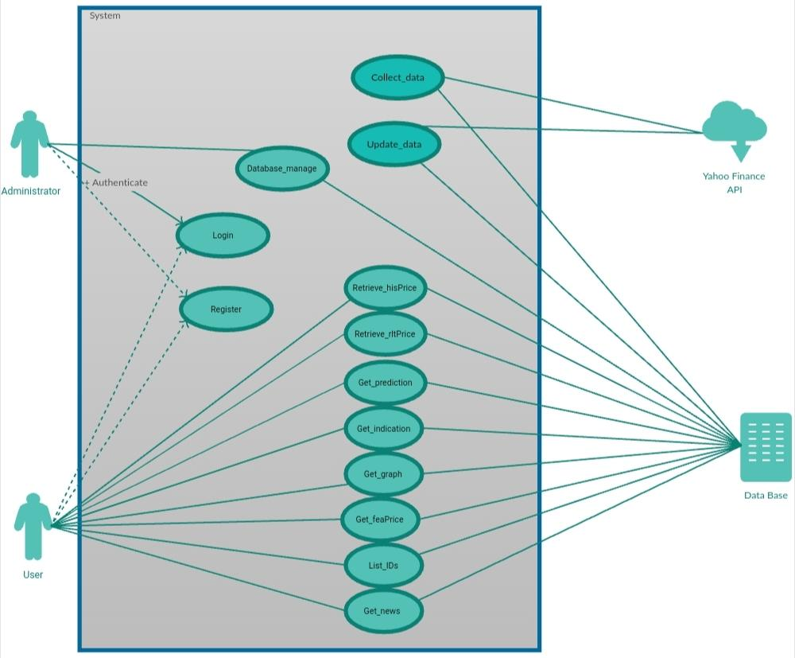
2.1 Use Case Diagram

Slide 14
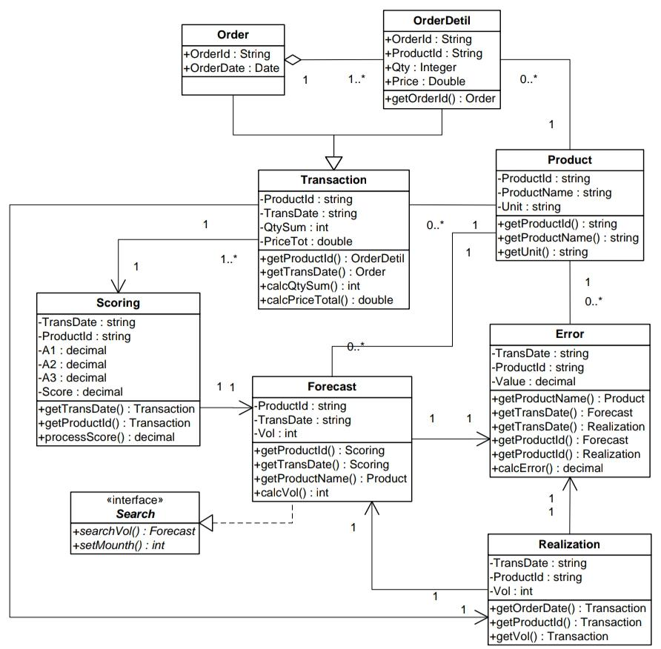
2.2 Class Diagram

Slide 15
2.3 Module 1
Login
Every store has their login credentials. This ensures segregation of data.
If the login credentials are incorrect access is denied.
Sessions are managed through these credentials.

Slide 16
2.4 Module 2
Warehouse
This tab takes input for incoming purchases.
The owners can keep a record of their inventory item through this tab.
It has date filters to sort inventory items.

Slide 17
2.5 Module 3
Billing
The shopkeepers can generate bills by adding product name and quantity.
The generated bill can be printed if required.
Purchase details of customers can be viewed through this tab.

Slide 18
2.5 Module 4
Analytics
Through this tab shopkeepers will get a graphical view of their sales data.
Sales prediction is viewed through the line graph.
Product analysis is given through PHPCharts.

Slide 19
2.6 Module 5
Prediction Model
This prediction model is based on Linear regression.
The previous sales data is given as input for the dependent variable and the quantitiy sold is used to compute the constant.
.The independent variable thus generated is the forecasted sales.

Slide 20
2.7 Module 6
Association Rules
Market Basket analysis is done through Apriori algorithm.
The algorithm scans the database and searches for frequently paired products.
The probability of these pairs is calculated and product recommendation is generated.

Slide 21
2.8 References
C. Ezhilarasan and S. Ramani, "Performance prediction using modified clustering techniques with fuzzy association rule mining approach for retail," 2017 International Conference on Intelligent Computing and Control (I2C2), Coimbatore, 2017
Xiaojun Zhang, Jisheng Pei and Xiaojun Ye, "Demographic transformation and clustering of transactional data for sales prediction of convenience stores," 2016 IEEE International Conference on Cloud Computing and Big Data Analysis (ICCCBDA), Chengdu, 2016
R. P. Santi and M. L. Khodra, "Profit Prediction Using Regression Model for Travel Agents," 2018 International Workshop on Big Data and Information Security (IWBIS), Jakarta, 2018
A. Setiawan, G. S. Budhi, D. H. Setiabudi and R. Djunaidy, "Data Mining Applications for Sales Information System Using Market Basket Analysis on Stationery Company," 2017 International Conference on Soft Computing, Intelligent System and Information Technology (ICSIIT), Denpasar, 2017

Slide 22
3. Planning for next semester
Implementing Data mining Tasks
Designing prediction model using Liner Regression algorithm
Recommendation model design using Apriori algorithm.
Enchancing security features.

Slide 23
Thank You

