Slide 1

E-Commerce Platform For Retailers
With Sales Prediction
Group No. 05
Group Members:
Tejal Tandel (16104047)
Sayali Wagal (17204016)
Nisha Singh (17204011)
Project Guide: Prof. Rujata Chaudhari
Project Co- guide: Prof. Vishal Badgujar

Slide 2
CONTENTS
Abstract
Introduction
Objectives
Literature Review
Problem Definition
Existing System Architecture/Working
Proposed System Architecture/Working
Conclusion

Slide 3
ABSTRACT
Data mining is a strong new technology with great potential to help companies to focus on the most important information in their data warehouses. This will help in marketing and sales.
The proposed system uses clustering and market basket analysis types of algorithm with modification which will make algorithm more efficient. The analyst can perform data mining and extraction and finally conclude the result and make appropriate decision for company.

Slide 4
INTRODUCTION
Data mining is the process of finding out useful patterns and correlations by filtering through a large amount of data.
Most of the retailers use traditional methods. Therefore, their company's efficiency and profits are not too satisfactory.
According to the predicting results, the company can handle their imports optimizing the available resources; storage, time, money. Therefore these reports would benefit the company to improve their incomes.

Slide 5
OBJECTIVE
To provide a platform for retailers to showcase their products to a wider audience.
To help retailers analyze their product demands and calculate the finances in order to avoid losses.
To help them in various activities like pre-ordering, re-ordering or discarding the product.

Slide 6
LITERATURE REVIEW
Paper Title: Performance prediction using modified techniques for retail.
Authors: Ezhilarasan C, Ramani S
Publication details : Published on IEEE 2016
Findings:
Performance evaluation is based on the website traffic and conversion rates
These attributes are given as cluster inputs and evaluation is done using Fuzzy logic
Advantages:
Fuzzy logic is efficient in prediction and sales analysis for particular clusters
Project can be hosted in any domain and it can used in real-time environment
Disadvantages:
Small amount of data cannot be computed
Precise transaction data is required everytime to predict the performance

Slide 7
LITERATURE REVIEW
Paper Title: Demographic Transformation clustering of transactional data for sales prediction of convenience stores
Authors: Xiaojun Zhang, Jisheng Pei, Xiaojun Ye
Publication details : Published on IEEE 2016
Findings:
Extracting customer characteristics through transactional data
Two different data attributes, customer type proportion and category profit score, and two different algorithms, k-means and EM, to cluster.
Advantages:
Provides prediction results per category
Market Basket Analysis can be easily integrated with the model
Disadvantages:
We can not forecast sales of a commodity precisely just according to its category

Slide 8
LITERATURE REVIEW
Paper Title: Profit prediction using regression model for travel agents
Authors: Rahmatika Santi, Masayu Leylia Khodra
Publication details : Published on IEEE 2018
Findings:
Model evaluation using linear regression
Advantages:
The model uses independent variables to estimate profit as per the travel agent’s required factor
This can give the cost estimation to travel agent to describe the value for target completion.
Disadvantages:
The model uses cumulative data of variable to generate results
It is focused of transactional data

Slide 9
PROBLEM DEFINITION
Problem Identified
[1] Retailers face a loss in revenue due to improper investment and management activities.
[2] Many incur loses because their customer reach is limited.
[3] Analyzing the demand and turnover will help with the strategic planning and boost the business.
Solution Identified
[1] Sales forecast is an important factor for efficiency of the businesses
[2] An e-commerce system will get the retailer businesses online and in-turn increase the reach of the same to the potential consumers.
3] Estimated sales can help them to make product based decisions.

Slide 10
TECHNOLOGY STACK
Frontend:
Flask, HTML5, CSS3, JavaScipt
Backend:
MySQL
Algorithms:
Classification, Clustering and Market Basket using Association rules

Slide 11
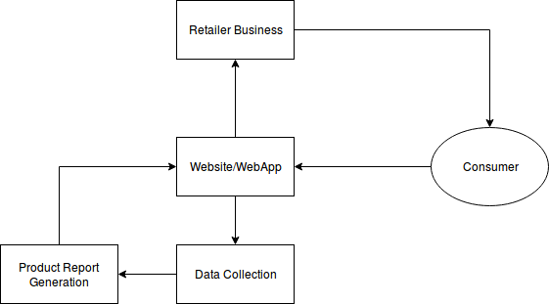
EXISTING SYSTEM ARCHITECTURE

Slide 12
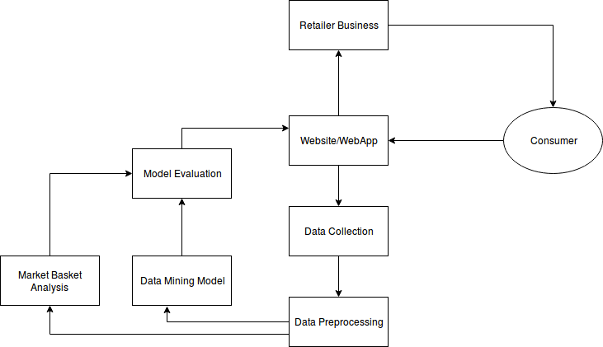
PROPOSED SYSTEM ARCHITECTURE

Slide 13
SCOPE OF THE PROJECT
Developing Android/ iOS app with same functionality
Integrating offline features
LIMITATIONS
The system cannot be accessed without internet connection
Retailers should keep the purchase data updated.

Slide 14
CONCLUSION
Evaluation of data mining factors will provide the retailer with effective suggestions for improving the sale of items.
It will help with the markup of profit for the business.
Promote the system to sell those products having more demand in the market and increase the customer base.

Slide 15
THANK YOU!

