Slide 1

Android App Development Session 7

Slide 2
Contents
Camera
Permission
Broadcast

Slide 3
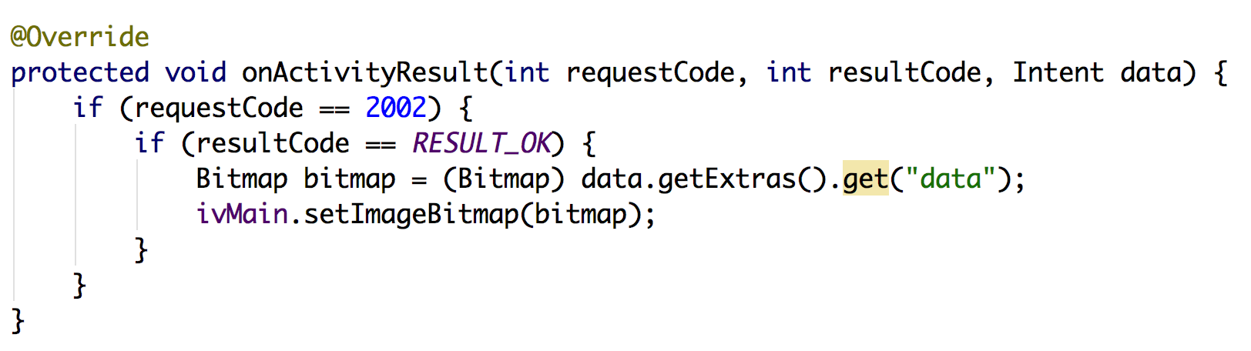
Camera

Slide 4
Camera

Slide 5
Permission
The purpose of a permission is to protect the privacy of an Android user.
Android apps must request permission to access sensitive user data (such as contacts and SMS), as well as certain system features (such as camera and internet).
Depending on the feature, the system might grant the permission automatically or might prompt the user to approve the request.
List of Normal Permission and dangerous permission

Slide 6
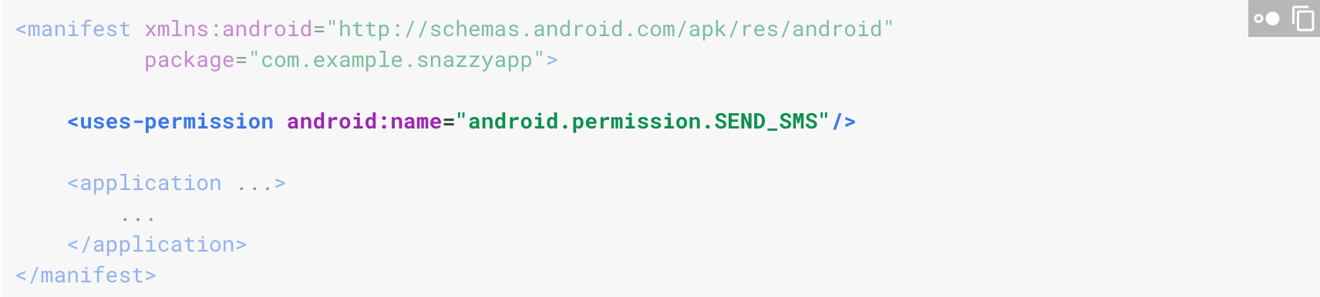
Taking Permission

Slide 7
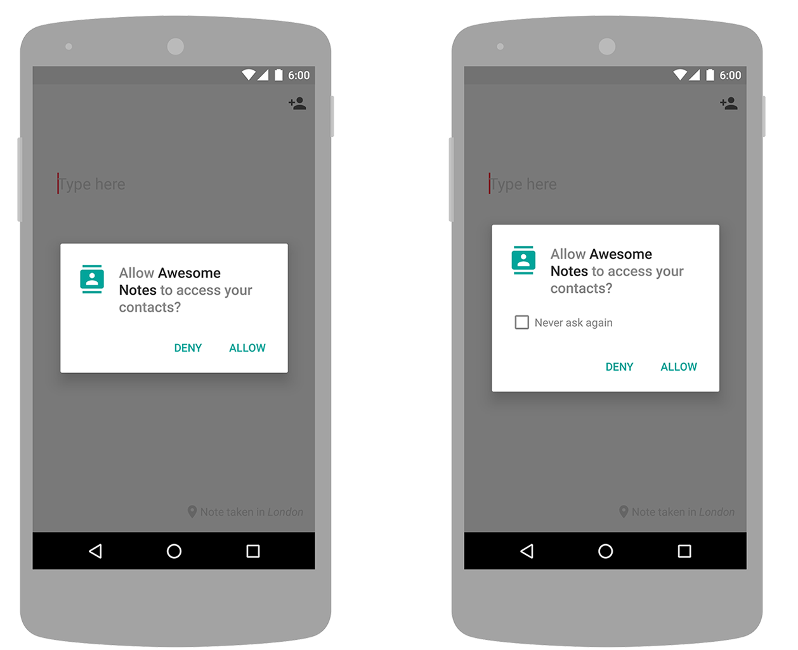
Permission

Slide 8
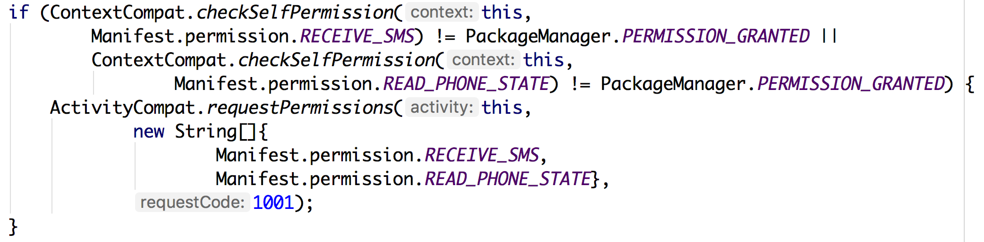
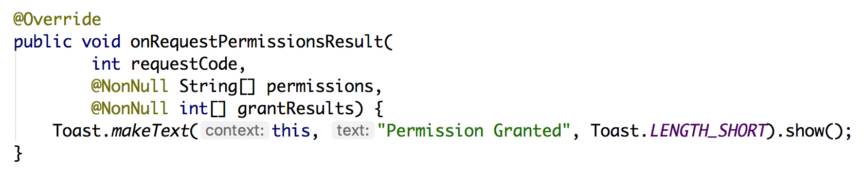
Permission

Slide 9
Broadcast
Android apps can send or receive broadcast messages from the Android system and other Android apps, similar to the publish-subscribe design pattern.
These broadcasts are sent when an event of interest occurs.
For example, the Android system sends broadcasts when various system events occur, such as when the system receiver SMS or phone calls.
Apps can register to receive specific broadcasts.
When a broadcast is sent, the system automatically routes broadcasts to apps that have subscribed to receive that particular type of broadcast.

Slide 10
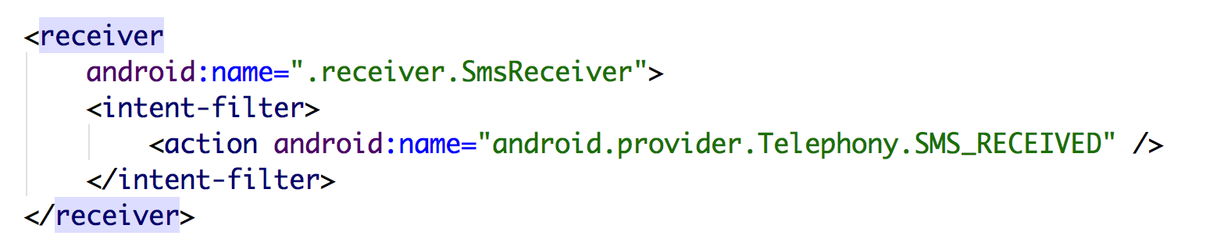
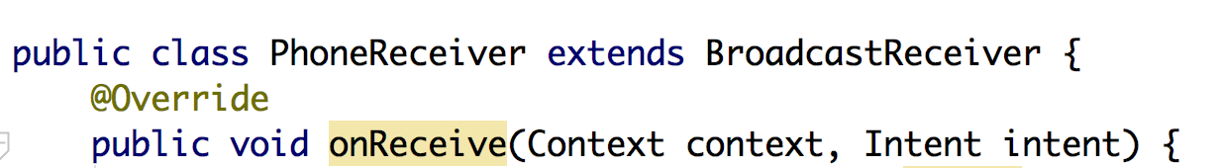
Declaring a Broadcast Receiver
Specify the <receiver> element in your app's manifest.
2. Subclass BroadcastReceiver and implement onReceive(Context, Intent).

Slide 11
References
https://developer.android.com/guide/components/broadcasts

Slide 12
Thanks!
Any questions?
You can find me at bibesh.manandhar@gmail.com

