Slide 1

Android App Development Session 4

Slide 2
Contents
ArrayList
LayoutManager
CardView
RecyclerView

Slide 3
RecyclerView
Requirements for RecyclerView
Custom View
CustomViewHolder
Data
LayoutManager
CustomAdapter

Slide 4
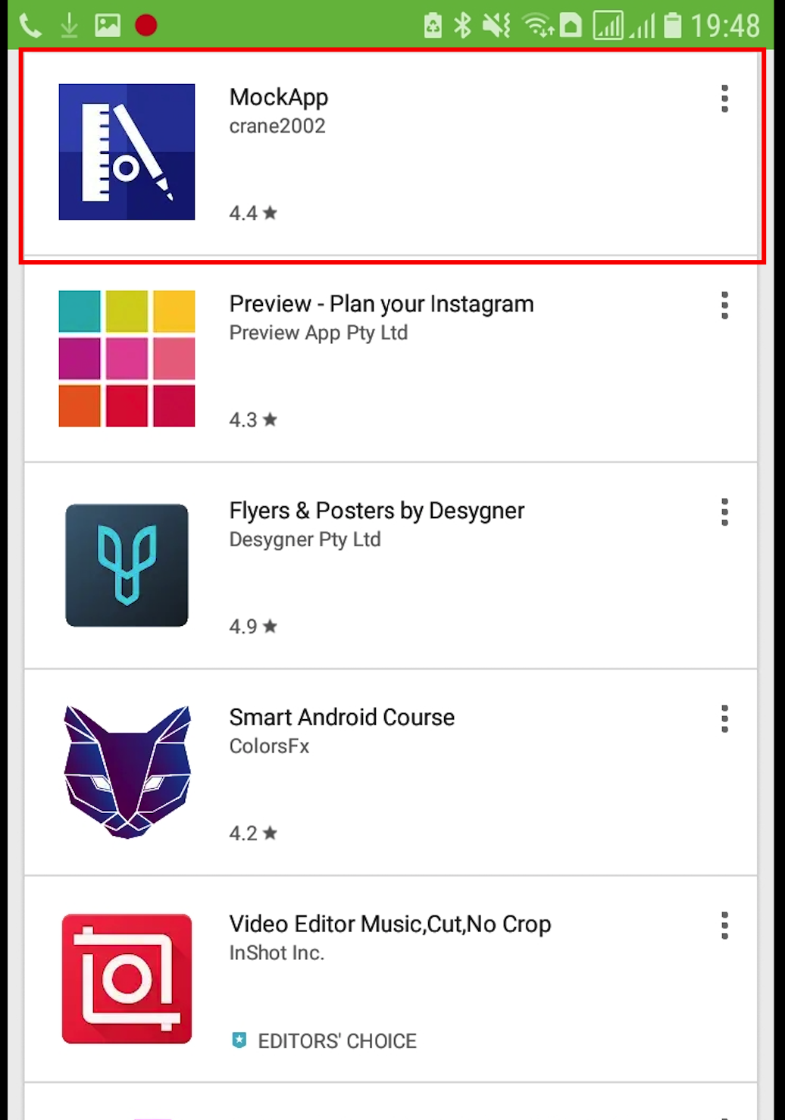
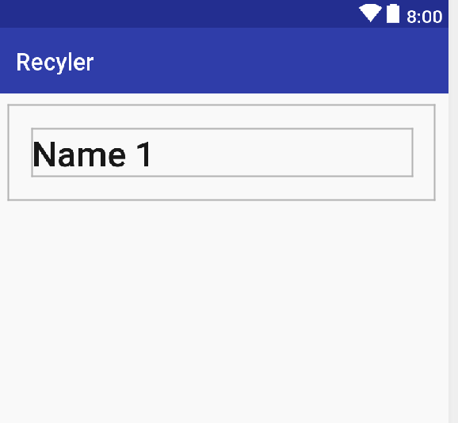
Custom View
View for single element

Slide 5
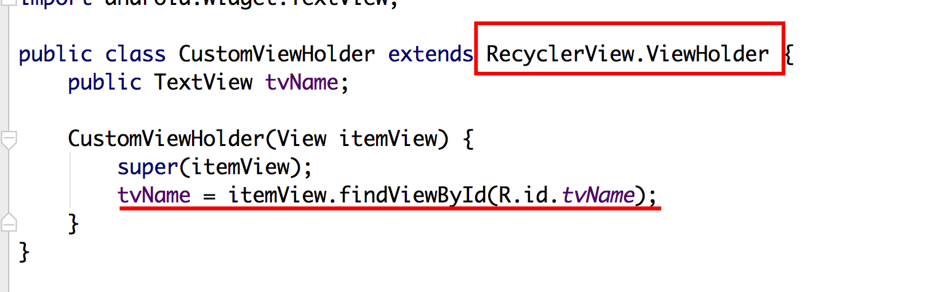
Custom ViewHolder
A view holder to hold the custom view.

Slide 6
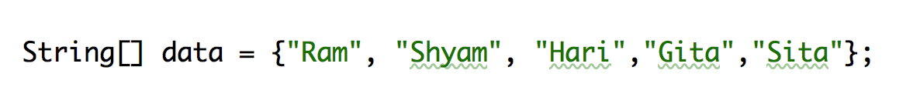
Data
Required data for the views.

Slide 7
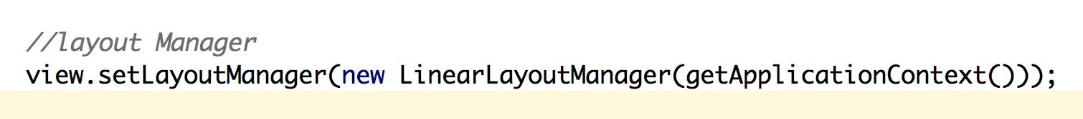
Layout Manager
Layout design
GridLayoutManager
LinearLayoutManager
StaggeredGridLayoutManager

Slide 8
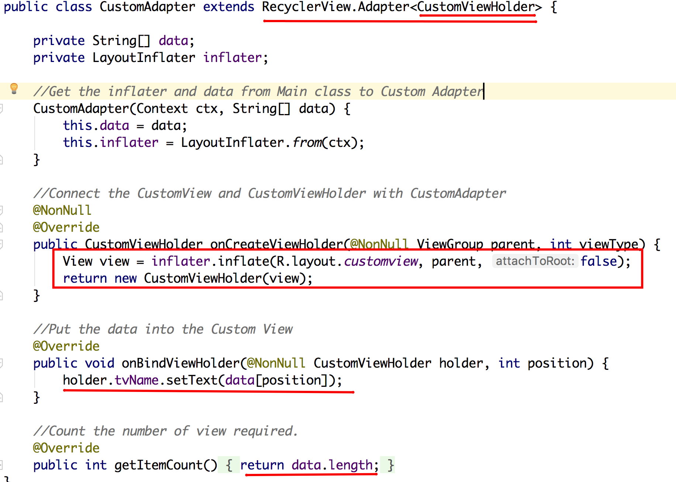
Custom Adapter

Slide 9
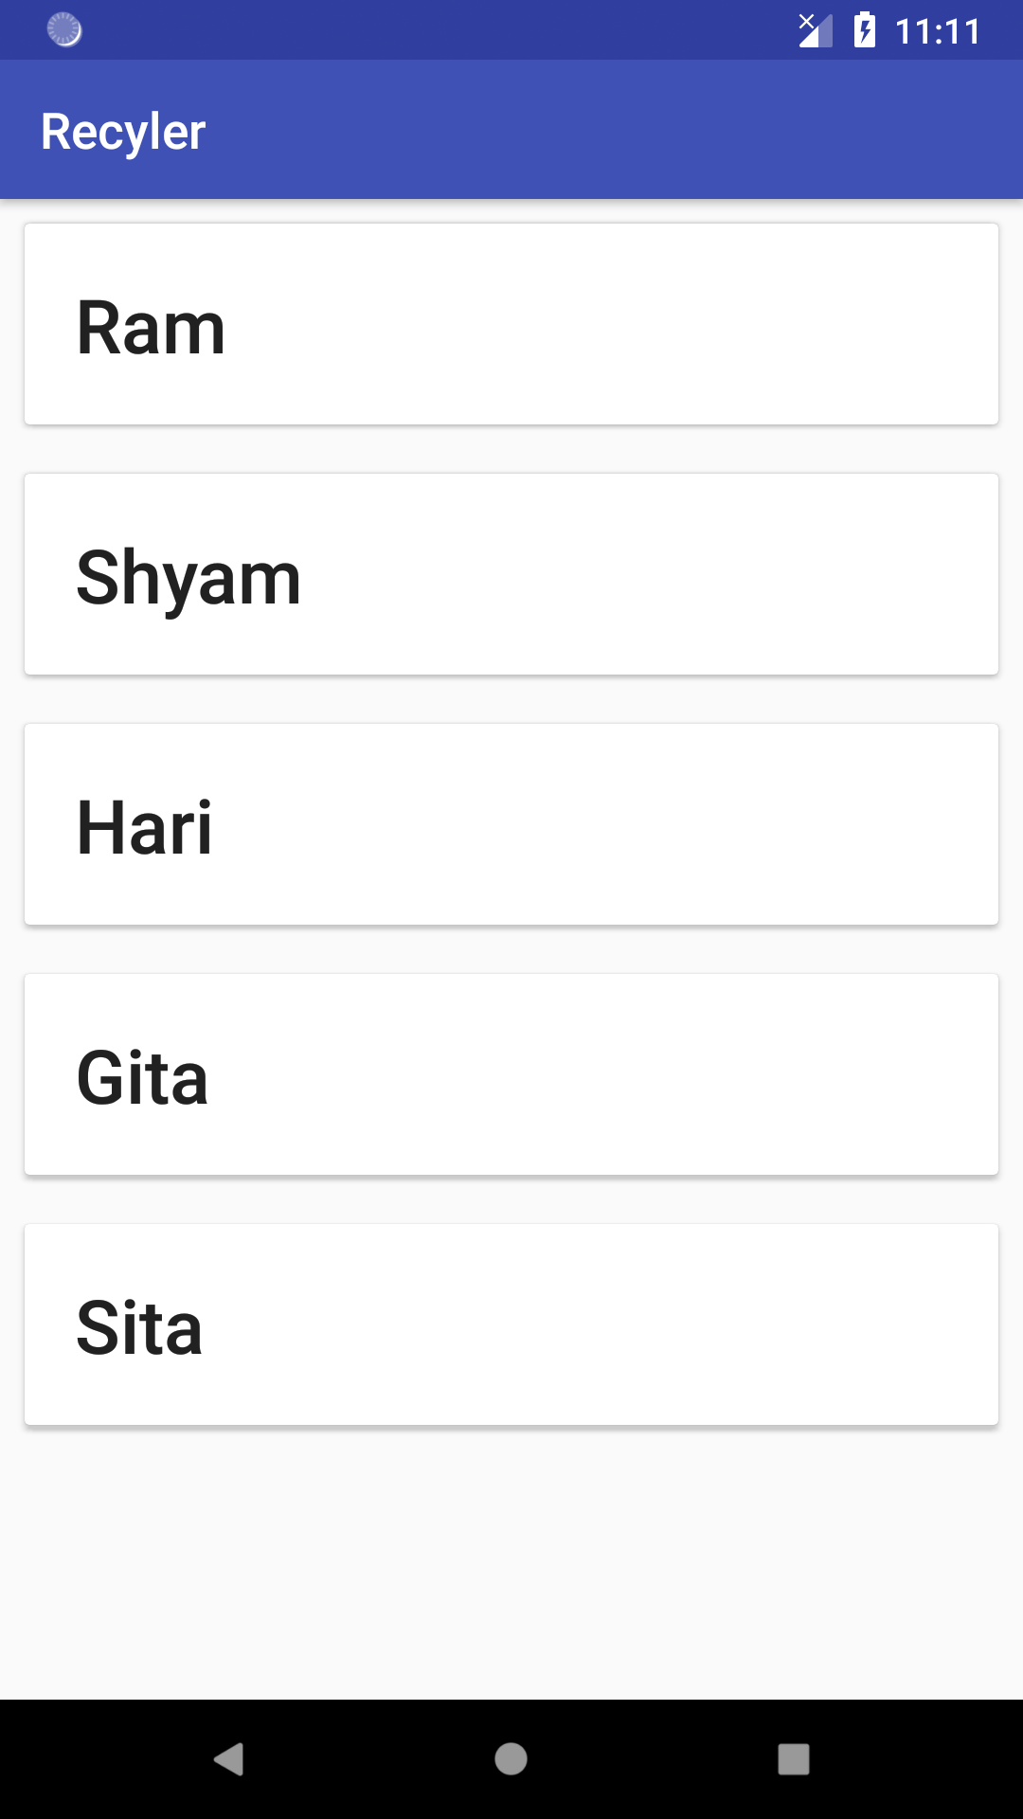
Result

Slide 10
Thanks!
Any questions?
You can find me at bibesh.manandhar@gmail.com

