Slide 1

Android App Development Session 6

Slide 2
Contents
Database
SQLite
Realm

Slide 3
SQLite
SQLite is one of the first embedded databases.
Its main idea is to move away from the client-server architecture and fit all application data on the device itself.
SQLite is the very popular database that is well-liked by many Android developers all over the world.
It is written in C.
The number of supported programming languages is more than 30.
This is the first but not the only solution that comes to mind when you decide to develop the out-of-server app.

Slide 4
Realm
Realm is the SQL-based product.
Using it, you can declare object relationships in the same manner you do it in an object of your programming language.
Realm is typically used for mobile app development.
It is extremely popular among young developers who just start their path in programming.

Slide 5
Realm
What exactly makes them opt for this database bypassing SQLite?

Slide 6
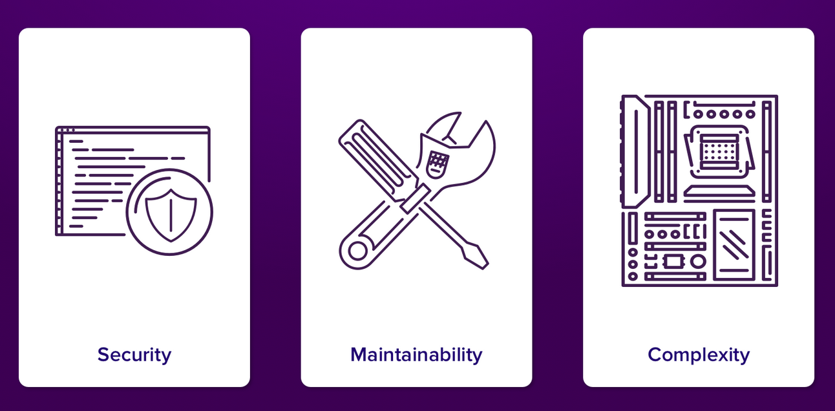
Issues with SQLite

Slide 7
Security
The database is stored in a single file
The journal files are not always deleted (roll back)

Slide 8
Flexibility
The older your application becomes, the more data accumulates in the database.
To maintain app productivity at a high level, you need to write more complicated queries and properly organize data migration.

Slide 9
Complexity
a complex database structure may become a complete nightmare.

Slide 10
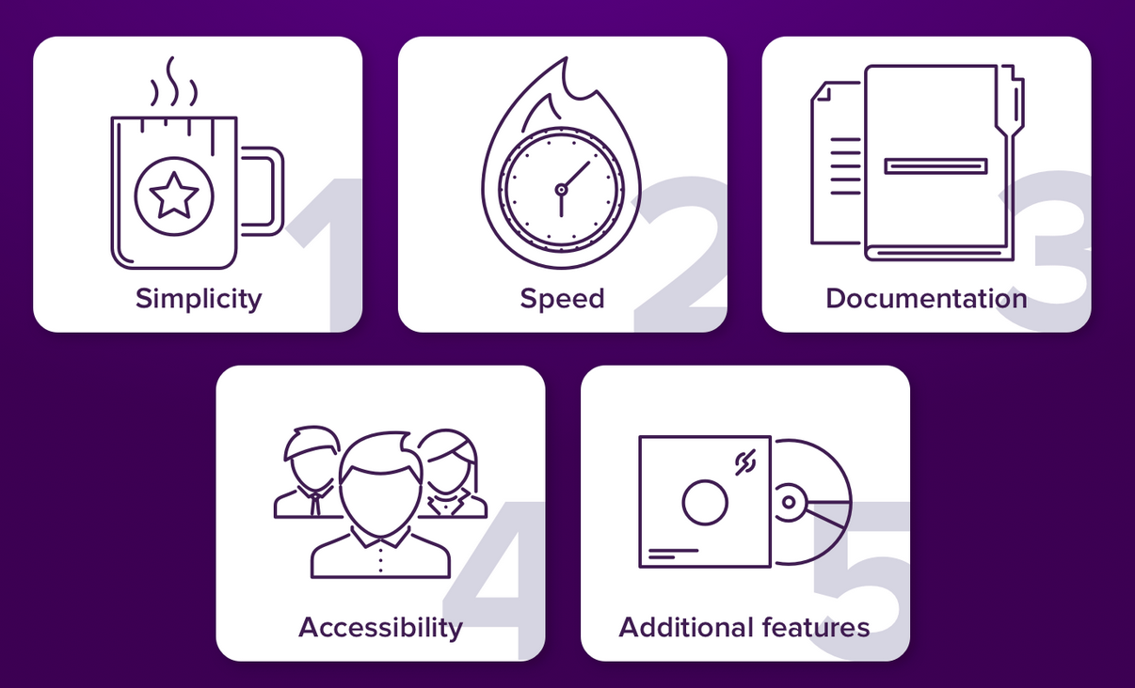
Advantages of Realm

Slide 11
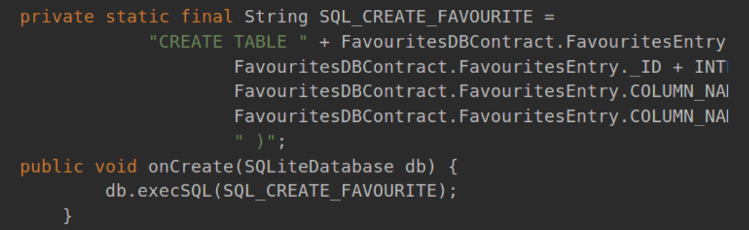
Simplicity
Creating Table in SQLite

Slide 12
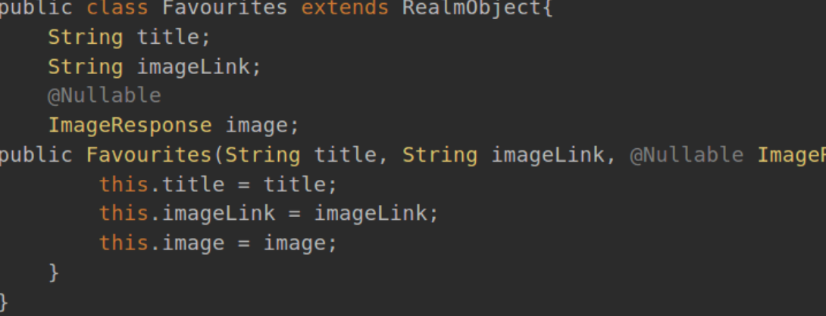
Simplicity
Creating Object in Realm

Slide 13
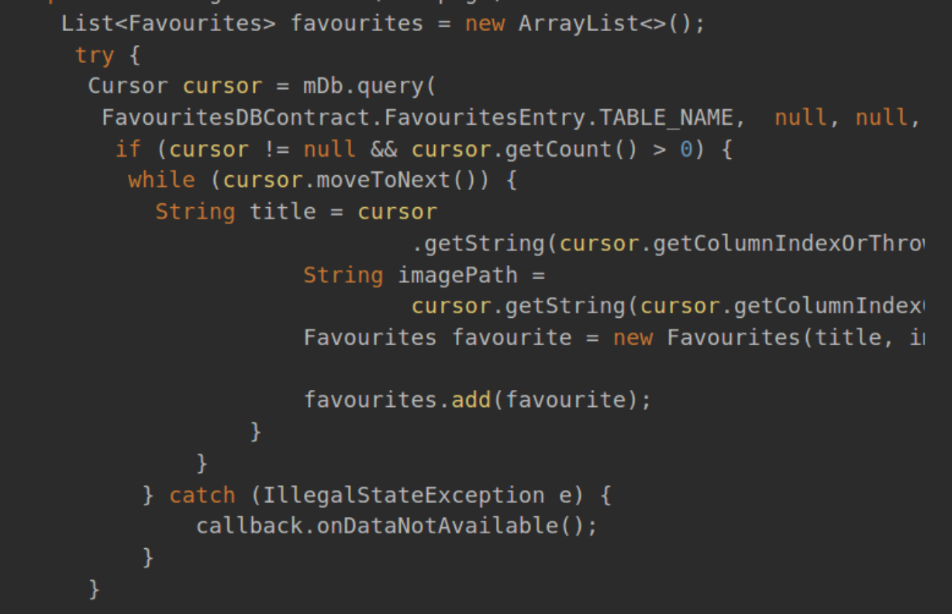
Simplicity
Accessing the database in SQLite

Slide 14
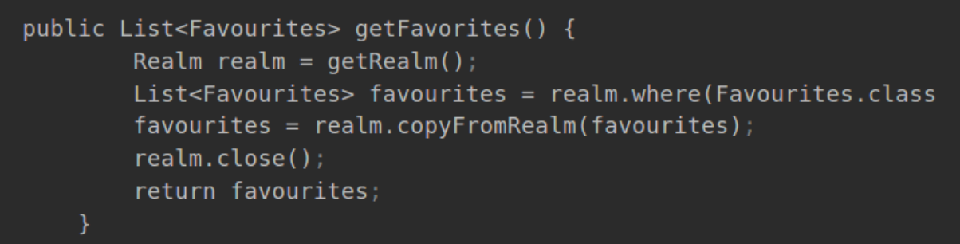
Simplicity
Accessing Database in Realm

Slide 15
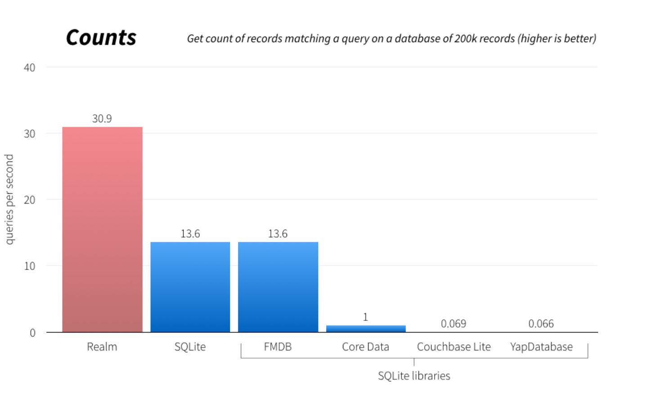
Speed

Slide 16
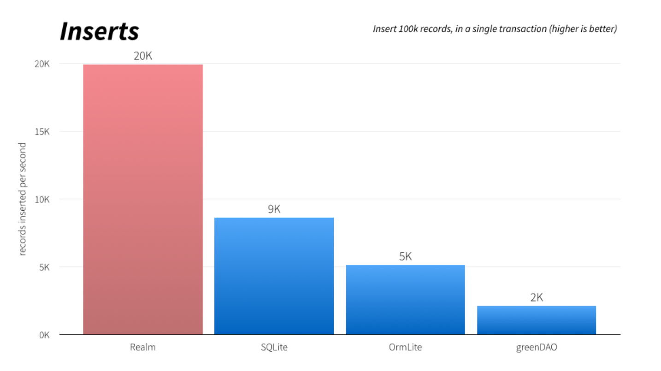
Speed

Slide 17
Advantages of Realm
The Realm database is a good choice if you need really fast and easy to use solution for storing and processing data in a mobile application.
Implementing a database now takes a lot less time than it used to with SQLite.

Slide 18
References
https://hackernoon.com/sqlite-or-realm-what-is-the-top-choice-for-android-app-2ee07dfcb82f
https://www.linkedin.com/pulse/android-realm-vs-sqlite-swati-shrivastava/

Slide 19
Thanks!
Any questions?
You can find me at bibesh.manandhar@gmail.com

