Slide 1

TravelMate
- Milan manandhar (353564)
- raman koju (353568)
- Roje awale (353570)

Slide 2
Contents
Use Case Diagram
Advantages
Limitations
References
Conclusion
Introduction
Features
Tools
Objectives
Data Flow Diagrams
Entity Relationship

Slide 3
Introduction
The application specially for travelers.
Traveler’s space for getting to know about various hotels.
A space for recommending various hotels on various places around the country.
User can decide which hotel to accommodate before they reach the destination.

Slide 4
Features
New users can register easily providing username and password.
Administrative authorization provided to add, delete or modify records.
Search for hotels through city name and max budget as well.
Short description about hotel giving information on its whereabouts will be provided.
Reviews from different users are provided.
Users are also able to search for hotels through maximum budget filter.

Slide 5
Tools
Frontend: HTML, CSS, Materialize CSS
Backend: PHP v 7.3.12, JavaScript, jQuery
Database: MySQL
Development tools: Visual Studio Code, XAMPP Control Panel v3.2.4

Slide 6
Objectives
Making travel a lot more easier.
Saving the time for travelers.
Encourage the tourism market.
Provide a high standard of services suitable for individuals seeking relaxing, comfortable and memorable experiences in the hospitality and tourism industry.

Slide 7
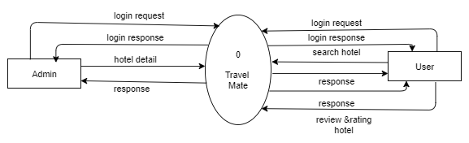
Data Flow Diagram(context level)

Slide 8
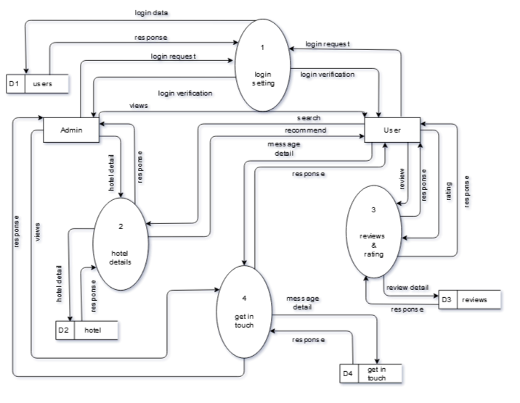
Data Flow Diagram(level 0)

Slide 9
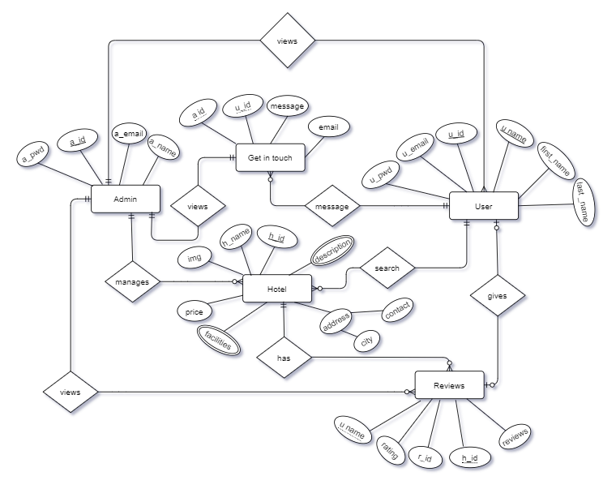
Entity Relationship Diagram

Slide 10
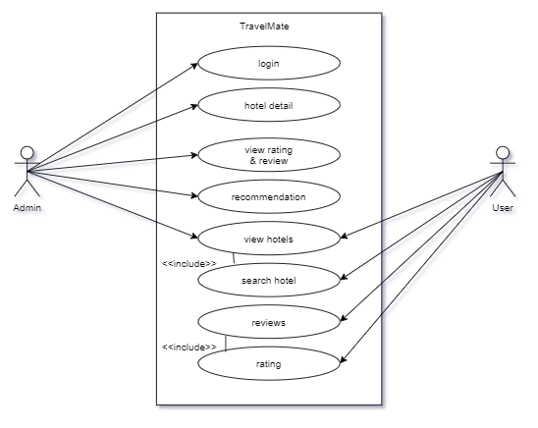
Use Case

Slide 11
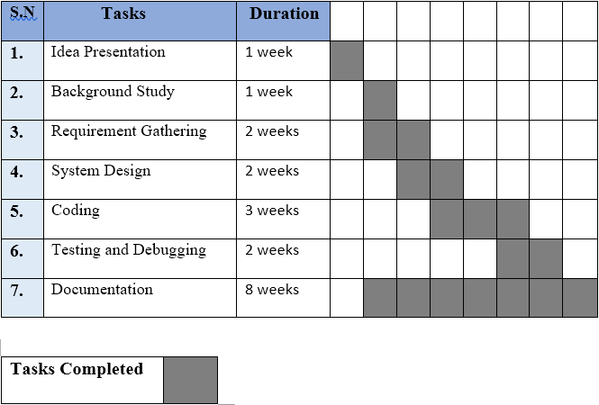
Gantt Chart

Slide 12
Advantages
This system is useful for those people who visit new places quite often.
People can easily decide whether the hotel is good or bad by using this application.
Using Collaborative filtering, user will get recommendations of hotels.
Since system ranks the feedback based on the weight age of the keywords in database, so the result is appropriate.
User can decide which hotel to accommodate before they reach the place.

Slide 13
Limitations
The system currently lacks booking of hotels.
Searching mechanism is limited to the location and maximum budget only.

Slide 14
Future Enhancements
Booking of hotels.
Enhancing the searching mechanisms to facilities as well.

Slide 15
Reference
Bayross, I. (2010).Web enabled commercial applications development using HTML, Dhtml, Javascript, Perl Cgi(4th ed).New Delhi: BPB Publication
https://www.w3school.com/sql/.
https://www.w3schools.com/js/
https://www.php.net/
https://fontawesome.com/

Slide 16
Conclusion
Hence, this website provides suitable space for travelers in choosing their hotels.

Slide 17
THANK YOU

