Slide 1
DDoS attack solutions in SDN Network using OpenFlow
Under the supervision of Dr. V. S Shekhawat Group No. 1 Aditya Karmarkar (2020H1120267P) Sayan Dey (2020H1120273P) V Kiran Kumar Reddy (2020H1120277P)

Slide 2
Agenda
Introduction and Motivation
DDoS attack in SDN
Research Background
Flow Chart
Attack Specifications
Proposed Topology
Future Work
Notes:
This is how presentation is arranged. Starting from introduction we ll see ddos attack in sdn, research background for the proposed idea, types of ddos attack

Slide 3
Introduction
SDN promises to revolutionize the networking field by providing a central view of the network through the controller- but also makes it a Single Point of Failure!
SDN architecture in itself does not provide any security feature hence equally vulnerable to all kinds of attacks as any conventional network.
We aim to detect DDoS attack- which still remains as one of the hardest issues in security
DDoS attacks (or any volume based attacks) focus on exhausting one of these-
Memory of switch and controller
Control channel bandwidth
Computational power at data and control plane
Notes:
The high disruptive behavior of ddos attack of victim system is the main motivation behind this project. The advanced features like global view of the network allows us to detect and mitigate the traffic flow. Ddos attack exhausts system resources like computational power, channel bandwidth and other resources because of which the system is unable to serve the legit users.

Slide 4
Motivation
Detecting or blocking some clever attacks by only using anomalous traffic statistics has become difficult, and devising countermeasures has been mostly left to the victim server.
SDN gives the network administrator more control of their infrastructure and the overview of network as a centralized entity thus reducing the overall capital and operational costs.
It involves understanding the controller programming such that it helps to identify and mitigate the DDoS attack.
The major challenge would be implementing the forwarding logic upon detecting the flooding of OpenFlow switches and controllers in the SDN network.
Notes:
Server and vitim host is relied till now
ad

Slide 5
DDoS attack in SDN
It is similar to DoS attack which is carried out from different attackers simultaneously.
DDoS attack can easily disrupt the working of the victim server.
Malicious user spoofs its IP and sends request to the target server through numerous IPs.
This will result in creation of new flow rules in the switches, along with the ‘Packet_In’ message being sent to the controller.
The global view of the entire network in the controller makes it easy to monitor the status of all connected switches based on this ‘Packet_In’ messages.
Notes:
Ddos attack is amplified version of dos attack. Here attack is carried out from various diifferencr source of attackers.

Slide 6
DDoS Types
SYN-TCP FLOODING
IP SPOOFING
BOTNETS
IP FRAGMENTATION ATTACKS
Notes:
Ddos attack are of various types. Like voulme based attack where goal is to exhaust bandwidth of the network examples of it like icmp flooding.
Protocol based Includes SYN floods, fragmented packet attacks more. This type of attack consumes actual server resources
IP Spoofing happens when the attacker sends IP packets with a fake source IP address. It's like forging a return address on a letter and pretending to be someone else.

Slide 7
Research Background
Mode: IP Spoofing
Components: OpenFlow + PacketIn + POX
A DDoS blocking scheme that uses Packet_In event inspection to distinguish between normal and malicious traffic
Less computational overhead for a sudden change in the incoming flow of packet
Install flows in switches to mitigate the attack traffic allows
Proposed detection mechanism will be simulated in mininet using OpenFlow protocol, minimal support from the server/victim under attack
Doesn’t exploit the global knowledge of network for packet inspection
Implemented as an SDN application on POX controller which can block traffic, install rate limiters or even change the default policy for an unmatched packet to drop it.

Slide 8
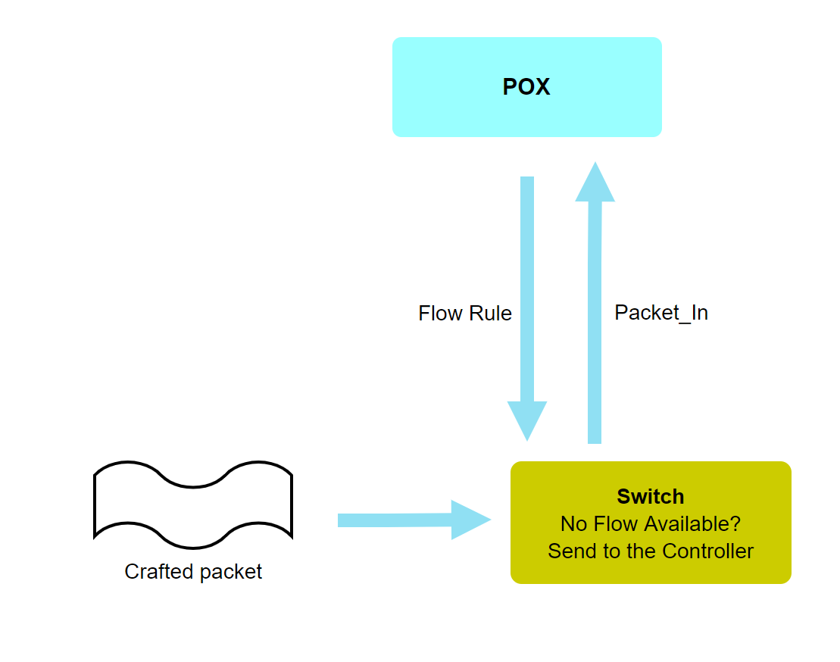
DDoS Detection Use case: Packet_In
“Packet_In” is the message for packet sent to the controller upon absence of flow rule in the switch.
Increased rate of Packet_In requests specifies the sudden change in traffic which is sensed to be abnormal.
Packet rate of 100 Packet_In request per second can act as potential alarming point for the controller to take explicit actions.
Flow entry is pushed down to switches upon the knowledge of new packets encountered over fixed intervals of time.

Slide 9
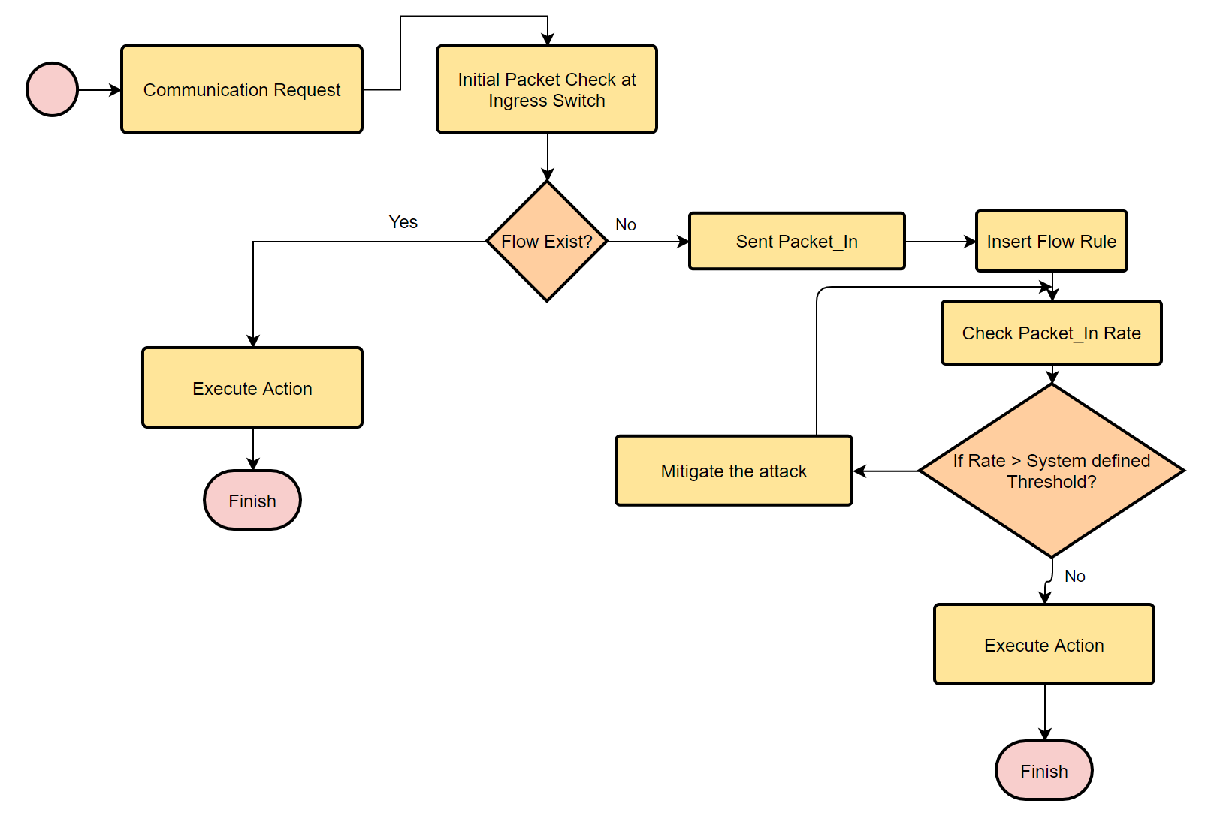
Flow Chart

Slide 10
Traffic generation strategy
Normal Traffic Generation:
Use hping3 from 2 hosts for random durations
Individual packet size- 100 bytes
Packet rate- 10 packet for second
Attack Traffic Generation:
Use hping3 from 1 host using random IPs
Individual packet size- 100 bytes
Packet rate- maximum, as possible in simulation (flood)

Slide 11
hping3 attack specifications
Used hping3 to generate SYN based attack
hping3 host [options]
Attack specification:
-V: verbose mode
-0: Raw IP; -1: ICMP; -2: UDP; -8: SCAN
-d <size> where size = number of bytes/packet
Host IP
-S: set SYN flag; -A: set ACK flag
-fast: 10 packets per second; --faster: 100 packets per second
We can perform the attack by varying the parameters as described above

Slide 12
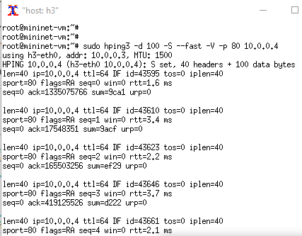
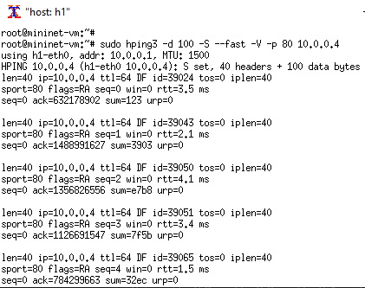
Normal Traffic
$sudo hping3 -d 100 -S --fast -V -p 80 10.0.0.4

Slide 13
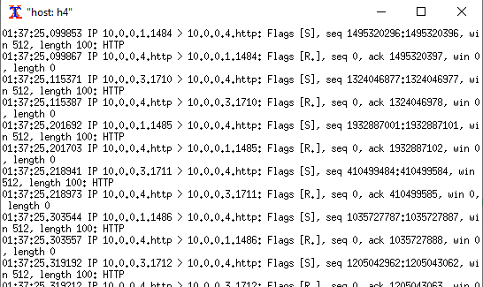
Normal Traffic
Packets seen at h4

Slide 14
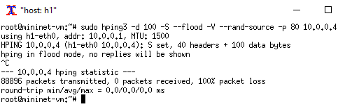
Attack Traffic
$sudo hping3 -d 100 -S --flood -V --rand-source -p 80 10.0.0.4

Slide 15
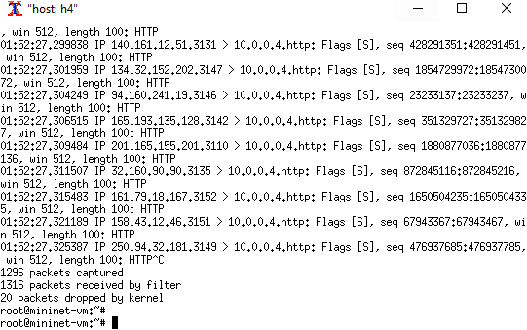
Attack Traffic
Packets seen at h4

Slide 16
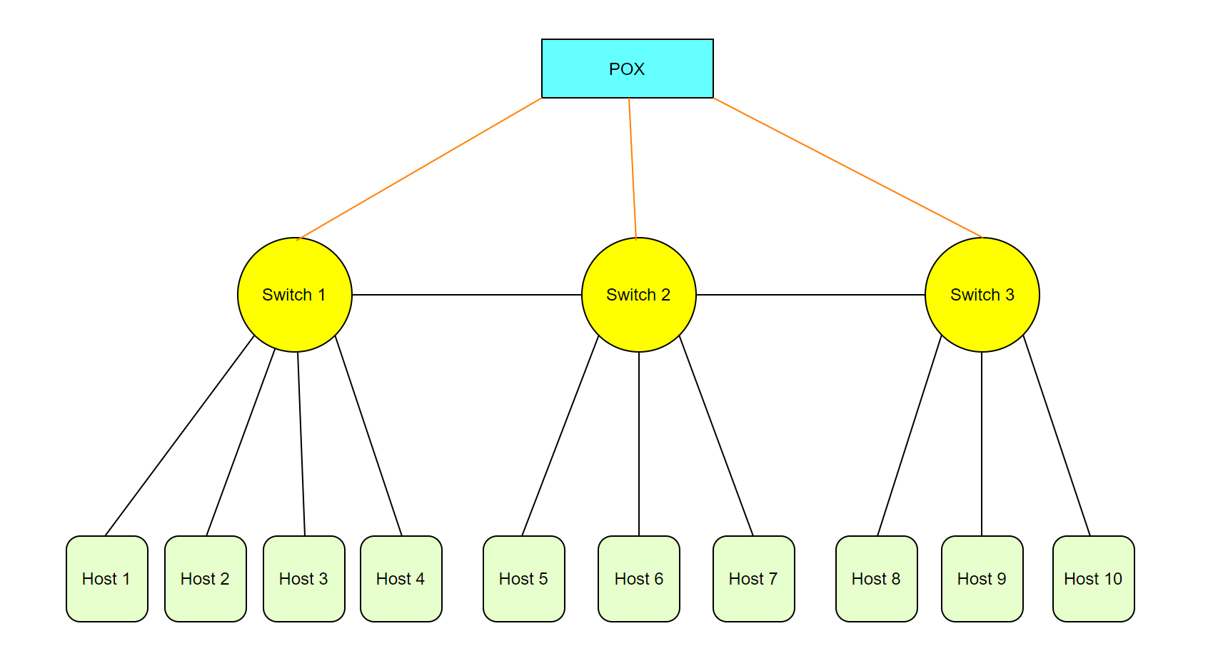
Proposed Topology
Notes:
This is our

Slide 17
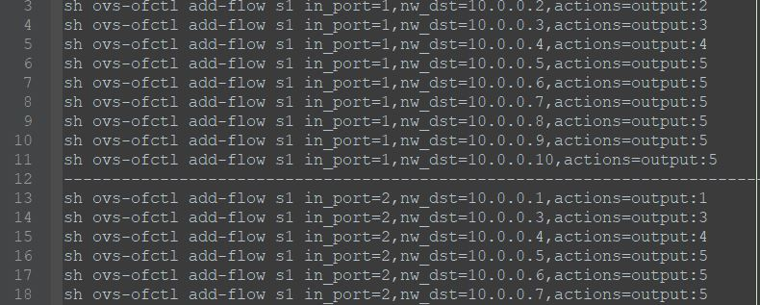
Flow Rules

Slide 18
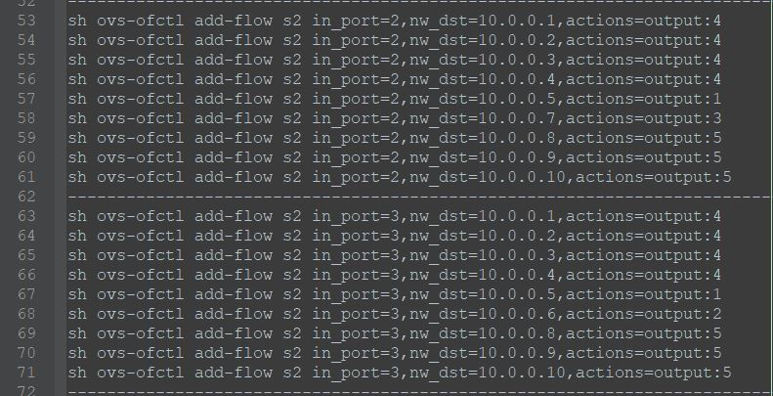
Flow Rules (contd...)

Slide 19
Research Gaps
DDoS attacks today typically target specific services so that only the targeted application is disabled. Such a targeted attack can easily hide itself in normal traffic due to low required attack intensity.
Packet_In strategy may fail incase botnet attacks where they hide itself in normal traffic due to low required attack intensity.
Efficient solution required to construct the flow table entries at the perimeter switches only instead updating it on all the switches of the network.

Slide 20
Future Work
Testing the detection mechanism using botnet attacks.
Aggregating the flow rules among multiple switches.
Implementation of avoidance mechanism using the proposed topology.
Simulation based results for the abnormal traffic generated.
To detect and classify any anomalous behavior of the network traffic.
Detecting legitimate requests during peak business hour.

Slide 21
References
[1] Nisha Ahuja, Gaurav Singal Department of CSE, Bennett University, Greater Noida, India “DDOS Attack Detection & Prevention in SDN using OpenFlow Statistics” 2019 9th International Conference on Advanced Computing (IACC)
[2] Nick McKeown et al., ”OpenFlow: enabling innovation in campus networks”. ACM SIGCOMM Computer Communication Review, vol. 38, no. 2, pp. 69-74 , April 2008.
[3] Xiang You, Yaokai Feng, Kouichi Sakurai, Kyushu University, Japan, “Packet In message based DDoS attack detection in SDN network using OpenFlow” 2017 Fifth International Symposium on Computing and Networking
[4] S. Lim, J. Ha, H. Kim, Korea University, Seoul, Korea, Y. Kim, S. Yang, Next Communication Research Laboratory, Daejon, Korea, “A SDN-Oriented DDoS Blocking Scheme for Botnet-Based Attacks”, 2014.

