Slide 1
DDoS attack detection in SDN Network using OpenFlow
Under the supervision of Dr. V. S Shekhawat Group No. 1 Aditya Karmarkar (2020H1120267P) Sayan Dey (2020H1120273P) V Kiran Kumar Reddy (2020H1120277P)

Slide 2
Agenda
Introduction
Improvements
Botnet Attack in SDN
Botnet Detection
Attack Specifications
Proposed Topology
Future Work
Notes:
This is how presentation is arranged. Starting from introduction we ll see ddos attack in sdn, research background for the proposed idea, types of ddos attack

Slide 3
Introduction
SDN abstracts network control from the underlying infrastructure of the network. This abstraction enables applications and network services to treat the network as one logical entity. This could increase the potential for the better mitigation of security.
SDN architecture in itself does not provide any security feature hence equally vulnerable to all kinds of attacks as any conventional network.
We aim to detect DDoS attack which is still a big challenge.
DDoS attacks (or any volume based attacks) focus on one of these-
Memory of switch and controller
Steal data from personal or corporation.
Exhausting computational power at data and control plane
Notes:
The high disruptive behavior of ddos attack of victim system is the main motivation behind this project. The advanced features like global view of the network allows us to detect and mitigate the traffic flow. Ddos attack exhausts system resources like computational power, channel bandwidth and other resources because of which the system is unable to serve the legit users.

Slide 4
Improvements
“Packet_In” is the message for packet sent to the controller upon absence of flow rule in the switch.
Earlier our approach was to count increased rate of Packet_In requests on sudden change of incoming requests, implementing it by comparing with the threshold count of Packet_In messages.
Previous approach was not enough to determine plausible DDoS scenario.
The new approach is based on monitoring the network flow on different metrics and statistically analysing the potential bots which communicates with C&C server periodically and dropping packets from it.
Assumption is made that Kth most destined host is C&C server.

Slide 5
Botnet attack in SDN
Botnets are a network of robots used to commit cyber crime. The cyber criminals controlling them are called botmasters or bot herders.
Botnets are divided into 3 main cycles in the way its phase of infection, C & C communication phase, and phase of attack.
Botmaster manages their C&C (Command and Control) to communicate with their bot indirectly in purpose to hide the C&C architecture.
Botnet use only small amounts of computing power to avoid disrupting normal device functions and alerting the user.
Notes:
Ddos attack is amplified version of dos attack. Here attack is carried out from various diifferencr source of attackers.

Slide 6
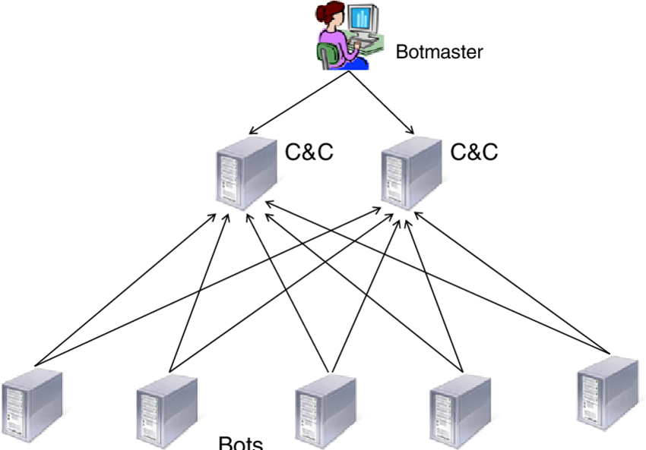
Attack configuration

Slide 7
Botnet Detection
Features of network flows such as source ip address and destination ip address and source port are used for detecting any bot.
Openflow devices analyse the traffic flowing through them and report the traffic flow information to the Controller.
The analysing flow parameters are kept record wise and host is monitored periodically with its request of frequency and age.
Based on threshold determined statistically our approach classifies the host as bot.
This approach of fingerprinting of a flow is scalable as a large amount of flow information is summarized into a database.

Slide 8
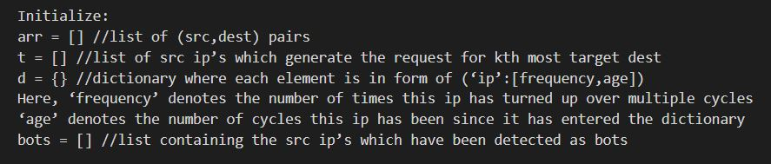
Botnet Detection Algorithm:

Slide 9
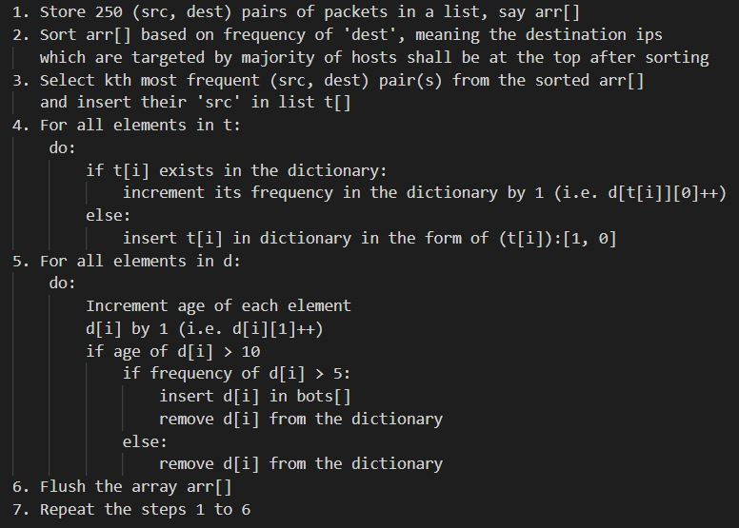

Slide 10
DEMO

Slide 11
Research Gaps
Determining the accurate value of K as it may result in blocking the legitimate users.
The proposed solution may fail when C&C server acts as legitimate server and non infected hosts communicate with it.
Space requirements can grow very high if the potential hosts have to be examined for longer durations before labelling them as bots.

Slide 12
Future Work
With this problem we need to develop various security methods in handling attack variation, this paper is devoted to variation of a Botnet attack which is Centralized C&C Server.
One of the most potential security methods in handling botnets is the handling of botnets with the honeypot system where honeypot has proven able to cope and learn botnet attack on the traditional network.
Detection of P2P botnet.
Detecting legitimate requests during peak business hour.
Deep Learning of potential bot hosts to minimize false positive.
Finding location & destroying C&C Server which is single point failure of botnets.

Slide 13
Bibiliography
[1] S. Lim, J. Ha, H. Kim, Y. Kim, S. Yang "A SDN-Oriented DDoS Blocking Scheme for Botnet-Based Attacks" 2014 Korea University Next Communication Research Laboratory Korea
[2] Dragos Comaneci, Ciprian Dobre "Securing Networks using SDN and Machine Learning" 2018 University Politehnica of Bucharest, Bucharest, Romania
[3] Ping Dong, Member, IEEE, Xiaojiang Du, Senior Member, IEEE, Hongke Zhang, Tong Xu "A Detection Method for a Novel DDoS Attack against SDN Controllers by Vast New Low-Traffic Lows" 2016, pdong@bjtu.edu.cn, xjdu@temple.edu
[4] Udaya Wijesinghe Udaya Tupakula Vijay Varadharajan "Botnet Detection using SDN" 2015, Advanced Cyber Security Research Centre Macquarie University Sydney, Australia

