Slide 1

AI VISION ASSISTANT
SAYAN ADHIKARY
Real-Time Object Detection & Voice-Powered Insight
HTML
CSS
JavaScript
DOM
Gemini AI
Web Speech API
Hackathon Build • 3-Hour Sprint • Live Camera to Live Voice

Slide 2



THE OBJECTIVE
Build an AI-Powered Vision Assistant
Using only HTML, CSS, JavaScript, and DOM concepts, build an application that turns a laptop camera into an intelligent assistant — one that sees a real-world object, identifies it with Gemini AI, and explains it out loud.
See
Capture the object via live camera feed
Think
3 hrs
10-15
100%
Identify it using Gemini AI vision reasoning
Build Window
Min Presentation
Browser-Native APIs
Speak
Explain the result aloud with voice synthesis
AI VISION ASSISTANT • HACKATHON
2

Slide 3



EXPECTED FLOW
From Camera Frame to Spoken Answer
1
2
3
4
5
6
Open App
Camera Starts
Capture Frame
Gemini Identifies
Show Details
Speak Result
›
›
›
User launches the assistant in-browser
getUserMedia() streams live video
Canvas grabs the current frame
Base64 image sent for AI analysis
Object info rendered to the DOM
SpeechSynthesis narrates the answer
AI VISION ASSISTANT • HACKATHON
3

Slide 4




TECHNOLOGY REQUIREMENTS
Built Entirely on Native Web Technology
HTML
CSS
JavaScript
DOM Manipulation
Semantic structure for camera view, results and controls
Glassmorphism styling, animations, dark/light themes
Application logic, async API calls, state handling
Dynamic updates to UI as detection results arrive
Camera Access
Gemini AI
Text-to-Speech
navigator.mediaDevices.getUserMedia()
Cloud vision reasoning for object identification
SpeechSynthesisUtterance for spoken responses
AI VISION ASSISTANT • HACKATHON
4

Slide 5

SYSTEM ARCHITECTURE
How a Frame Becomes a Spoken Answer
<video>
→
<canvas>
→
toDataURL()
→
fetch()
→
Gemini AI
→
DOM Update
→
SpeechSynthesis
Live stream
Frame grab
Base64 encode
POST to API
Vision analysis
Render result
Voice output
The captured frame never leaves the browser unprocessed — it is base64-encoded client-side, sent securely to Gemini AI, and the structured JSON response drives both the on-screen card and the spoken narration.
AI VISION ASSISTANT • HACKATHON
5

Slide 6
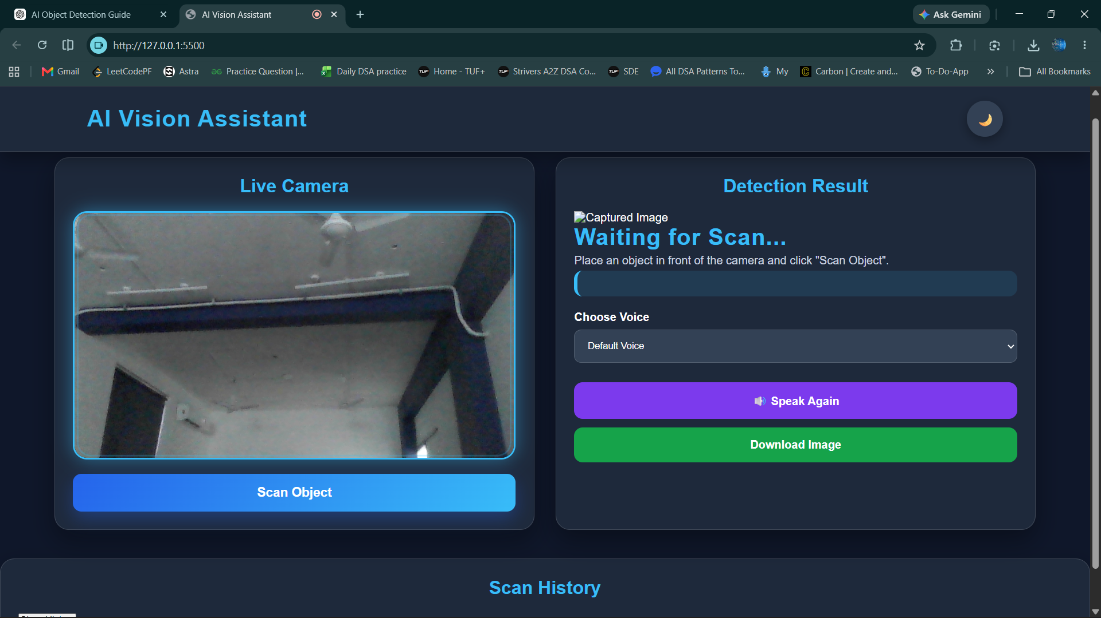

Slide 7

CORE FEATURES
What the Assistant Does Today
Live Camera Feed
One-Click Capture
Base64 + fetch()
getUserMedia() streams video directly into an on-page <video> element.
<canvas> grabs the current frame the instant an object is placed in view.
toDataURL() encodes the frame and ships it to Gemini AI over fetch().
AI Identification
Automatic Narration
Dark / Light Theme
Gemini analyzes the image and returns structured object details.
SpeechSynthesisUtterance speaks the result the moment it arrives.
CSS variables + data-theme attribute switch the whole UI instantly.
AI VISION ASSISTANT • HACKATHON
6

Slide 8




BONUS FUN FEATURES
Extra Touches That Set It Apart
Robot-Style Assistant UI
Scan History
A friendly AI persona anchors the interface.
Previously identified objects are logged for the session.
Thinking Animations
Dark / Light Switch
Smooth loading states while Gemini analyzes the frame.
One-tap theme toggle using data-theme + CSS variables.
Confidence Score
Fun Facts Mode
Each identification is shown with an AI confidence rating.
Bonus trivia surfaces alongside each object's details.
AI VISION ASSISTANT • HACKATHON
7

Slide 9
UI / UX DESIGN
Modern Glassmorphism, Built to Adapt
The interface leans on translucent, blurred glass panels over a soft gradient backdrop, giving the assistant a premium, futuristic feel appropriate for a live AI experience.
Scanning...
Analyzing object with Gemini AI
CSS variables defined in :root drive every color and radius
html[data-theme="light"] overrides variables for light mode
Camera and result panels use frosted-glass card styling
Flexbox / Grid layout reflows across screen sizes
Object: Coffee Mug
Confidence: 96%
A ceramic drinkware item typically used for hot beverages such as coffee or tea.
AI VISION ASSISTANT • HACKATHON
8

Slide 10

TECHNICAL FOUNDATIONS
DOM & JavaScript Concepts Used
Element Selection
document.documentElement, querySelector() locate targets in the DOM
Attribute Control
getAttribute() / setAttribute() drive the data-theme toggle
Event Handling
addEventListener() wires clicks, camera-ready, and theme-toggle events
Content Updates
textContent updates labels, results, and the theme button state live
Async Operations
async/await + fetch() manage the round-trip to the Gemini API
Media APIs
navigator.mediaDevices.getUserMedia() and canvas.toDataURL() handle capture
AI VISION ASSISTANT • HACKATHON
9

Slide 11
AI INTEGRATION
How Gemini AI Powers Identification
01
Encode
canvas.toDataURL() converts the captured frame into a base64 image string.
02
Prompt
A structured prompt asks Gemini to return the object name, description, and confidence as JSON.
03
Request
fetch() sends the image and prompt to the Gemini API endpoint asynchronously.
04
Parse & Render
The JSON response is parsed and rendered into the result card via the DOM.
05
Narrate
The same response text is handed to SpeechSynthesisUtterance for spoken output.
AI VISION ASSISTANT • HACKATHON
10

Slide 12

LOOKING BACK, LOOKING AHEAD
Challenges Faced & Future Improvements
Challenges Faced
Future Improvements
Requesting and handling camera permissions reliably
Managing Gemini API latency without blocking the UI
Prompt-tuning for consistent, structured JSON replies
Keeping the glass UI responsive across screen sizes
Object quiz mode where the AI questions the user
Side-by-side object comparison mode
Multiple selectable AI voice personalities
Screenshot / download of scan results
AI VISION ASSISTANT • HACKATHON
11

Slide 13



Thank You
Every teammate can explain the full pipeline — from camera pixel to spoken word.
Live Demo
Gemini AI Walkthrough
Open Q&A
Built with HTML • CSS • JavaScript • DOM • Gemini AI • Web Speech API

